Slide 1
A Changing World:
Helping Students Prepare for
Life in a Scary World that
We Know Little About
Emil Barnabas
Emil@barnabas.com
Notes:
We educators have the responsibility to make sure that every student has explored all of their career options and has some kind of career direction when they graduate from high school.
The job market has changed considerably from when we graduated from high school. Many of the careers that our current students will have - have yet to be thought of, which makes career preparation an even bigger challenge.
I’m Emil Barnabas, an educator from North Carolina.
You should have a half sheet of paper with information about this session. Look at the vertical side.
In this session, we will take a hard look at where we are and where we should be in preparing our students for the future job market.
====
ACTE CareerTech VISION Convention, 12/6/2013, 10:00 - 11:30 am, Room N226

Slide 2
ACTE
ADVERTISEMENT
New and Related Services Division
  School-to-Work/Careers Section
Guidance and Career Development Division
Notes:
And now a word from one of our sponsors…
Are you a member of your professional association?
Within ACTE I am a member of two different divisions.
I’m in the School-to Work section, which falls under the New and Related Services Division.
The New and Related Services Division is home to lots of small sections that are not big enough to be divisions.
I’m also a member of the Guidance and Career Development Division.
I happen to be the national president of the School-to-Work section.
If you are not already a member, I encourage you to join your professional association.
If it wasn’t for ACTE, we all wouldn’t be sitting here today learning how to get kids ready for the real world.

Slide 3
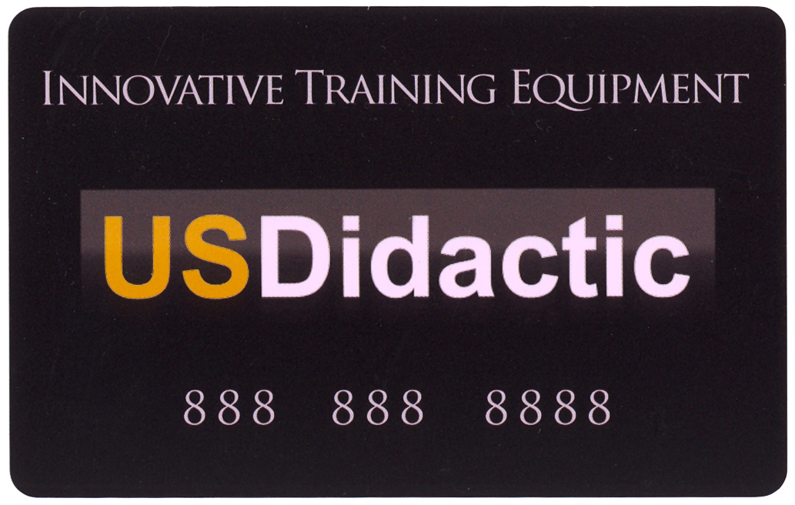
Scan your Smart Card
Notes:
3
Please, don’t forget to scan your conference Smart Card in order to mark your attendance at this session.

Slide 4
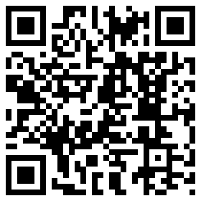
QR-Code
www.CareerOutlook.US/presentations
Notes:
I hope by now everyone knows that this is a QR code.
If you have a smart phone or iPad,-- and you are smart enough to use it, -- you capture this code, and it takes you to this website where you can download a copy of my PowerPoint file.
Or you can just go to Career Outlook dot US and click on the “presentations” link.
Has anyone already downloaded my PowerPoint? I will warn you that it is a very large file loaded with lots of graphics.
And there are about 200 slides at the end of the PowerPoint file that we won’t even talk about today. Take a look, you might find something you can use.
Feel free to use all or part of it. If it can help a child get on a path toward a rewarding career, then you can take and use anything I have to give.
I will also warn you that I talk very fast and have too much information that I want to cover. My goal is to get the information to you so that you can go back and digest it later. I’ve documented my information sources in the notes section of the PowerPoint, to allow you to further research anything that you see here.
-- So buckle up, and crank up the flux capacitor, you’re in for a fast ride into the future!
=====
A QR code (short for Quick Response) is a specific matrix barcode (or two-dimensional code), readable by dedicated QR barcode readers and camera phones. The code consists of black modules arranged in a square pattern on a white background. The information encoded can be text, URL, or other data. (Wikipedia 2011)
Free Q-Code generator http://qrcode.kaywa.com/

Slide 5
NC Board of Education Mission
Every public school student will graduate from high school, globally competitive for work and postsecondary education and prepared for life in the 21st Century.
Notes:
5
5
Here is the public school board mission in North Carolina. Your state should have something like this.
It’s full of a lot of big words talking about things like kids being globally competitive for work.
Let me show you the simplified version.

Slide 6
Education Plan
All students must graduate from
high school and be career,
college, and citizenship ready.
Notes:
6
6
All students must graduate from
high school -- and be career,
college, and citizenship ready.
The education mission in your state should also be focused on these three elements, since the kids need to be ready for all three.
Today I’m focusing on the Career-Ready part.
===
http://legislative.ncpublicschools.gov/resources-for-legislation/2012/20120608-sup-howmeasure.pdf

Slide 7
The primary aim of education is not to enable students to do well in school, but to help them do well in the lives they lead outside of school.
Elliot W. Eisner
Notes:
Sometimes we get too caught up in how well kids do in school --
and we loose sight of the goal to produce adult citizens who can function outside of school.
We have to get back to the true purpose of education.
===
This line is often quoted without any reference. Here are two people who claim the quote and a school district that uses it as their motto.
Elliot W. Eisner
http://www.ascd.org/publications/educational-leadership/dec03/vol61/num04/Preparing-for-Today-and-Tomorrow.aspx
Raymond McNulty
http://unioneagle.com/2012/01/education-leader-challenges-teachers-to-be-different/
Bellevue Community School District
http://bellevue.k12.ia.us/
7

Slide 8
Surprises
Future Demand
Changing World
New Ideas
Building Community
www.CareerOutlook.US/presentations
Notes:
Here is what we will be covering today.
Surprises in the job market,
Future Demand in occupations,
Our Changing World,
New Ideas about careers,
and what we need to do to Build Communities.
→
We will start with a few facts that might surprise you.

Slide 9
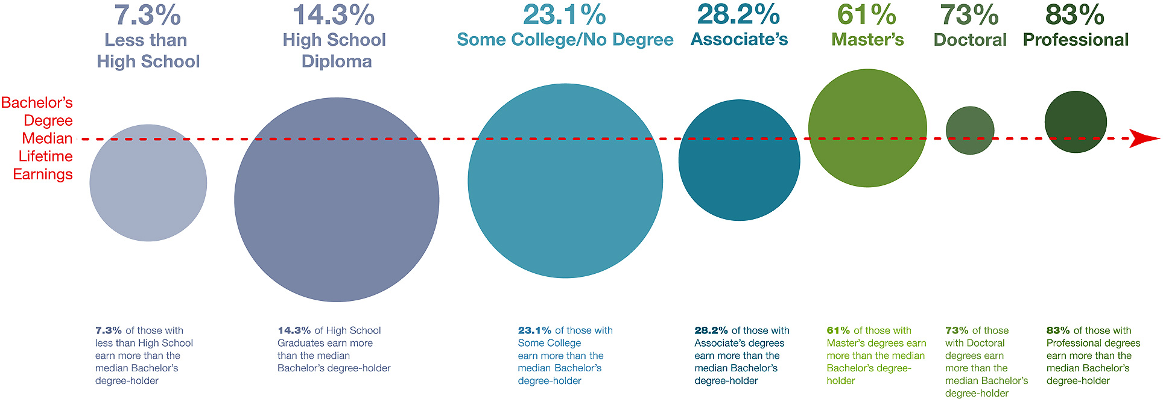
Earnings Overlap percent earning more than Bachelor’s degree
Notes:
This chart shows the percentage of people with various levels of education who earn more than the median lifetime earnings with a Bachelor’s degree.
As an example, in the middle of the screen, 28.2 percent of folks with an Associate's degree earn more than the average person with a Bachelor’s degree.
But this is for people who are currently employed.
For these high paying jobs that require a high degree of education, will there be any openings for our students five to ten years from now?
====
http://cew.georgetown.edu/collegepayoff/
http://www9.georgetown.edu/grad/gppi/hpi/cew/pdfs/collegepayoff-summary.pdf
Page 4, 5
9

Slide 10
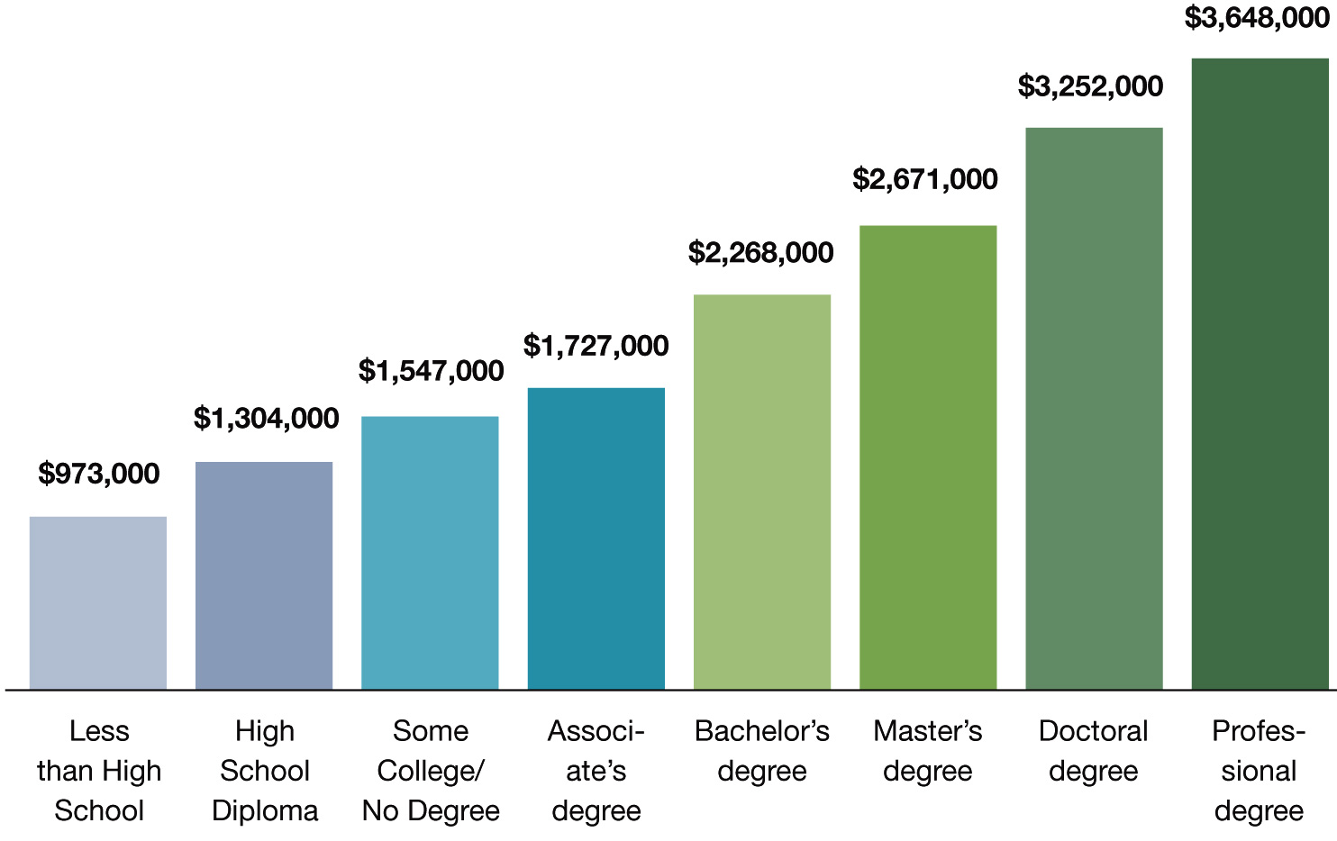
Degree Level Matters
People with more education make more money than those with less education
Notes:
This chart shows that, on average, people earn more over their lifetime if they have a higher level of education.
There’s no surprise here. But the reason I include this chart is to remind you that this chart shows people who are currently employed.
What does this say to our students who will be employed in five to ten years from now? Will the chart look different for them?
What if lifetime education costs and student loan interest is figured in? Does that narrow the gap?
What about cost of business attire, business social expenses, club memberships, and other expenses that might be different at different levels of employment?
What if all of that is figured in?
What about a lifestyle choice?
What does this chart tell our kids about their future?
====
http://cew.georgetown.edu/collegepayoff/
http://www9.georgetown.edu/grad/gppi/hpi/cew/pdfs/collegepayoff-summary.pdf
Page 4, 5
10

Slide 11
Average Starting Salaries for
2009 College Graduates in FL
$47,708 Associate in Science (community college)
$44,558 Bachelor degree (private college)
$39,108 Certificate (community college)
$36,552 Bachelor degree (state college)
Miami Herald - Jan 1, 2011
Notes:
A recent study in Florida looked at the actual starting salaries of college graduates. What they discovered was that the community college graduates earned more money than the folks who earned a Bachelor’s degree.
The stark reality is that there is a high demand for jobs that you prepare for by attending community college. And those jobs being in high demand, command surprisingly high salaries.
I assume that many of the bachelor program graduates in this study could not find a job in their field and settled for much less.
Compare this slide with the previous slide, and you can see that the data can be very confusing. The previous slide tells were we were for past graduates, this slide shows were we are now for our current graduates.
I’m about to show you where we will be in the future, which is when our high school students will be employed.
But first, salary data from a few more states.
====
http://www.miamiherald.com/2011/01/01/1996875/study-less-earn-more-at-least.html#ixzz1BP94m3Nj
http://www.miamiherald.com/2011/01/01/1996875/study-less-earn-more-at-least.html
11

Slide 12
Average Starting Salaries for
2005 College Graduates in OH
$35,648 Associate degree
$33,218 Bachelor degree
Notes:
Ohio found similar results when they polled their recent college graduates.
===
I’m not down on Bachelor degrees,
it’s just that associate degrees have been the Rodney Dangerfield of the education world.
It’s time they get the respect they deserve.
====
http://www.ohiocommunitycolleges.org/public-page.php?s=community-college-facts
12

Slide 13
Average Salaries
TN CC earn $1,300 higher than 4-year grads.
VA CC - occupational and technical degree
programs earn $2,500 more than bachelor's.
Notes:
Recent Tennessee Community College graduates earn more than the graduates of the state's four-year institutions.
Similar for Virginia.
-----
http://money.cnn.com/2013/02/26/pf/college/community-college-earnings/index.html
13

Slide 14

Notes:
Here’s the Tennessee data
====
http://www.air.org/reports-products/index.cfm?fa=viewContent&content_id=2061
The Earning Power of Graduates from Tennessee's Colleges and Universities
How Are Graduates from Different Degree Programs Doing in the Labor Market?
http://www.air.org/files/Earning_Power_TN_Graduates_Sept12.pdf
http://www.collegemeasures.org/
http://www.collegemeasures.org/post/2012/09/Big-Gaps-in-Earnings-for-Tennessee-College-Grads--Study-Shows-Wage-Disparities-Between-Degree-Programs-and-Schools.aspx
Among the findings in this report:
• In general, graduates with bachelor’s degrees in health, business, and engineering earn more
than graduates with liberal arts degrees. A closer look tells a more complex story. Graduates in
the health professions programs at The University of Tennessee at Martin (UT-Martin) earned
nearly $60,000 in their first year in the workforce (among the highest of all earners in the
state), while graduates from health professions programs at Tennessee State University earned
$46,000. However, UT-Martin graduates in history are among the lowest earners of all recent
bachelor’s degree holders in the state at around $25,000 annually, while Tennessee State
University history graduates earned over $37,000 per year.
• The average first-year earnings of associate’s degree graduates were over $1,000 more than
the average first-year earnings of bachelor’s degree graduates, but, again, there was wide
variation at the program level. Recent graduates with associate’s degrees in health professions
from Dyersburg and Volunteer State Community Colleges earned around $10,000 more per year
than graduates in the same areas of study at Northeast State or Nashville State Community
Colleges. Recent graduates with business degrees from Roane State and Southwest Tennessee
Community Colleges had average first-year earnings around $7,000 more than graduates from
the same programs at Jackson State or Motlow State Community College.
• The average earnings of individuals with certificates were often quite close to the average
earnings of associate’s degree holders in the most popular fields of study. However, as
with both bachelor’s and associate’s degrees, there is a wide range between the highest
and lowest earnings of certificate holders.

Slide 15

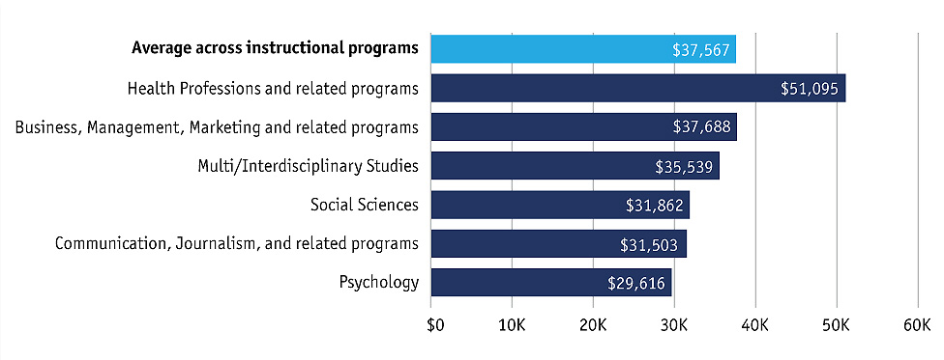
Average First-year Earnings –
Bachelor’s Degree
Notes:
Tennessee Data for Bachelor’s Degree
====
http://www.air.org/reports-products/index.cfm?fa=viewContent&content_id=2061
The Earning Power of Graduates from Tennessee's Colleges and Universities
How Are Graduates from Different Degree Programs Doing in the Labor Market?
http://www.air.org/files/Earning_Power_TN_Graduates_Sept12.pdf
http://www.collegemeasures.org/
http://www.collegemeasures.org/post/2012/09/Big-Gaps-in-Earnings-for-Tennessee-College-Grads--Study-Shows-Wage-Disparities-Between-Degree-Programs-and-Schools.aspx

Slide 16
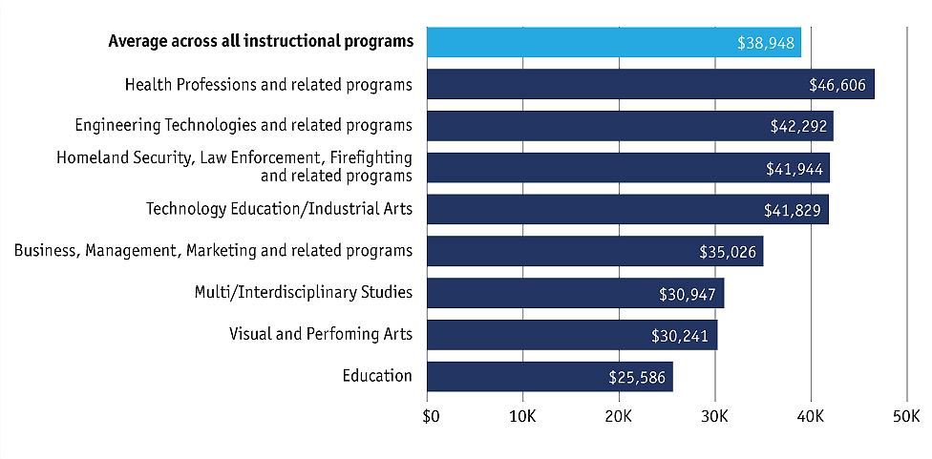
Average First-year Earnings –
Associate’s Degree
Notes:
Tennessee Data for Associate’s Degree
====
http://www.air.org/reports-products/index.cfm?fa=viewContent&content_id=2061
The Earning Power of Graduates from Tennessee's Colleges and Universities
How Are Graduates from Different Degree Programs Doing in the Labor Market?
http://www.air.org/files/Earning_Power_TN_Graduates_Sept12.pdf
http://www.collegemeasures.org/
http://www.collegemeasures.org/post/2012/09/Big-Gaps-in-Earnings-for-Tennessee-College-Grads--Study-Shows-Wage-Disparities-Between-Degree-Programs-and-Schools.aspx

Slide 17
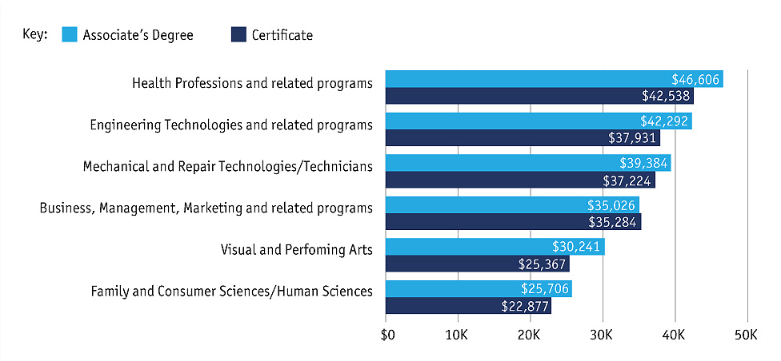
Average First-year Earnings –
Certificate vs. Associate’s Degree
Notes:
In most cases the Associate Degrees earn more then the certificate programs, but not always.
====
http://www.air.org/reports-products/index.cfm?fa=viewContent&content_id=2061
The Earning Power of Graduates from Tennessee's Colleges and Universities
How Are Graduates from Different Degree Programs Doing in the Labor Market?
http://www.air.org/files/Earning_Power_TN_Graduates_Sept12.pdf
http://www.collegemeasures.org/
http://www.collegemeasures.org/post/2012/09/Big-Gaps-in-Earnings-for-Tennessee-College-Grads--Study-Shows-Wage-Disparities-Between-Degree-Programs-and-Schools.aspx

Slide 18

Notes:
And here is the Virginia Data.
============
http://www.air.org/files/Virginia_EMS_Report1.pdf
The Earning Power of Recent Graduates From Virginia’s Colleges and Universities:
How are graduates from different degree programs doing in the labor market?
---
Among the findings in this report:
• Substantial variation exists in the early-career earnings of students from different programs and different degree levels across the Commonwealth. Graduates of occupational/technical associate’s degree programs, with an average salary of just under $40,000, out-earned not just nonoccupational associate’s degree graduates (by about $6,000) but even bachelor’s degree graduates by almost $2,500 statewide.
• At the bachelor’s degree level, the highest earning graduates came from two career-oriented programs at the University of Richmond, where graduates in information sciences and in human resources management averaged more than $69,000 per year. Meanwhile, graduates from sixteen programs across the Commonwealth earned on average less than $24,000. Most of these are traditional liberal arts programs, such as Philosophy or fine arts related.
• Across Virginia, setting aside nursing, graduates with degrees in business-related programs (including finance, accounting, and economics) earned more than other graduates. But students from different business programs could earn quite different amounts. For example, graduates from University of Richmond’s business administration program earned between $2,500 and $19,000 more than graduates in the same program from other universities across Virginia.
• Although differences in other popular bachelor’s degree majors were not as wide, recent graduates from Emory and Henry College’s psychology program earned around $22,000, whereas psychology graduates from University of Virginia and George Mason University averaged more than $32,000.
• Among many of Virginia’s community colleges, earnings of graduates with a technical associate’s degree could exceed $10,000 more than those with a bachelor’s credit–oriented associate’s degree; in three community colleges (John Tyler, Germanna, and Lord Fairfax), the difference was greater than $12,000.

Slide 19
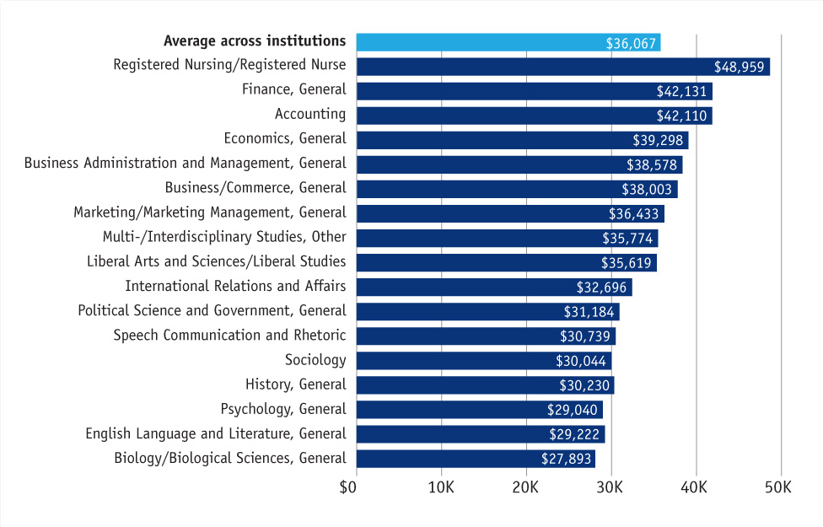

Average First-year Wages - Bachelor’s Degree Programs
Notes:
============
http://www.air.org/files/Virginia_EMS_Report1.pdf
The Earning Power of Recent Graduates From Virginia’s Colleges and Universities:
How are graduates from different degree programs doing in the labor market?

Slide 20
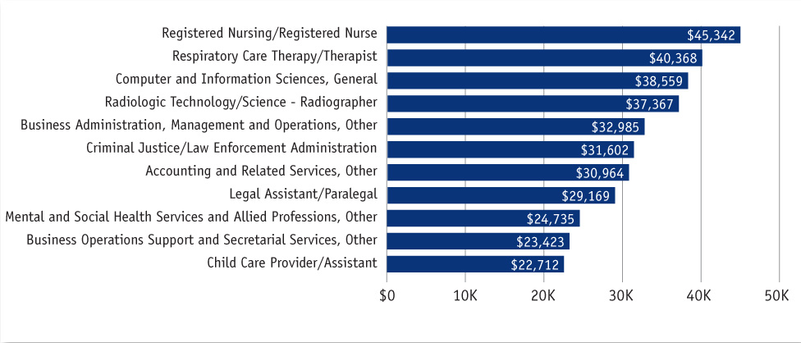
Average First-year Wages - Associate’s Degree Programs
Notes:
============
http://www.air.org/files/Virginia_EMS_Report1.pdf
The Earning Power of Recent Graduates From Virginia’s Colleges and Universities:
How are graduates from different degree programs doing in the labor market?

Slide 21

Notes:
Texas Data
====
Among the findings are:
• Technical-oriented associate’s degree programs in the state of Texas are helping many
students successfully enter the labor market by equipping them with skills that are in demand.
On average, a year after graduation, students with two-year technical degrees have first-year
median earnings of more than $50,000, just over $11,000 more than graduates of bachelor’s
degree programs across the state.
• Graduates with these two-year technical degrees earn, on average, about $30,000 more
than students who completed academically oriented two-year degrees and are now in the
labor force.
=====
http://www.air.org/files/Texas_Graduates_Earnings_Report_4.26.13.pdf
http://www.air.org/reports-products/index.cfm?fa=viewContent&content_id=2476
Higher Education Pays: The Initial Earnings of Graduates of Texas Colleges and Universities Who Are Working in Texas
---
Blog about it
https://www.acteonline.org/ctepolicywatch.post.aspx?id=4253&blogid=2289#.UZU7AkqXQgE
---
Among the findings are:
• Technical-oriented associate’s degree programs in the state of Texas are helping many
students successfully enter the labor market by equipping them with skills that are in demand.
On average, a year after graduation, students with two-year technical degrees have first-year
median earnings of more than $50,000, just over $11,000 more than graduates of bachelor’s
degree programs across the state.
• Graduates with these two-year technical degrees earn, on average, about $30,000 more
than students who completed academically oriented two-year degrees and are now in the
labor force.

Slide 22

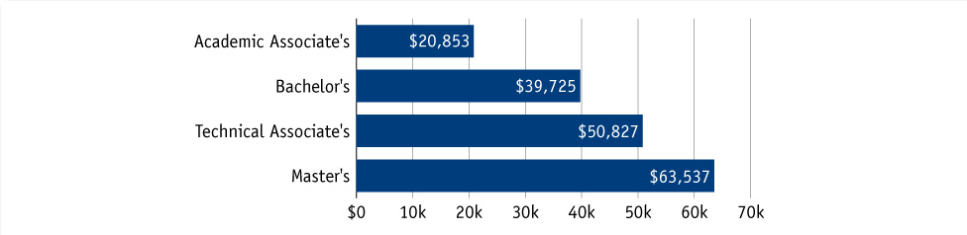
Median First-year Earnings by Degree
Notes:
Technical Associates Degrees earn $10,000 more than the Average Bachelor’s Degree.
=====
http://www.air.org/files/Texas_Graduates_Earnings_Report_4.26.13.pdf
http://www.air.org/reports-products/index.cfm?fa=viewContent&content_id=2476
Higher Education Pays: The Initial Earnings of Graduates of Texas Colleges and Universities Who Are Working in Texas
---
Blog about it
https://www.acteonline.org/ctepolicywatch.post.aspx?id=4253&blogid=2289#.UZU7AkqXQgE

Slide 23
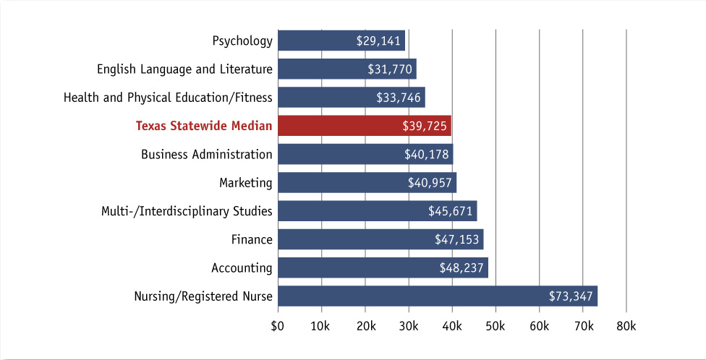
Median First-year Earnings – Bachelor’s Degree
Notes:
=====
http://www.air.org/files/Texas_Graduates_Earnings_Report_4.26.13.pdf
http://www.air.org/reports-products/index.cfm?fa=viewContent&content_id=2476
Higher Education Pays: The Initial Earnings of Graduates of Texas Colleges and Universities Who Are Working in Texas
---
Blog about it
https://www.acteonline.org/ctepolicywatch.post.aspx?id=4253&blogid=2289#.UZU7AkqXQgE

Slide 24
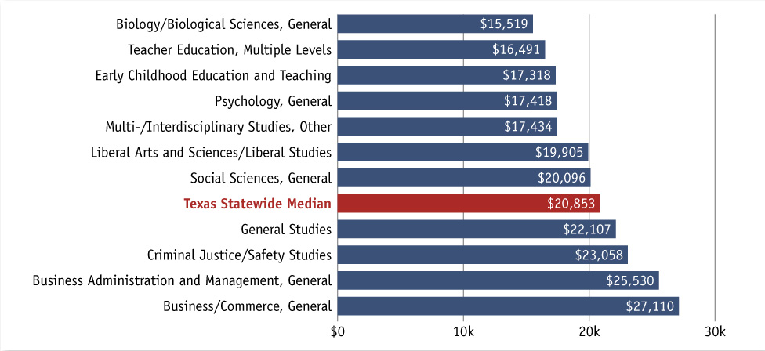
Median First-year Earnings –
Academic Associate’s Degree
Notes:
=====
http://www.air.org/files/Texas_Graduates_Earnings_Report_4.26.13.pdf
http://www.air.org/reports-products/index.cfm?fa=viewContent&content_id=2476
Higher Education Pays: The Initial Earnings of Graduates of Texas Colleges and Universities Who Are Working in Texas
---
Blog about it
https://www.acteonline.org/ctepolicywatch.post.aspx?id=4253&blogid=2289#.UZU7AkqXQgE

Slide 25
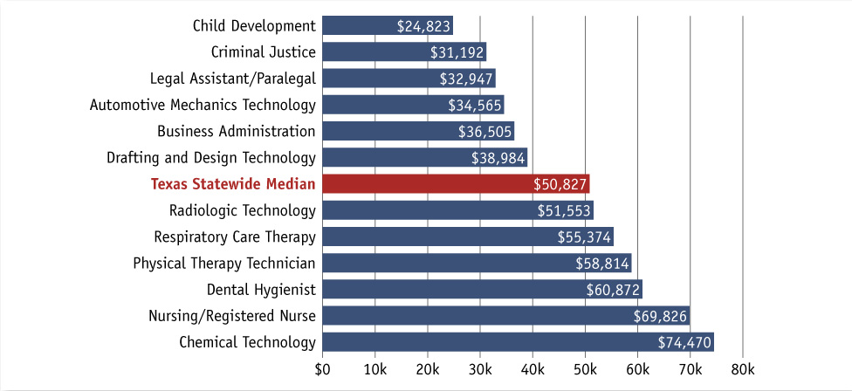
Median First-year Earnings –
Technical Associate’s Degree
Notes:
=====
http://www.air.org/files/Texas_Graduates_Earnings_Report_4.26.13.pdf
http://www.air.org/reports-products/index.cfm?fa=viewContent&content_id=2476
Higher Education Pays: The Initial Earnings of Graduates of Texas Colleges and Universities Who Are Working in Texas
---
Blog about it
https://www.acteonline.org/ctepolicywatch.post.aspx?id=4253&blogid=2289#.UZU7AkqXQgE

Slide 26
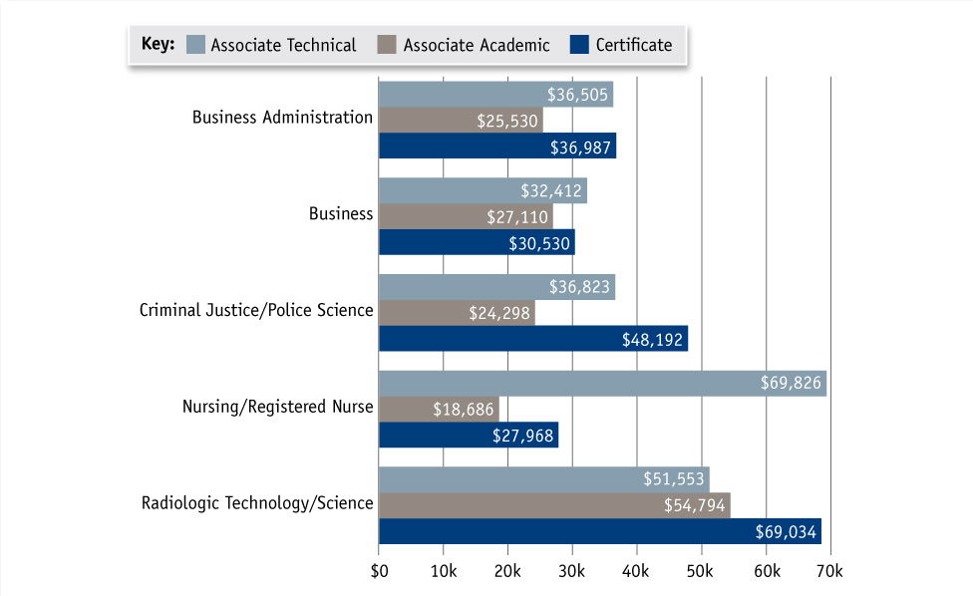
Median First-year Earnings –
Certificate vs. Associate’s Degree
Notes:
And here we see that many of the Certificate programs in dark blue earn more than those with an Associate degree.
Not in Nursing, but in most other areas.
It’s a different world out there.
=====
http://www.air.org/files/Texas_Graduates_Earnings_Report_4.26.13.pdf
http://www.air.org/reports-products/index.cfm?fa=viewContent&content_id=2476
Higher Education Pays: The Initial Earnings of Graduates of Texas Colleges and Universities Who Are Working in Texas
---
Blog about it
https://www.acteonline.org/ctepolicywatch.post.aspx?id=4253&blogid=2289#.UZU7AkqXQgE

Slide 27
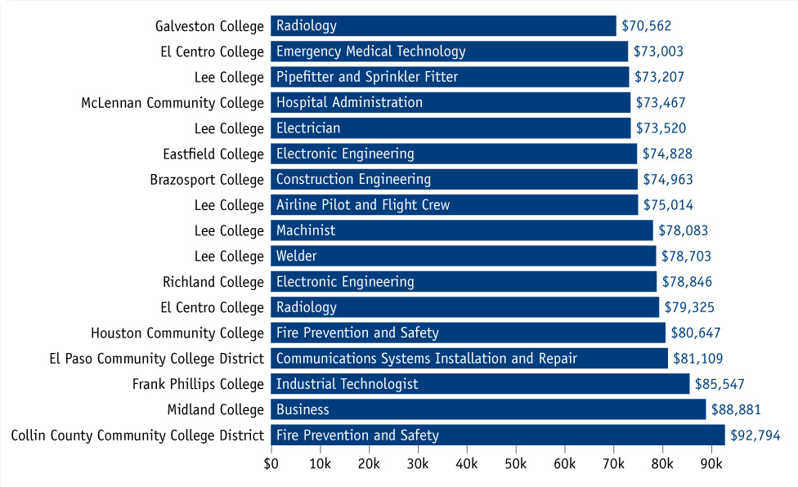
Median First-year Earnings –
Certificates by College
Notes:
Look at these first-year salaries for folks with a community college certificate, not even an associate degree.
Those look like PhD. Salaries!
That’s more money in the first year than most of us educators ever hope to make.
=====
http://www.air.org/files/Texas_Graduates_Earnings_Report_4.26.13.pdf
http://www.air.org/reports-products/index.cfm?fa=viewContent&content_id=2476
Higher Education Pays: The Initial Earnings of Graduates of Texas Colleges and Universities Who Are Working in Texas
---
Blog about it
https://www.acteonline.org/ctepolicywatch.post.aspx?id=4253&blogid=2289#.UZU7AkqXQgE

Slide 28
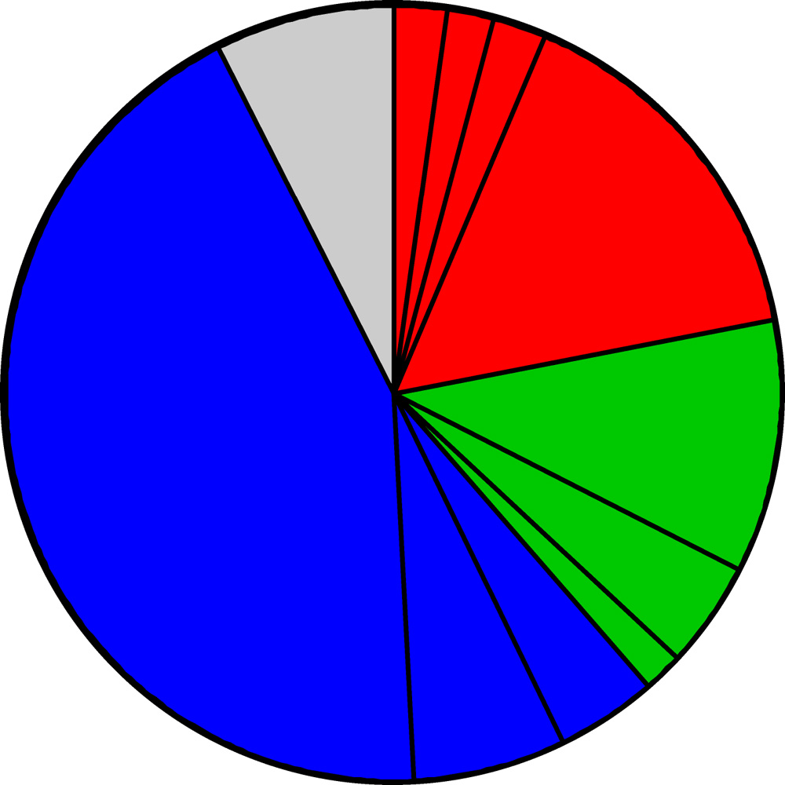
2008-2018 Projected NC Employment:
Education Required
Doctorate & Professional degree
work exp.
Master’s degree
Bachelor + work exp.
7.5%
Bachelor’s degree
15.5%
10.6%
Associate degree
43.3%
short OJT
4.2%
1,2 year college
6.5%
Apprenticeship
long OJT
mod. OJT
Notes:
Here is the breakdown of the minimum education required for all job openings in North Carolina projected over a 10-year period through 2018.
Nationally, the data is about the same.
You will notice that the largest portion, in blue, are the jobs that do not require any education past high school in order to get the job.
They do however, require some kind of learning on-the-job.
====
NC Employment Security Commission data via www.CareerOutlook.US
These are for all jobs that get a paycheck, not for contracted positions, or small business owners who do not write themselves a paycheck.
====
captured from the NC ESC website on Sept 6, 2012
http://eslmi23.esc.state.nc.us/projections/EmpByOccGrp.asp?AreaType=01&Area=000037&PeriodID=08
2008-2018 projections
High Demand = growth >1.14% per year and 100 projected annual openings
New definition of high demand is mean of all (Average Total Annual Openings) = 60.09
Thus if Average Total Annual Openings > 60, then it is high demand
7.53% Work experience in a related occupation
43.26% Short-term on-the-job (OJT) training
6.47% Moderate-term on-the-job (OJT) training
4.00% Long-term on-the-job (OJT) training
1.91% Apprenticeship
4.25% One/two years of college
10.65% Associate Degree
15.53% Bachelor's Degree
2.25% Bachelor's Degree plus work experience
1.82% Master's Degree
2.34% Doctoral or professional degree

Slide 29
2012 NC High School
Graduate Intentions
Other
Employment
8.2%
Military
Trade and
Business
Schools
5.0%
Public Senior
Institutions
35.1%
Private
Junior
Colleges
37.5%
10.0%
Community and
Technical Colleges
Private Senior
Institutions
Notes:
And here you see the breakdown of the postsecondary intentions of our high school graduates.
Almost half of them say they are going to a four-year college program. Your state’s data should be similar.
I have lumped the military in with direct employment even though there will be some postsecondary training involved.
The Other category is the two percent of the students who plan to sit on Mom’s couch the rest of their lives playing Nintendo.
=====
NC Public Schools Statistical Profile 2012 data
http://www.ncpublicschools.org/fbs/resources/data/
This is where our students say they are going after high school. Half say they are going to a four-year college.
35.1% Public Senior Institutions
10.0% Private Senior Institutions
37.5% Community/Technical College
0.5% Private Junior College
1.7% Trade/Business School
5.0% Military
8.2% Employment
2.0% Other

Slide 30
Postsecondary Intentions vs. Reality
Graduate Intentions
Education Required
7.5%
OJT
4 year
13.2%
21.9%
4 year
45.1%
16.8%
1-2 year
1-2 year
OJT
39.7%
53.7%
Notes:
Here we can compare these two charts.
On the left is where the students say they are going, and on the right is what the projected job openings require.
→45 percent of our students say they are going to a four-year college program, which will prepare them for 22 percent of the projected job openings.
If you do the math, it looks like half of them will drop out or be left holding a sheepskin with no job to show for it.
→Likewise, almost 40 percent of our high school graduates say they are going to a one- or two-year program at a community college or private training facility.
This prepares them for almost 17 percent of the projected job openings.
Whether you use old math or new math, you still see that there is some disparity between the number of people going into a training program and the number of jobs that are available.
→Though the blue on the right shows that almost 54 percent of the jobs do not require postsecondary education, there are community college programs for most of these jobs, which means that the education is not required, but in these days of high unemployment, the postsecondary education is preferred, and you will be more likely to get hired.
Are we encouraging our students to get an education that will prepare them for a non-existent job?
=============

Slide 31
Associate Degree Required
(2011 NC Starting Salaries - 2018 High Demand)
$62,210 Construction Managers
$51,360 Dental Hygienists
$46,040 Registered Nurses
$42,350 Respiratory Therapists
$40,690 Radiologic Technologists and Technicians
$40,420 Physical Therapist Assistants
$28,030 Paralegals and Legal Assistants
$26,840 Medical and Clinical Laboratory Technicians
$19,810 Veterinary Technologists and Technicians
$17,400 Preschool Teachers, except Special Education
Notes:
Here are High demand jobs in NC that require a 2-year associate degree.
Getting your foot in the door with one of these entry-level jobs can lead to other jobs. Some employers may even pay for the education you need to advance.
I’ve underlined the word Manager to remind you that this occupation requires previous work in the industry as well as the associate degree, so that is one reason why the starting salary is higher then many of the others.
Look at all of the health professionals!
Go to school for two years an start making some good money.
All of these can relate to the Health industry.
First-year teachers in North Carolina (2012) make $30,800
A teacher would have to work almost 30 years to make $49,000 (assuming there are pay increases each year, which currently there is not), and here, some make that two years out of high school.
And if you add in the cost of the education, it appears that teachers will never make the same salary as the starting salary for dental hygienists and others who went to community college.
Don’t discount the community colleges because you assume that their graduates make low salaries.
===============
www.CareerOutlook.us based on NC Employment Security Commission data
High Demand is above the Mean of all Average Total Annual Openings, which for 2008-2018 is above 60 openings per year.

Slide 32
Bachelor Degree Required
(2011 NC Starting Salaries - 2018 High Demand)
$86,820 Computer and Information Systems Managers
$72,800 Financial Managers
$71,430 Software Developers, Systems Software
$63,180 Medical and Health Services Managers
$61,140 Software Developers, Applications
$54,740 Sales Managers
$54,430 Computer Systems Analysts
$49,890 Financial Analysts
$49,270 Network and Computer Systems Administrators
$47,950 Management Analysts
$46,380 Civil Engineers
$43,880 Accountants and Auditors
$43,360 Securities, Commodities, and Financial Services Sales Agents
$40,950 Financial Specialists, All Other
$40,830 Environmental Scientists and Specialists, Including Health
$40,790 Compensation, Benefits, and Job Analysis Specialists
$39,040 Sales Representatives, Wholesale and Manufacturing, Technical and Scientific Products
$38,140 Training and Development Specialists
$38,040 Compliance Officers
$37,160 Cost Estimators
$36,990 Market Research Analysts and Marketing Specialists
$36,230 Personal Financial Advisors
$35,500 Public Relations Specialists
$34,770 Secondary School Teachers, Except Special and Career/Technical Education
$34,060 Special Education Teachers, Preschool, Kindergarten, and Elementary School
$33,750 Elementary School Teachers, Except Special Education
$33,710 Middle School Teachers, Except Special and Career/Technical Education
$33,630 Kindergarten Teachers, Except Special Education
$33,380 Mental Health and Substance Abuse Social Workers
$32,890 Child, Family, and School Social Workers
$32,160 Adult Basic and Secondary Education and Literacy Teachers and Instructors
$28,300 Clergy
$28,100 Graphic Designers
$16,890 Recreation Workers
Notes:
Here the underlined occupations are in management, which means that not only does the job require a bachelor degree, but also requires some years of work experience in that field.
Unfortunately, more schooling does not always mean more money.
A Dental Hygienist with only two years of college, makes more money the first year than many of these jobs that require 4-year degree.
Considering the student loans to pay back, who will be able to afford that fancy sports car the soonest?
=============
www.CareerOutlook.us based on NC Employment Security Commission data
High Demand is above the Mean of all Average Total Annual Openings, which for 2008-2018 is above 60 openings per year.

Slide 33

Notes:
===
http://www.naceweb.org/salary-survey-data/
Salary Survey Report
April 2013 Executive Summary

Slide 34
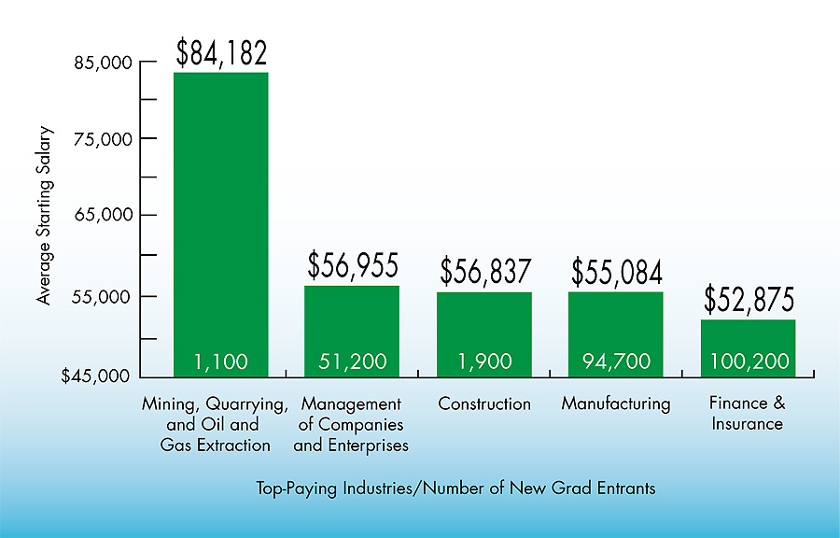
Notes:
This chart shows the top five industries that paid the highest starting salaries to this year’s brand new bachelor’s degree Graduates.
How many of your students want to be a petroleum engineer? Who’s ever heard of a petroleum engineer?
After teaching for 20 years -- how many of you wish you were making the starting salary of a petroleum engineer?
I’m glad you decided to be an educator.
===
http://www.naceweb.org/salary-survey-data/
Salary Survey Report
April 2013 Executive Summary

Slide 35
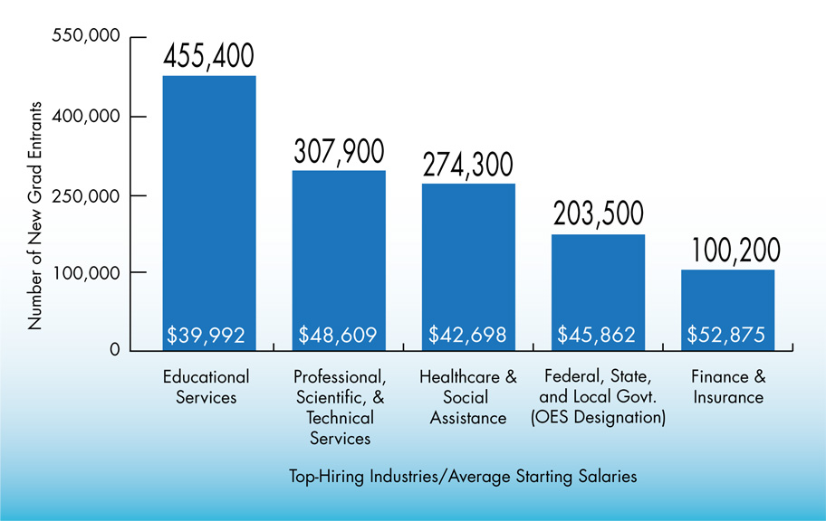
Notes:
Here’s who’s hiring!
This chart shows the top five industries that reported the highest number of new hires who have a fresh bachelor’s degree. That’s the numbers on top.
At the bottom of the bar is the average salary for that industry.
===
http://www.naceweb.org/salary-survey-data/
Salary Survey Report
April 2013 Executive Summary

Slide 36
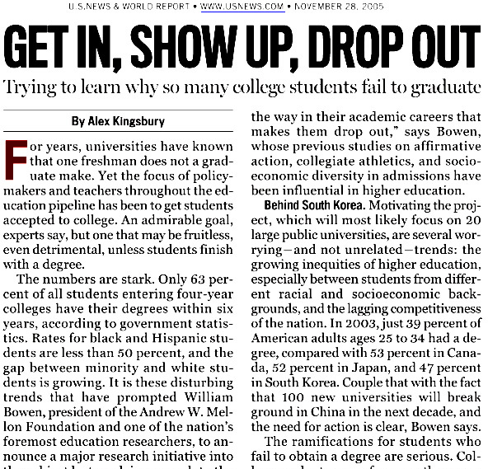
56% of bachelor’s-seeking students get
degree in 6 years (35% in 4 years)
National Center for Education Statistics,
U.S. Department of Education (nces.ed.gov)
Notes:
Almost half of the students that we send to a four-year college program will drop out.
======
http://www.usnews.com/usnews/news/articles/051128/28bowen.htm
National Center for Education statistics, U.S. Department of Education (nces.ed.gov)
“Enrollment in Postsecondary Institutions, Fall 2004; Graduation Rates, 1998 & 2001 Cohorts; and Financial Statistics, Fiscal Year 2004”
http://nces.ed.gov/pubs2006/2006155.pdf

Slide 37
6-Year College Graduation Rate - USA
2009 data
3,137 colleges in the USA
7,684,301 students
53.4% average
Notes:
According to another data source, -- Nationally, the average is 53.4 percent of students start a four-year program and fail to complete it at that same college within six years.
We hear a lot of talk about high school graduation rates, but what about the college graduation rates?
In the notes section I’ve given you the link so you can find the graduation rate for any college.
====
Find graduation rates for any college
www.collegeresults.org
====
2137 colleges in the USA
2009 6-year graduation rate
Simply averaging the graduation rate of all colleges irrespective to the student population = 49.23%
Multiply college graduation rate by number of students (undergrad FTE) in each college.
Add those together = 4,106,142
and divide by total number of students = 7,684,301
= 53.44%

Slide 38
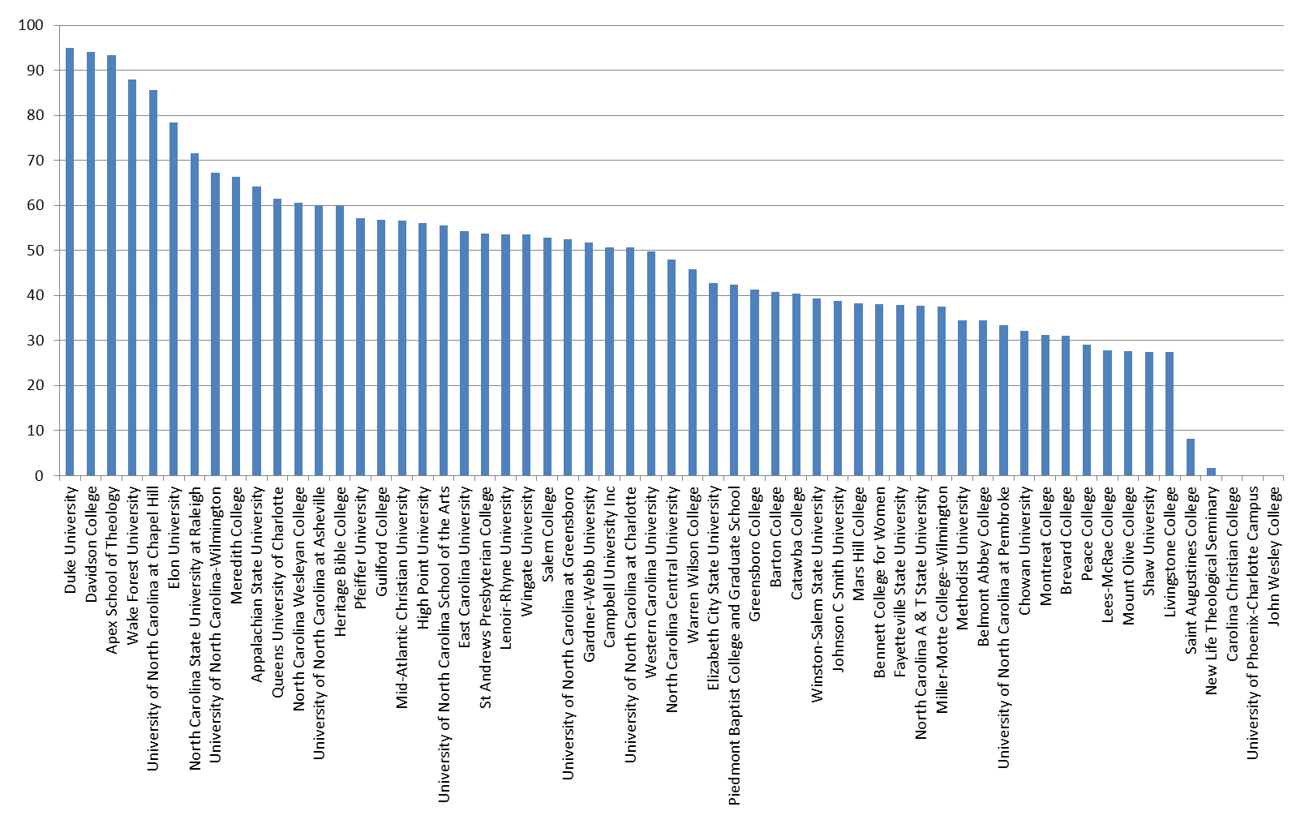
North Carolina
6-year Graduation Rate – 2008
57.6% average
Notes:
Here’s a chart that shows the graduation rate for all of the colleges in North Carolina
=====
Almost half of the students that we send to a four-year college program in North Carolina will drop out.
This chart shows the percentage of students who start a four-year degree and complete it within 6 years.
Duke’s graduation rate is very high, but they are also very picky about who they let in.
One drawback to this data is that it is showing how many start a four-year program and complete it in six years at the same institution.
Some of the smaller, private colleges have low graduation rates because students might start there, and then transfer to a larger state university.
This counts as a negative where the student started, and does not count at all where the student completed their degree.
Anytime you look at data, you have to take time to truly understand it, -- so you don’t jump to the wrong conclusion.
====
www.collegeresults.org
Average 57.6% for all NC undergraduates listed

Slide 39
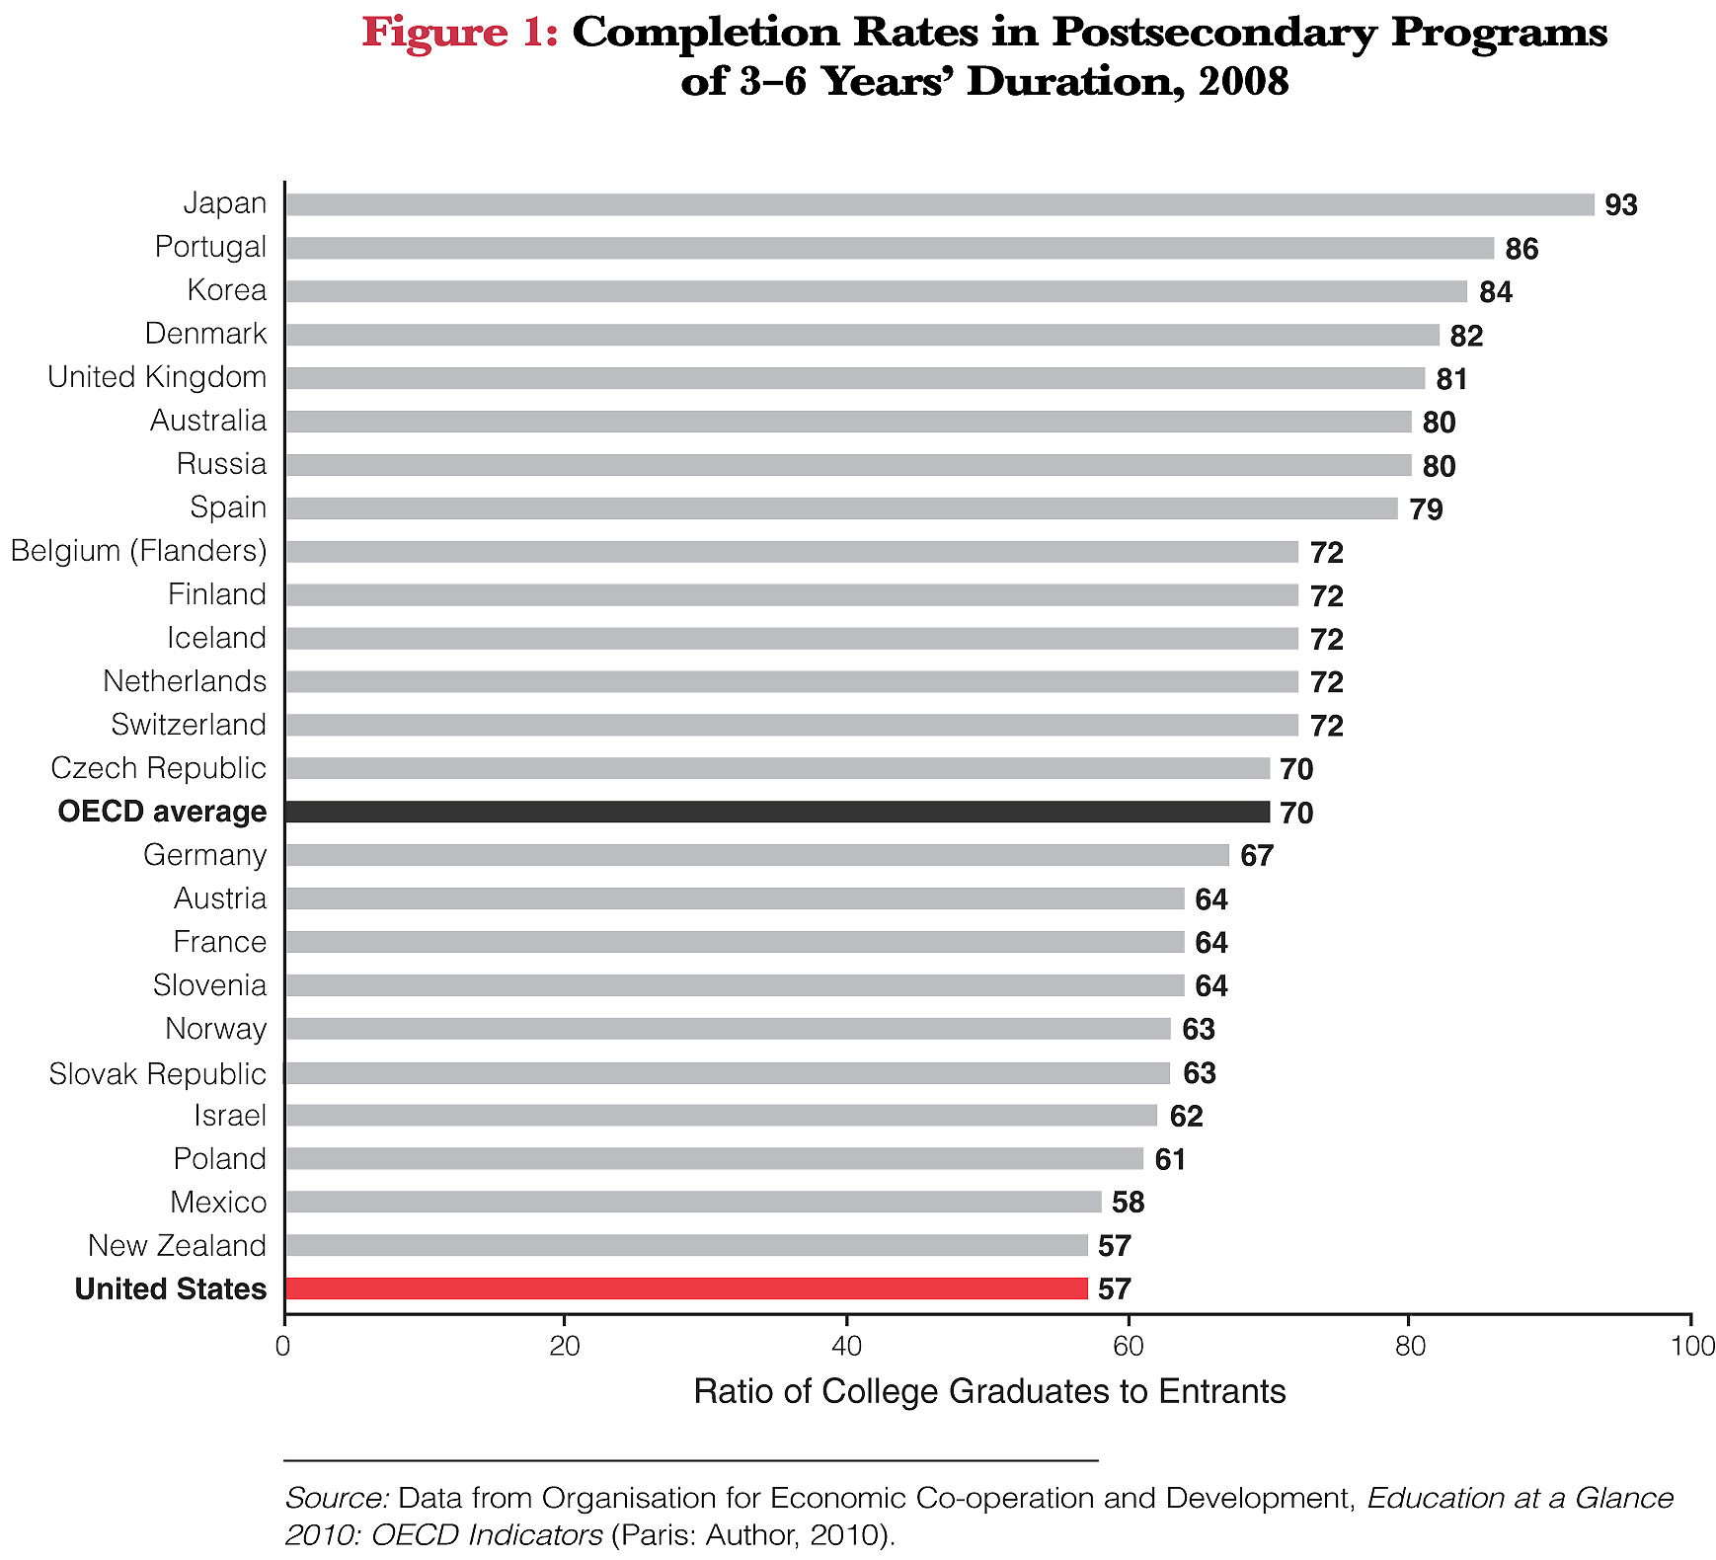

Notes:
Here we see the college completion rate of the United States compared with other countries.
That’s us at the bottom -- showing that 57 percent of American students start a four-year college program and complete it in six years.
What this data does not show is students who transfer to another college. Those students count as a negative at the college where they start the degree, and do not count at all at the college where they complete the degree. Something to think about.
====
ACT 2011
Affirming the Goal - Is College and Career Readiness an Internationally Competitive Standard?
http://www.act.org/research/policymakers/pdf/AffirmingtheGoal.pdf

Slide 40
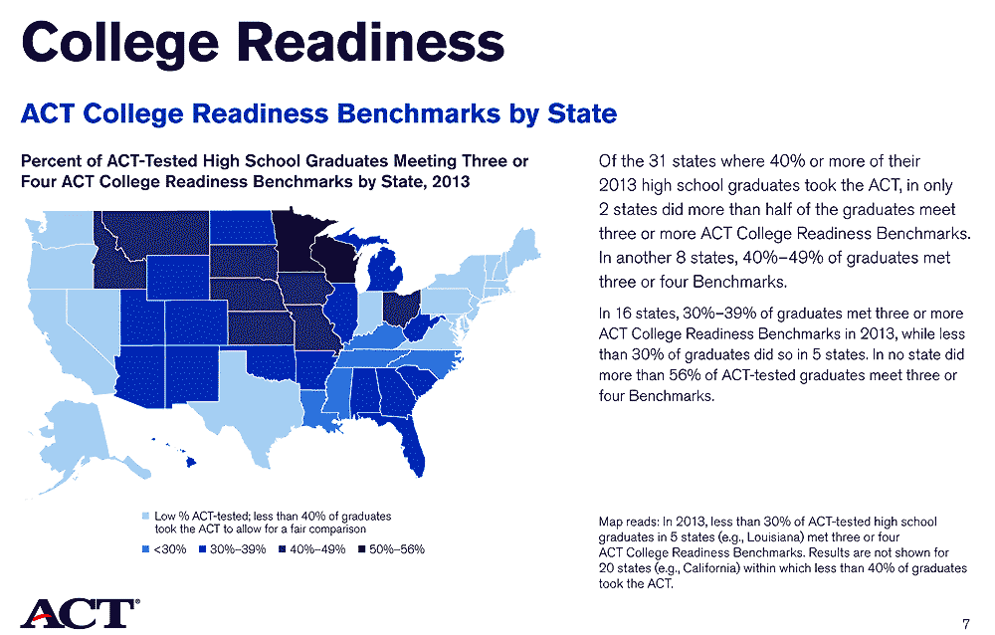

Notes:
The darkest states are creating college-ready high school graduates.
Only two states, Minnesota and Wisconsin, are graduating 50 percent of their students college-ready. The others are less.
====
The Condition of College & Career Readiness 2013
http://www.act.org/research/policymakers/cccr13/
August 21, 2013
Using the ACT College Readiness Benchmarks and ACT® test scores, the Condition of College & Career Readiness reports provide national and state snapshots of college readiness of the graduating seniors of the class of 2013 who took the ACT in high school.

Slide 41
It makes you think?
What happens to our
4-year program dropouts?
25% of all students
in Community College
have a 4-year degree.
Did we send them to
the wrong school?
Notes:
→What happens to our college dropouts? Do they come back to high school and say “That didn’t work out. What should I try next?”
Probably not.
→Many university graduates are going to community colleges to get the specific education they need for a job.
I’m not saying that four-year degrees are not important… But for career purposes, (especially entry-level) it may not always be the best choice.
It’s important to tell our students about life-long learning. Gone are the days where the first part of your life was learning and the rest of you life is doing.
Now the learning and doing go together forever.
→About a fourth of our high school graduating class drops out of a 4-year college program. Did we send them to the wrong school? Did we not adequately prepare them for college work?
We spend a lot of time looking at our high school graduation rate, but what about our career and college readiness rate? We should be talking about that.

Slide 42
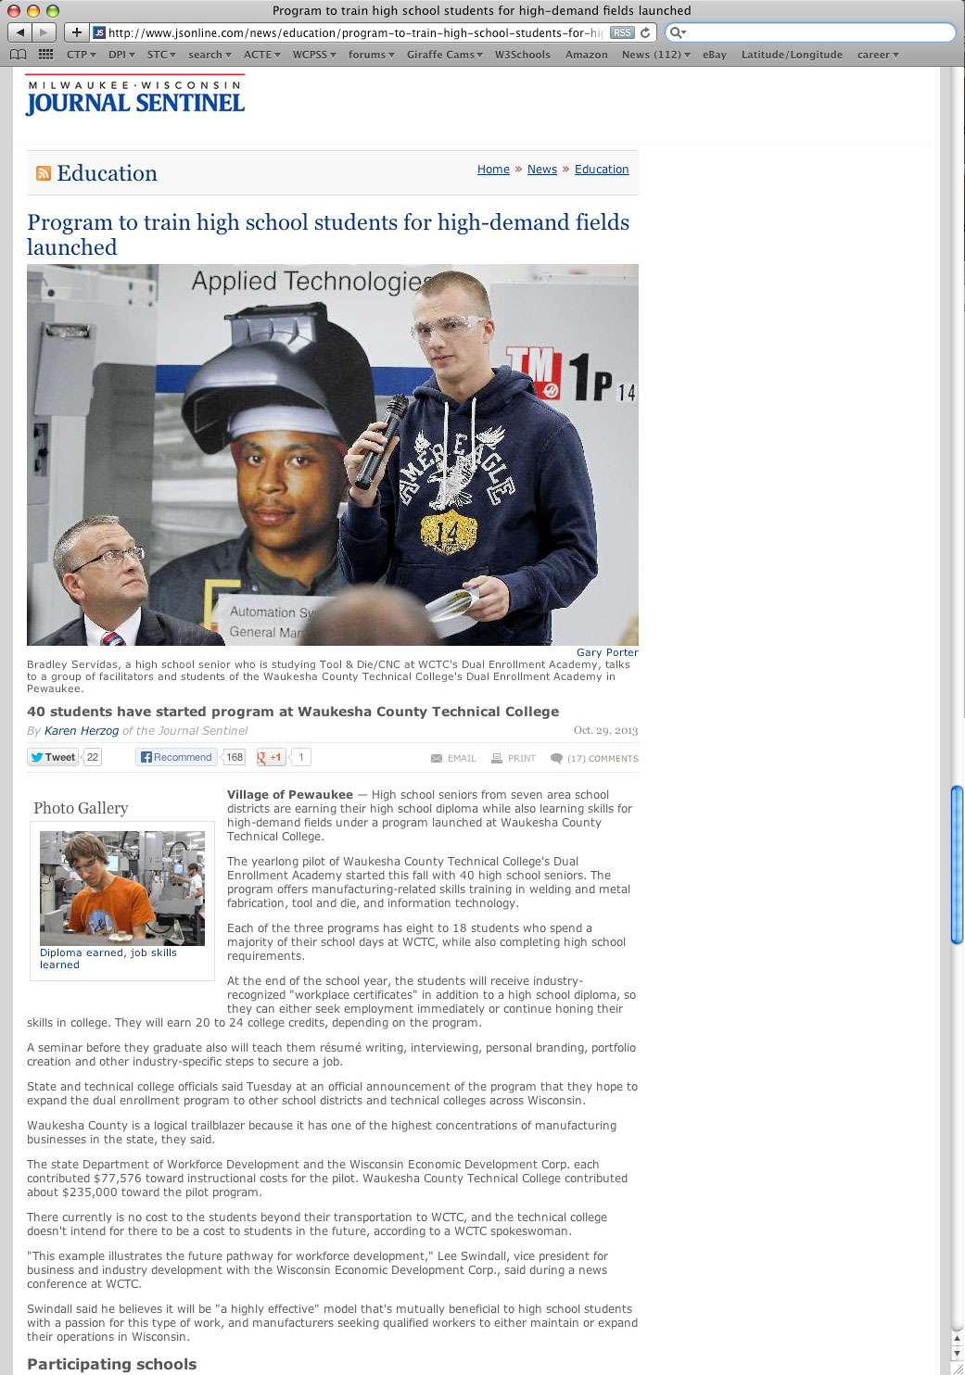
Notes:
The best line in this article is where the governor said
“The fastest growing segment of technical college enrollment is students with four-year degrees who realize the job market is strongest for those with technical skills,"
===
http://www.jsonline.com/news/education/program-to-train-high-school-students-for-high-demand-fields-launched-b99130553z1-229717831.html
Program to train high school students for high-demand fields launched
"The fastest growing segment of technical college enrollment is students with four-year degrees who realize the job market is strongest for those with technical skills," the governor said.

Slide 43
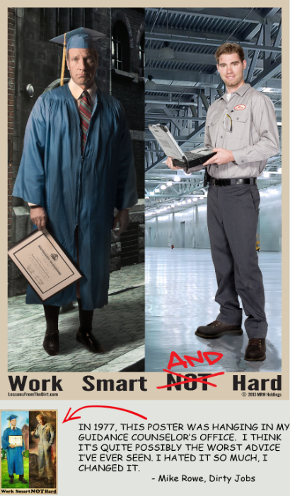
Notes:
Mike Rowe, of Dirty Jobs fame, reworked the poster he saw hanging in his high school.
Mike is trying to bring back respect for blue-color jobs.
===
article
http://www.theblaze.com/stories/2013/10/23/mike-rowe-of-dirty-jobs-speaks-about-hard-work-how-many-are-following-the-worst-advice-in-the-history-of-the-world/
poster:
http://www.theblaze.com/wp-content/uploads/2013/10/Work-Smart-AND-Hard.png
<br />
Rowe said there’s a difference between work and labor, explaining that “work is the thing you admire, [and] labor is the thing you have to do.”

Slide 44
Surprises
Future Demand
Changing World
New Ideas
Building Community
www.CareerOutlook.US/presentations
Notes:
→
Now --- let’s look towards the future

Slide 45
If we really want to prepare our students for successful careers, we need to know all we can about the rapidly changing job market.
C. Droessler
Notes:
45
The job market has changed considerably from when we graduated from high school.
Many of the careers our current students will have - have yet to be thought of, which makes career preparation an even bigger challenge.
We get most of our career guidance from our parents.
Do our student's parents keep up with the rapidly changing job market?
====
Chris Droessler & Emil Barnabas

Slide 46
Fastest Growing Occup. in USA
Requiring Postsecondary Education
(Total Change in Positions Projected from 2010 - 2020)
711,900 Registered Nurses
358,400 Elementary and Middle School Teachers
314,600 Software Developers and Programmers
305,700 Postsecondary Teachers
302,000 Nursing Aides, Orderlies, and Attendants
248,800 Elementary School Teachers, Except Special Education
190,700 Accountants and Auditors
183,700 Health Practitioner Support Technologists and Technicians
178,600 Counselors
168,500 Licensed Practical and Licensed Vocational Nurses
168,300 Physicians and Surgeons
157,200 Management Analysts
146,300 Preschool and Kindergarten Teachers
143,800 Software Developers, Applications
Notes:
46
Not counting the occupations that require less than a year of on-the-job-training (OJT),
here are the high-demand occupations in the United States that require some kind of postsecondary education.
The number listed is the projected change in the number of positions in the US over the ten-year projection period.
In 2020, The United States will need 711,900 more registered nurses than we had in 2010.
We’ll talk about that in a minute.
Look at all the teachers we need at all levels of education.
(the other handout)
==========
These data are from www.CareerOutlook.US
http://www.bls.gov/emp/ep_table_112.htm
Education and training assignments
updated January 13, 2012

Slide 47
Fastest Growing Occup. in USA
(Total Change in Positions Projected from 2010 - 2020)
711,900 Registered Nurses
706,800 Retail Salespersons
706,300 Home Health Aides
607,000 Personal Care Aides
497,700 Driver/Sales Workers and Truck Drivers
489,500 Office Clerks, General
437,300 Laborers and Material Movers, Hand
425,400 Fast Food and Counter Workers
398,000 Combined Food Preparation and Serving Workers, Including Fast Food
359,000 Building Cleaning Workers
358,400 Elementary and Middle School Teachers
338,400 Customer Service Representatives
330,100 Heavy and Tractor-Trailer Truck Drivers
328,500 Miscellaneous Healthcare Support Occupations
319,100 Laborers and Freight, Stock, and Material Movers, Hand
314,600 Software Developers and Programmers
305,700 Postsecondary Teachers
302,000 Nursing Aides, Orderlies, and Attendants
262,000 Childcare Workers
259,000 Bookkeeping, Accounting, and Auditing Clerks
250,200 Cashiers
248,800 Elementary School Teachers, Except Special Education
248,500 Receptionists and Information Clerks
247,800 Cashiers
246,400 Janitors and Cleaners, Except Maids and Housekeeping Cleaners
240,800 Landscaping and Groundskeeping Workers
223,400 Sales Representatives, Wholesale and Manufacturing, Except Technical and Scientific Products
212,400 Construction Laborers
210,200 Medical Secretaries
203,400 First-Line Supervisors of Office and Administrative Support Workers
196,000 Carpenters
195,900 Waiters and Waitresses
195,600 Security Guards and Gaming Surveillance Officers
195,000 Security Guards
191,100 Teacher Assistants
190,700 Accountants and Auditors
190,400 Therapists
183,700 Health Practitioner Support Technologists and Technicians
178,600 Counselors
172,700 Miscellaneous Community and Social Service Specialists
168,500 Licensed Practical and Licensed Vocational Nurses
168,300 Physicians and Surgeons
162,900 Medical Assistants
Notes:
47
Here I’ve added to the list the short and moderate on-the-job-training occupations in green so you can compare their demand with the others. Thus the green jobs are the ones you can get right out of high school, whereas the blue ones need some college work.
This list shows all occupations in The United States that require the most new workers projected through 2020.
Only one occupation on this top list requires a 4-year degree! And once you get past the bottom of the page you find a variety of education occupations that also require the 4-year degree.
The highest demand jobs that require a four year degree are all educators. Are we telling that to our students?
In 2020 the United States will need 711,900 more registered nurses than we had in 2010.
That’s almost three-quarters of a million more nurses.
Where will they all come from?
We are importing trained nurses from other countries, because we can’t create them fast enough in this country.
Other countries saw this demand coming and told their kids that they need to prepare for nursing careers in the United States.
Are we providing this information to our kids? Should we be?
…
--------
These data are from www.CareerOutlook.US
http://www.bls.gov/emp/ep_table_112.htm
Education and training assignments
updated January 13, 2012

Slide 48
Fastest Growing Occup. in USA
(Percent Change in Positions Projected from 2010 - 2020)
70.5 Personal Care Aides
69.4 Home Health Aides
61.7 Biomedical Engineers
60.1 Helpers--Brickmasons, Blockmasons, Stonemasons, and Tile and Marble Setters
55.7 Helpers--Carpenters
52.0 Veterinary Technologists and Technicians
48.6 Reinforcing Iron and Rebar Workers
45.7 Physical Therapist Assistants
45.4 Helpers--Pipelayers, Plumbers, Pipefitters, and Steamfitters
44.6 Physical Therapist Assistants and Aides
43.7 Meeting, Convention, and Event Planners
43.5 Diagnostic Medical Sonographers
43.3 Occupational Therapy Assistants
43.1 Physical Therapist Aides
42.4 Glaziers
42.2 Interpreters and Translators
41.3 Medical Secretaries
41.2 Market Research Analysts and Marketing Specialists
41.2 Marriage and Family Therapists
41.2 Occupational Therapy Assistants and Aides
40.5 Brickmasons and Blockmasons
39.9 Brickmasons, Blockmasons, and Stonemasons
39.0 Physical Therapists
37.7 Dental Hygienists
37.6 Bicycle Repairers
36.8 Audiologists
36.5 Health Educators
36.5 Stonemasons
36.4 Cost Estimators
1,017,700 in 2010 :: 706,000 increase
15,700 in 2010 :: 9,700 increase
Notes:
48
Here you see the projected percentage change over the same ten-year period.
Sometimes you might have a small number of workers in a particular occupation, but the percentage change might be high, which means that the industry is expanding.
->There were only 15,700 Biomedical Engineers in the United States in 2010, so a 61 percent increase is 9,700 positions.
Compare that with the Home Health Aides with over a million positions in 2010, so a 69 percent increase is 706,000 positions.
You need to look at both the numbers of positions and the percentage increase.
…
--------
These data are from www.CareerOutlook.US
http://www.bls.gov/emp/ep_table_112.htm
Education and training assignments
updated January 13, 2012

Slide 49
Fastest Declining Occup. in USA
(Total Change in Positions Projected from 2010 - 2020)
-96,100 Farmers, Ranchers, and Other Agricultural Managers
-68,900 Postal Service Mail Sorters, Processors, and Processing Machine Operators
-42,100 Sewing Machine Operators
-38,100 Postal Service Mail Carriers
-33,200 Switchboard Operators, Including Answering Service
-31,600 Postal Service Clerks
-19,100 Cooks, Fast Food
-15,900 Data Entry Keyers
-13,200 Word Processors and Typists
-13,000 Textile Machine Setters, Operators, and Tenders
-12,400 Electrical, Electronics, and Electromechanical Assemblers
-12,400 Miscellaneous Plant and System Operators
-11,500 Door-to-Door Sales Workers, News and Street Vendors, and Related Workers
-10,600 Food Service Managers
-10,400 Electrical and Electronic Equipment Assemblers
-8,800 File Clerks
-8,100 Prepress Technicians and Workers
-7,400 Computer Operators
-6,800 Office Machine Operators, Except Computer
-6,800 Pressers, Textile, Garment, and Related Materials
-6,800 Postmasters and Mail Superintendents
-6,200 Floral Designers
-6,200 Petroleum Pump System Operators, Refinery Operators, and Gaugers
-5,700 Loan Interviewers and Clerks
-5,500 Paper Goods Machine Setters, Operators, and Tenders
-5,300 Chemical Plant and System Operators
-4,500 Photographic Process Workers and Processing Machine Operators
Notes:
49
And here are the jobs to stay away from. We need this many less of each of these jobs over this projection period. For most of these positions, machines are replacing humans.
--------
These data are from www.CareerOutlook.US
http://www.bls.gov/emp/ep_table_112.htm
Education and training assignments
updated January 13, 2012
Textiles – socks in NC
http://www.nctextileconnect.com/connect_detail.cfm?valuechain_catid=38
Socks made in USA
http://www.americansworking.com/socks.html

Slide 50
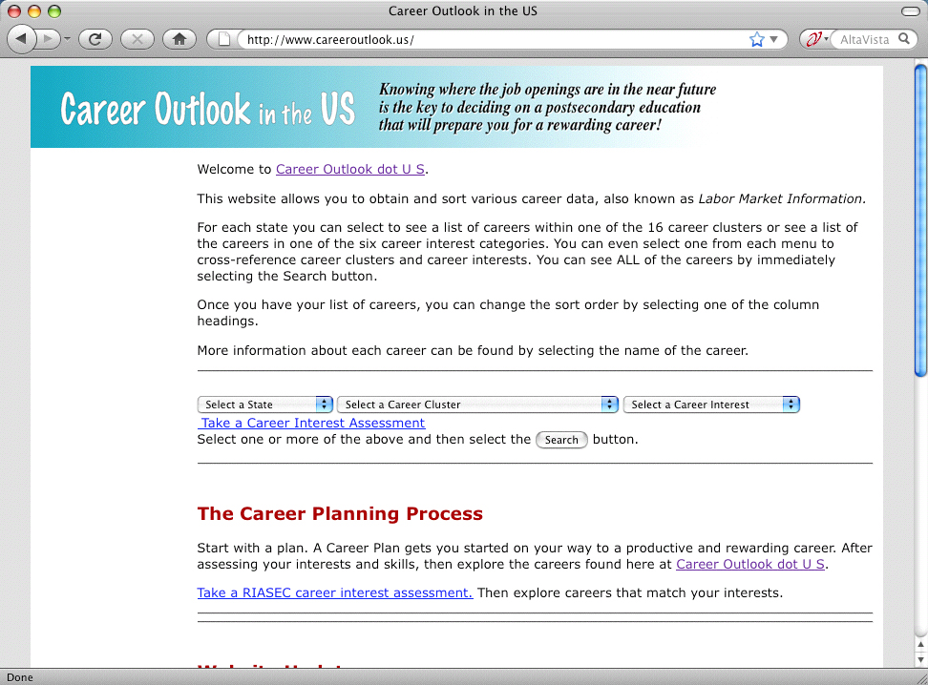
www.CareerOutlook.US
Notes:
→
See the data yourself here at Career Outlook dot US. You can see the projections for each occupation for each state.
See the details about this website on the backside of your handout.
====
www.CareerOutlook.US
50

Slide 51
The primary aim of education is not to enable students to do well in school, but to help them do well in the lives they lead outside of school.
Elliot W. Eisner
Notes:
We get too caught up in how well kids do in school --
and we loose sight of the goal to produce adults who can function outside of school.
We have to get back to the purpose of education.
===
This line is often quoted without any reference. Here are two people who claim the quote and a school district that uses it as their motto.
Elliot W. Eisner
http://www.ascd.org/publications/educational-leadership/dec03/vol61/num04/Preparing-for-Today-and-Tomorrow.aspx
Raymond McNulty
http://unioneagle.com/2012/01/education-leader-challenges-teachers-to-be-different/
Bellevue Community School District
http://bellevue.k12.ia.us/
51

Slide 52

Begin with the
end in mind.
Does education prepare for a career, or the next level of education?
Notes:
Education for the sake of education does not prepare you for a job, it prepares you for more education.
And although education is not a bad thing (we should all be prepared for a life of education) the old-school notion of getting an education first and then trying to find a job that will be yours until retirement -- is no longer valid.

Slide 53
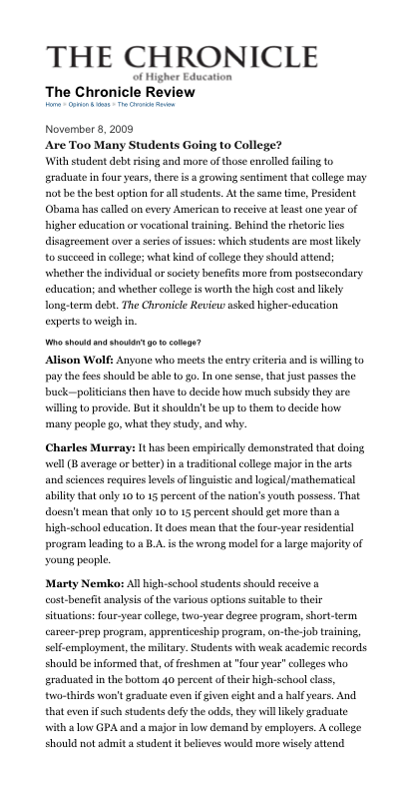
Notes:
There have been many discussions and debates lately about whether too many students are going to college.
Unfortunately the definition of the word “college” is not the same among all people.
I think the real discussion should be – “are too many students going to the wrong college?”
Or the wrong postsecondary educational program?
===
http://chronicle.com/article/Are-Too-Many-Students-Going-to/49039/

Slide 54
Who’s Writing the Curriculum?
Educators?
Business Persons?
Politicians?
What are we preparing students for?
More Education?
Entry-Level Career?
Life?
Notes:
Who’s writing the curriculum?
Who should be writing the curriculum?
What are we preparing our students for? More education or a career? Or both?
Actually, to be grammatically correct, it should be “For what are we preparing the students,” but you get the point.

Slide 55
Vs
CompTIA
ServSafe
ProStart
CNA
ASE
NCCER
NIMS
PrintEd
AWS
HS Diploma
2-year Certificate
Associate Degree
Bachelor Degree
Master Degree
Doctoral Degree
Professional Degree
Notes:
We asked industry what they wanted, and they said they would like for us to teach our students to their standards.
Many of our CTE courses now use industry-written curriculum that prepares kids to pass industry certification exams.
Who is driving education?
What are the important credentials?
Which is better, -- education credentials that you see on the left, or industry credentials that you see on the right?
Better for whom; -- educators, business, parents, etc?
Do you think there will come a time when the education credentials on the left don’t mean anything and the businesses will look only for their credentials in their new recruits?
Is that good or bad?

Slide 56
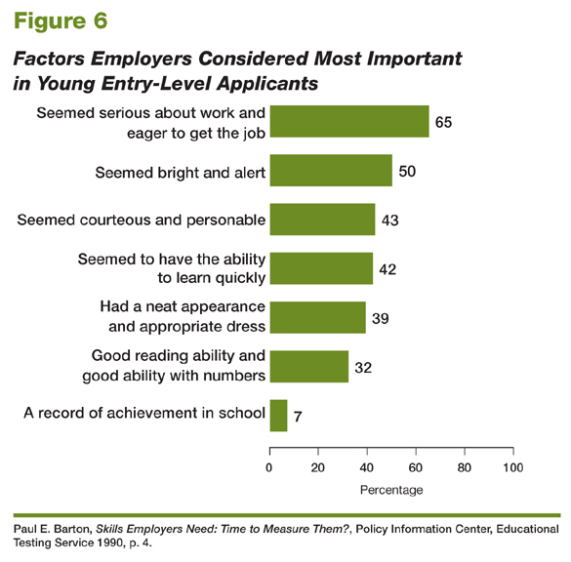
Educational Testing Service, 2006
Notes:
56
Here is what employers are looking for in their new recruits.
Where do school grades fall on the chart? They are at the bottom of the list with only seven percent of the employers even mentioning it.
Which of these factors do we teach in high school?
What can we be doing to help prepare the next generation of entry-level workers?
====
High School Reform and Work: Facing Labor Market Realities
Written by Paul E. Barton, Educational Testing Service, 2006
http://www.ets.org/research/researcher/PIC-HSWORK.html

Slide 57
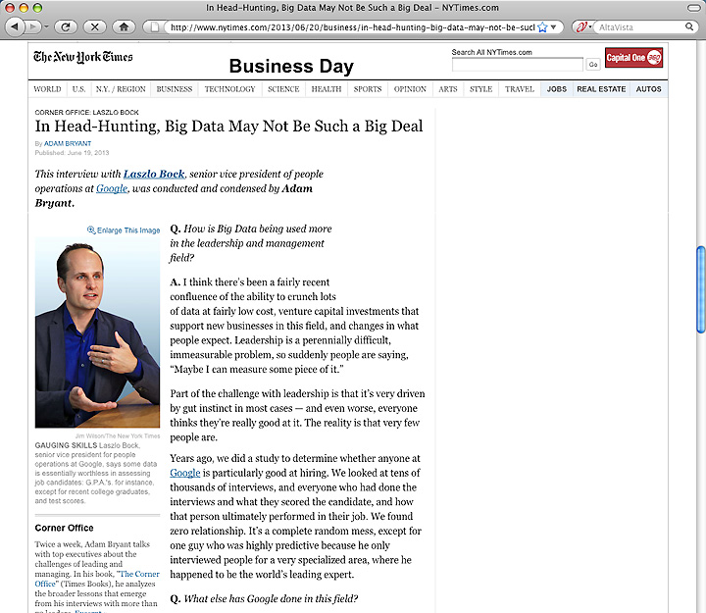
Notes:
Google has crunched the numbers and found that GPA is a worthless criteria for hiring.
But the thing that stood out for me in this article is their characterization of the academic environment as being an artificial environment. They say they want more from their new recruits.
They want new recruits who can work in a team to solve a problem that has never been solved before.
Google claims that educators spend too much time helping their students solve the problem their way rather than encouraging their students to really step outside the box.
Of course as an educator, I know that would be harder to assess and place a grade on that, but in reality, it’s what the business community wants, and after all- aren’t we in the business of creating their future employees?
=======
http://www.nytimes.com/2013/06/20/business/in-head-hunting-big-data-may-not-be-such-a-big-deal.html?pagewanted=all&_r=1&
In Head-Hunting, Big Data May Not Be Such a Big Deal
June 19, 2013
One of the things we’ve seen from all our data crunching is that G.P.A.’s are worthless as a criteria for hiring, and test scores are worthless — no correlation at all except for brand-new college grads, where there’s a slight correlation. Google famously used to ask everyone for a transcript and G.P.A.’s and test scores, but we don’t anymore, unless you’re just a few years out of school. We found that they don’t predict anything.
What’s interesting is the proportion of people without any college education at Google has increased over time as well. So we have teams where you have 14 percent of the team made up of people who’ve never gone to college.
After two or three years, your ability to perform at Google is completely unrelated to how you performed when you were in school, because the skills you required in college are very different. You’re also fundamentally a different person. You learn and grow, you think about things differently.
Another reason is that I think academic environments are artificial environments. People who succeed there are sort of finely trained, they’re conditioned to succeed in that environment. One of my own frustrations when I was in college and grad school is that you knew the professor was looking for a specific answer. You could figure that out, but it’s much more interesting to solve problems where there isn’t an obvious answer. You want people who like figuring out stuff where there is no obvious answer.
===
Google no longer hires based on GPA or test scores
"One of the things we’ve seen from all our data crunching is that G.P.A.’s are worthless as a criteria for hiring, and test scores are worthless"
Google also said that "academic environments are artificial environments." Students are "conditioned to succeed in that environment ... looking for a specific answer." Google wants "people who like figuring out stuff where there is no obvious answer."
These problem-solving skills that Google and others are looking for can be taught in our CTE classes, but the learning can be hard to measure, which makes it tough to convice the administration that these skills need to be taught.
http://www.nytimes.com/2013/06/20/business/in-head-hunting-big-data-may-not-be-such-a-big-deal.html?pagewanted=all&_r=1&

Slide 58
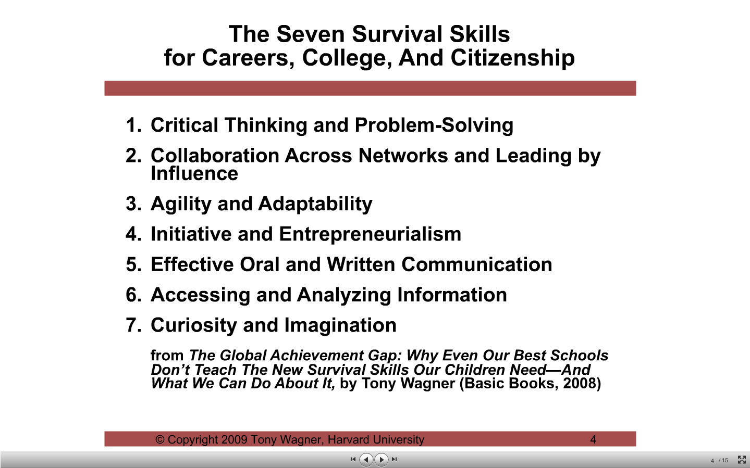
Notes:
58
At the top of this list from Tony Wagner is Critical Thinking and Problem Solving – it’s not just for the math teachers any more.
I visited a factory recently and found the teams taking responsibility for their work. They work together to find ways to make the work safer, more productive, less waste, etc. and they get rewarded for their efforts.
Do you do that in the classroom? Do you regularly ask your students "What could I have done to help you learn more/better?”
And number 5. The number one complaint from employers about their new recruits is poor Oral and Written Communication.
The problem with bad writing is usually bad thinking. Kids are not thinking and analyzing before they write. They can spit out facts, but they don't know what they mean, and they don’t know how those facts could ever apply to their lives.
Kids need to learn how to write persuasive writing. Teach the kids how to write a grant application and then get them to write a real one for your school. Real-world learning. We call that Relevance.
====
Looking back, I think my best writing teacher was my 8th grade science teacher. Did any one else here have Quantitative Physical Science with Mr. Charles D. Keck, Jr.? He insisted on detailed, very complete lab write-ups. We even had to detail what we learned, not just what we observed. I hated it. I dreaded QPS nights, where kids across town were staying up late at night writing their lab report for Quantitative Physical Science.
==========
Yet, the skills I learned in that class prepared me for having better-than-average writings in high school and have prepared me for the writings I do at work. On a regular basis I have to tell my manger what I'm going to be doing, and then write up what I did. And it's not just a collection of the facts, I need to analyze what has happened and then predict how it will impact student learning in North Carolina. My English teachers never taught me how to do that.
And number 7 -- We need to build curiosity in the kids. We often hate those kids with the persistent "Why?" questions, “Why do we do it this way, Why do we have to learn this?, How do you know that’s the right answer? Why do I have to take the WorkKeys test if I’m going to college?”
Yet, we should be encouraging the Why Questions. We should be encouraging structured debate. We should encourage our kids to gather the facts and create a persuasive argument. Even if they are arguing against school traditions. We should also be encouraging debate at home as well. We do the kids a disservice when we say "that's just the way it is." or "because I'm the teacher, or parent.”
Are we preparing kids for the next level of education or are we preparing kids for a career and a life where they can live independent from us, yet are still interdependent on their peers?
What is the purpose for K12 education? Is it 12 years of standardized curriculum and a specified amount of seat time? Or is it to prepare kids for what lies beyond high school graduation?
=====
Seven Skills Students Will Need For Their Future
Dr. Tony Wagner, Author of the Global Achievement Gap
352d8fa934f11457.flv

Slide 59
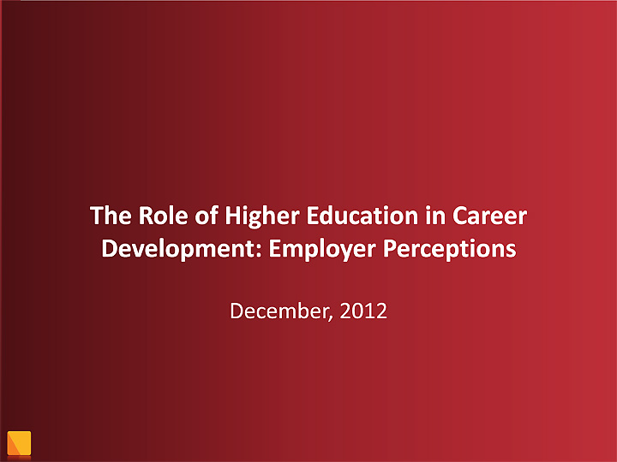
Notes:
================
Employers value a four-year college degree, many of them more than ever.
Yet half of those surveyed recently by The Chronicle and American Public Media's Marketplace said they had trouble finding recent graduates qualified to fill positions at their company or organization. Nearly a third gave colleges just fair to poor marks for producing successful employees. And they dinged bachelor's-degree holders for lacking basic workplace proficiencies, like adaptability, communication skills, and the ability to solve complex problems.
======
http://chronicle.com/article/The-Employment-Mismatch/137625/#id=overview
The Employment Mismatch: A College Degree Sorts Job Applicants, but Employers Wish It Meant More
Employers value a four-year college degree, many of them more than ever.
Yet half of those surveyed recently by The Chronicle and American Public Media's Marketplace said they had trouble finding recent graduates qualified to fill positions at their company or organization. Nearly a third gave colleges just fair to poor marks for producing successful employees. And they dinged bachelor's-degree holders for lacking basic workplace proficiencies, like adaptability, communication skills, and the ability to solve complex problems.
The report
The Role of Higher Education in Career Development: Employer Perceptions
http://chronicle.com/items/biz/pdf/Employers%20Survey.pdf

Slide 60
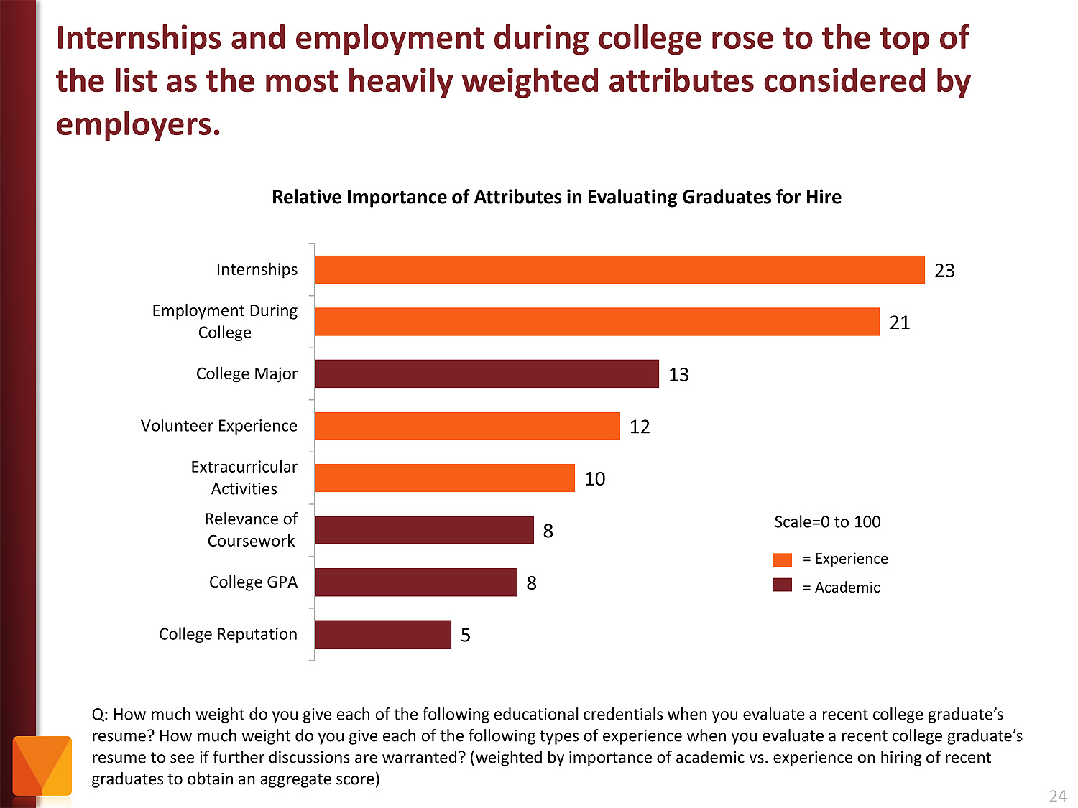
Notes:
Employers value Internships and other employment while in school as more important than college major and GPA.
And I showed earlier how Google has the data to prove that GPA is not a determining factor in whether someone will be a good employee.
======
http://chronicle.com/article/The-Employment-Mismatch/137625/#id=overview
The Employment Mismatch: A College Degree Sorts Job Applicants, but Employers Wish It Meant More
Employers value a four-year college degree, many of them more than ever.
Yet half of those surveyed recently by The Chronicle and American Public Media's Marketplace said they had trouble finding recent graduates qualified to fill positions at their company or organization. Nearly a third gave colleges just fair to poor marks for producing successful employees. And they dinged bachelor's-degree holders for lacking basic workplace proficiencies, like adaptability, communication skills, and the ability to solve complex problems.
The report
The Role of Higher Education in Career Development: Employer Perceptions
http://chronicle.com/items/biz/pdf/Employers%20Survey.pdf

Slide 61
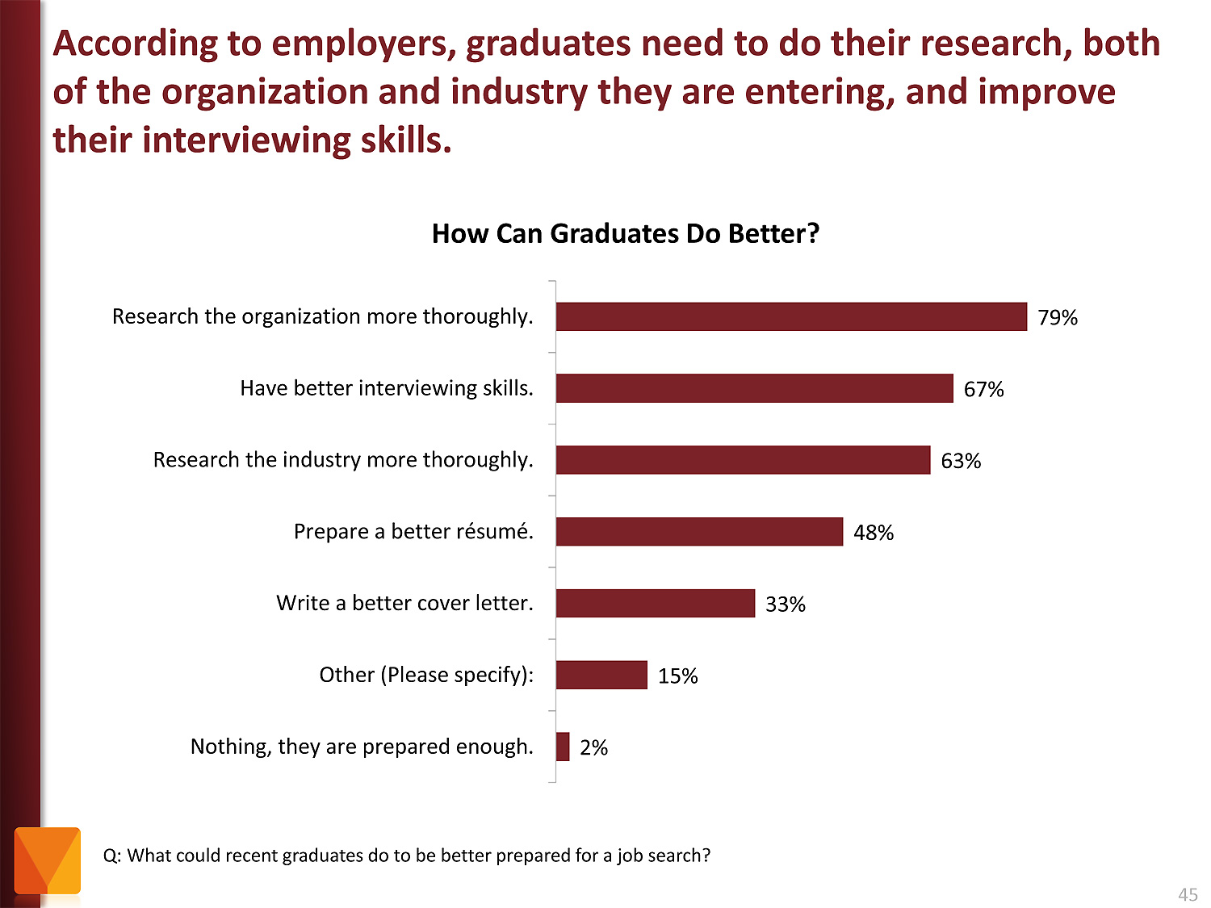
Notes:
Tell your students to research the companies where they are applying for work. And learn about the interview process.
======
http://chronicle.com/article/The-Employment-Mismatch/137625/#id=overview
The Employment Mismatch: A College Degree Sorts Job Applicants, but Employers Wish It Meant More
Employers value a four-year college degree, many of them more than ever.
Yet half of those surveyed recently by The Chronicle and American Public Media's Marketplace said they had trouble finding recent graduates qualified to fill positions at their company or organization. Nearly a third gave colleges just fair to poor marks for producing successful employees. And they dinged bachelor's-degree holders for lacking basic workplace proficiencies, like adaptability, communication skills, and the ability to solve complex problems.
The report
The Role of Higher Education in Career Development: Employer Perceptions
http://chronicle.com/items/biz/pdf/Employers%20Survey.pdf

Slide 62

Notes:
62
Here is a recent publication from the US Chamber of Commerce
===
http://icw.uschamber.com/publication/life-21st-century-workforce-national-perspective
Life in the 21st Century Workforce: A National Perspective
Posted September 27, 2011

Slide 63
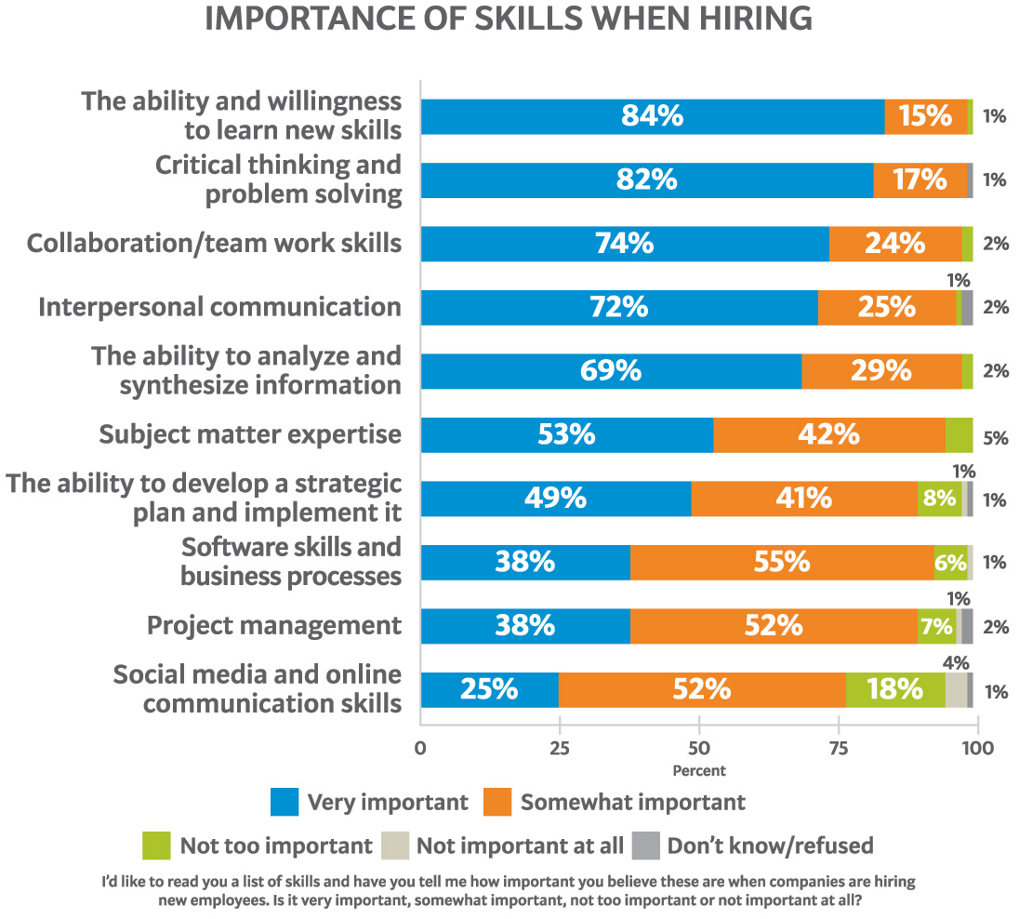
Notes:
63
Here is their list of skills that employers said were important when hiring their new recruits. Do you think our students should know this information?
Where in our K-12 schools are we teaching these skills that the employers say are the most important when hiring new employees?
===
http://icw.uschamber.com/publication/life-21st-century-workforce-national-perspective
Life in the 21st Century Workforce: A National Perspective
Posted September 27, 2011

Slide 64
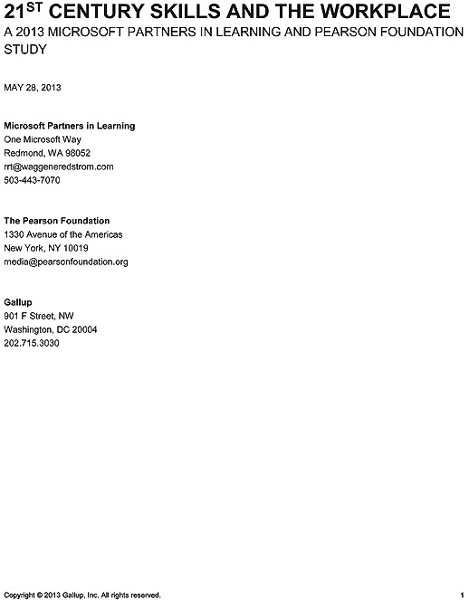
Notes:
I always thought that a Gallup poll had something to do with running horses.
They recently partnered with Microsoft and came up with this report with a boring cover, but it’s got some great information for us within its pages.
==========
article
http://www.gallup.com/poll/162818/21st-century-skills-linked-work-success.aspx
report
http://www.gallup.com/strategicconsulting/162821/21st-century-skills-workplace.aspx
21st Century Skills and the Workplace

Slide 65
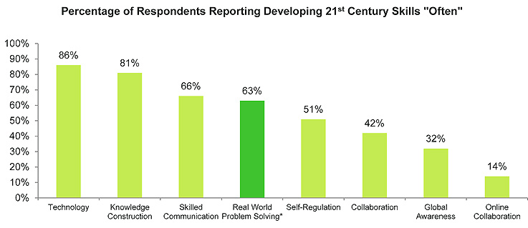
Notes:
This shows the percentage of students who learned these 21st century skills in high school.
The data show that developing 21st century skills in the last year of school is positively correlated with higher work quality later in life.
Across the 21st century skills included in this study, real world problem solving is the most significant driver of higher work quality; however, only 63% of students report often developing this skill in their last year of school.
Our students need more “real-world problem solving” activities.
======
Real world problem solving is measured based on two supporting survey questions. The first question is "Thinking about
your last year in school, about how often, if ever, did you work on a long-term project that took several classes to
complete?" The second question is "Thinking about your last year in school, about how often, if ever, did you use what
you were learning about to develop solutions to real problems in your community or in the world?" These two specific
activities support project-based learning in school, which is designed to give students opportunities to apply knowledge
and ideas to real world problems.
The aim of 21st century skill development is to maximize the potential of each student to achieve success in life and reach
his or her goals. To measure this perceived success, respondents assessed their current quality of work and were asked
four questions to measure the concept of excellence in work quality.
==========
article
http://www.gallup.com/poll/162818/21st-century-skills-linked-work-success.aspx
report
http://www.gallup.com/strategicconsulting/162821/21st-century-skills-workplace.aspx
21st Century Skills and the Workplace

Slide 66
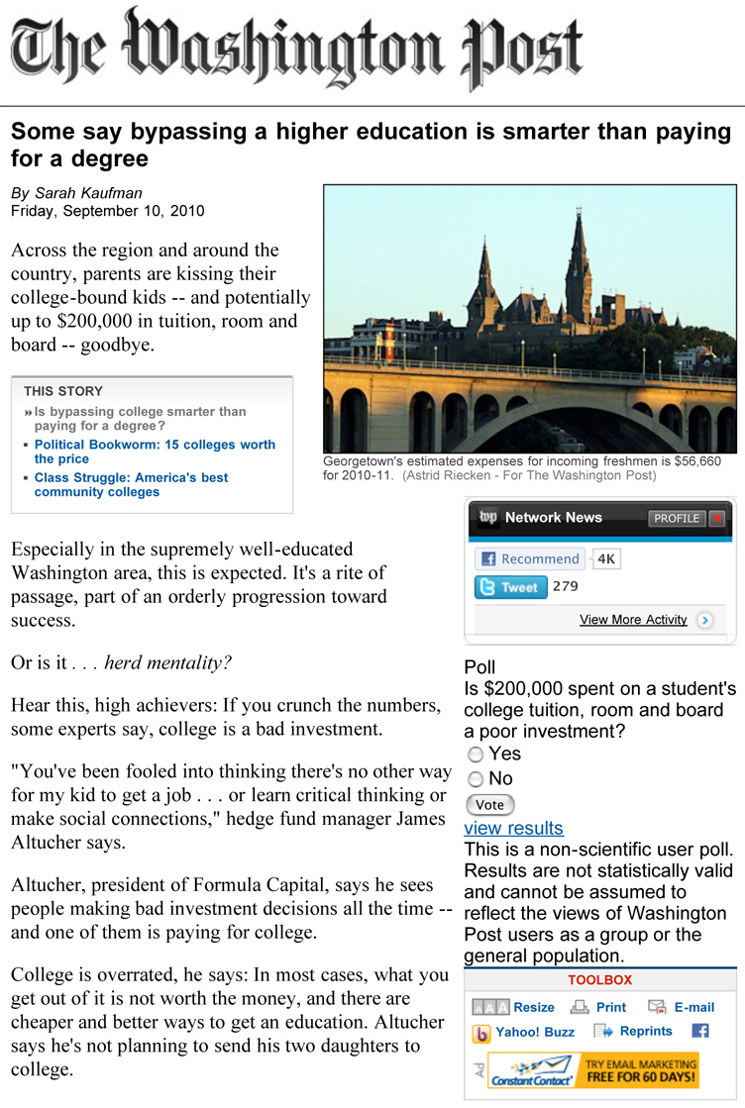
Notes:
Some kids are convincing their parents to just give them the $200,000 in projected college expenses to start their own business rather than to spend that money on a formal college education.
Is that a good thing, or a bad thing?
====
http://www.washingtonpost.com/wp-dyn/content/article/2010/09/09/AR2010090903350.html

Slide 67
States with Most New Jobs
(Total Change in Positions Projected from 2008 - 2018)
15,273,900 United States
1,996,020 Texas
1,652,300 California
679,770 Georgia
597,930 Virginia
548,420 Illinois
438,110 Florida
419,680 North Carolina
310,090 Utah
304,670 Washington
287,050 New York
266,410 Indiana
257,640 Michigan
251,750 Maryland
249,000 Ohio
233,930 Alabama
195,660 Mississippi
195,000 Minnesota
178,670 Oklahoma
172,990 Tennessee
172,610 Iowa
164,870 Colorado
163,520 Louisiana
159,950 Oregon
158,480 Arizona
157,310 South Carolina
148,690 Kentucky
147,720 Kansas
145,900 Pennsylvania
120,400 New Jersey
112,430 Massachusetts
111,300 Idaho
110,840 Nebraska
95,420 Missouri
95,210 Arkansas
93,900 Nevada
83,670 Wisconsin
82,950 Connecticut
73,140 New Mexico
61,050 New Hampshire
59,384 Puerto Rico
54,370 D.C.
52,320 Montana
48,850 Hawaii
41,145 South Dakota
39,670 Rhode Island
38,530 North Dakota
34,450 Delaware
33,670 Alaska
31,180 Vermont
26,520 Wyoming
25,830 West Virginia
14,390 Maine
% change
21.41 Utah
17.04 Texas
15.58 Idaho
15.41 Georgia
14.90 Virginia
14.32 Mississippi
11.03 Montana
10.61 Alabama
10.46 Alaska
10.21 Oklahoma
10.15 Nebraska
10.12 United States
9.82 Kansas
9.79 Iowa
9.71 California
9.44 North Carolina
9.17 North Dakota
9.15 Maryland
9.06 Oregon
9.03 Washington
8.89 South Dakota
8.78 New Hampshire
8.66 Illinois
8.65 Wyoming
8.60 Indiana
8.51 Vermont
8.20 New Mexico
8.01 Louisiana
7.81 South Carolina
7.79 Rhode Island
7.58 Delaware
7.45 Kentucky
7.12 Hawaii
6.98 Arkansas
6.94 Nevada
6.91 D.C.
6.59 Minnesota
6.53 Colorado
5.66 Tennessee
5.65 Michigan
5.55 Arizona
5.31 Puerto Rico
5.15 Florida
4.56 Connecticut
4.35 Ohio
3.27 West Virginia
3.22 Missouri
3.20 Massachusetts
3.04 New York
2.75 New Jersey
2.72 Wisconsin
2.34 Pennsylvania
2.13 Maine
Notes:
If you are looking for work, it should make sense to move where the jobs are going to be
On the left you see the number of job openings projected over the next ten years for each state.
On the right you see the percentage change in jobs over the next ten years for each state.
Some states are predicting a large number of job openings, but for our highly populated states it might not be a large percentage of jobs based on the size of the population.
You see states that I’ve highlighted in red - like Utah, Texas, Georgia, and Virginia are near the top of both sides. That means they are expecting a large number of job openings, which is also a large percentage of their current workforce. Those are the states that are growing the fastest.
Maine is at the bottom of both lists. 14,390 job openings projected over the ten-year period with a 2.1 percentage increase.
============
“Total, All Occupations” for each state.
“Numeric Employment Change” is the number of new jobs projected over the ten year period.
www.projectionscentral.com/

Slide 68
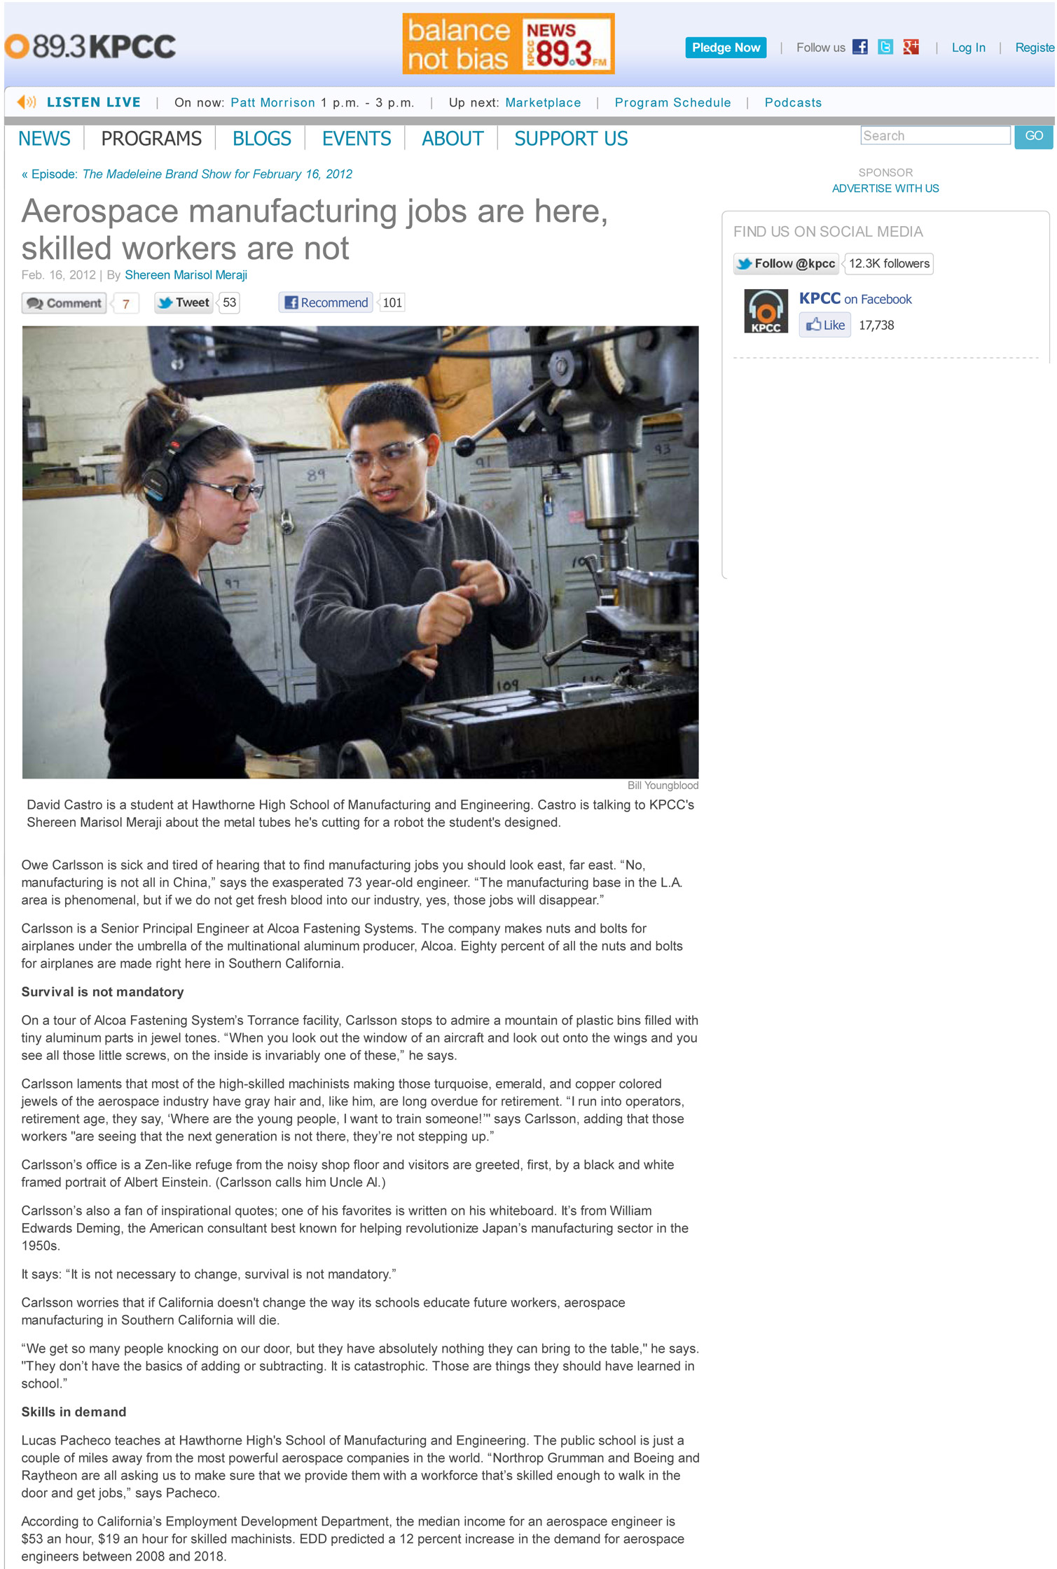
Notes:
North Carolina makes a lot of parts for the Aerospace industry.
The problem is that the trained workers are not here.
One problem is that the manufacturing plants do not look anything like what we think they do.
Modern factories are more like a giant video game than like the factories that we know. Who’s telling the kids that?
====
Aerospace manufacturing jobs are here, skilled workers are not
http://www.scpr.org/programs/madeleine-brand/2012/02/16/22561/aerospace-manufacturing-jobs-are-here-skilled-work

Slide 69
Notes:
→
This article says that Southern California is afraid they might loose their aerospace manufacturing if the schools don’t step up to the table and start training qualified workers.
That’s fine, they can all come to North Carolina.
→
In many cases the new hires do not know basic math. Who’s fault is that?
====
Aerospace manufacturing jobs are here, skilled workers are not
http://www.scpr.org/programs/madeleine-brand/2012/02/16/22561/aerospace-manufacturing-jobs-are-here-skilled-work

Slide 70
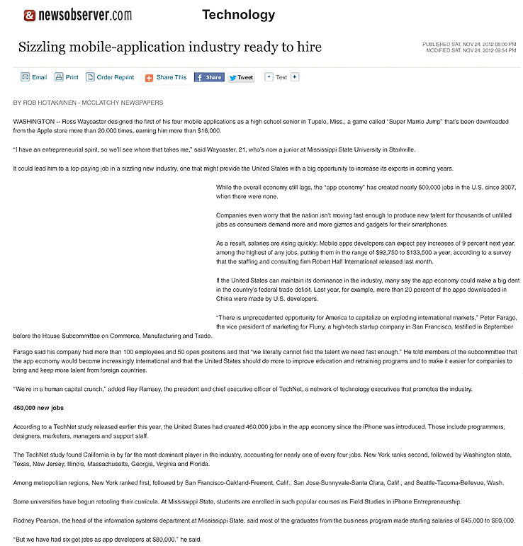
Notes:
People who can write apps for mobile devices are in high demand.
======
Published Sat, Nov 24, 2012 08:00 PM
Sizzling mobile-application industry ready to hire
http://www.newsobserver.com/2012/11/24/2499331/sizzling-mobile-application-industry.html#storylink=misearch
70

Slide 71

Notes:
The average salary for mobile application developers is over 100,000 dollars.
I know middle school kids who are writing and selling apps. How can you integrate app development into your curriculum?
====
Some surprising six-figure jobs
====
http://www.bizjournals.com/triangle/blog/2012/06/slideshow-six-surprising-six-figure.html?ana=e_du_pap&s=article_du&ed=2012-06-27

Slide 72
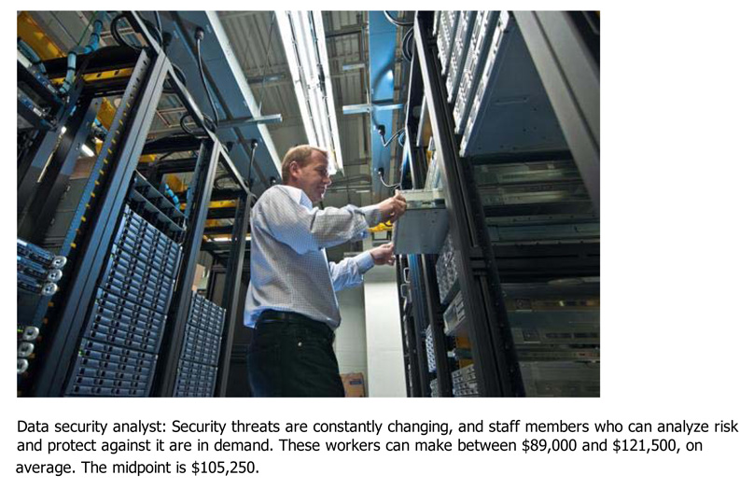
Notes:
Another job in high demand that pays well is a Data Security Analyst, who works hard to keep our computer networks safe. The average salary is over 100,000 dollars.
===
Some surprising six-figure jobs
====
http://www.bizjournals.com/triangle/blog/2012/06/slideshow-six-surprising-six-figure.html?ana=e_du_pap&s=article_du&ed=2012-06-27

Slide 73
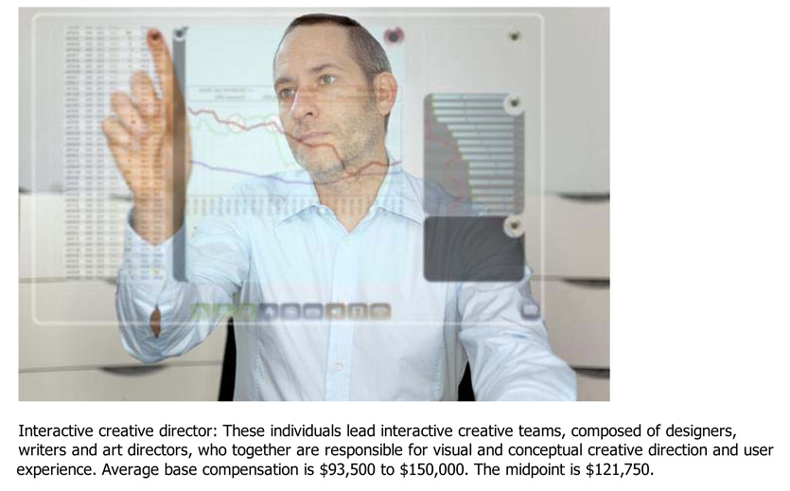
Notes:
How about an Interactive Creative Director? They create the interface that allows you to use the computer without having to know binary numbers. Once again, the average salary is over 100,000 dollars.
====
Some surprising six-figure jobs
====
http://www.bizjournals.com/triangle/blog/2012/06/slideshow-six-surprising-six-figure.html?ana=e_du_pap&s=article_du&ed=2012-06-27

Slide 74
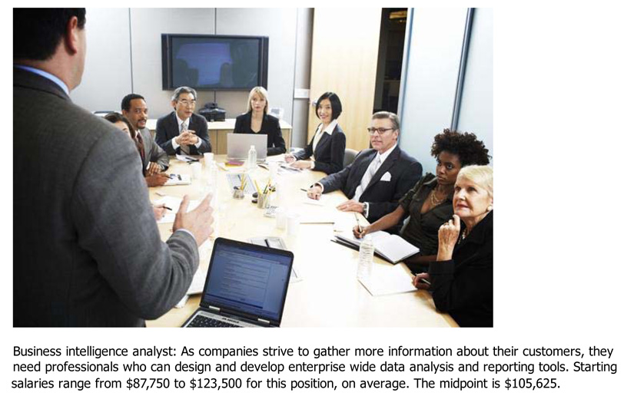
Notes:
Who’s heard of a Business Intelligence Analyst? They gather data from all sources, turn it into usefull informaiton, and use it to help improve companies. Average salary is again over 100,000 dollars.
===
Some surprising six-figure jobs
====
http://www.bizjournals.com/triangle/blog/2012/06/slideshow-six-surprising-six-figure.html?ana=e_du_pap&s=article_du&ed=2012-06-27

Slide 75

Notes:
This report discusses the future of manufacturing and how important manufacturing is to our economy.
Remember, I’ve included the links to all of these documents in the notes section of the PowerPpint.
====
McKinsey report
http://www.mckinsey.com/insights/mgi/research/productivity_competitiveness_and_growth/the_future_of_manufacturing
November 19, 2012
75

Slide 76
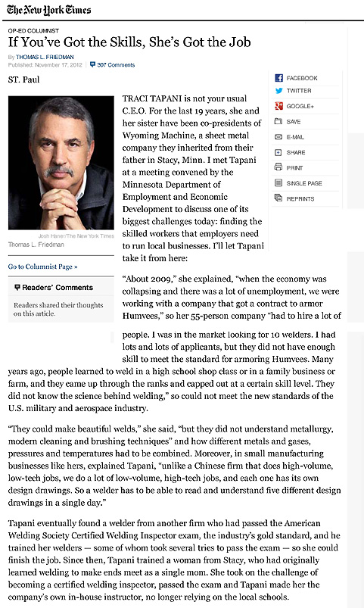
Notes:
The owner of this fabrication shop says that the welders she is searching for don’t just need to do quality welds -----
They need to be AWS certified, and they need to understand metallurgy, how different metals, gasses, pressures, and temperatures have to be combined to join metals.
Hey Kids! This is where you will use all of that stuff you learned in physics class!
=====
http://www.nytimes.com/2012/11/18/opinion/sunday/Friedman-You-Got-the-Skills.html?ref=thomaslfriedman
76

Slide 77
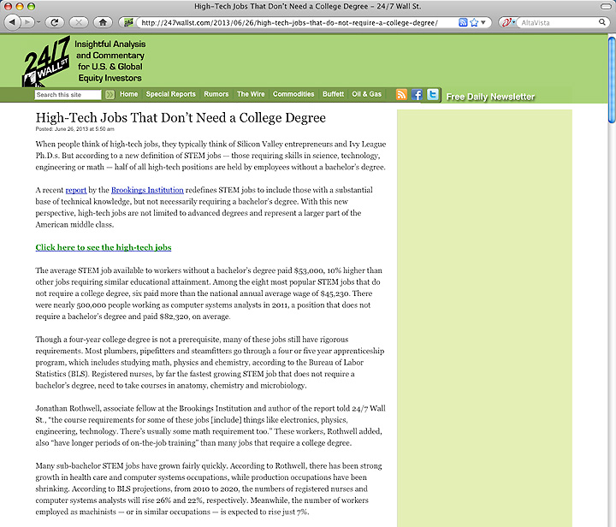
1. Registered Nurses
2. Automotive Service Technicians and Mechanics
3. Carpenters
4. Electricians
5. Computer Systems Analysts
6. Machinists
7. Plumbers, Pipefitters, Steamfitters
8. Welders, Cutters, Solderers and Brazers
Notes:
There are lots of different hot job lists out there. Make sure your kids find a few of them.
====
The average STEM job available to workers without a bachelor’s degree paid $53,000, 10% higher than other jobs requiring similar educational attainment.
1. Registered Nurses
2. Automotive Service Technicians and Mechanics
3. Carpenters
4. Electricians
5. Computer Systems Analysts
6. Machinists
7. Plumbers, Pipefitters, Steamfitters
8. Welders, Cutters, Solderers and Brazers
====
http://247wallst.com/2013/06/26/high-tech-jobs-that-do-not-require-a-college-degree/
High-Tech Jobs That Don’t Need a College Degree
Read more: High-Tech Jobs That Don’t Need a College Degree - 24/7 Wall St. http://247wallst.com/2013/06/26/high-tech-jobs-that-do-not-require-a-college-degree/#ixzz2XQ7hpswB
June 26, 2013
The average STEM job available to workers without a bachelor’s degree paid $53,000, 10% higher than other jobs requiring similar educational attainment. Among the eight most popular STEM jobs that do not require a college degree, six paid more than the national annual average wage of $45,230. There were nearly 500,000 people working as computer systems analysts in 2011, a position that does not require a bachelor’s degree and paid $82,320, on average.
Though a four-year college degree is not a prerequisite, many of these jobs still have rigorous requirements. Most plumbers, pipefitters and steamfitters go through a four or five year apprenticeship program, which includes studying math, physics and chemistry, according to the Bureau of Labor Statistics (BLS). Registered nurses, by far the fastest growing STEM job that does not require a bachelor’s degree, need to take courses in anatomy, chemistry and microbiology.
Read more: High-Tech Jobs That Don’t Need a College Degree - 24/7 Wall St. http://247wallst.com/2013/06/26/high-tech-jobs-that-do-not-require-a-college-degree/#ixzz2XQ7ptbo3

Slide 78
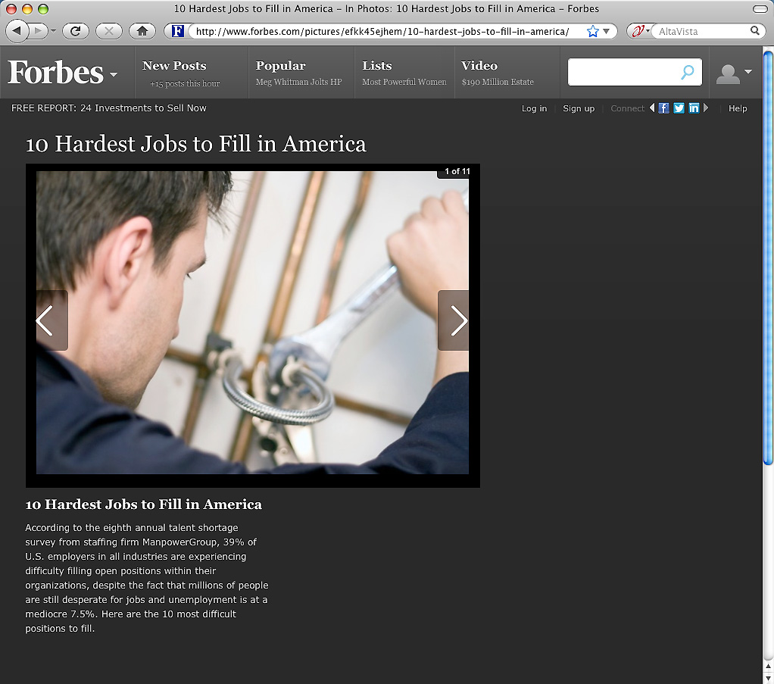
Notes:
Forbes recently looked at the 10 Hardest to Fill Jobs in America
===
http://www.forbes.com/sites/jacquelynsmith/2013/05/28/the-10-hardest-jobs-to-fill-in-2013/

Slide 79

10 Hardest to Fill Jobs in America
Notes:
Teachers
======
Forbes recently looked at the 10 Hardest to Fill Jobs in America
===
http://www.forbes.com/sites/jacquelynsmith/2013/05/28/the-10-hardest-jobs-to-fill-in-2013/

Slide 80

10 Hardest to Fill Jobs in America
Notes:
======
Forbes recently looked at the 10 Hardest to Fill Jobs in America
===
http://www.forbes.com/sites/jacquelynsmith/2013/05/28/the-10-hardest-jobs-to-fill-in-2013/

Slide 81

10 Hardest to Fill Jobs in America
Notes:
======
Forbes recently looked at the 10 Hardest to Fill Jobs in America
===
http://www.forbes.com/sites/jacquelynsmith/2013/05/28/the-10-hardest-jobs-to-fill-in-2013/

Slide 82

10 Hardest to Fill Jobs in America
Notes:
======
Forbes recently looked at the 10 Hardest to Fill Jobs in America
===
http://www.forbes.com/sites/jacquelynsmith/2013/05/28/the-10-hardest-jobs-to-fill-in-2013/

Slide 83

10 Hardest to Fill Jobs in America
Notes:
======
Forbes recently looked at the 10 Hardest to Fill Jobs in America
===
http://www.forbes.com/sites/jacquelynsmith/2013/05/28/the-10-hardest-jobs-to-fill-in-2013/

Slide 84

10 Hardest to Fill Jobs in America
Notes:
======
Forbes recently looked at the 10 Hardest to Fill Jobs in America
===
http://www.forbes.com/sites/jacquelynsmith/2013/05/28/the-10-hardest-jobs-to-fill-in-2013/

Slide 85
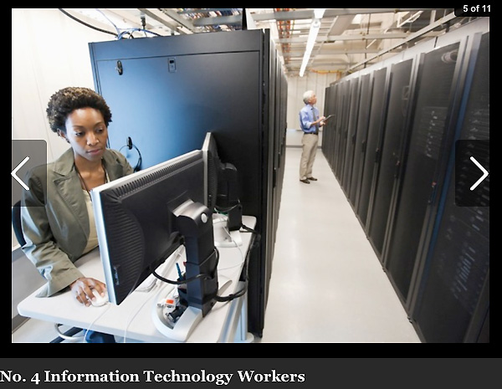
10 Hardest to Fill Jobs in America
Notes:
======
Forbes recently looked at the 10 Hardest to Fill Jobs in America
===
http://www.forbes.com/sites/jacquelynsmith/2013/05/28/the-10-hardest-jobs-to-fill-in-2013/

Slide 86
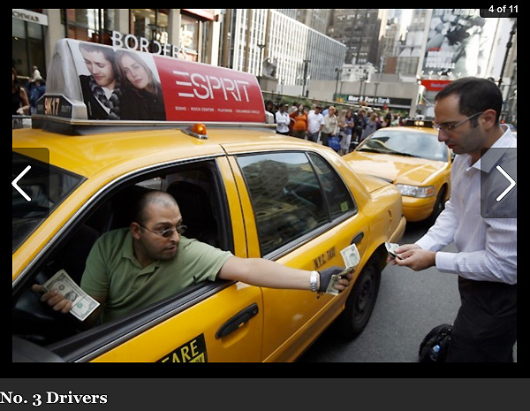
10 Hardest to Fill Jobs in America
Notes:
======
======
Forbes recently looked at the 10 Hardest to Fill Jobs in America
===
http://www.forbes.com/sites/jacquelynsmith/2013/05/28/the-10-hardest-jobs-to-fill-in-2013/

Slide 87

10 Hardest to Fill Jobs in America
Notes:
======
Forbes recently looked at the 10 Hardest to Fill Jobs in America
===
http://www.forbes.com/sites/jacquelynsmith/2013/05/28/the-10-hardest-jobs-to-fill-in-2013/

Slide 88

10 Hardest to Fill Jobs in America
Notes:
======
Forbes recently looked at the 10 Hardest to Fill Jobs in America
===
http://www.forbes.com/sites/jacquelynsmith/2013/05/28/the-10-hardest-jobs-to-fill-in-2013/

Slide 89
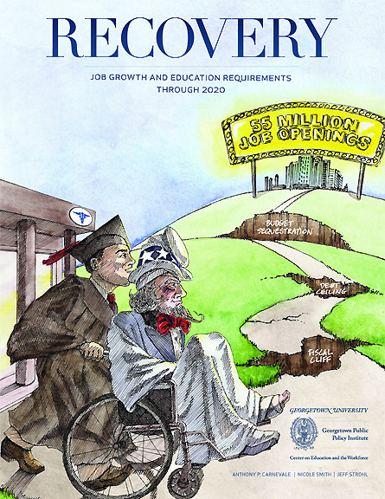
Notes:
New study released a few months ago from Georgetown.
=====
http://cew.georgetown.edu/recovery2020/
Recovery 2020: Job Growth and Education Requirements Through 2020
June 26, 2013
Recovery 2020 finds that:
There will be 55 million job openings in the economy through 2020: 24 million openings from newly created jobs and 31 million openings due to baby boom retirements.
By educational attainment: 35 percent of the job openings will require at least a bachelor’s degree, 30 percent of the job openings will require some college or an associate’s degree and 36 percent of the job openings will not require education beyond high school.
STEM, Healthcare Professions, Healthcare Support, and Community Services will be the fastest growing occupations, but also will require high levels of post-secondary education.
Most jobs will require some type of post-secondary education, and individuals that only posses a high school diploma will have fewer employment options.
Employers will seek cognitive skills such as communication and analytics from job applicants rather than physical skills traditionally associated with manufacturing.
The United States will fall short by 5 million workers with postsecondary education – at the current production rate – by 2020.

Slide 90
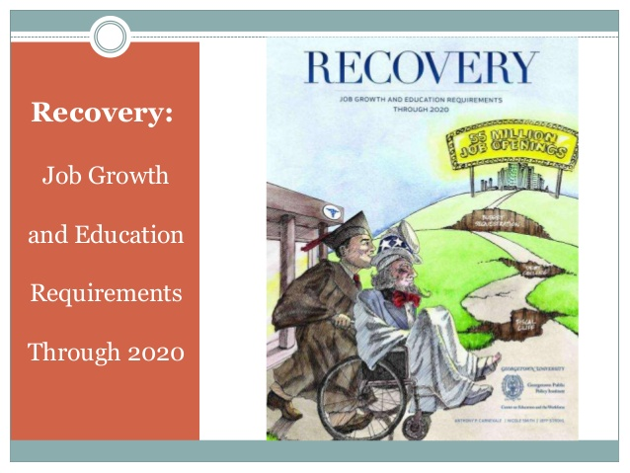
Notes:
Job Growth and Education Requirements Through 2020
=====
http://cew.georgetown.edu/recovery2020/
Recovery 2020: Job Growth and Education Requirements Through 2020
June 26, 2013
Recovery 2020 finds that:
There will be 55 million job openings in the economy through 2020: 24 million openings from newly created jobs and 31 million openings due to baby boom retirements.
By educational attainment: 35 percent of the job openings will require at least a bachelor’s degree, 30 percent of the job openings will require some college or an associate’s degree and 36 percent of the job openings will not require education beyond high school.
STEM, Healthcare Professions, Healthcare Support, and Community Services will be the fastest growing occupations, but also will require high levels of post-secondary education.
Most jobs will require some type of post-secondary education, and individuals that only posses a high school diploma will have fewer employment options.
Employers will seek cognitive skills such as communication and analytics from job applicants rather than physical skills traditionally associated with manufacturing.
The United States will fall short by 5 million workers with postsecondary education – at the current production rate – by 2020.

Slide 91
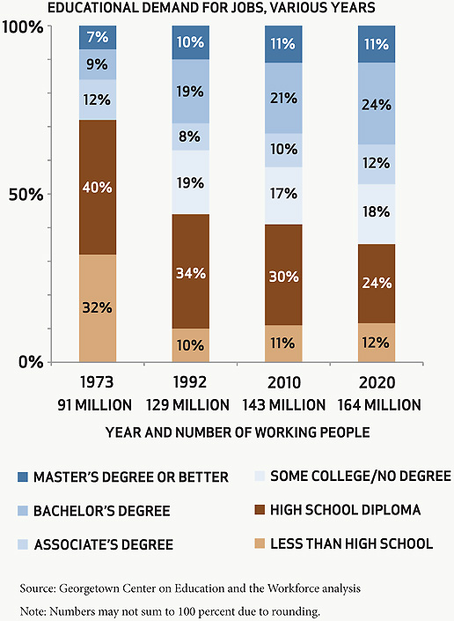
Master’s Degree or better
Bachelor’s Degree
Associate’s Degree
Some College/No Degree
HS Diploma
Less than HS Diploma
Notes:
Here we see the change in the need for more workers with postsecondary training.
You see in the brown and the tan, that in 1973, 72 percent of the jobs were for folks without any postsecondary education.
in 2020, that will be cut in half to 36 percent.
Kids need to know that they need some kind of postsecondary education or training.
=====
ES page 4
http://cew.georgetown.edu/recovery2020/
Recovery 2020: Job Growth and Education Requirements Through 2020
June 26, 2013
Recovery 2020 finds that:
There will be 55 million job openings in the economy through 2020: 24 million openings from newly created jobs and 31 million openings due to baby boom retirements.
By educational attainment: 35 percent of the job openings will require at least a bachelor’s degree, 30 percent of the job openings will require some college or an associate’s degree and 36 percent of the job openings will not require education beyond high school.
STEM, Healthcare Professions, Healthcare Support, and Community Services will be the fastest growing occupations, but also will require high levels of post-secondary education.
Most jobs will require some type of post-secondary education, and individuals that only posses a high school diploma will have fewer employment options.
Employers will seek cognitive skills such as communication and analytics from job applicants rather than physical skills traditionally associated with manufacturing.
The United States will fall short by 5 million workers with postsecondary education – at the current production rate – by 2020.

Slide 92
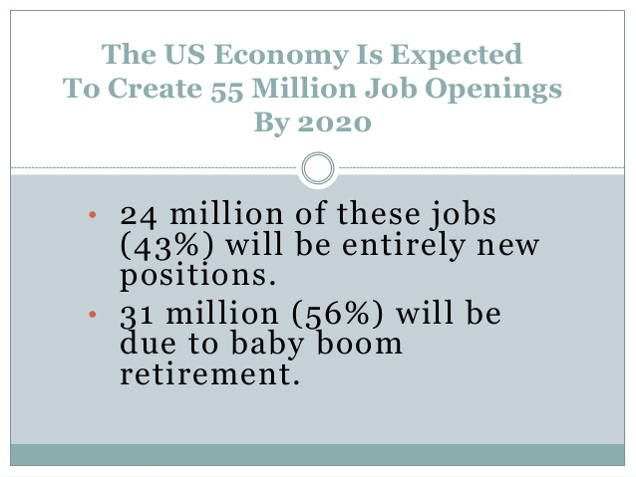
Notes:
The baby boomers will retire someday! Right?
=====
http://cew.georgetown.edu/recovery2020/
Recovery 2020: Job Growth and Education Requirements Through 2020
June 26, 2013
Recovery 2020 finds that:
There will be 55 million job openings in the economy through 2020: 24 million openings from newly created jobs and 31 million openings due to baby boom retirements.
By educational attainment: 35 percent of the job openings will require at least a bachelor’s degree, 30 percent of the job openings will require some college or an associate’s degree and 36 percent of the job openings will not require education beyond high school.
STEM, Healthcare Professions, Healthcare Support, and Community Services will be the fastest growing occupations, but also will require high levels of post-secondary education.
Most jobs will require some type of post-secondary education, and individuals that only posses a high school diploma will have fewer employment options.
Employers will seek cognitive skills such as communication and analytics from job applicants rather than physical skills traditionally associated with manufacturing.
The United States will fall short by 5 million workers with postsecondary education – at the current production rate – by 2020.

Slide 93

Notes:
Who Will Be Hiring??
=====
http://cew.georgetown.edu/recovery2020/
Recovery 2020: Job Growth and Education Requirements Through 2020
June 26, 2013
Recovery 2020 finds that:
There will be 55 million job openings in the economy through 2020: 24 million openings from newly created jobs and 31 million openings due to baby boom retirements.
By educational attainment: 35 percent of the job openings will require at least a bachelor’s degree, 30 percent of the job openings will require some college or an associate’s degree and 36 percent of the job openings will not require education beyond high school.
STEM, Healthcare Professions, Healthcare Support, and Community Services will be the fastest growing occupations, but also will require high levels of post-secondary education.
Most jobs will require some type of post-secondary education, and individuals that only posses a high school diploma will have fewer employment options.
Employers will seek cognitive skills such as communication and analytics from job applicants rather than physical skills traditionally associated with manufacturing.
The United States will fall short by 5 million workers with postsecondary education – at the current production rate – by 2020.

Slide 94

Notes:
By 2020, 65 Percent of All Jobs Will Require Postsecondary Education
=====
http://cew.georgetown.edu/recovery2020/
Recovery 2020: Job Growth and Education Requirements Through 2020
June 26, 2013
Recovery 2020 finds that:
There will be 55 million job openings in the economy through 2020: 24 million openings from newly created jobs and 31 million openings due to baby boom retirements.
By educational attainment: 35 percent of the job openings will require at least a bachelor’s degree, 30 percent of the job openings will require some college or an associate’s degree and 36 percent of the job openings will not require education beyond high school.
STEM, Healthcare Professions, Healthcare Support, and Community Services will be the fastest growing occupations, but also will require high levels of post-secondary education.
Most jobs will require some type of post-secondary education, and individuals that only posses a high school diploma will have fewer employment options.
Employers will seek cognitive skills such as communication and analytics from job applicants rather than physical skills traditionally associated with manufacturing.
The United States will fall short by 5 million workers with postsecondary education – at the current production rate – by 2020.

Slide 95

Notes:
Who likes pie?
===
There Will Be Fewer Jobs Available For Individuals That Only Possess a High School Diploma
=====
ES page 6
http://cew.georgetown.edu/recovery2020/
Recovery 2020: Job Growth and Education Requirements Through 2020
June 26, 2013
Recovery 2020 finds that:
There will be 55 million job openings in the economy through 2020: 24 million openings from newly created jobs and 31 million openings due to baby boom retirements.
By educational attainment: 35 percent of the job openings will require at least a bachelor’s degree, 30 percent of the job openings will require some college or an associate’s degree and 36 percent of the job openings will not require education beyond high school.
STEM, Healthcare Professions, Healthcare Support, and Community Services will be the fastest growing occupations, but also will require high levels of post-secondary education.
Most jobs will require some type of post-secondary education, and individuals that only posses a high school diploma will have fewer employment options.
Employers will seek cognitive skills such as communication and analytics from job applicants rather than physical skills traditionally associated with manufacturing.
The United States will fall short by 5 million workers with postsecondary education – at the current production rate – by 2020.

Slide 96

Notes:
===
Even The Fastest Growing Fields Will Require High Postsecondary Education? STEM, healthcare professions, healthcare support, and community services will all require high levels of education in order to compete for a position.? Healthcare support will not have the same high demand for postsecondary education.? Healthcare support careers, however, will have lower wage growth.
=====
http://cew.georgetown.edu/recovery2020/
Recovery 2020: Job Growth and Education Requirements Through 2020
June 26, 2013
Recovery 2020 finds that:
There will be 55 million job openings in the economy through 2020: 24 million openings from newly created jobs and 31 million openings due to baby boom retirements.
By educational attainment: 35 percent of the job openings will require at least a bachelor’s degree, 30 percent of the job openings will require some college or an associate’s degree and 36 percent of the job openings will not require education beyond high school.
STEM, Healthcare Professions, Healthcare Support, and Community Services will be the fastest growing occupations, but also will require high levels of post-secondary education.
Most jobs will require some type of post-secondary education, and individuals that only posses a high school diploma will have fewer employment options.
Employers will seek cognitive skills such as communication and analytics from job applicants rather than physical skills traditionally associated with manufacturing.
The United States will fall short by 5 million workers with postsecondary education – at the current production rate – by 2020.

Slide 97

Notes:
====
The Fastest Growing Occupations Require High Levels of Postsecondary Education
=====
http://cew.georgetown.edu/recovery2020/
Recovery 2020: Job Growth and Education Requirements Through 2020
June 26, 2013
Recovery 2020 finds that:
There will be 55 million job openings in the economy through 2020: 24 million openings from newly created jobs and 31 million openings due to baby boom retirements.
By educational attainment: 35 percent of the job openings will require at least a bachelor’s degree, 30 percent of the job openings will require some college or an associate’s degree and 36 percent of the job openings will not require education beyond high school.
STEM, Healthcare Professions, Healthcare Support, and Community Services will be the fastest growing occupations, but also will require high levels of post-secondary education.
Most jobs will require some type of post-secondary education, and individuals that only posses a high school diploma will have fewer employment options.
Employers will seek cognitive skills such as communication and analytics from job applicants rather than physical skills traditionally associated with manufacturing.
The United States will fall short by 5 million workers with postsecondary education – at the current production rate – by 2020.

Slide 98

Notes:
The third bullet – listening skills
And at the bottom – communication skills.
Where do kids learn these skills in school?
=====
Recovery 2020 confirms cognitive skills are highly sought after by employers.? Physically intensive skills are less important.? Forty-eight percent of jobs require high levels of active listening.? Other skills most coveted by employers:? Leadership? Communication? Analytics? Administration
What Skills Will Get You Hired?
=====
http://cew.georgetown.edu/recovery2020/
Recovery 2020: Job Growth and Education Requirements Through 2020
June 26, 2013
Recovery 2020 finds that:
There will be 55 million job openings in the economy through 2020: 24 million openings from newly created jobs and 31 million openings due to baby boom retirements.
By educational attainment: 35 percent of the job openings will require at least a bachelor’s degree, 30 percent of the job openings will require some college or an associate’s degree and 36 percent of the job openings will not require education beyond high school.
STEM, Healthcare Professions, Healthcare Support, and Community Services will be the fastest growing occupations, but also will require high levels of post-secondary education.
Most jobs will require some type of post-secondary education, and individuals that only posses a high school diploma will have fewer employment options.
Employers will seek cognitive skills such as communication and analytics from job applicants rather than physical skills traditionally associated with manufacturing.
The United States will fall short by 5 million workers with postsecondary education – at the current production rate – by 2020.

Slide 99

Notes:
This report has details by state. Check it out.
====
13. Recovery 2020 By State? The report also gauges each state’s position compared to the national average;
Compares the educational composition of jobs in the base year (2010) to the forecast year (2020);
Shows where the jobs will be by state, education level and occupations for 25 detailed occupational categories in 2020;
Twenty-seven states will be at or above the 65 percent proportion of jobs that will require postsecondary education beyond HS in 2020.
The highest proportion of BA jobs and graduate jobs will be concentrated in northeastern states.
Jobs for HS graduates or dropouts will be concentrated in the southern states.
=====
http://cew.georgetown.edu/recovery2020/
Recovery 2020: Job Growth and Education Requirements Through 2020
June 26, 2013
Recovery 2020 finds that:
There will be 55 million job openings in the economy through 2020: 24 million openings from newly created jobs and 31 million openings due to baby boom retirements.
By educational attainment: 35 percent of the job openings will require at least a bachelor’s degree, 30 percent of the job openings will require some college or an associate’s degree and 36 percent of the job openings will not require education beyond high school.
STEM, Healthcare Professions, Healthcare Support, and Community Services will be the fastest growing occupations, but also will require high levels of post-secondary education.
Most jobs will require some type of post-secondary education, and individuals that only posses a high school diploma will have fewer employment options.
Employers will seek cognitive skills such as communication and analytics from job applicants rather than physical skills traditionally associated with manufacturing.
The United States will fall short by 5 million workers with postsecondary education – at the current production rate – by 2020.

Slide 100

Notes:
====
15. RECOVERY 2020 in Summary? Most jobs will require applicants to have postsecondary education and training beyond high school.
More jobs will be available as baby boomers begin to retire.
The fastest growing fields will be in STEM, healthcare professions, healthcare support, and community services.
Employers will be looking for cognitive skills such as active listening, ability to communicate well, and critical thinking. Despite the existing variation between states’ educational attainment, nearly all states will need to boost their rates of postsecondary education
=====
http://cew.georgetown.edu/recovery2020/
Recovery 2020: Job Growth and Education Requirements Through 2020
June 26, 2013
Recovery 2020 finds that:
There will be 55 million job openings in the economy through 2020: 24 million openings from newly created jobs and 31 million openings due to baby boom retirements.
By educational attainment: 35 percent of the job openings will require at least a bachelor’s degree, 30 percent of the job openings will require some college or an associate’s degree and 36 percent of the job openings will not require education beyond high school.
STEM, Healthcare Professions, Healthcare Support, and Community Services will be the fastest growing occupations, but also will require high levels of post-secondary education.
Most jobs will require some type of post-secondary education, and individuals that only posses a high school diploma will have fewer employment options.
Employers will seek cognitive skills such as communication and analytics from job applicants rather than physical skills traditionally associated with manufacturing.
The United States will fall short by 5 million workers with postsecondary education – at the current production rate – by 2020.

Slide 101

Notes:
Are we teaching these skills that the employers value?
=====
FR page 26
http://cew.georgetown.edu/recovery2020/
Recovery 2020: Job Growth and Education Requirements Through 2020
June 26, 2013
Recovery 2020 finds that:
There will be 55 million job openings in the economy through 2020: 24 million openings from newly created jobs and 31 million openings due to baby boom retirements.
By educational attainment: 35 percent of the job openings will require at least a bachelor’s degree, 30 percent of the job openings will require some college or an associate’s degree and 36 percent of the job openings will not require education beyond high school.
STEM, Healthcare Professions, Healthcare Support, and Community Services will be the fastest growing occupations, but also will require high levels of post-secondary education.
Most jobs will require some type of post-secondary education, and individuals that only posses a high school diploma will have fewer employment options.
Employers will seek cognitive skills such as communication and analytics from job applicants rather than physical skills traditionally associated with manufacturing.
The United States will fall short by 5 million workers with postsecondary education – at the current production rate – by 2020.

Slide 102

Notes:
Abilities that we could be teaching.
=====
FR page 28
http://cew.georgetown.edu/recovery2020/
Recovery 2020: Job Growth and Education Requirements Through 2020
June 26, 2013
Recovery 2020 finds that:
There will be 55 million job openings in the economy through 2020: 24 million openings from newly created jobs and 31 million openings due to baby boom retirements.
By educational attainment: 35 percent of the job openings will require at least a bachelor’s degree, 30 percent of the job openings will require some college or an associate’s degree and 36 percent of the job openings will not require education beyond high school.
STEM, Healthcare Professions, Healthcare Support, and Community Services will be the fastest growing occupations, but also will require high levels of post-secondary education.
Most jobs will require some type of post-secondary education, and individuals that only posses a high school diploma will have fewer employment options.
Employers will seek cognitive skills such as communication and analytics from job applicants rather than physical skills traditionally associated with manufacturing.
The United States will fall short by 5 million workers with postsecondary education – at the current production rate – by 2020.

Slide 103

Notes:
Here are skills that the employers would like to see in heir new recruits. Are we teaching these to our students? Can we be doing more?
We are doing some of this in our Career and Technical Education programs, and in our Arts Education programs. How about in our core subjects?
====
Many core teachers are too busy teaching the curriculum to be bothered with skills the kids will need when they grow up. Teaching these skills to the kids while they are still young will also boost the economy. Yes, we have the power to positively impact the economy.
=====
ES page 8
http://cew.georgetown.edu/recovery2020/
Recovery 2020: Job Growth and Education Requirements Through 2020
June 26, 2013
Recovery 2020 finds that:
There will be 55 million job openings in the economy through 2020: 24 million openings from newly created jobs and 31 million openings due to baby boom retirements.
By educational attainment: 35 percent of the job openings will require at least a bachelor’s degree, 30 percent of the job openings will require some college or an associate’s degree and 36 percent of the job openings will not require education beyond high school.
STEM, Healthcare Professions, Healthcare Support, and Community Services will be the fastest growing occupations, but also will require high levels of post-secondary education.
Most jobs will require some type of post-secondary education, and individuals that only posses a high school diploma will have fewer employment options.
Employers will seek cognitive skills such as communication and analytics from job applicants rather than physical skills traditionally associated with manufacturing.
The United States will fall short by 5 million workers with postsecondary education – at the current production rate – by 2020.

Slide 104

Notes:
Here are knowledge domains that the new recruits should have.
=====
ES page 9
http://cew.georgetown.edu/recovery2020/
Recovery 2020: Job Growth and Education Requirements Through 2020
June 26, 2013
Recovery 2020 finds that:
There will be 55 million job openings in the economy through 2020: 24 million openings from newly created jobs and 31 million openings due to baby boom retirements.
By educational attainment: 35 percent of the job openings will require at least a bachelor’s degree, 30 percent of the job openings will require some college or an associate’s degree and 36 percent of the job openings will not require education beyond high school.
STEM, Healthcare Professions, Healthcare Support, and Community Services will be the fastest growing occupations, but also will require high levels of post-secondary education.
Most jobs will require some type of post-secondary education, and individuals that only posses a high school diploma will have fewer employment options.
Employers will seek cognitive skills such as communication and analytics from job applicants rather than physical skills traditionally associated with manufacturing.
The United States will fall short by 5 million workers with postsecondary education – at the current production rate – by 2020.

Slide 105

Notes:
More abilities. Which of these are learned in your classrooms?
=====
ES page 10
http://cew.georgetown.edu/recovery2020/
Recovery 2020: Job Growth and Education Requirements Through 2020
June 26, 2013
Recovery 2020 finds that:
There will be 55 million job openings in the economy through 2020: 24 million openings from newly created jobs and 31 million openings due to baby boom retirements.
By educational attainment: 35 percent of the job openings will require at least a bachelor’s degree, 30 percent of the job openings will require some college or an associate’s degree and 36 percent of the job openings will not require education beyond high school.
STEM, Healthcare Professions, Healthcare Support, and Community Services will be the fastest growing occupations, but also will require high levels of post-secondary education.
Most jobs will require some type of post-secondary education, and individuals that only posses a high school diploma will have fewer employment options.
Employers will seek cognitive skills such as communication and analytics from job applicants rather than physical skills traditionally associated with manufacturing.
The United States will fall short by 5 million workers with postsecondary education – at the current production rate – by 2020.

Slide 106
Surprises
Future Demand
Changing World
New Ideas
Building Community
www.CareerOutlook.US/presentations
Notes:
→
Next we will look at the rapidly changing world in which we are preparing our students to live and work.

Slide 107
Upsetting the Projection Data
Recession
Natural Disasters
Immigration
Automation / Technology
Job relocation
Elections
Notes:
All of that projection data I showed you earlier can be easily upset by a variety of conditions.
The current recession swooped in just after those data were published.
Natural disasters, such as hurricane Katrina, can drastically change which jobs are in high demand and which ones are not.

Slide 108

Notes:
We used to think that being a teacher was a safe harbor during a recession.
But not anymore.
===
http://money.cnn.com/2010/09/09/news/economy/no_teaching_jobs/index.htm

Slide 109

Notes:
I’m certified to teach Industrial Arts Education.
How many of you took Industrial Arts, or Shop class while in high school?
Unfortunately, some of our high schools are still teaching classes like this.
Some because a lack of funds to modernize,
Some because the same teacher is still there after 30 years.
=====
http://www.rootsweb.ancestry.com/~innwigs/ImageArchive/LibertyTownship/LibertyTwpPorterCoIndiana-LibertyCenterHighSchool-IndustrialArtsRoom-1931-SS.jpg

Slide 110

Notes:
But our modern shop classes should look like this. Some do.
We’ve had to modernize to keep up with business and industry.
Unfortunately this does not happen everywhere.
====
http://www.caboces.org/sites/default/files/images/John%20Gethicker/AMPBabb8744LR.jpg

Slide 111

Notes:
Why would a school counselor allow a young lady to take a manufacturing class knowing that she could end up with a job like this?
Compare the cleanliness of the equipment and the floor in this picture with …
====
https://dwd.wisconsin.gov/dwd/dwdhistory/images/women_in_factory_big.jpg

Slide 112

Notes:
This one, where they are building jet engines in Durham, North Carolina.
You could eat off of that floor!
====
http://www.bizjournals.com/triangle/news/2012/08/03/slideshow-a-look-at-ge-aviations.html?ana=e_du_pap&s=article_du&ed=2012-08-03
Slideshow: A look at General Electric Aviation engine plant
The Durham plant, just off Miami Boulevard, is beginning to retool as the company triples its production of GEnx turbofan engines for Boeing Co.’s (NYSE: BA) new 787 Dreamliner. It has also recently expanded production of the giant GE90 engine and several lines of smaller engines, all of which are aimed at replacing older designs that are less fuel efficient.
photo shows:
A GE90 engine nears completion at the GE Aviation factory off South Miami Boulevard in Durham. The GE90 is used for large commercial aircraft such as the Boeing 777. More than 1,000 777s have been built over the years, incorporating a total of more than 2,000 engines from Boeing, Rolls-Royce and United Technologies' Pratt & Whitney division.

Slide 113

Notes:
The reality is that most educators, students, and their parents have no idea of what is happening in today’s factories.
Name one TV show that shows employees working in a modern factory.
How can students, teachers, and everyone else learn about modern industry?
Field trips, job shadowing, internships, open houses?
=====
http://files.gereports.com/wp-content/uploads/2012/04/AMSTC3.jpg

Slide 114
We are currently preparing students for jobs that don’t yet exist …
Notes:
You may have seen this quote that is spread across the next three slides.
It profoundly reminds us that we are preparing our students for jobs that don’t yet exist…

Slide 115
… using technologies that haven’t yet been invented …
Notes:
… Using technologies that have not yet been invented …

Slide 116
… in order to solve problems we don’t even know are problems yet.
Notes:
… In order to solve the problems that we do not yet know are problems.
Have we enabled the next generation with the knowledge and tools they will need to do this?

Slide 117
Who predicted these?
Cell phones for everyone
iPads, Kindles
Smart phones
iPod - portable music and videos
Hand-held GPS
Text messaging
Blogs, Twitter
MySpace, FaceBook
Wikipedia, YouTube
Notes:
Think back 20 years ago.
Would you have predicted any of these?
What’s next?
How soon will these be obsolete? Yes, these will all be obsolete someday soon!

Slide 118
Old technologies making a comeback
Vegetable powered-Diesel engines
Wind power
Rain barrels
Recycling building materials
Biofuel (Moonshine)
Notes:
Some of the latest trends are actually old technologies making a comeback.
Over 100 years ago. When Rudolph Diesel first demonstrated his diesel engine, he powered it with peanut oil.
Then along came this cheap stuff called petroleum that even Jed Clampett didn’t want at first, and Rudolph Diesel quickly switched over to the newly created Diesel fuel because it was so cheap to make.
Now people are paying McDonalds to let them take away their waste cooking oil so they can use it to fuel their Diesel-powered vehicle.
And the Biofuels Center of North Carolina is helping people build government-approved stills to create legal moonshine that we can burn in our cars.
(And for those of you who don’t know, stock car racing was invented in North Carolina by the folks with the fastest cars who transported moonshine around the state.
Yes, some old technologies are coming back around again.

Slide 119
Economic Epochs
Agricultural economy (school calendar)
Industrial economy (bell schedule)
Postindustrial economy
  Service economy
  Information economy
  Knowledge economy
  Digital economy
Notes:
119
We still have our school calendar left over from when we were an agricultural economy.
How many of our high school students still work in the fields during the hot summer months?
Next came the industrial economy where everything ran by the clock.
Our bell schedules are still a hold over from those days when we were preparing our kids to work in factories.
What are we preparing our kids for in this postindustrial economy? And what will we call it?
Are we still preparing the next generation for a non-existent Industrial Economy? If so, the only jobs we have prepared them for are over in China. But even China is slowly moving past the Industrial economy.
======
Susan McLester and Todd McIntire. The Workforce Readiness Crisis. Technology & Learning. Nov 15, 2006.

Slide 120

http://www.carteretcountyschools.org/techmedia/pix/21skills.gif
Notes:
120
We’re well into the 21st century.
Where are we on skill attainment in these areas?
====
http://www.carteretcountyschools.org/techmedia/pix/21skills.gif

Slide 121

Notes:
The North Carolina Association of Workforce Development Boards recently surveyed employers in all of our 100 counties.
=======
Survey Conducted by North Carolina Business Services Representatives representing the Workforce Development Boards of North Carolina
They surveyed employers in all 100 counties.
Skills Survey
http://www.agreatworkforce.com/newsstory.cfm?NewsID=13
news article, news video
http://triangle.news14.com/content/top_stories/652523/survey-shows-n-c--workforce-skills-lacking

Slide 122

xx
Notes:
Here is what the employers say are the skills lacking in their new recruits.
Nobody said that standardized-test-taking skills were lacking.
Which of these skills are we teaching in our high schools?
=======
Skills Survey
http://www.agreatworkforce.com/newsstory.cfm?NewsID=13
news article, news video
http://triangle.news14.com/content/top_stories/652523/survey-shows-n-c--workforce-skills-lacking

Slide 123

xx
Notes:
And as far as soft skills go – the new recruits don’t seem to know how to communicate.
In the Health and Community Service sector, 64 percent said that Communication/Interpersonal skills were lacking in new recruits.
An employer recently told me that when interviewing new recruits, he determines if this would be someone with whom he would like to have lunch.
His reasoning was that if you can’t hold up your end of a casual lunch conversation, then you probably can’t communicate on the job.
Which of these skills are we teaching in our high schools?
Which could we easily teach?
=======
Skills Survey
http://www.agreatworkforce.com/newsstory.cfm?NewsID=13
news article, news video
http://triangle.news14.com/content/top_stories/652523/survey-shows-n-c--workforce-skills-lacking

Slide 124

xx
Notes:
Over forty-six percent of the respondents indicated the primary reason for rejecting applications was due to Lack of Relevant Work Experience.
How can we get our students work experience? Maybe through one of our work-based-learning programs like job shadowing, internships, and apprenticeships. Whatever it takes to get the kids in the workplace applying what they learn in school.
Lack of Technical Skills was indicated more frequently as a second choice at 46 percent.
People are applying for jobs without the prerequisite skills. Where can they go to get the skills they need to be hired?
Respondents indicated a strong third choice at 44 percent as being Applicants with Poor Attitude or Presentation.
That means our students need more practice standing in front of the classroom giving presentations. When I was in high school I hated presenting before the class, and I was not very good at it. But through repeated attempts, and lots of constructive criticism, this shy introvert has become a decent public speaker.
Criminal record is an often overlooked item. A single drug conviction can lock you out of the entire healthcare industry, and that’s were most of the jobs are. Even the military is not recruiting anyone with the criminal background. I know several ex-offenders who are having a hard time finding employment.
=======
Skills Survey
http://www.agreatworkforce.com/newsstory.cfm?NewsID=13
news article, news video
http://triangle.news14.com/content/top_stories/652523/survey-shows-n-c--workforce-skills-lacking

Slide 125

Notes:
=====
http://www.commcorp.org/resources/detail.cfm?ID=988
Commonwealth Corporation
Since 1999, the share of employed teens in Massachusetts plummeted from 53 percent to 26.8 percent during 2012. This reflects a national trend in declining teen employment rates over the last decade.
While working certainly has the ability to bolster the consumption of teens and their families, working at an early age generates a set of additional and longer lasting benefits that are manifest in improved lifetime employment and earnings outcomes as well as improved educational attainment outcomes.
Through this study, we have learned that employers of entry level workers such as teens take recruitment and hiring very seriously and engage in a variety of activities to find prospective workers they believe will contribute to output and profitability in their organizations. The findings of this study can inform the ways that schools, community based organizations, workforce boards, career centers and businesses can intervene to help increase youth employment.

Slide 126

What
Teen unemployment dropped 53% from 1999 to 2012
Working at an early age generates a set of benefits that are manifest in improved lifetime employment and earnings outcomes as well as improved educational attainment outcomes.
Notes:
Teens are not working jobs like they did a generation ago, yet we know that internships, or other work while in school helps prepare for future employment.
=====
http://www.commcorp.org/resources/detail.cfm?ID=988
Commonwealth Corporation
Since 1999, the share of employed teens in Massachusetts plummeted from 53 percent to 26.8 percent during 2012. This reflects a national trend in declining teen employment rates over the last decade.
While working certainly has the ability to bolster the consumption of teens and their families, working at an early age generates a set of additional and longer lasting benefits that are manifest in improved lifetime employment and earnings outcomes as well as improved educational attainment outcomes.
Through this study, we have learned that employers of entry level workers such as teens take recruitment and hiring very seriously and engage in a variety of activities to find prospective workers they believe will contribute to output and profitability in their organizations. The findings of this study can inform the ways that schools, community based organizations, workforce boards, career centers and businesses can intervene to help increase youth employment.

Slide 127
Findings
Employers perceive teens’ math, writing and reading skills as comparable to adults who are applying for entry level jobs in their firms
Notes:
=====
http://www.commcorp.org/resources/detail.cfm?ID=988
Commonwealth Corporation
Since 1999, the share of employed teens in Massachusetts plummeted from 53 percent to 26.8 percent during 2012. This reflects a national trend in declining teen employment rates over the last decade.
While working certainly has the ability to bolster the consumption of teens and their families, working at an early age generates a set of additional and longer lasting benefits that are manifest in improved lifetime employment and earnings outcomes as well as improved educational attainment outcomes.
Through this study, we have learned that employers of entry level workers such as teens take recruitment and hiring very seriously and engage in a variety of activities to find prospective workers they believe will contribute to output and profitability in their organizations. The findings of this study can inform the ways that schools, community based organizations, workforce boards, career centers and businesses can intervene to help increase youth employment.

Slide 128
Findings
Employers perceive teens’ technology skills as far superior to the skills of adults who are applying for entry level jobs in their firms
Notes:
OK, that’s a no brainer. Kids can work computers better than us.
=====
http://www.commcorp.org/resources/detail.cfm?ID=988
Commonwealth Corporation
Since 1999, the share of employed teens in Massachusetts plummeted from 53 percent to 26.8 percent during 2012. This reflects a national trend in declining teen employment rates over the last decade.
While working certainly has the ability to bolster the consumption of teens and their families, working at an early age generates a set of additional and longer lasting benefits that are manifest in improved lifetime employment and earnings outcomes as well as improved educational attainment outcomes.
Through this study, we have learned that employers of entry level workers such as teens take recruitment and hiring very seriously and engage in a variety of activities to find prospective workers they believe will contribute to output and profitability in their organizations. The findings of this study can inform the ways that schools, community based organizations, workforce boards, career centers and businesses can intervene to help increase youth employment.

Slide 129
Findings
Employers perceive teens’ work behaviors as inferior to work behaviors of adults or college students, in particular attendance, punctuality and quit rates; these work behaviors are one of the
most significant barriers to
hiring teens
Notes:
Work behaviors is something we can work on in the classroom.
=====
http://www.commcorp.org/resources/detail.cfm?ID=988
Commonwealth Corporation
Since 1999, the share of employed teens in Massachusetts plummeted from 53 percent to 26.8 percent during 2012. This reflects a national trend in declining teen employment rates over the last decade.
While working certainly has the ability to bolster the consumption of teens and their families, working at an early age generates a set of additional and longer lasting benefits that are manifest in improved lifetime employment and earnings outcomes as well as improved educational attainment outcomes.
Through this study, we have learned that employers of entry level workers such as teens take recruitment and hiring very seriously and engage in a variety of activities to find prospective workers they believe will contribute to output and profitability in their organizations. The findings of this study can inform the ways that schools, community based organizations, workforce boards, career centers and businesses can intervene to help increase youth employment.

Slide 130
Findings
Online applications are a major barrier to hiring for teens, in particular, they are not well prepared or coached about the personality testing that is imbedded in the application process
Notes:
We need to teach kids about the current job application and interview process, and then simulate it so they will be ready.
=====
http://www.commcorp.org/resources/detail.cfm?ID=988
Commonwealth Corporation
Since 1999, the share of employed teens in Massachusetts plummeted from 53 percent to 26.8 percent during 2012. This reflects a national trend in declining teen employment rates over the last decade.
While working certainly has the ability to bolster the consumption of teens and their families, working at an early age generates a set of additional and longer lasting benefits that are manifest in improved lifetime employment and earnings outcomes as well as improved educational attainment outcomes.
Through this study, we have learned that employers of entry level workers such as teens take recruitment and hiring very seriously and engage in a variety of activities to find prospective workers they believe will contribute to output and profitability in their organizations. The findings of this study can inform the ways that schools, community based organizations, workforce boards, career centers and businesses can intervene to help increase youth employment.

Slide 131
Findings
Employers highly value references for teens from individuals who understand the business and culture of the firm and have a longstanding relationship with the firm; this may include current high performing employees, relatives, teachers or staff in
youth serving organizations;
Notes:
Employers value references more than grades.
=====
http://www.commcorp.org/resources/detail.cfm?ID=988
Commonwealth Corporation
Since 1999, the share of employed teens in Massachusetts plummeted from 53 percent to 26.8 percent during 2012. This reflects a national trend in declining teen employment rates over the last decade.
While working certainly has the ability to bolster the consumption of teens and their families, working at an early age generates a set of additional and longer lasting benefits that are manifest in improved lifetime employment and earnings outcomes as well as improved educational attainment outcomes.
Through this study, we have learned that employers of entry level workers such as teens take recruitment and hiring very seriously and engage in a variety of activities to find prospective workers they believe will contribute to output and profitability in their organizations. The findings of this study can inform the ways that schools, community based organizations, workforce boards, career centers and businesses can intervene to help increase youth employment.

Slide 132
Findings
Employers find it difficult to connect with teachers or guidance counselors in high schools, with the exception of career and technical high schools
Notes:
We need to do a better job at connecting schools with employers.
=====
http://www.commcorp.org/resources/detail.cfm?ID=988
Commonwealth Corporation
Since 1999, the share of employed teens in Massachusetts plummeted from 53 percent to 26.8 percent during 2012. This reflects a national trend in declining teen employment rates over the last decade.
While working certainly has the ability to bolster the consumption of teens and their families, working at an early age generates a set of additional and longer lasting benefits that are manifest in improved lifetime employment and earnings outcomes as well as improved educational attainment outcomes.
Through this study, we have learned that employers of entry level workers such as teens take recruitment and hiring very seriously and engage in a variety of activities to find prospective workers they believe will contribute to output and profitability in their organizations. The findings of this study can inform the ways that schools, community based organizations, workforce boards, career centers and businesses can intervene to help increase youth employment.

Slide 133
Findings
Some employers, particularly those in retail, do not hire teens under the age of 18 as a result of employment laws that restrict the scheduling of teens.
Notes:
=====
http://www.commcorp.org/resources/detail.cfm?ID=988
Commonwealth Corporation
Since 1999, the share of employed teens in Massachusetts plummeted from 53 percent to 26.8 percent during 2012. This reflects a national trend in declining teen employment rates over the last decade.
While working certainly has the ability to bolster the consumption of teens and their families, working at an early age generates a set of additional and longer lasting benefits that are manifest in improved lifetime employment and earnings outcomes as well as improved educational attainment outcomes.
Through this study, we have learned that employers of entry level workers such as teens take recruitment and hiring very seriously and engage in a variety of activities to find prospective workers they believe will contribute to output and profitability in their organizations. The findings of this study can inform the ways that schools, community based organizations, workforce boards, career centers and businesses can intervene to help increase youth employment.

Slide 134
Interview tips
Do NOT bring drinks, food, cell phone, friends, parents
Make good eye contact
Shake hands
Ask questions
Be clean and neat
Dress for the job
Explain your availability
Notes:
I have heard from many employers that the way you enter the door and greet the interviewer has a dramatic impact on getting hired.
Also the interview starts the first time you have contact with the company. Through an employee, the application process, scheduling the interview, etc.
Don’t come to a job interview ready to answer questions, come to the job interview ready to demonstrate why the company needs you.
=====
http://www.commcorp.org/resources/detail.cfm?ID=988
Commonwealth Corporation
Since 1999, the share of employed teens in Massachusetts plummeted from 53 percent to 26.8 percent during 2012. This reflects a national trend in declining teen employment rates over the last decade.
While working certainly has the ability to bolster the consumption of teens and their families, working at an early age generates a set of additional and longer lasting benefits that are manifest in improved lifetime employment and earnings outcomes as well as improved educational attainment outcomes.
Through this study, we have learned that employers of entry level workers such as teens take recruitment and hiring very seriously and engage in a variety of activities to find prospective workers they believe will contribute to output and profitability in their organizations. The findings of this study can inform the ways that schools, community based organizations, workforce boards, career centers and businesses can intervene to help increase youth employment.

Slide 135
Basic Knowledge Skills
English Language (spoken)
Reading Comprehension (in English)
Writing in English (grammar, spelling, etc.)
Mathematics
Science
Government/Economics
Humanities/Arts
Foreign Languages
History/Geography
Notes:
135
This is what we have always done well in our schools.
We are very good at teaching these basic knowledge skills.
====
Susan McLester and Todd McIntire. The Workforce Readiness Crisis. Technology & Learning. Nov 15, 2006.

Slide 136
Applied Skills
Critical Thinking, Problem Solving
Oral Communications
Written Communications
Teamwork, Collaboration
Diversity
Information Technology Application
Leadership
Creativity, Innovation
Lifelong Learning, Self Direction
Professionalism, Work Ethic
Ethics, Social Responsibility
Bloom's Taxonomy
Creating
Evaluating
Analyzing
Applying
Understanding
Remembering
Notes:
136
But the business community wants employees who know how to apply that basic knowledge.
Here are some of the skills that the employers would like to see.
Where in K-12 do we teach these applied skills?
In CTE, The Arts, athletics ??
→
This is only the third step in Bloom’s Taxonomy.
We have the power to get these kids all the way to the top level, yet somehow all the business community sees is new recruits with only basic Knowledge skills, and they are asking only for Applying skills.
====
Susan McLester and Todd McIntire. The Workforce Readiness Crisis. Technology & Learning. Nov 15, 2006.

Slide 137
When funds are short we cut…
Art, Music, Dance, Theater, Computers, Athletics,
Career and Technical Education
These are the programs where students are asked to apply the skills they learn in core courses
Electives are now essentials !!
Notes:
137
When funds are short, what programs do we start cutting?
->Here we find CTE along with The Arts and athletics.
But according to what I was just saying, -- which is what the business community is saying, not just me…
->These are the programs where the students get to apply the knowledge skills that they learn at school.
->Thus, the evidence seems to indicate that these so-called elective courses, should now be called the “essential courses.”
Is the business community talking loud enough so the local school board can hear them?

Slide 138

Notes:
And speaking of Arts Education …
===
http://www.aep-arts.org/wp-content/uploads/2013/04/Preparing-Students-for-the-Next-America-FINAL.pdf
Preparing Students for the Next America: The Benefits of an Arts Education

Slide 139

Notes:
The arts classes do a lot of the same things we do in CTE courses to help prepare students for success in the workplace.
Show this to your art teachers.
===
http://www.aep-arts.org/wp-content/uploads/2013/04/Preparing-Students-for-the-Next-America-FINAL.pdf
Preparing Students for the Next America: The Benefits of an Arts Education

Slide 140

Notes:
Here is where Arts Education and Career and Technical Education can come together to help prepare students for the workplace.
===
http://www.lasvegassun.com/news/2013/may/29/us-swing-dancing-engineers/#axzz2UiLBpcDF
http://www.washingtonpost.com/national/health-science/engineering-students-learn-how-to-swing-dance-during-class-to-help-with-problem-solving-skills/2013/05/29/c0a21520-c82e-11e2-9cd9-3b9a22a4000a_story.html

Slide 141

Notes:
Dancing is a problem for many. But for your kinesthetic learners, it might be a good way to solve problems.
===
http://www.lasvegassun.com/news/2013/may/29/us-swing-dancing-engineers/#axzz2UiLBpcDF
http://www.washingtonpost.com/national/health-science/engineering-students-learn-how-to-swing-dance-during-class-to-help-with-problem-solving-skills/2013/05/29/c0a21520-c82e-11e2-9cd9-3b9a22a4000a_story.html

Slide 142


Notes:
Employers want employees that can do non-routine work. They want folks that can identify and solve new problems.
Gone are the jobs that required routine manual labor.
===
http://www.oecd.org/site/piaac/
https://www.oecd.org/site/piaac/
-----
OECD Skills Outlook 2013
http://skills.oecd.org/skillsoutlook.html
First Results from the Survey of Adult Skills
OECD_Skills_Outlook_2013.pdf
Key Findings
SkillsOutlook_2013_KeyFindings.pdf
Summary
9789264204256-sum-en.pdf
-----
PIAAC Results Released
On Oct. 8, 2013, the Organization for Economic Cooperation and Development (OECD) released the results of the Program for International Assessment of Adult Competencies, (PIAAC). This direct assessment was conducted with nationally representative samples from 23 countries from adults ages 16 through 65. It is an international household survey to assess the cognitive and workplace skills needed for success in the 21st-century global economy. The results are designed to help public, private, educational, and philanthropic sectors work with a shared language and set of benchmarks to enhance cooperation around the development and implementation of economic, education, and social policies that strengthen adult skills. The survey is intended to be administered every 10 years, making this a baseline report to set benchmarks against which countries and sectors can measure their improvement efforts. Multiple reports, datasets, and several data tools were released with the results, including:
The OECD Skills Outlook 2013: First Results from the Survey of Adult Skills, a freely available book in PDF form;
a summary, Skilled for Life? Key Findings;
a brief U.S. report, Survey of Adult Skills, First Results: United States; and
a report from the U.S. Department of Education’s National Center for Educational Statistics, Literacy, Numeracy, and Problem Solving in Technology-Rich Environments Among U.S. Adults: Results from the Program for the International Assessment of Adult Competencies 2012: First Look, was published on Oct. 18, once the U.S. federal government was re-opened. This report highlights the U.S. performance in the international data and unique U.S. demographic characteristics.
On Nov. 12, 2013, the OECD-authored report, Time for the United States to Reskill? What the Survey of Adult Skills Says, will be released. This report was funded by OVAE to offer a more detailed profile of low-skilled adults in the U.S. It will also identify policy implications and offer broad policy recommendations for the U.S.
Links to all of these resources, as well as events and press coverage, may be found at www.piaacgateway.com.
This article relies heavily on data included in the NCES “First Look” report. Further analysis of the PIAAC data will appear in future issues of OVAE Connection.
The Survey
The PIAAC assessment focuses on the working-age adult population, and measures cognitive and workplace skills necessary for successful participation in the 21st century society and global economy. In the U.S., as in all of the countries participating, 5,000 individuals were surveyed to create a nationally representative dataset. An additional 5,000 people will be surveyed for a supplement that will be added to the data set in 2015.
Drawing from a rich background questionnaire, the PIAAC measures relationships among respondents’ educational background, parental educational attainment, work history and skills, occupational attainment, use of information and communications technology, and cognitive skills in the domains of literacy, numeracy, and problem solving in technology-rich environments.
Findings are presented in the First Look report as country averages, and tables are used to place countries’ performances above, at, or below the international average. Within each domain, performance is also reported as a percentage of the population that performs in five levels of proficiency: Below Level 1, Level 1, Level 2, Level 3, and combined Levels 4/5, Level descriptors can be found in the First Look report in Exhibit B-1 for literacy, B-3 for numeracy, and B-5 for problem-solving in a technology-rich environment. Performance below Level 2 is considered “weak” or “low.”
The assessment is unique in that it is the first international literacy survey that is both adaptive and administered on a laptop computer. Given as a household survey, respondents were allowed to choose whether to take the assessment on a laptop or with pencil and paper. In the U.S., nearly 80 percent of respondents completed the survey on the computer, which means that they passed an initial screening test on basic computer use and navigation.
The direct measure of cognitive and workplace skills in this study creates a much more nuanced perspective on skills than the more commonly reported measure of educational attainment. For example, the attainment category of “some college,” which appears on many surveys of adult skills, says very little about the knowledge, skills, and abilities of an individual, and is rarely accompanied by information on the courses taken, training completed, and skills gained. Having more information about skills, including where they are learned and how they are used, as this survey provides, will inform educators, workforce development stakeholders, human resource personnel, employers, and policymakers about the mechanisms that are effective in increasing the skill and talent inventory in regions, sectors, and across the country.
Key Findings
On three domains (literacy, numeracy, and problem-solving in a technology-rich environment) the U.S. average performance is significantly lower than the international average. Within domains, the U.S. profile shows a large portion of adults with skills below Level 2, and small percentages of adults with strong skills in the upper level.
In the literacy domain, the U.S. average percentile performance is 270; the international average is 273. Within the domain, the U.S. profile shows 4 percent at Below Level 1, 14 percent at Level 1, 34 percent at Level 2, 36 percent at Level 3, and 12 percent at the combined Level 4/5. The U.S. has an equivalent percentage of adults in the highest level as the international average, 12 percent (see First Look, Figure 2A).
In the numeracy domain, the U.S. average performance is 253; the international average is 269. Within the domain, the U.S. profile shows 10 percent at Below Level 1, 20 percent at Level 1, 34 percent at Level 2, 27 percent at Level 3, and 9 percent at the combined Level 4/5. The U.S. has a lower percentage of adults in the highest level than the international average, which is 12 percent (see First Look, Figure 2B).
In problem-solving in a technology-rich environment, the U.S. average performance is 277; the international average is 283. Within the domain, which reports only four levels, the U.S. profile shows 20 percent at Below Level 1, 41 percent at Level 1, 33 percent at Level 2, and 6 percent at Level 3. The U.S. has a lower percentage of adults in the highest level than the international average, which is 8 percent (see First Look, Figure 2C).
The PIAAC item framework is aligned to previous international literacy assessments, allowing trend analysis for the past 20 years. The First Look report shows that the average U.S. literacy score for adults on the PIAAC is not significantly lower than it was in 2003-08 as reported on the International Adult Literacy Survey (IALS), but is lower than the average score was in 1994-98 as reported on the Adult Literacy and Lifeskills Survey (ALL) (Tables 1-A and 1-B). The average U.S. numeracy score on the PIAAC is lower than it was in 2003-08 as reported in the IALS.
Implications
These survey findings show that the U.S. has significant basic skill weaknesses within the adult working-age population in comparison to other industrialized countries. This skill profile has negative implications for the growth and strength of the U.S. economy and middle class. Although two-thirds of the low-skilled respondents in the U.S. sample are employed, they are not employed in jobs with high wages.
The findings show that work tasks influence skills. Adults who report frequently using literacy, numeracy, and problem-solving skills in their daily work routines have greater proficiencies in those skills. The reverse is also shown in the data: Workers in low-skilled jobs may have fewer opportunities to use and enhance their skills (see First Look, Figures 8 A, B, and C).
Weak skills have implications for civic life as well, as has been demonstrated in previous surveys of adult literacy. Adults with weak skills are less likely to vote or volunteer in their communities, and more likely to suffer poor health. In fact, adults with low skills are four times more likely to report “fair” or “poor” health than those with strong skills (see First Look, Figures 10 A, B, and C). This relationship is twice as strong as the international average.
Moreover, a concerning trend emerges in this data set. Unlike most other countries surveyed, in the U.S., younger cohorts’ skills are not surpassing the older cohorts’ skills. This has serious implications for the future of our workforce and underscores the need for continuing education and training.

Slide 143

Notes:
What will be the number one job skill that employers are looking for in 2020?
Empathy
Dictionary: the intellectual identification with or vicarious experiencing of the feelings, thoughts, or attitudes of another.
Cultural Dictionary:
Identifying oneself completely with an object or person, sometimes even to the point of responding physically, as when, watching a baseball player swing at a pitch, one feels one's own muscles flex.
Not to just feel sorry for someone, like Sympathy, but to truly feel their pain is Empathy.
When do we get to know our students so well we feel their pain?
How can we teach this highly praised skill to our students?
=====
http://www.linkedin.com/today/post/article/20130611180041-59549-the-no-1-job-skill-in-2020
The Number One Job Skill in 2020
June 11, 2013

Slide 144

Notes:
→
I like Tony Wagner’s last statement the best. “What gets tested is what gets taught.”
Unfortunately what I have been discussing won’t be tested until our students enter the workforce, and by then it might be too late.
But what if the business community went to the principal or the school board and told them the truth about preparing kids to be career ready?
===
Tony Wagner

Slide 145
ICLE Application Model
Knowledge in one discipline
Application within discipline
Application across disciplines
Application to real-world predictable situations
Application to real-world unpredictable situations
ICLE
Notes:
Which of these levels of application do you see in our classrooms and on our standardized tests?
The top two levels have traditionally been important to educators,
whereas the bottom two are what business and industry want.
This brings us back to the purpose of education.
====
ICLE Application Model

Slide 146
Who’s Writing the Curriculum?
Educators?
Business Persons?
Politicians?
What are we preparing students for?
More Education?
Entry-Level Career?
Life?
Notes:
Once again I ask
“Who’s writing the curriculum?”
“Who should be writing the curriculum?”
For what are we preparing our students?
More education or a career?
What is the real purpose of education?
Is it to show the politicians that we are spending their money wisely?
Or is it to prepare young minds for college and career and citizenship?

Slide 147

Notes:
Some businesses have stopped waiting for us to educate their new recruits and are taking matters into their own hands.
→Here is a manufacturing company that started it’s own school to teach metal machining.
And it’s even teaching trigonometry to its employees because they lack the math skills they need on the job.
Why didn’t the kids learn that math in school?
What if our high school kids were taught a hands-on problem-based trigonometry class, rather than just memorizing formulas and solving meaningless problems?
====
http://www.vpr.net/npr/131362831/

Slide 148

Notes:
While building a world out of Lego blocks on the computer may not sound very educational,
this simulation lets you put students in pairs or groups to collectively design and build a solution to a problem.
===
http://mindshift.kqed.org/2011/03/legos-for-the-digital-age-students-build-imaginary-worlds/

Slide 149

Notes:
It’s not about the Lego bricks, it’s about the higher-level thinking skills the kids develop while working as a team, solving real problems.
These are skills that the business community wants to see in their new recruits.
What standardized test is measuring that kind of learning?
===
http://mindshift.kqed.org/2011/03/legos-for-the-digital-age-students-build-imaginary-worlds/

Slide 150
21 Things that will be Obsolete by 2020
Desks
Language Labs
Computers
Homework
The Role of Standardized Tests in College Admissions
Differentiated Instruction as a Sign of Distinguished Teacher
Fear of Wikipedia
Paperbacks
Attendance Offices
Lockers
I.T. Departments
Centralized Institutions
Organization of Educational Services by Grade
Education Schools that fail to Integrate Technology
Paid/Outsourced Professional Development
Current Curricular Norms
Parent-teacher Conference Night
Typical Cafeteria Food
Outsourced Graphic Design and Web Design
High School Algebra 1
Paper
Notes:
Here is a list of school stuff that could become obsolete in 10 years.
For some items on this list, like number three computers, it’s not that computers will go away,
but the concept of computers as we now know it will be gone.
We’ll have more specialized computers, more hand-held iPad-like devices.
The room full of desktop computers of our day will no longer be needed.
====
http://mindshift.kqed.org/2011/03/21-things-that-will-be-obsolete-by-2020
21 Things That Will Be Obsolete by 2020
1. DESKS
The 21st century does not fit neatly into rows. Neither should your students. Allow the network-based concepts of flow, collaboration, and dynamism help you rearrange your room for authentic 21st century learning.
2. LANGUAGE LABS
Foreign language acquisition is only a smartphone away. Get rid of those clunky desktops and monitors and do something fun with that room.
3. COMPUTERS
Ok, so this is a trick answer. More precisely this one should read: ‘Our concept of what a computer is’. Because computing is going mobile and over the next decade we’re going to see the full fury of individualized computing via handhelds come to the fore. Can’t wait.
4. HOMEWORK
The 21st century is a 24/7 environment. And the next decade is going to see the traditional temporal boundaries between home and school disappear. And despite whatever Secretary Duncan might say, we don’t need kids to ‘go to school’ more; we need them to ‘learn’ more. And this will be done 24/7 and on the move (see #3).
5. THE ROLE OF STANDARDIZED TESTS IN COLLEGE ADMISSIONS
The AP Exam is on its last legs. The SAT isn’t far behind. Over the next ten years, we will see Digital Portfolios replace test scores as the #1 factor in college admissions.
6. DIFFERENTIATED INSTRUCTION AS A SIGN OF DISTINGUISHED TEACHER
The 21st century is customizable. In ten years, the teacher who hasn’t yet figured out how to use tech to personalize learning will be the teacher out of a job. Differentiation won’t make you ‘distinguished’; it’ll just be a natural part of your work.
7. FEAR OF WIKIPEDIA
Wikipedia is the greatest democratizing force in the world right now. If you are afraid of letting your students peruse it, it’s time you get over yourself.
8. PAPERBACKS
Books were nice. In ten years’ time, all reading will be via digital means. And yes, I know, you like the ‘feel’ of paper. Well, in ten years’ time you’ll hardly tell the difference as ‘paper’ itself becomes digitized.
9. ATTENDANCE OFFICES
Bio scans. ‘Nuff said.
10. LOCKERS
A coat-check, maybe.
11. I.T. DEPARTMENTS
Ok, so this is another trick answer. More subtly put: IT Departments as we currently know them. Cloud computing and a decade’s worth of increased wifi and satellite access will make some of the traditional roles of IT — software, security, and connectivity — a thing of the past. What will IT professionals do with all their free time? Innovate. Look to tech departments to instigate real change in the function of schools over the next twenty years.
12. CENTRALIZED INSTITUTIONS
School buildings are going to become ‘homebases’ of learning, not the institutions where all learning happens. Buildings will get smaller and greener, student and teacher schedules will change to allow less people on campus at any one time, and more teachers and students will be going out into their communities to engage in experiential learning.
13. ORGANIZATION OF EDUCATIONAL SERVICES BY GRADE
Education over the next ten years will become more individualized, leaving the bulk of grade-based learning in the past. Students will form peer groups by interest and these interest groups will petition for specialized learning. The structure of K-12 will be fundamentally altered.
14. EDUCATION SCHOOLS THAT FAIL TO INTEGRATE TECHNOLOGY
This is actually one that could occur over the next five years. Education Schools have to realize that if they are to remain relevant, they are going to have to demand that 21st century tech integration be modeled by the very professors who are supposed to be preparing our teachers.
15. PAID/OUTSOURCED PROFESSIONAL DEVELOPMENT
No one knows your school as well as you. With the power of a PLN (professional learing networks) in their back pockets, teachers will rise up to replace peripatetic professional development gurus as the source of schoolwide professional development programs. This is already happening.
16. CURRENT CURRICULAR NORMS
There is no reason why every student needs to take however many credits in the same course of study as every other student. The root of curricular change will be the shift in middle schools to a role as foundational content providers and high schools as places for specialized learning.
17. PARENT-TEACHER CONFERENCE NIGHT
Ongoing parent-teacher relations in virtual reality will make parent-teacher conference nights seem quaint. Over the next ten years, parents and teachers will become closer than ever as a result of virtual communication opportunities. And parents will drive schools to become ever more tech integrated.
18. TYPICAL CAFETERIA FOOD
Nutrition information + handhelds + cost comparison = the end of $3.00 bowls of microwaved mac and cheese. At least, I so hope so.
19. OUTSOURCED GRAPHIC DESIGN AND WEB DESIGN
You need a website/brochure/promo/etc.? Well, for goodness sake just let your kids do it. By the end of the decade — in the best of schools — they will be.
20. HIGH SCHOOL ALGEBRA 1
Within the decade, it will either become the norm to teach this course in middle school or we’ll have finally woken up to the fact that there’s no reason to give algebra weight over statistics and I.T. in high school for non-math majors (and they will have all taken it in middle school anyway).
21. PAPER
In ten years’ time, schools will decrease their paper consumption by no less than 90%. And the printing industry and the copier industry and the paper industry itself will either adjust or perish.

Slide 151
Myth # 1
All of the manufacturing is moving to China.
Notes:
151
If you read the front page of the newspaper you might still believe this.
But if you read the Business section like I do …

Slide 152

Notes:
… you will find that times have changed -- and the manufacturing is coming back home.
=====
http://www.forbes.com/sites/singularity/2012/07/23/the-end-of-chinese-manufacturing-and-rebirth-of-u-s-industry/
The End of Chinese Manufacturing and Rebirth of U.S. Industry

Slide 153

Notes:
People don’t believe me when I tell them that Chinese companies have moved some of their manufacturing to North Carolina.
=====
http://money.cnn.com/2012/04/24/smallbusiness/china-us-manufacturing/index.htm
China offshores manufacturing to the U.S.

Slide 154

Notes:
154
Here we have a Chinese all-terrain vehicle company that is building a manufacturing plant in North Carolina that will hire 600, and maybe 1,000 workers by the time they complete the facility.
====
China-based RATO to open U.S. HQ in Lincoln County, hire up to 600 (maybe 1000 jobs)
Feb 16, 2012
http://www.bizjournals.com/charlotte/blog/outside_the_loop/2012/02/chinese-company-to-open-in-lincoln.html

Slide 155

Notes:
Another Chinese company is bringing their solar panel factory to Charlotte, North Carolina.
====
International company will bring up to 36 jobs; site will serve as main manufacturing
plant.
http://www.charlotteobserver.com/2011/06/24/2402136/solar-panel-jobs-coming-to-charlotte.html#storylink=misearch
155

Slide 156

Notes:
156
And Wind Power technologies coming to Raleigh, North Carolina.
What should we be doing to prepare our current high school students for these jobs, and the jobs that will follow?
How are we preparing our kids to work for a company with cultural norms that our different from ours?
===
China Ming Yang Wind Power Group Limited, a wind turbine manufacturer in China, opened a North American research and development center on N.C. State’s Centennial Campus on Tuesday.
The center will focus on offshore wind turbine research and development. Shu Ching Quek, president of Ming Yang Wind Power USA Inc. (NYSE: MY), will lead the center.
Initially, the company will employ about five people at Centennial Campus, according to Gene Pinder, the campus’ marketing director. It has leased space formerly occupied by WebAssign in the Venture Center IV building at Centennial Campus.
http://www.bizjournals.com/triangle/news/2012/03/13/ncsus-centennial-campus-lands-new.html

Slide 157

Notes:
And Lenovo, who makes the IBM ThinkPads, is setting up manufacturing in the United States.
=====
http://www.bloomberg.com/news/2013-07-11/chinese-pc-giant-lenovo-starts-manufacturing-in-u-s-.html
Chinese PC Giant Lenovo Starts Manufacturing in U.S.
The Chinese electronics giant, now the world's largest PC maker, recently opened a manufacturing plant in North Carolina. Bloomberg Television was given a tour of the facility.
The world's largest electronics companies, including those in the U.S., instinctively use Asian labor for assembly. The operations, led by Foxconn Technology Group, are typically cheap and highly skilled. But the practice of sending that work overseas has made these companies punching bags for politicians and pundits trying to explain America's long-term unemployment crisis.

Slide 158

Notes:
Here is an American manufacturing company in North Carolina that is shipping it’s mattresses to China.
Yes, products made in America being sold in China.
===
http://www.bizjournals.com/triangle/morning_call/2012/10/mattress-maker-kingsdown-to-sell-in.html?ana=e_trig_rdup&s=newsletter&ed=2012-10-12
158

Slide 159

Who’s Buying North Carolina’s Goods
Notes:
The number one buyer of goods made in North Carolina is Canada.
=====
Who’s Buying North Carolina’s Goods
Feb 26, 2013
Triangle Business Journal
http://www.bizjournals.com/triangle/news/2013/02/26/slideshow-whos-buying-north.html

Slide 160

Who’s Buying North Carolina’s Goods
Notes:
And number two is China, buying two and a half billion dollars worth of stuff from us each year.
And we need skilled people to make that stuff.
=====
Who’s Buying North Carolina’s Goods
Feb 26, 2013
Triangle Business Journal
http://www.bizjournals.com/triangle/news/2013/02/26/slideshow-whos-buying-north.html

Slide 161

Notes:
Let’s look at the jobs in this country that support our exports.
================
US Department of Commerce
International Trade Administration
Manufacturing and Services Economics Briefs: Jobs Supported by Exports, 1993-2011
released - October 2012
http://www.trade.gov/mas/ian/build/groups/public/@tg_ian/documents/webcontent/tg_ian_003978.pdf

Slide 162

Notes:
One-fourth of all manufacturing in this country is exported to other countries.
One-fourth of all agriculture in this country is exported to other countries.
========
"Jobs supported by exports increased to 9.7 million in 2011, up 0.6 million from 2010 and
1.2 million from 2009. Indeed, in the years since 1993, only 2008 saw a larger number: 9.8
million jobs supported by exports."
"Moreover, manufacturing jobs supported by exports accounted for 25
percent of all jobs in the manufacturing sector. Of total manufacturing jobs, the share supported
by exports has been increasing over the years."
================
US Department of Commerce
International Trade Administration
Manufacturing and Services Economics Briefs: Jobs Supported by Exports, 1993-2011
released - October 2012
http://www.trade.gov/mas/ian/build/groups/public/@tg_ian/documents/webcontent/tg_ian_003978.pdf

Slide 163

Notes:
Workers in export-intensive manufacturing industries earn 18 percent more, on average, than comparable workers in other manufacturing industries.
Workers in export-intensive services industries earn 15 to 20 percent more than comparable workers in other services industries."
=====
"Riker (2010) estimates that workers in export-intensive manufacturing industries earn 18
percent more, on average, than comparable workers in other manufacturing industries. Similarly,
Riker and Thurner (2011b) estimate that workers in export-intensive services industries earn 15
to 20 percent more than comparable workers in other services industries."
================
US Department of Commerce
International Trade Administration
Manufacturing and Services Economics Briefs: Jobs Supported by Exports, 1993-2011
released - October 2012
http://www.trade.gov/mas/ian/build/groups/public/@tg_ian/documents/webcontent/tg_ian_003978.pdf

Slide 164

In 2011, exports accounted for 13.9 percent of GDP, compared to 9.8 percent in 1993.
Notes:
Here are the industries that are exporting from our country.
Our exports are going up, which means that there are good jobs to be had in manufacturing in this country.
In 2011, exports accounted for almost 14 percent of our gross domestic product, compared to almost 10
percent in 1993.
Our manufacturing production is not only increasing, but we are exporting more to other countries.
Don’t let the politicians fool you into thinking that the economy is in the toilet.
======
"U.S. exports reached all-time highs in 2011, both in dollars ($2.1 trillion) and as a share
of the U.S. economy (13.9 percent)."
"In 2011, exports accounted for 13.9 percent of GDP, compared to 9.8
percent in 1993."
================
US Department of Commerce
International Trade Administration
Manufacturing and Services Economics Briefs: Jobs Supported by Exports, 1993-2011
released - October 2012
http://www.trade.gov/mas/ian/build/groups/public/@tg_ian/documents/webcontent/tg_ian_003978.pdf

Slide 165

Notes:
As American manufacturing is making its comeback, we find that the old Manufacturing jobs that required a strong back and no education are not coming back.
=====
http://www.washingtonpost.com/blogs/wonkblog/wp/2012/11/19/american-manufacturing-is-coming-back-manufacturing-jobs-arent/
165

Slide 166
Does it matter if your child is blue-collar or white-collar?
The real questions should be :
Are they happy?
Can they support themselves and their family?
Gold-collar means that they earn enough to maintain their standard of living.
Notes:
Does it matter?
Too many parents have bought into the notion that university degrees are the guarantee for their child’s future.
The blue-collar jobs of tomorrow are not like the blue collar jobs of yesterday.
Enjoying the work you do should be important.

Slide 167

Notes:
,,,
It’s a different world.
Many moms want to wave their child’s university sheepskin high in the air at the country club and
would not see eye to eye with the mom on the right.
====
http://www.kingfeatures.com/features/edcar/smith/bio.htm

Slide 168
Surprises
Future Demand
Changing World
New Ideas
Building Community
www.CareerOutlook.US/presentations
Notes:
->
Let’s look at some new ideas.

Slide 169

Notes:
Sometimes we have to think outside the box.
This is not just for our kids, but it’s for us as well.
====
http://cdn.elev8.com/files/2010/07/think-outside-the-box.jpg

Slide 170

Notes:
We are coming to the end of the era of smart phones. Yes, you heard that right.
I’m guessing that many in this room have not even embraced the concept of smart phones and are now ready to through their hands in the air and accept defeat.
Technology is changing fast, which is leading to big changes in the job market.
=====
http://www.businessinsider.com/the-end-of-the-smartphone-era-is-coming-2012-11
170

Slide 171
What is an HMD?
HMDs will replace smart phones
Head-mounted display
Notes:
HMDs are now in the works to replace the smart phone.
HMDs are head-mounted displays that will create a truly hands-free connection to the world.
=====
Apple’s patent
http://www.freepatentsonline.com/8212859.pdf
171

Slide 172

Notes:
Here are the prototypes from the 1980s and 90s.
Would anyone want to walk around with one of these?
They certainly don’t make you look cool, like a smart phone does now.
======
http://upload.wikimedia.org/wikipedia/commons/3/3f/Wearcompevolution.jpg
172

Slide 173

Frazer Harrison/Getty Images
Notes:
But if the smart phone replacement can make me look this good, then sign me up!
Basically, the glasses can show text that lets you know a phone call is coming through .
You can also read text on your glasses.
You then talk to to send text messages. No more fumbling with your thumbs.
There are three big players in the market right now.
This is the prototype of Google glasses.
====
http://www.businessinsider.com/the-end-of-the-smartphone-era-is-coming-2012-11
173

Slide 174

Notes:
Here is Apple’s patent application for their version of what will probably be called iGlasses.
===
http://www.ibtimes.com/apple-iglasses-coming-soon-new-patent-reveals-rival-googles-project-glass-721486
actual patent http://www.freepatentsonline.com/8212859.pdf
174

Slide 175

Notes:
This is a drawing from Microsoft’s patent application for a similar device.
Yes, the smart phone’s days are numbered!
Which of our students will be doing the final design for these? Who will write the software?
Which of our students will be thinking up the replacement to the iGlasses?
Who has a headache from just thinking about this?
===
http://www.unwiredview.com/2012/11/22/microsoft-has-its-own-project-glass-augmented-reality-glasseswearable-computer-combo/
175

Slide 176

Notes:
Here is what is next.
In case you don’t read The Journal of Neural Engineering, here’s the news: scientists have created a brain implant that restores lost memory function and strengthens recall.
And they are working on eliminating the computer mouse and keyboard with a brain implant that will allow us to just think a connection to our data in the cloud.
Are we preparing our students for this?
=====
http://onpoint.wbur.org/2011/06/21/bionic-brains

Slide 177


Notes:
Here are some more high-tech products designed to make life better.
In this case, you create a three-dimensional object on your computer and e-mail the design to this company.
They reproduce it in chocolate, and send it to you.
Yes, that is a dress made from chocolate.
=====
http://www.dailymail.co.uk/sciencetech/article-2010978/That-looks-tasty-The-website-let-design-chocolate.html

Slide 178


Notes:
Some people don’t like wearing a motorcycle helmet. Or wearing a helmet while bicycling or skateboarding. It’s not cool at all.
Someone thought way outside the box and created the head protection that you see here.
Look closely at the fabric around the neck.
======
http://www.hovding.com/

Slide 179

Notes:
It’s an airbag helmet for cyclists. Similar to the airbags that you have in your car and hope that you never have to use.
It even has a “black box,” like they have on airplanes that will record the last 10 seconds of data.
The company even recycles the used airbag helmets and gives the rider a discount on a new one.
Are we teaching our kids to collaborate with others to solve real problems like this?
======
http://www.hovding.com/

Slide 180

Plastisoil - concrete-like substance made from discarded plastic bottles, that rain water can pass through instead of running into storm sewers.
Notes:
Have you heard of the problem of storm water runoff?
You probably have a line-item on your water bill in order to pay for it.
Basically, water runs off hard surfaces like houses, roads, and parking lots causing floods when it rains. If the water could instead soak into the ground, it wouldn’t run off and cause problems.
Here is a concrete-like substance made from discarded plastic bottles that lets the rain sink through, thus eliminating the storm water runoff.
Which of your students are thinking up creative solutions to world problems like this?
====
http://www.gizmag.com/palstisoil-pervious-concrete-made-from-bottles/17000/
In order to make Plastisoil, discarded polyethylene terephthalate (PET) plastic bottles are pulverized and mixed with soil, and then that mixture is blended with a coarse aggregate and heated. The result is a hard yet non-watertight substance, similar to pervious concrete or porous asphalt.

Slide 181


Notes:
Soul Stix Surfboards had a problem like many other companies about what to do with it’s waste material when they cut a new surfboard from a block of polyurethane foam.
It creates flakes like snowflakes that are hard enough just to capture out of the air, much less dispose of.
What they found is that this special “saw dust” is very good at sopping up chemicals, like spilled oil in the ocean. Yes -- what was once a waste product is now helping to clean up oil spills.
You know the saying – “One man’s trash is another man’s treasure.”
Are we teaching kids to recycle? and then to go one step further to look for new things to recycle?
In my house, the recycle bin has more in it than the garbage bin.
Can we ever get to the point where everything is recyclable and nothing goes to the landfill?
=====
http://www.forbes.com/forbes/2011/1024/entrepreneurs-green-technology-surfboards-monarch-todd-woody.html
Photo
http://www.degree33surfboards.com/blog/surf-education/sell-surfboard-craigslist/

Slide 182

Notes:
You know how mosquitos can spread malaria and other diseases?
Here is a company comprised of kids under the age of 18 who are going to get the mosquitos to instead carry vaccines.
Imagine being able to vaccinate an entire village without a single syringe?
Their first goal is to combat the West Nile Virus.
Who’s got kids like this in their school, and what are we doing to help them learn.
Sometimes we just have to point them to the lab and then get out of their way.
=====
http://www.fastcoexist.com/1681305/this-biotechnology-company-run-by-high-schoolers-is-developing-a-flying-syringe#1

Slide 183

Notes:
Today’s 3-D printers can generally only build things out of one type of material—usually a plastic or, in certain expensive industrial versions of the machines, a metal.
This article discusses the world’s first 3-D printed battery, made from two different electrode “inks.”
IF you have a 3D printer, you might be able to just make a new battery for an old device rather than buying one.
What’s next?
=====
http://www.technologyreview.com/news/516561/a-battery-and-a-bionic-ear-a-hint-of-3-d-printings-promise/

Slide 184

Notes:
Here is an 11-year old kid who couldn’t find the kind of bow tires that he wanted to wear, so he got his grandmother to teach him how to make his own.
Now his ties are sold at six stores in multiple states.
Entrepreneurship. Are we teaching it?
=====
http://upstart.bizjournals.com/entrepreneurs/hot-shots/2013/02/11/moziah-bridges-of-mos-bows-about-ties.html?ana=e_du_ubj&s=article_du&ed=2013-02-12&page=all
Sartorial 11-year-old rocks the bow tie
February 11, 2013

Slide 185

Notes:
An Arduino is a small circuit board with a microprocessor that can be used to build almost anything.
Here is a 12-year old who has unleashed the potential and is building useful products.
======
http://www.popsci.com/technology/article/2013-08/short-circuit
A 12-Year-Old's Quest To Remake Education, One Arduino At A Time

Slide 186

Notes:
Here is a closeup of this circuit board that costs about $30.
Think of this as an electronic version of the tinker toys or erector sets we grew up with.
======
http://www.popsci.com/technology/article/2013-08/short-circuit
A 12-Year-Old's Quest To Remake Education, One Arduino At A Time

Slide 187

Notes:
This 12-year old girl created a beautiful pendant you can wear around your neck that monitors your heart beat.
======
http://www.popsci.com/technology/article/2013-08/short-circuit
A 12-Year-Old's Quest To Remake Education, One Arduino At A Time

Slide 188

Notes:
What does a typical 12 year old build worth all this technology? . . .
======
http://www.popsci.com/technology/article/2013-08/short-circuit
A 12-Year-Old's Quest To Remake Education, One Arduino At A Time

Slide 189

Notes:
A small robot that is built around one of these Arduino circuits that has a built-in methane detector.
In plain language--- this 12-year old boy has built a self-propelled fart detector.
======
http://www.popsci.com/technology/article/2013-08/short-circuit
A 12-Year-Old's Quest To Remake Education, One Arduino At A Time

Slide 190

Notes:
Here is the 12-year old teaching a class on a Saturday morning to people that want to learn how to make and program things with the Arduino microprocessor.
======
http://www.popsci.com/technology/article/2013-08/short-circuit
A 12-Year-Old's Quest To Remake Education, One Arduino At A Time

Slide 191

Notes:
And here is a cel phone that you can make using the Arduino microprocessor and a 3D-printed case.
Are we setting up our students to be this creative?
===
http://www.engadget.com/2013/07/22/arduino-hackaphone/
This Arduino hackaphone was never going to be pretty, but it does the job

Slide 192


The way of doing business is changing
Competitiveness is not working and is going away.
Collaboration is the way of the future. Businesses creating a niche market and working with other businesses to help each other.
We need to change the focus from self-centered learning to group-centered learning.
Notes:
We need more diversity of thought. With more women entering the higher levels of business, we are seeing a shift in the way of doing business. And I like it.
The traditional male version of running a business, built upon a platform of competitiveness, is now evolving.
Collaboration is the new way of life in the business world. Small businesses supporting each other rather than trying to buy out the competition.
So how does this affect what we are doing in the classroom?
Our education system is set up to encourage students to compete with each other for the best grades, class rank, and the honor of being the valedictorian. Is this preparing them for the future workplace?
In schools, we have traditionally called collaboration “cheating.”
Kids are collaborating with each other on their smart phones, but rather then trying to stop it, we should be encouraging it.
And we should be teaching them the proper way of using technology and the proper way of collaborating that brings about synergistic results.
We need to change the focus from self-centered learning to group-centered learning.
From individuals doing great on individualized assessments to students working together to solve a relevant problem.
We need to change our schools to reflect this change in the work environment.
This is assuming that one of the purposes of education is to prepare kids for the workplace.
192

Slide 193

Notes:
North Carolina Company Tipper Tie made a radical change a few years ago.
Employees were given the authority to call the shots and make decisions.
They are even allowed to shoot down the boss’s ideas.
That change in philosophy created a productivity boost that has saved a day a week in wasted labor.
They changed the culture of “Do what I tell you to do and wait for me to tell you what to do next” -- to a culture of 140 skilled problem solvers.
Can we do this in the classroom and expect a boost in productivity?
Can you change your style of instruction from “Do what I tell you to do and wait for me to tell you what to do next” -- to a classroom of skilled problem solvers.
If you can do this, you will be truly preparing your students for jobs of the future.
And they should score better on the standardized tests, because you have now empowered them to take control of their own learning.
=====
http://www.newsobserver.com/2013/02/09/2664806/nc-officials-seek-ways-to-boost.html#storylink=misearch
Feb 9, 2013
NC officials seek ways to boost shrinking manufacturing sector

Slide 194

Notes:
I like this quote
“We must reimagine middle school science and math not as a way to prepare students for high school, but as a place where students are inventors, scientists, and mathematicians today.”
=====
This is an article about the Maker Movement. It’s about kids making things. And we are talking about middle schools here, though this would also be appropriate fro high schools, as well as colleges.
The cost of three dimensional printers has come down to where schools can have them in the classroom. If you can design it on the computer, the 3-D printer will make it for you.
Curious children like to design and make things. This gets them ready for the business community where they will be asked to design and make things. Businesses don’t wabnt kids who are only good at taking standardized tests.
=====
http://www.middleweb.com/8362/classroom-tinkers-inventors/
Invent to Learn: Makers in the Classroom

Slide 195

Notes:
We’ve been doing this for ever in Industrial Arts Education.
Project based learning has always made sense to me, but before I became a teacher I ran projects in business. Big projects, small projects, life is full of projects that need to be planned, executed, and reflected upon.
We need to do what’s right for getting kids ready for college and careers.
====
http://www.usnews.com/education/blogs/high-school-notes/2013/06/24/tips-for-transitioning-to-project-based-learning
Tips for Transitioning to Project-Based Learning
June 24, 2013
The Texas school doesn't use textbooks. It doesn't offer Advanced Placement classes, either. Instead, it relies 100 percent on project-based learning.
Rather than tacking a group project onto the end of a unit, this approach introduces a project at the beginning and uses it to drive the unit. Students at Manor New Tech complete 65 projects each year, capping each off with a public presentation.

Slide 196

The 10 key skills for the future of work
Sense-making
Social intelligence
Novel and adaptive thinking
Cross-cultural competency
Computational thinking
New-media literacy
Transdisciplinarity
Design mind-set
Cognitive load management
Virtual collaboration
Notes:
Here are some broad skills that will help workers adapt to the changing career landscape:
Sense-making is the ability to determine the deeper meaning or significance of what is being expressed
Social intelligence is the ability to connect to others in a deep and direct way, to sense and stimulate reactions and desired interactions
Novel and adaptive thinking is proficiency at thinking and coming up with solutions and responses beyond that which is rote or rule-based
Cross-cultural competency is the ability to operate in different cultural settings
Computational thinking is the ability to translate vast amounts of data into abstract concepts and to understand data-based reasoning
New-media literacy is the ability to critically assess and develop content that uses new media forms and to leverage these media for persuasive communication
Transdisciplinarity is literacy in, and ability to understand concepts across multiple disciplines
Design mind-set is the ability to represent and develop tasks and work processes for desired outcomes
Cognitive load management is the ability to discriminate and filter information for importance and to understand how to maximize cognitive functioning using a variety of tools and techniques, and
Virtual collaboration is the ability to work productively, drive engagement, and demonstrate presence as a member of a virtual team
Are we teaching these skills to our students? If not, then who will?
========
GigaOM
Dec. 16, 2011,
http://gigaom.com/collaboration/the-10-key-skills-for-the-future-of-work/?utm_source=General%20Users&utm_campaign=9bd9bdcde9-c%3Atec%20d%3A12-17&utm_medium=email
What are the jobs of the future? The demographics of an aging population suggests health care will be big, say some.
Broad skills that will help workers adapt to the changing career landscape:
Sense-making. The ability to determine the deeper meaning or significance of what is being expressed
Social intelligence. The ability to connect to others in a deep and direct way, to sense and stimulate reactions and desired interactions
Novel and adaptive thinking. Proficiency at thinking and coming up with solutions and responses beyond that which is rote or rule-based
Cross-cultural competency. The ability to operate in different cultural settings
Computational thinking. The ability to translate vast amounts of data into abstract concepts and to understand data-based reasoning
New-media literacy. The ability to critically assess and develop content that uses new media forms and to leverage these media for persuasive communication
Transdisciplinarity. Literacy in and ability to understand concepts across multiple disciplines
Design mind-set. Ability to represent and develop tasks and work processes for desired outcomes
Cognitive load management. The ability to discriminate and filter information for importance and to understand how to maximize cognitive functioning using a variety of tools and techniques
Virtual collaboration. The ability to work productively, drive engagement and demonstrate presence as a member of a virtual team

Slide 197

Notes:
People like to do what they like to do. How can we find out what our students really like, and then how can we use that information to help them plan a career pathway?
===
http://blogs.kqed.org/mindshift/2013/11/how-the-power-of-interest-drives-learning/
How the Power of Interest Drives Learning
In recent years researchers have begun to build a science of interest, investigating what interest is, how interest develops, what makes things interesting, and how we can cultivate interest in ourselves and others. They are finding that interest can help us think more clearly, understand more deeply, and remember more accurately. Interest has the power to transform struggling performers, and to lift high achievers to a new plane.
So what is interest? Interest is a psychological state of engagement, experienced in the moment, and also a predisposition to engage repeatedly with particular ideas, events, or objects over time. Why do we have it? Paul Silvia of the University of North Carolina speculates that interest acts as an Òapproach urgeÓ that pushes back against the Òavoid urgesÓ that would keep us in the realm of the safe and familiar. Interest pulls us toward the new, the edgy, the exotic. As Silvia puts it, interest Òdiversifies experience.Ó But interest also focuses experience. In a world too full of information, interests usefully narrow our choices: they lead us to pay attention to this and not to that.

Slide 198

Notes:
The Love of Learning, Joy and Meaningful Work.
That’s why we are here today.
The Love of Learning, Joy, and Meaningful Work.
===
http://blog.careertech.org/?p=1568

Slide 199

What is the Purpose of School?
Learning how to sit in rows.
Learning how to get up and move en masse at the sound of a bell.
Learning how to stay in place for 45-minute increments.
Learning how to override your bodily functions.
Learning how to answer the questions that the person standing in front of the room already knows the answer to.
It’s a training ground for behavioral management.
It’s the place where kids go to watch adults work really hard!
Notes:
It often seems that this is the de facto purpose for school.
If this is not the list of skills that business and industry are looking for in their new recruits, then we need to hear that. And we need to do something about it.
Learning these skills will not grow the economy.
=====
http://mindshift.kqed.org/feature/school-day-of-the-future/

Slide 200
Essential Question
How can we improve our K-12 education system to better prepare our students to be career and college ready?
  What should we teach?
  Connect Education and Business
Notes:
Which leads us to our essential question.
We want to do a better job of educating the entry-level employees of tomorrow.
What should we be teaching that we are not already?
How can we get business and industry to sit down with educators? and what would they talk about?
These are tough questions without easy answers.

Slide 201
Surprises
Future Demand
Changing World
New Ideas
Building Community
www.CareerOutlook.US/presentations
Notes:
→
Let’s look at how we are building community
201

Slide 202

Notes:
202
This book is the result of a survey of businesses in North Carolina -- that points a long finger at public education in a way that I believe that we can do something about it.
In fact, we are already addressing the issues raised in this publication. We just need to do more.
I believe that we can use publications like this to show our core education colleagues that we need to do a better job of preparing kids for the workplace.
And I don’t mean that we just need to teach more Vocational Education classes.
I really like the second half of the title, “Reconnecting Public Education With Economic Reality.”
===
http://www.nclabor.com/appren/2006_skills_market_survey.pdf

Slide 203
2006 NC Skills Market Survey
“NC employers believe high schools are too focused on preparing graduates for college and believe that not enough emphasis is placed on preparing graduates to go to work.”
Notes:
203
Here are a few lines from that publication.
The business community feels that we are too focused on sending kids to college and neglecting our promise that we are preparing kids for careers as well.
====
http://www.nclabor.com/appren/2006_skills_market_survey.pdf
2006 NC Skills Market Survey: Reconnecting Public Education With Economic Reality
NC Department of Labor

Slide 204
2006 NC Skills Market Survey
“Parents, who for the most part have one vision for career and financial success which is attainment of a four-year degree, also need to be exposed to career information and opportunities to help their children make good career choices.”
Notes:
204
Parents are the number one source of career information for our kids. TV is second.
What do our parents know about industries like nanotechnology and bioinformatics?
Both industries became popular in the 1980s, but few kids know of the job possibilities. Name a TV show with a bioinformatics specialist as the main character.
It’s up to us to educate the kids, as well as their parents, about all of the careers that will be out there when they graduate.
====
http://www.nclabor.com/appren/2006_skills_market_survey.pdf

Slide 205
2006 NC Skills Market Survey
“Additionally, some employers do not think students are being exposed to opportunities in skilled trades where many jobs are high-paying and offer advancement opportunities. Most decry the deterioration of vocational training in high schools and said educators are out of touch with economic realities.”
Notes:
205
Are we listening to the business community?
Should we be listening to the business community?
What is the purpose of education?
Is it just to create high school graduates?
Or is our purpose to prepare kids for success in postsecondary education and to prepare them for entry-level jobs?
As you see here -- The business professionals think that educators are out-of touch with economic realities.
Is that true? If so, what can we do to change that?
====
http://www.nclabor.com/appren/2006_skills_market_survey.pdf

Slide 206

Notes:
Aligning secondary and postsecondary programs is what we have been trying to do in College Tech Prep for many years.
Here the League for Innovation in the Community Colleges discusses the Significant Discussions that should be occurring in all communities–- connecting education with business and the entire community.
====
http://www.league.org/league/projects/Significant_Discussions/index.cfm

Slide 207
Significant Discussions
Misalignment of curriculum among secondary schools, community colleges, universities, and employers creates barriers to student success
Collaborative discussions about curriculum alignment across educational sectors are often random and voluntary
Few systems are in place to institutionalize
or incentivize collaborative work to improve alignment
Notes:
They discuss the misalignment of curriculum between all levels of the education system,
and the fact that most educational systems work separately from the others.
It’s time to bring all of the education partners and the business partners together to the same table to look at what we can all do, working together, to build the community.
===
http://www.league.org/league/projects/Significant_Discussions/index.cfm

Slide 208

Notes:
Here is the latest blueprint for transforming Career and Technical Education. This document might give you some insight on the Perkins reauthorization that is coming soon.
=====
http://www2.ed.gov/about/offices/list/ovae/pi/cte/transforming-career-technical-education.pdf
http://www.ed.gov/news/speeches/investing-americas-future-blueprint-transforming-career-and-technical-education
208

Slide 209

Notes:
Among other things, this document talks about the need to align our school programs with the needs of the local labor market.
That means talking to the local busiensses and finding out what you can do to help prepare their future employees.
=====
http://www2.ed.gov/about/offices/list/ovae/pi/cte/transforming-career-technical-education.pdf
http://www.ed.gov/news/speeches/investing-americas-future-blueprint-transforming-career-and-technical-education
209

Slide 210

Notes:
There is a lot of talk about jobs in the current economy, and here is the straight talk from the Human Resource professionals.
===
http://www.hrpolicy.org/downloads/blueprint/Blueprint%20for%20Jobs%20Report.pdf

Slide 211
Blueprint For Jobs In The 21st Century: A Vision for a competitive Human Resource Policy for the American Workforce
Most importantly, there is no coordinated commitment by all the various institutions involved in generating economic opportunity—employers, educators, government, and employees—to take the steps necessary to restore America’s competitiveness and provide employment
security.
Notes:
You’ve heard the old saying that “it takes a whole village …”
We need to open the doors of our education silos and make sure that what we are doing in education is truly what needs to be done in today’s world.
We are preparing the entry-level employees for business and industry, yet we seldom listen to what they have to say about what we are doing for them.
===
http://www.hrpolicy.org/downloads/blueprint/Blueprint%20for%20Jobs%20Report.pdf

Slide 212
Blueprint For Jobs In The 21st Century: A Vision for a competitive Human Resource Policy for the American Workforce
Companies would prefer to use corporate training resources to build specialized skill sets; however, many are currently being forced to sponsor remedial programs that either fix something that was broken in the new employee’s education process or provide something that was not but should have been available in his or her
schooling.
Notes:
If we are graduating kids without the basic skills, who is going to train them?
Who ends up paying for the training that should have occurred much more efficiently in the public education system.
===
http://www.hrpolicy.org/downloads/blueprint/Blueprint%20for%20Jobs%20Report.pdf

Slide 213
What steps could the U.S. Government take that would result in your company hiring more employees in America over the next 3 years than you currently expect to hire?
51% Create a less adversarial, more sensible regulatory environment
47% Provide certainty regarding government regulatory and enforcement requirements
38% Reform the corporate income tax system and significantly lower the rate
34% Make significant policy changes to lower health care costs
31% Increase the supply of qualified workers by improving the U.S. education system and
focusing job training on business needs
Notes:
Here is what these businesses say they would like to see in place before they hire more people.
51 percent say there are tired of the political parties bickering. I would have thought it was higher than that.
And at the bottom of the slide, we see that 31 percent say that we need to change the way that we prepare their new recruits.
We may not be able to do anything about the two-party political system, but we can, and must, do something about the education system.
===
http://www.hrpolicy.org/downloads/blueprint/Blueprint%20for%20Jobs%20Report.pdf

Slide 214

Notes:
A recent study from ACT
====
http://www.act.org/research/policymakers/reports/breakingnewground.html

Slide 215
Breaking New Ground:
The nation is dealing with one of the profound economic shifts in history.
The education and training systems that we depend are struggling to keep up with the demand for skilled workers
Necessary for workers to continue to upgrade skills for both existing jobs and those emerging in the new economy.
Development of a national workforce readiness credentialing system
Notes:
ACT looked at what we are doing to prepare the future workforce.
And they are talking about many of the things I have already mentioned.
===
http://www.act.org/research/policymakers/reports/breakingnewground.html

Slide 216

Notes:
There is a skills gap in US manufacturing.
67% of manufacturers reported a moderate to severe shortage of available, qualified workers -- and
56% anticipate the shortage to grow worse in the next three to five years.
5% of current jobs at respondent manufacturers are unfilled due to a lack of qualified candidates.
They need for us to introduce our students to these great career opportunities.
====
Manufacturing Institute
2011 Skills Gap Report
http://www.themanufacturinginstitute.org/Research/Skills-Gap-in-Manufacturing/2011-Skills-Gap-Report/2011-Skills-Gap-Report.aspx

Slide 217

Notes:
The hardest jobs to fill are those that have the biggest impact on performance.
Shortages in skilled production jobs – machinists, operators, craft workers, distributors, technicians, and more – are taking their toll on manufacturers’ ability to expand operations, drive innovation, and improve productivity.
====
Manufacturing Institute
2011 Skills Gap Report
http://www.themanufacturinginstitute.org/Research/Skills-Gap-in-Manufacturing/2011-Skills-Gap-Report/2011-Skills-Gap-Report.aspx

Slide 218

Methods that employers use to overcome the workforce shortage
Notes:
To overcome this critical workforce challenge, U.S. manufacturers are going to have to develop new and better hiring practices. When asked what methods are currently used, over half of companies surveyed rely on word of mouth, while fewer than 15% use educational institutions like technical schools and community colleges.
While they recognize the importance of recruiting and developing talent, many manufacturers depend on outdated approaches for finding the right people, developing their employees’ skills, and improving their performance.
Did they think about talking to the high schools? Should they? We need to convince the businesses that we are a good source of raw talent.
====
Manufacturing Institute
2011 Skills Gap Report
http://www.themanufacturinginstitute.org/Research/Skills-Gap-in-Manufacturing/2011-Skills-Gap-Report/2011-Skills-Gap-Report.aspx

Slide 219

Notes:
Recently, Condoleezza Rice and others took a hard look at the need for Education Reform based on National Security.
Raise your hand if you knew that what you do in the classroom -- directly impacts our national security!
=====
Council on Foreign Relations
U.S. Education Reform and National Security
released March 2012
http://www.cfr.org/united-states/us-education-reform-national-security/p27618

Slide 220
Qualified Worker Shortage
Despite sustained unemployment:
63 percent of life science and aerospace firms report shortages of qualified workers
60 percent of the existing workforce in defense and aerospace industries reaches retirement in the coming decade
Notes:
Despite sustained unemployment, employers are finding it difficult to hire Americans with necessary skills, and many expect this problem to intensify.
====
For example, 63 percent of life science and aerospace firms report shortages of qualified workers.
In the defense and aerospace industries, many executives fear this problem will accelerate in the coming decade as 60 percent of the existing workforce reaches retirement age.
=====
Council on Foreign Relations
U.S. Education Reform and National Security
released March 2012
http://www.cfr.org/united-states/us-education-reform-national-security/p27618
220

Slide 221
Qualified Military Recruits
75 percent of U.S. citizens between the ages of 17 and 24 are not qualified to join the military
  physically unfit
  criminal records
  inadequate levels of education.
  30 percent of HS graduates do not know enough math, science, and English to perform
  well on the mandatory ASVAB
Notes:
75 percent of our teens are not qualified to join the military.
====
A recent study on military readiness found that 75 percent of U.S. citizens between the ages of seventeen and twenty-four are not qualified to join the military because they are physically unfit, have criminal records, or have inadequate levels of education.
The 25 percent of students who drop out of high school are unqualified to serve, as are the approximately 30 percent of high school graduates who do graduate but do not know enough math, science, and English to perform well on the mandatory Armed Services Vocational Aptitude Battery, otherwise known as the ASVAB test.
75 percent of our teens are not qualified to join the military.
=====
Council on Foreign Relations
U.S. Education Reform and National Security
released March 2012
http://www.cfr.org/united-states/us-education-reform-national-security/p27618
221

Slide 222
1st Degree in Science or Engineering
4.5% of American college students obtain engineering degree.
33% of Chinese college students obtain engineering degree.
Foreign students earn in US
  57% of engineering doctorates
  54% of graduate-level computer science degrees
  51% of graduate-level physics degrees
Notes:
===========
Today, less than a third of American students graduate with a first university degree in any science or engineering field.
More than half of these students have studied social or behavioral sciences; only 4.5 percent of U.S. college students, overall, graduate with degrees in engineering.
In China, by comparison, more than half of college students receive their first university degree in science or engineering.
Six percent study social and behavioral sciences, and 33 percent graduate with a degree in engineering.
At the graduate level in the United States, about one-third of science and engineering students are foreign nationals.
Foreign students earn 57 percent of engineering doctorates in the United States, 54 percent of computer science degrees, and 51 percent of physics doctoral degrees.
Only a minority of these students can obtain visas to remain in the United States after graduation. Fewer still are eligible for the U.S. security clearances needed to work in many defense-sector jobs.
=====
Council on Foreign Relations
U.S. Education Reform and National Security
released March 2012
http://www.cfr.org/united-states/us-education-reform-national-security/p27618
222

Slide 223
New Enlistees
Many U.S. generals caution that too many new enlistees cannot read training manuals for technologically sophisticated equipment.
The lack of fully qualified young people was “an imminent and menacing threat to our national security.”
Notes:
Our military generals say that our kids can’t read.
They claim this to be “an imminent and menacing threat to our national security.”
We have to teach these kids to be better readers.
=====
Council on Foreign Relations
U.S. Education Reform and National Security
released March 2012
http://www.cfr.org/united-states/us-education-reform-national-security/p27618
223

Slide 224
After-action Military Report
From intelligence staff headquarters of 250 in Iraq, only “four or five personnel were capable analysts with an aptitude to put pieces together to form a conclusion.”
Notes:
And they apparently can’t write!
Only one in fifty could draw a conclusion from the facts at hand.
=====
Council on Foreign Relations
U.S. Education Reform and National Security
released March 2012
http://www.cfr.org/united-states/us-education-reform-national-security/p27618
224

Slide 225
College Readiness of HS Graduates
ACT found that 22 percent of tested HS students in US met “college-ready” standards in English, mathematics, reading, and science.
Only 3 percent of African-American students met these standards.
Among those headed to college, only 43 percent met college-ready standards.
Notes:
ACT says that 22 percent of the seniors we hand a diploma to are ready for college.
And only 3 percent of our African Americans are college ready.
With the way the job market is today, 100 percent of our high school graduates need to be ready for postsecondary education.
What’s your part in making that happen?
=====
Council on Foreign Relations
U.S. Education Reform and National Security
released March 2012
http://www.cfr.org/united-states/us-education-reform-national-security/p27618
225

Slide 226
College Readiness of HS Graduates
Students who need to take remedial courses to attempt to relearn what they failed to master in high school.
42 percent of students at two-year colleges
39 percent of students at four-year colleges
Students who enroll in a remedial reading course
are 41 percent more likely to drop out
Notes:
About 40 percent of students who apply to college have to take remedial courses.
This means our graduates are not college ready.
===
And those that do, are likely to drop out.
In some cases their financial aid runs out before they get to take any real college courses.
We need to make sure they are really ready by incorporating more algebra and basic math concepts into all of our high school courses.
We need to get our students at all levels to read and write more.
According to this report, our national security depends on it.
=====
Council on Foreign Relations
U.S. Education Reform and National Security
released March 2012
http://www.cfr.org/united-states/us-education-reform-national-security/p27618
226

Slide 227
Business Surveys
More than 60 percent of U.S. employers are having difficulties finding qualified workers
64 percent of companies are already struggling to hire qualified candidates with experience in management, science, and computer engineering.
Notes:
Businesses can not find qualified workers -- because we are not preparing them.
=====
Council on Foreign Relations
U.S. Education Reform and National Security
released March 2012
http://www.cfr.org/united-states/us-education-reform-national-security/p27618
227

Slide 228
High Demand Skills
Same skills that students were supposed to be learning in school 50 or 100 years ago
write and speak clearly and persuasively
solve problems and think critically
work both independently and on teams
Notes:
Most employers say that the skills that are in high demand today are the same skills that students were supposed to be learning in school fifty or one hundred years ago:
-- the ability to write and speak clearly and persuasively,
-- the ability to solve problems and think critically, and
-- the ability to work both independently and on teams.
In the past you could always get a factory job or join the army and carry a gun.
But those days are over.
Most jobs today require sophisticated skills.
=====
Council on Foreign Relations
U.S. Education Reform and National Security
released March 2012
http://www.cfr.org/united-states/us-education-reform-national-security/p27618
228

Slide 229
Nation at Risk
The failure of U.S. K-12 schools to prepare young Americans with essential skills and knowledge puts this nation’s economic growth and competitiveness, physical security, information security, and national character at risk.
Notes:
***last slide***
If you never venture far out of our education bubble, you will never see the impact we have on the economy and national security.
Whether you know it or not, we are preparing the future workforce.
The nation’s economy -- and the nation’s security are in our hands.
=====
Council on Foreign Relations
U.S. Education Reform and National Security
released March 2012
http://www.cfr.org/united-states/us-education-reform-national-security/p27618
229

Slide 230

Notes:
What does it mean to be career-ready?
Many are helping to define the term,
but who is changing their high school program to truly create career-ready graduates?
=====
Career Readiness Partnership Council
“Building Blocks for Change: What it Means to be Career Ready”
http://www.careerreadynow.org/

Slide 231
The Career Planning Process
Assessments! Skill and interest inventories.
Do your homework! Research all careers.
Get out there! Job shadowing, internship, etc.
Talk to adults! Find out what they do.
Pick a career! An entry-level position.
Start a plan! Schooling, certification, background checks, or other requirements.
Choose elective classes based on career plan.
What’s next? What does it take to get to the next level?
Notes:
Here is my Career Planning Process
Number one. Assessments. Help kids discover their passion! This might be through a formal career interest profiler or through trying out different hobbies, but we need to help these kids find out what makes them want to get out of bed in the morning.
Number 2. Do your homework! Research all careers. Pay close attention to the education required for each job, the entry-level salary, and most important, the future demand for those jobs. CareerOutlook.US is a good place to start.
3. Get out there! Get into a job shadowing, or internship program so you can get hands on experiences being in the workplace.
4. Talk to adults! Talk to your internship boss, and talk to other adults about their job, jobs around where they work. Find out what people do in a variety of jobs. Find out what motivates people to go to work. If it’s just for the money, then talk to someone else.
5. Pick a career and feel free to change it at any time. Don’t start at the top, start at the bottom, but plan on how you can rise to the top, if that is what you want.
6. Start a Plan of Study! Find out what it takes to get into the jobs you think you might like. Determine the schooling or other requirements. Find out about background checks, and drug screening procedures used that might keep some people from those jobs.
7. Choose your high school electives based on your career aspirations. If you don’t like the class, then change your career direction. It’s cheaper to change your major in high school than it is to change your major in college.
8. Don’t just settle for an entry-level job for the rest of your life. It’s a big step to get in the door and get hired, but what does it take to get to the next level? Where do you see yourself after 10 or 20 years, and what steps must you take to get there? Is it more education, is it a matter of performance, is it knowing the right people?
I wish I knew all of this when I was in high school.
====
Chris D

Slide 232
Ten-Year Education/Career Plan
Four-Year High School Plan
Goal is high school graduation
Reviewed by parents, counselor
vs
“Where do you want to be at age 25?”
Goal is successful entry into the workplace
Reviewed by parents, counselor, and future employers
Notes:
We do a four-year plan with our students to get them through high school. If our goal is solely to create high school graduates, then this is a great plan.
If our goal is to prepare kids for college and career, then we need to get them to plan a little further.
->If we can get them to think about where they want to be at age 25, then that will take them through high school, postsecondary education, and into a entry-level job. It might get them to starting a family, buying a house, or driving a fancy car.
We have to get kids to stop looking at high school graduation as a major milestone and start looking at high school graduation as a place where their education path starts pointing in a new direction.
If the student has a long-range plan, hopefully their short-term decisions will support their plan. That includes high school elective courses, work-based learning opportunities, and postsecondary education necessary to achieve their goal.
If high school education is a crucial link in their plan, then it should make sense to them to stay in school, and more than that, to apply oneself since there is now the realization that those courses can actually have an impact on their chosen profession.
And the last line is important because kids should be talking to people in their chosen profession about their education pathway. If you want to be a doctor, then talk to doctors about your education plan. If you want to be an archeologist, then talk to archeologists about your education plan.
The professionals know what you need to get hired and be successful.

Slide 233
Our Mission
Help our students find the right career:
  High demand occupations in growing industries
  ROI - Education vs. Salary
  Jobs with potential for advancement
  Future-proof occupations
  Transferable skills
  Job satisfaction
Notes:
Our mission is to help our students find the right career. It’s not enough to just give them 12 years of reading, writing, and arithmetic.
We have to look 5 to 10 years down the road to help our students plan their future. This means keeping up with the latest career trends, as well as teaching the students what it means to have a job.
Get them to look at the growing industries, which have jobs that are in high demand.
Look at the return on the investment of education verses wages.
Look for jobs that have a pathway to higher jobs.
We need to get past the generation of employees who do not like their jobs and only go to work to earn the money to support their hobbies and interests.
Wouldn’t it be nice if everyone could get paid to do the thing they are most passionate about? With our guidance they can.

Slide 234
Questions before I conclude?
Emil Barnabas
Emil@barnabas.com
Notes:
Before I conclude my presentation, I will pause here to see if anyone has any questions.
Usually by this time most of the audience is overwhelmed and just need a break to digest what I’ve said.
Remember that you can download the PowerPoint and use it however you can.
Any questions before I conclude this presentation?

Slide 235

The Golden Rule
He who has the Gold
makes the rules!
Notes:
You all know the Golden Rule:
→
He who has the Gold makes the rules! Or so it seems in this current political climate.
No, … let’s look at the real Golden Rule…
----
Gold picture
http://spectrum.ieee.org/nanoclast/biomedical/devices/gold-nanoparticles-offer-nontoxic-treatment-for-eradicating-lymphoma
--

Slide 236


Golden Rule:
Treat others the way YOU want to be treated.
Platinum Rule:
Treat others the way THEY want to be treated.
Double Platinum Rule:
Treat others the way they don’t even know they want to be treated.
Notes:
Though we may think otherwise, The Golden rule is really self serving.
The Golden rule assumes that we should treat people the way that we would want to be treated. That assumes that everyone thinks the same way that we do.
When I was a young Boy Scout, it was often joked about our task of helping little old ladies cross the street, which in itself is a noble gesture, since navigating your way across many streets can be dangerous. A flaw in the golden rule is revealed when the Boy Scout, who helps the little old lady across the street, sadly discovers that she had no intention of crossing the street. He knew that in a similar situation he would appreciate having a young man help him across the street, but in this situation, his act of helpfulness was not what the little old lady wanted at all. The Golden rule has its flaws.
→((Platinum Rule: Treat others the way THEY want to be treated.))
The Platinum rule goes one step above the Golden rule and assumes that other people’s wants, desires, and needs may be different from our own.
For the Platinum rule to work you have to get to know your fellow man. Find out what they truly want.
First ask the little old lady if she would like your assistance. Find out what she thinks she needs. If she says that she does not need help crossing the street, then leave her alone.
-----------------------
→(Double Platinum Rule: Treat others the way they don’t even know they want to be treated)
And now-- if I haven’t already blown your mind, -- Here is the Double Platinum Rule – I found this term used in the hotel industry, but it applies really nice here as well. To use the Double Platinum Rule you need to know not only what your customer wants, but be able to predict what they don’t even know they want.
The Double Platinum rule is about getting into the head of your customer and not only giving them what they want, but being able to suggest things that they would like or need, but are not even aware of.
You might notice that this little old lady, the one that does not want to cross the street, is carrying her groceries in a bag that is wearing out across the bottom. It might be because she has been dragging it on the concrete not realizing that the fabric is wearing out and the groceries might soon fall out. What if the strap can be easily shortened? Will this keep the bag from dragging? What about finding her a new bag? What about putting wheels on her bag? What about an old suitcase with wheels. She might not even know that there is a problem, so she is certainly not even looking for a solution.
We’ve been using the Golden rule for too long in education. We teach the way we want to teach because we assume that we know what’s best for everyone. After all – we are the educators!
Just about everyone on staff in your school has a bachelor’s degree. The counselors who are helping your students plan their future all have a Master’s degree. The Golden Rule applied here suggests that since we all have bachelor degrees or higher, and it’s been good for us, then we need to get all of our kids to go for a Bachelor’s degree.
If we apply the Platinum rule to education, it forces us to reach outside of our comfort zone and realize that everyone learns differently, everyone has different motivations, and it forces us to rethink the real purpose of education.
If the real purpose of education is just to teach enough stuff to get kids to the next level of education, then we are doing a great job.
But if we are truly preparing kids for college, career, and citizenship, then we need to step out of our educational silos and find out what society is demanding of our high school graduates. We assume it’s just a certain number of high school credits, but in reality, it’s much more.
We have to work together to make our community, state, and country a better place. If we do that, then we will all succeed.
What’s our part in that improvement process?
If we can work closely with the business community and the postsecondary education community, then we can transform our K-12 schools into a place where kids truly become college and career ready.
And if we apply the Double Platinum Rule, we need to know all we can about the future so we can help kids make decisions about things that they don't even know they need to decide about.
It’s a scary unknown future out there for our students, who will soon become the future world leaders. We have to help them to predict the problems they might face, and ensure that they have the tools to make those tough life-changing decisions that they will encounter.
Working together we can change the world.
Thanks for what you are doing to help make the future possible.
====
Golden Rule: Treat others the way YOU want to be treated.
Platinum Rule: Treat others the way THEY want to be treated.
Double Platinum Rule: Treat others the way they don’t even know they want to be treated
----
Platinum Rule
http://www.alessandra.com/abouttony/aboutpr.asp
----
Double Platinum Rule
http://www.hotel-online.com/News/PR2007_2nd/Jun07_GoldenRule.html
----
Gold picture
http://www.marketwatch.com/story/gold-prices-aim-for-upbeat-end-to-rough-month-2013-04-30
Platinum picture
http://www.monex.com/prods/platinum.html
--

Slide 237
Golden Rule:
Treat others the way YOU want to be treated.
Platinum Rule:
Treat others the way THEY want to be treated.
Double Platinum Rule:
Treat others the way they don’t even know they want to be treated.
Notes:
→(Double Platinum Rule: Treat others the way they don’t even know they want to be treated)
And now-- if I haven’t already blown your mind, -- Here is the Double Platinum Rule – I found this term used in the hotel industry, but it applies really nice here as well. To use the Double Platinum Rule you need to know not only what your customer wants, but be able to predict what they don’t even know they want.
The Double Platinum rule is about getting into the head of your customer and not only giving them what they want, but being able to suggest things that they would like or need, but are not even aware of.
You might notice that this little old lady, the one that does not want to cross the street, is carrying her groceries in a bag that is wearing out across the bottom. It might be because she has been dragging it on the concrete not realizing that the fabric is wearing out and the groceries might soon fall out. What if the strap can be easily shortened? Will this keep the bag from dragging? What about finding her a new bag? What about putting wheels on her bag? What about an old suitcase with wheels. She might not even know that there is a problem, so she is certainly not even looking for a solution.
We’ve been using the Golden rule for too long in education. We teach the way we want to teach because we assume that we know what’s best for everyone. After all – we are the educators!
-----------------
Just about everyone on staff in your school has a bachelor’s degree. The counselors who are helping your students plan their future all have a Master’s degree. The Golden Rule applied here suggests that since we all have bachelor degrees or higher, and it’s been good for us, then we need to get all of our kids to go for a Bachelor’s degree.
If we apply the Platinum rule to education, it forces us to reach outside of our comfort zone and realize that everyone learns differently, everyone has different motivations, and it forces us to rethink the real purpose of education.
If the real purpose of education is just to teach enough stuff to get kids to the next level of education, then we are doing a great job.
But if we are truly preparing kids for college, career, and citizenship, then we need to step out of our educational silos and find out what society is demanding of our high school graduates. We assume it’s just a certain number of high school credits, but in reality, it’s much more.
We have to work together to make our community, state, and country a better place. If we do that, then we will all succeed.
What’s our part in that improvement process?
If we can work closely with the business community and the postsecondary education community, then we can transform our K-12 schools into a place where kids truly become college and career ready.
And if we apply the Double Platinum Rule, we need to know all we can about the future so we can help kids make decisions about things that they don't even know they need to decide about.
It’s a scary unknown future out there for our students, who will soon become the future world leaders. We have to help them to predict the problems they might face, and ensure that they have the tools to make those tough life-changing decisions that they will encounter.
Working together we can change the world.
Thanks for what you are doing to help make the future possible.
====
Golden Rule: Treat others the way YOU want to be treated.
Platinum Rule: Treat others the way THEY want to be treated.
Double Platinum Rule: Treat others the way they don’t even know they want to be treated
----
Platinum Rule
http://www.alessandra.com/abouttony/aboutpr.asp
----
Double Platinum Rule
http://www.hotel-online.com/News/PR2007_2nd/Jun07_GoldenRule.html
----
Gold picture
http://www.marketwatch.com/story/gold-prices-aim-for-upbeat-end-to-rough-month-2013-04-30
Platinum picture
http://www.monex.com/prods/platinum.html
--

Slide 238
Golden Rule:
Treat others the way YOU want to be treated.
Platinum Rule:
Treat others the way THEY want to be treated.
Double Platinum Rule:
Treat others the way they don’t even know they want to be treated.
Notes:
Just about everyone on staff in your school has a bachelor’s degree. The counselors who are helping your students plan their future all have a Master’s degree. The Golden Rule applied here suggests that since we all have bachelor degrees or higher, and it’s been good for us, then we need to get all of our kids to go for a Bachelor’s degree.
If we apply the Platinum rule to education, it forces us to reach outside of our comfort zone and realize that everyone learns differently, everyone has different motivations, and it forces us to rethink the real purpose of education.
If the real purpose of education is just to teach enough stuff to get kids to the next level of education, then we are doing a great job.
But if we are truly preparing kids for college, career, and citizenship, then we need to step out of our educational silos and find out what society is demanding of our high school graduates. We assume it’s just a certain number of high school credits, but in reality, it’s much more.
We have to work together to make our community, state, and country a better place. If we do that, then we will all succeed.
What’s our part in that improvement process?
-------------------------
If we can work closely with the business community and the postsecondary education community, then we can transform our K-12 schools into a place where kids truly become college and career ready.
And if we apply the Double Platinum Rule, we need to know all we can about the future so we can help kids make decisions about things that they don't even know they need to decide about.
It’s a scary unknown future out there for our students, who will soon become the future world leaders. We have to help them to predict the problems they might face, and ensure that they have the tools to make those tough life-changing decisions that they will encounter.
Working together we can change the world.
Thanks for what you are doing to help make the future possible.
====
Golden Rule: Treat others the way YOU want to be treated.
Platinum Rule: Treat others the way THEY want to be treated.
Double Platinum Rule: Treat others the way they don’t even know they want to be treated
----
Platinum Rule
http://www.alessandra.com/abouttony/aboutpr.asp
----
Double Platinum Rule
http://www.hotel-online.com/News/PR2007_2nd/Jun07_GoldenRule.html
----
Gold picture
http://www.marketwatch.com/story/gold-prices-aim-for-upbeat-end-to-rough-month-2013-04-30
Platinum picture
http://www.monex.com/prods/platinum.html
--

Slide 239
Golden Rule:
Treat others the way YOU want to be treated.
Platinum Rule:
Treat others the way THEY want to be treated.
Double Platinum Rule:
Treat others the way they don’t even know they want to be treated.
Notes:
If we can work closely with the business community and the postsecondary education community, then we can transform our K-12 schools into a place where kids truly become college and career ready.
And if we apply the Double Platinum Rule, we need to know all we can about the future so we can help kids make decisions about things that they don't even know they need to decide about.
It’s a scary unknown future out there for our students, who will soon become the future world leaders. We have to help them to predict the problems they might face, and ensure that they have the tools to make those tough life-changing decisions that they will encounter.
Working together we can change the world.
Thanks for what you are doing to help make the future possible.
====
Golden Rule: Treat others the way YOU want to be treated.
Platinum Rule: Treat others the way THEY want to be treated.
Double Platinum Rule: Treat others the way they don’t even know they want to be treated
----
Platinum Rule
http://www.alessandra.com/abouttony/aboutpr.asp
----
Double Platinum Rule
http://www.hotel-online.com/News/PR2007_2nd/Jun07_GoldenRule.html
----
Gold picture
http://www.marketwatch.com/story/gold-prices-aim-for-upbeat-end-to-rough-month-2013-04-30
Platinum picture
http://www.monex.com/prods/platinum.html
--

Slide 240
Thanks for listening!
Emil Barnabas
Emil@barnabas.com
Notes:
Thanks for inviting me to come speak today.

Slide 241
Please scan your Smart Card on the way out
Emil Barnabas
Emil@barnabas.com
Notes:
Thanks for inviting me to come speak today.

Slide 242
Help students discover their passion, then help them get on a pathway where they can turn that passion into a career.
CLD
Notes:
Though the term “vocational” has earned a bad reputation in the last few decades, the original meaning of the term is clear that your “vocation” is your life’s calling.
Our vocation as educators is educating young minds and preparing them for the real world.
What is your student’s vocation? What is life calling them to do? What is their purpose in life?
We need to help students discover their passion.
What makes them get up in the morning and want to learn something new?
And we need to help them to turn that passion into a rewarding career.
-- --
In the future -- when our students are employed and someone asks them what they do for a living, --
wouldn’t it be great if they could say –
“I get to make a difference in the world.”
===
Chris Droessler
242

Slide 243
Our Mission
Help our students find the right career:
  High demand occupations in growing industries
  ROI - Education vs. Salary
  Jobs with potential for advancement
  Future-proof occupations
  Transferable skills
  Job satisfaction
Notes:
Back to our mission.
→
I’m going to conclude my presentation with a few thoughts about job satisfaction.

Slide 244

Everybody’s Working For The Weekend (Loverboy)
Take This Job And Shove It (Johnny Paycheck)
Rainy Days And Mondays Always Get Me Down (Carpenters)
I Don’t Like Mondays (Boomtown Rats)
Don’t Talk To Me About Work (Lou Reed )
The Work Song (Billy Squier)
Goin’ To Work (Martina McBride )
Off To Work (Chicago)
I’ve Been Working On The Railroad (John Denver)
I Don’t Wanna Work That Hard (Blaine Larsen)
Seven Day Weekend (Abc)
The Weekend Song (Alanis Morissette)
Living For The Weekend (Hard-Fi)
Notes:
244
What is our attitude towards work?
Are you just working for the weekend?
How do you feel about Mondays?
,,,
Are there any songs that talk about looking forward to going to work?

Slide 245
Passion and Purpose
Thriving in your work, not just surviving.
Leaving the world a little better off because you cared to make a difference in your work.
Helping students discover their passion and then helping them turn that passion into an educational pathway that will lead to a rewarding career.
Notes:
->What makes you want to get up in the morning?
->Are you passionate about your own career?
->How can we help our students discover their passion, and put them on an education pathway, to turning their passion into a career?
--
======
Chris Droessler

Slide 246

Notes:
246
Have you ever known anyone more passionate about their job (than Mister Rogers)?
I can’t imagine MisterRogers ever dreading going to work on Monday morning.
He is passionate about educating children.
Wouldn’t it be great if our kids could all find a career that they are passionate about?
Not just a job that pays for their weekend activities, but a job that gives them a sense of purpose?
What if that sense of purpose led to a thirst for knowledge?
A desire for life-long education.
A desire to share that passion with others.
===
Graphic from http://pbskids.org/rogers/
Video from http://www.youtube.com/watch?v=JMFDphMXTlQ&feature=related

Slide 248

Education Plan
All students must graduate from
high school and be career,
college, and citizenship
READY.
Notes:
248
This takes us back to our plan.
All students must graduate from high school -- and be career, college, and citizenship ready.
This is what we are, or should be, doing.
Our focus should not be on getting kids to graduate form high school,
it should be on getting kids ready for career, college, and citizenship. That’s ready for all three.
The world is changing, so too we must change the way we educate.
Working together, we can ensure that they will all be truly READY.
===
http://legislative.ncpublicschools.gov/resources-for-legislation/2012/20120608-sup-howmeasure.pdf

Slide 249
The Career Planning Process
Assessments! Skill and interest inventories.
Do your homework! Research all careers.
Get out there! Job shadowing, internship, etc.
Talk to adults! Find out what they do.
Pick a career! An entry-level position.
Start a plan! Schooling, certification, background checks, or other requirements.
Choose elective classes based on career plan.
What’s next? What does it take to get to the next level?
Notes:
Here is my Career Planning Process
Number one. Assessments. Help kids discover their passion! This might be through a formal career interest profiler or through trying out different hobbies, but we need to help these kids find out what makes them want to get out of bed in the morning.
Number 2. Do your homework! Research all careers. Pay close attention to the education required for each job, the entry-level salary, and most important, the future demand for those jobs. CareerOutlook.US is a good place to start.
3. Get out there! Get into a job shadowing, or internship program so you can get hands on experiences being in the workplace.
4. Talk to adults! Talk to your internship boss, and talk to other adults about their job, jobs around where they work. Find out what people do in a variety of jobs. Find out what motivates people to go to work. If it’s just for the money, then talk to someone else.
5. Pick a career and feel free to change it at any time. Don’t start at the top, start at the bottom, but plan on how you can rise to the top, if that is what you want.
6. Start a Plan of Study! Find out what it takes to get into the jobs you think you might like. Determine the schooling or other requirements. Find out about background checks, and drug screening procedures used that might keep some people from those jobs.
7. Choose your high school electives based on your career aspirations. If you don’t like the class, then change your career direction. It’s cheaper to change your major in high school than it is to change your major in college.
8. Don’t just settle for an entry-level job for the rest of your life. It’s a big step to get in the door and get hired, but what does it take to get to the next level? Where do you see yourself after 10 or 20 years, and what steps must you take to get there? Is it more education, is it a matter of performance, is it knowing the right people?
I wish I knew all of this when I was in school.
====
Chris D

Slide 250

Notes:
If current education and labor market trends continue, North Carolina could face a shortage of 46,000 workers. Some areas of our state are already experiencing a deficit of highly educated and "middle-skill" workers. Looking forward, experts estimate that approximately 77,000 middle-skill workers are at risk of being "under-employed" but lack the education to move into occupations that typically require a bachelor's degree or higher.
======
Ensuring North Carolina's Global Success: Reducing our "skills gap" through proven investments in kids
report
http://americasedge.s3.amazonaws.com/wp-content/uploads/AE-NC-Skills-Report.pdf
company that reported
http://www.americasedge.org/
press release
March 26, 2013
http://www.americasedge.org/press-release/3215/
If current education and labor market trends continue, North Carolina could face a shortage of 46,000 workers. Some areas of our state are already experiencing a deficit of highly educated and "middle-skill" workers. Looking forward, experts estimate that approximately 77,000 middle-skill workers are at risk of being "under-employed" but lack the education to move into occupations that typically require a bachelor's degree or higher.

Slide 251

Notes:
If current education and labor market trends continue, North Carolina could face a shortage of 46,000 workers. Some areas of our state are already experiencing a deficit of highly educated and "middle-skill" workers. Looking forward, experts estimate that approximately 77,000 middle-skill workers are at risk of being "under-employed" but lack the education to move into occupations that typically require a bachelor's degree or higher.
======
Ensuring North Carolina's Global Success: Reducing our "skills gap" through proven investments in kids
report
http://americasedge.s3.amazonaws.com/wp-content/uploads/AE-NC-Skills-Report.pdf
company that reported
http://www.americasedge.org/
press release
March 26, 2013
http://www.americasedge.org/press-release/3215/
If current education and labor market trends continue, North Carolina could face a shortage of 46,000 workers. Some areas of our state are already experiencing a deficit of highly educated and "middle-skill" workers. Looking forward, experts estimate that approximately 77,000 middle-skill workers are at risk of being "under-employed" but lack the education to move into occupations that typically require a bachelor's degree or higher.

Slide 252

Notes:
Here is a shop that makes food service equipment.
They called an all-hands meeting a few years ago and announced: Workers would no longer be treated like assembly-line automatons. Instead, employees were given the authority to call the shots and make decisions – even shoot down the boss’s ideas at company meetings.
The result has been a company-wide productivity boost that has saved a day a week in wasted labor in one department. A change in another workplace procedure saved the company $280,000 a year in overtime costs.
Their vice president said “We wanted to have 140 skilled problem solvers,” “We were in a culture of ‘Do what I told you to do and wait for me to tell you what to do next.’ ”
Can we do this in the classroom? Can we stop treating kids like automatons?
Can we tell them what needs to be learned and get them to help design the lesson plan?
While they are in school is a great time to talk about how to have a professional discussion with a colleague or a manager.
Kids have great ideas, and we need to get them to feel like they are part of the solution, rather than just the sponge that is only asked to absorb new knowledge.
====
http://www.newsobserver.com/2013/02/09/2664806/nc-officials-seek-ways-to-boost.html#storylink=misearch
Feb 9, 2013
NC officials seek ways to boost shrinking manufacturing sector
Tipper Tie, an Apex shop that makes food service equipment, called an all-hands meeting a few years ago and announced: Workers would no longer be treated like assembly-line automatons. Instead, employees were given the authority to call the shots and make decisions – even shoot down the boss’s ideas at company meetings.
The result has been a company-wide productivity boost that has saved a day a week in wasted labor in one department. A change in another workplace procedure saved the company $280,000 a year in overtime costs.
“We wanted to have 140 skilled problem solvers,” said vice president William Roy. “We were in a culture of ‘Do what I told you to do and wait for me to tell you what to do next.’ ”

Slide 253

Notes:
Employers value a four-year college degree, many of them more than ever.
Yet half of those surveyed recently by The Chronicle and American Public Media's Marketplace said they had trouble finding recent graduates qualified to fill positions at their company or organization. Nearly a third gave colleges just fair to poor marks for producing successful employees. And they dinged bachelor's-degree holders for lacking basic workplace proficiencies, like adaptability, communication skills, and the ability to solve complex problems.
======
http://chronicle.com/article/The-Employment-Mismatch/137625/#id=overview
The Employment Mismatch: A College Degree Sorts Job Applicants, but Employers Wish It Meant More
Employers value a four-year college degree, many of them more than ever.
Yet half of those surveyed recently by The Chronicle and American Public Media's Marketplace said they had trouble finding recent graduates qualified to fill positions at their company or organization. Nearly a third gave colleges just fair to poor marks for producing successful employees. And they dinged bachelor's-degree holders for lacking basic workplace proficiencies, like adaptability, communication skills, and the ability to solve complex problems.
The report
The Role of Higher Education in Career Development: Employer Perceptions
http://chronicle.com/items/biz/pdf/Employers%20Survey.pdf

Slide 254
Notes:
Employers value a four-year college degree, many of them more than ever.
Yet half of those surveyed recently by The Chronicle and American Public Media's Marketplace said they had trouble finding recent graduates qualified to fill positions at their company or organization. Nearly a third gave colleges just fair to poor marks for producing successful employees. And they dinged bachelor's-degree holders for lacking basic workplace proficiencies, like adaptability, communication skills, and the ability to solve complex problems.
======
http://chronicle.com/article/The-Employment-Mismatch/137625/#id=overview
The Employment Mismatch: A College Degree Sorts Job Applicants, but Employers Wish It Meant More
Employers value a four-year college degree, many of them more than ever.
Yet half of those surveyed recently by The Chronicle and American Public Media's Marketplace said they had trouble finding recent graduates qualified to fill positions at their company or organization. Nearly a third gave colleges just fair to poor marks for producing successful employees. And they dinged bachelor's-degree holders for lacking basic workplace proficiencies, like adaptability, communication skills, and the ability to solve complex problems.
The report
The Role of Higher Education in Career Development: Employer Perceptions
http://chronicle.com/items/biz/pdf/Employers%20Survey.pdf

Slide 255

Notes:
Employers value a four-year college degree, many of them more than ever.
Yet half of those surveyed recently by The Chronicle and American Public Media's Marketplace said they had trouble finding recent graduates qualified to fill positions at their company or organization. Nearly a third gave colleges just fair to poor marks for producing successful employees. And they dinged bachelor's-degree holders for lacking basic workplace proficiencies, like adaptability, communication skills, and the ability to solve complex problems.
======
http://chronicle.com/article/The-Employment-Mismatch/137625/#id=overview
The Employment Mismatch: A College Degree Sorts Job Applicants, but Employers Wish It Meant More
Employers value a four-year college degree, many of them more than ever.
Yet half of those surveyed recently by The Chronicle and American Public Media's Marketplace said they had trouble finding recent graduates qualified to fill positions at their company or organization. Nearly a third gave colleges just fair to poor marks for producing successful employees. And they dinged bachelor's-degree holders for lacking basic workplace proficiencies, like adaptability, communication skills, and the ability to solve complex problems.
The report
The Role of Higher Education in Career Development: Employer Perceptions
http://chronicle.com/items/biz/pdf/Employers%20Survey.pdf

Slide 256

Notes:
Employers value a four-year college degree, many of them more than ever.
Yet half of those surveyed recently by The Chronicle and American Public Media's Marketplace said they had trouble finding recent graduates qualified to fill positions at their company or organization. Nearly a third gave colleges just fair to poor marks for producing successful employees. And they dinged bachelor's-degree holders for lacking basic workplace proficiencies, like adaptability, communication skills, and the ability to solve complex problems.
======
http://chronicle.com/article/The-Employment-Mismatch/137625/#id=overview
The Employment Mismatch: A College Degree Sorts Job Applicants, but Employers Wish It Meant More
Employers value a four-year college degree, many of them more than ever.
Yet half of those surveyed recently by The Chronicle and American Public Media's Marketplace said they had trouble finding recent graduates qualified to fill positions at their company or organization. Nearly a third gave colleges just fair to poor marks for producing successful employees. And they dinged bachelor's-degree holders for lacking basic workplace proficiencies, like adaptability, communication skills, and the ability to solve complex problems.
The report
The Role of Higher Education in Career Development: Employer Perceptions
http://chronicle.com/items/biz/pdf/Employers%20Survey.pdf

Slide 257
Notes:
Employers value a four-year college degree, many of them more than ever.
Yet half of those surveyed recently by The Chronicle and American Public Media's Marketplace said they had trouble finding recent graduates qualified to fill positions at their company or organization. Nearly a third gave colleges just fair to poor marks for producing successful employees. And they dinged bachelor's-degree holders for lacking basic workplace proficiencies, like adaptability, communication skills, and the ability to solve complex problems.
======
http://chronicle.com/article/The-Employment-Mismatch/137625/#id=overview
The Employment Mismatch: A College Degree Sorts Job Applicants, but Employers Wish It Meant More
Employers value a four-year college degree, many of them more than ever.
Yet half of those surveyed recently by The Chronicle and American Public Media's Marketplace said they had trouble finding recent graduates qualified to fill positions at their company or organization. Nearly a third gave colleges just fair to poor marks for producing successful employees. And they dinged bachelor's-degree holders for lacking basic workplace proficiencies, like adaptability, communication skills, and the ability to solve complex problems.
The report
The Role of Higher Education in Career Development: Employer Perceptions
http://chronicle.com/items/biz/pdf/Employers%20Survey.pdf

Slide 258

Notes:
Employers value a four-year college degree, many of them more than ever.
Yet half of those surveyed recently by The Chronicle and American Public Media's Marketplace said they had trouble finding recent graduates qualified to fill positions at their company or organization. Nearly a third gave colleges just fair to poor marks for producing successful employees. And they dinged bachelor's-degree holders for lacking basic workplace proficiencies, like adaptability, communication skills, and the ability to solve complex problems.
======
http://chronicle.com/article/The-Employment-Mismatch/137625/#id=overview
The Employment Mismatch: A College Degree Sorts Job Applicants, but Employers Wish It Meant More
Employers value a four-year college degree, many of them more than ever.
Yet half of those surveyed recently by The Chronicle and American Public Media's Marketplace said they had trouble finding recent graduates qualified to fill positions at their company or organization. Nearly a third gave colleges just fair to poor marks for producing successful employees. And they dinged bachelor's-degree holders for lacking basic workplace proficiencies, like adaptability, communication skills, and the ability to solve complex problems.
The report
The Role of Higher Education in Career Development: Employer Perceptions
http://chronicle.com/items/biz/pdf/Employers%20Survey.pdf

Slide 259

Notes:
Employers value a four-year college degree, many of them more than ever.
Yet half of those surveyed recently by The Chronicle and American Public Media's Marketplace said they had trouble finding recent graduates qualified to fill positions at their company or organization. Nearly a third gave colleges just fair to poor marks for producing successful employees. And they dinged bachelor's-degree holders for lacking basic workplace proficiencies, like adaptability, communication skills, and the ability to solve complex problems.
======
http://chronicle.com/article/The-Employment-Mismatch/137625/#id=overview
The Employment Mismatch: A College Degree Sorts Job Applicants, but Employers Wish It Meant More
Employers value a four-year college degree, many of them more than ever.
Yet half of those surveyed recently by The Chronicle and American Public Media's Marketplace said they had trouble finding recent graduates qualified to fill positions at their company or organization. Nearly a third gave colleges just fair to poor marks for producing successful employees. And they dinged bachelor's-degree holders for lacking basic workplace proficiencies, like adaptability, communication skills, and the ability to solve complex problems.
The report
The Role of Higher Education in Career Development: Employer Perceptions
http://chronicle.com/items/biz/pdf/Employers%20Survey.pdf

Slide 260
Notes:
Employers value a four-year college degree, many of them more than ever.
Yet half of those surveyed recently by The Chronicle and American Public Media's Marketplace said they had trouble finding recent graduates qualified to fill positions at their company or organization. Nearly a third gave colleges just fair to poor marks for producing successful employees. And they dinged bachelor's-degree holders for lacking basic workplace proficiencies, like adaptability, communication skills, and the ability to solve complex problems.
======
http://chronicle.com/article/The-Employment-Mismatch/137625/#id=overview
The Employment Mismatch: A College Degree Sorts Job Applicants, but Employers Wish It Meant More
Employers value a four-year college degree, many of them more than ever.
Yet half of those surveyed recently by The Chronicle and American Public Media's Marketplace said they had trouble finding recent graduates qualified to fill positions at their company or organization. Nearly a third gave colleges just fair to poor marks for producing successful employees. And they dinged bachelor's-degree holders for lacking basic workplace proficiencies, like adaptability, communication skills, and the ability to solve complex problems.
The report
The Role of Higher Education in Career Development: Employer Perceptions
http://chronicle.com/items/biz/pdf/Employers%20Survey.pdf

Slide 261

Notes:
Employers value a four-year college degree, many of them more than ever.
Yet half of those surveyed recently by The Chronicle and American Public Media's Marketplace said they had trouble finding recent graduates qualified to fill positions at their company or organization. Nearly a third gave colleges just fair to poor marks for producing successful employees. And they dinged bachelor's-degree holders for lacking basic workplace proficiencies, like adaptability, communication skills, and the ability to solve complex problems.
======
http://chronicle.com/article/The-Employment-Mismatch/137625/#id=overview
The Employment Mismatch: A College Degree Sorts Job Applicants, but Employers Wish It Meant More
Employers value a four-year college degree, many of them more than ever.
Yet half of those surveyed recently by The Chronicle and American Public Media's Marketplace said they had trouble finding recent graduates qualified to fill positions at their company or organization. Nearly a third gave colleges just fair to poor marks for producing successful employees. And they dinged bachelor's-degree holders for lacking basic workplace proficiencies, like adaptability, communication skills, and the ability to solve complex problems.
The report
The Role of Higher Education in Career Development: Employer Perceptions
http://chronicle.com/items/biz/pdf/Employers%20Survey.pdf

Slide 262

Notes:
Employers value a four-year college degree, many of them more than ever.
Yet half of those surveyed recently by The Chronicle and American Public Media's Marketplace said they had trouble finding recent graduates qualified to fill positions at their company or organization. Nearly a third gave colleges just fair to poor marks for producing successful employees. And they dinged bachelor's-degree holders for lacking basic workplace proficiencies, like adaptability, communication skills, and the ability to solve complex problems.
======
http://chronicle.com/article/The-Employment-Mismatch/137625/#id=overview
The Employment Mismatch: A College Degree Sorts Job Applicants, but Employers Wish It Meant More
Employers value a four-year college degree, many of them more than ever.
Yet half of those surveyed recently by The Chronicle and American Public Media's Marketplace said they had trouble finding recent graduates qualified to fill positions at their company or organization. Nearly a third gave colleges just fair to poor marks for producing successful employees. And they dinged bachelor's-degree holders for lacking basic workplace proficiencies, like adaptability, communication skills, and the ability to solve complex problems.
The report
The Role of Higher Education in Career Development: Employer Perceptions
http://chronicle.com/items/biz/pdf/Employers%20Survey.pdf

Slide 263

Notes:
Employers value a four-year college degree, many of them more than ever.
Yet half of those surveyed recently by The Chronicle and American Public Media's Marketplace said they had trouble finding recent graduates qualified to fill positions at their company or organization. Nearly a third gave colleges just fair to poor marks for producing successful employees. And they dinged bachelor's-degree holders for lacking basic workplace proficiencies, like adaptability, communication skills, and the ability to solve complex problems.
======
http://chronicle.com/article/The-Employment-Mismatch/137625/#id=overview
The Employment Mismatch: A College Degree Sorts Job Applicants, but Employers Wish It Meant More
Employers value a four-year college degree, many of them more than ever.
Yet half of those surveyed recently by The Chronicle and American Public Media's Marketplace said they had trouble finding recent graduates qualified to fill positions at their company or organization. Nearly a third gave colleges just fair to poor marks for producing successful employees. And they dinged bachelor's-degree holders for lacking basic workplace proficiencies, like adaptability, communication skills, and the ability to solve complex problems.
The report
The Role of Higher Education in Career Development: Employer Perceptions
http://chronicle.com/items/biz/pdf/Employers%20Survey.pdf

Slide 264

Notes:
Employers value a four-year college degree, many of them more than ever.
Yet half of those surveyed recently by The Chronicle and American Public Media's Marketplace said they had trouble finding recent graduates qualified to fill positions at their company or organization. Nearly a third gave colleges just fair to poor marks for producing successful employees. And they dinged bachelor's-degree holders for lacking basic workplace proficiencies, like adaptability, communication skills, and the ability to solve complex problems.
======
http://chronicle.com/article/The-Employment-Mismatch/137625/#id=overview
The Employment Mismatch: A College Degree Sorts Job Applicants, but Employers Wish It Meant More
Employers value a four-year college degree, many of them more than ever.
Yet half of those surveyed recently by The Chronicle and American Public Media's Marketplace said they had trouble finding recent graduates qualified to fill positions at their company or organization. Nearly a third gave colleges just fair to poor marks for producing successful employees. And they dinged bachelor's-degree holders for lacking basic workplace proficiencies, like adaptability, communication skills, and the ability to solve complex problems.
The report
The Role of Higher Education in Career Development: Employer Perceptions
http://chronicle.com/items/biz/pdf/Employers%20Survey.pdf

Slide 265

Notes:
Employers value a four-year college degree, many of them more than ever.
Yet half of those surveyed recently by The Chronicle and American Public Media's Marketplace said they had trouble finding recent graduates qualified to fill positions at their company or organization. Nearly a third gave colleges just fair to poor marks for producing successful employees. And they dinged bachelor's-degree holders for lacking basic workplace proficiencies, like adaptability, communication skills, and the ability to solve complex problems.
======
http://chronicle.com/article/The-Employment-Mismatch/137625/#id=overview
The Employment Mismatch: A College Degree Sorts Job Applicants, but Employers Wish It Meant More
Employers value a four-year college degree, many of them more than ever.
Yet half of those surveyed recently by The Chronicle and American Public Media's Marketplace said they had trouble finding recent graduates qualified to fill positions at their company or organization. Nearly a third gave colleges just fair to poor marks for producing successful employees. And they dinged bachelor's-degree holders for lacking basic workplace proficiencies, like adaptability, communication skills, and the ability to solve complex problems.
The report
The Role of Higher Education in Career Development: Employer Perceptions
http://chronicle.com/items/biz/pdf/Employers%20Survey.pdf

Slide 266

Notes:
Employers value a four-year college degree, many of them more than ever.
Yet half of those surveyed recently by The Chronicle and American Public Media's Marketplace said they had trouble finding recent graduates qualified to fill positions at their company or organization. Nearly a third gave colleges just fair to poor marks for producing successful employees. And they dinged bachelor's-degree holders for lacking basic workplace proficiencies, like adaptability, communication skills, and the ability to solve complex problems.
======
http://chronicle.com/article/The-Employment-Mismatch/137625/#id=overview
The Employment Mismatch: A College Degree Sorts Job Applicants, but Employers Wish It Meant More
Employers value a four-year college degree, many of them more than ever.
Yet half of those surveyed recently by The Chronicle and American Public Media's Marketplace said they had trouble finding recent graduates qualified to fill positions at their company or organization. Nearly a third gave colleges just fair to poor marks for producing successful employees. And they dinged bachelor's-degree holders for lacking basic workplace proficiencies, like adaptability, communication skills, and the ability to solve complex problems.
The report
The Role of Higher Education in Career Development: Employer Perceptions
http://chronicle.com/items/biz/pdf/Employers%20Survey.pdf

Slide 267

Notes:
Employers value a four-year college degree, many of them more than ever.
Yet half of those surveyed recently by The Chronicle and American Public Media's Marketplace said they had trouble finding recent graduates qualified to fill positions at their company or organization. Nearly a third gave colleges just fair to poor marks for producing successful employees. And they dinged bachelor's-degree holders for lacking basic workplace proficiencies, like adaptability, communication skills, and the ability to solve complex problems.
======
http://chronicle.com/article/The-Employment-Mismatch/137625/#id=overview
The Employment Mismatch: A College Degree Sorts Job Applicants, but Employers Wish It Meant More
Employers value a four-year college degree, many of them more than ever.
Yet half of those surveyed recently by The Chronicle and American Public Media's Marketplace said they had trouble finding recent graduates qualified to fill positions at their company or organization. Nearly a third gave colleges just fair to poor marks for producing successful employees. And they dinged bachelor's-degree holders for lacking basic workplace proficiencies, like adaptability, communication skills, and the ability to solve complex problems.
The report
The Role of Higher Education in Career Development: Employer Perceptions
http://chronicle.com/items/biz/pdf/Employers%20Survey.pdf

Slide 268

Notes:
Here are the fastest growing state economies that have emerged from the recession.
====
http://www.bizjournals.com/triangle/news/2013/06/17/the-fastest-growing-state-economies.html
http://www.bizjournals.com/triangle/news/2013/06/17/the-fastest-growing-state-economies.html?s=image_gallery

Slide 269

Notes:
====
http://www.bizjournals.com/triangle/news/2013/06/17/the-fastest-growing-state-economies.html?s=image_gallery

Slide 270

Notes:
====
http://www.bizjournals.com/triangle/news/2013/06/17/the-fastest-growing-state-economies.html?s=image_gallery

Slide 271

Notes:
====
http://www.bizjournals.com/triangle/news/2013/06/17/the-fastest-growing-state-economies.html?s=image_gallery

Slide 272

Notes:
====
http://www.bizjournals.com/triangle/news/2013/06/17/the-fastest-growing-state-economies.html?s=image_gallery

Slide 273

Notes:
====
http://www.bizjournals.com/triangle/news/2013/06/17/the-fastest-growing-state-economies.html?s=image_gallery

Slide 274

Notes:
====
http://www.bizjournals.com/triangle/news/2013/06/17/the-fastest-growing-state-economies.html?s=image_gallery

Slide 275

Notes:
====
http://www.bizjournals.com/triangle/news/2013/06/17/the-fastest-growing-state-economies.html?s=image_gallery

Slide 276

Notes:
====
http://www.bizjournals.com/triangle/news/2013/06/17/the-fastest-growing-state-economies.html?s=image_gallery

Slide 277

Notes:
====
http://www.bizjournals.com/triangle/news/2013/06/17/the-fastest-growing-state-economies.html?s=image_gallery

Slide 278

Notes:
====
http://www.bizjournals.com/triangle/news/2013/06/17/the-fastest-growing-state-economies.html?s=image_gallery

Slide 279

Notes:
====
http://www.bizjournals.com/triangle/news/2013/06/17/the-fastest-growing-state-economies.html?s=image_gallery

Slide 280

Notes:
====
http://www.bizjournals.com/triangle/news/2013/06/17/the-fastest-growing-state-economies.html?s=image_gallery

Slide 281

Notes:
====
http://www.bizjournals.com/triangle/news/2013/06/17/the-fastest-growing-state-economies.html?s=image_gallery

Slide 282

Notes:
====
http://www.bizjournals.com/triangle/news/2013/06/17/the-fastest-growing-state-economies.html?s=image_gallery

Slide 283

Notes:
A strong academic foundation is necessary to diminish the need for wasteful and discouraging remedial
courses, and to promote student success. High school and college curricula should be aligned so
students can enter college prepared, and continue to build new knowledge on a strong academic
foundation. Not only will this help students get in to college, but it will also help them persist in their
studies and graduate. In fact, when traditionally underperforming students, like minority and low income
students, enter college with a solid academic foundation, achievement gaps narrow
significantly.42 For those students who still require help once they begin school, academic supports
should be embedded into first year courses and programs. By making academic help a co-requisite
rather than a pre-requisite, students can receive the support they need while still building credits
towards graduation.
====
Pathways through College: Strategies for Improving Community College Student Success
April 2013
http://www.opp.org/docs/PathwaysCollegeStrategies_StudentSuccess.pdf
Publisher
Our Piece of the Pie: Helping urban youth become sucessful adults
http://www.opp.org/index.html

Slide 284

Notes:
====
http://www.bizjournals.com/triangle/news/2013/07/16/americas-best-states-for-new.html
America's best states for new manufacturing jobs (slideshow)
According to the Bureau of Labor Statistics, the United States has added 520,000 manufacturing jobs since January of 2010. That figure is counted among the nation's 12 million total manufacturing jobs, which contribute about 12 percent of America’s gross domestic product, CNBC reports.

Slide 285

Notes:
88,100 new manufacturing jobs in Michigan created December 2009 to March 2013
====
http://www.bizjournals.com/triangle/news/2013/07/16/americas-best-states-for-new.html
America's best states for new manufacturing jobs (slideshow)
According to the Bureau of Labor Statistics, the United States has added 520,000 manufacturing jobs since January of 2010. That figure is counted among the nation's 12 million total manufacturing jobs, which contribute about 12 percent of America’s gross domestic product, CNBC reports.

Slide 286

Notes:
57,500 new manufacturing jobs in Texas created December 2009 to March 2013
====
http://www.bizjournals.com/triangle/news/2013/07/16/americas-best-states-for-new.html
America's best states for new manufacturing jobs (slideshow)
According to the Bureau of Labor Statistics, the United States has added 520,000 manufacturing jobs since January of 2010. That figure is counted among the nation's 12 million total manufacturing jobs, which contribute about 12 percent of America’s gross domestic product, CNBC reports.

Slide 287

Notes:
53,400 new manufacturing jobs in indiana created December 2009 to March 2013
====
http://www.bizjournals.com/triangle/news/2013/07/16/americas-best-states-for-new.html
America's best states for new manufacturing jobs (slideshow)
According to the Bureau of Labor Statistics, the United States has added 520,000 manufacturing jobs since January of 2010. That figure is counted among the nation's 12 million total manufacturing jobs, which contribute about 12 percent of America’s gross domestic product, CNBC reports.

Slide 288

Notes:
51,800 new manufacturing jobs in Ohio created December 2009 to March 2013
====
http://www.bizjournals.com/triangle/news/2013/07/16/americas-best-states-for-new.html
America's best states for new manufacturing jobs (slideshow)
According to the Bureau of Labor Statistics, the United States has added 520,000 manufacturing jobs since January of 2010. That figure is counted among the nation's 12 million total manufacturing jobs, which contribute about 12 percent of America’s gross domestic product, CNBC reports.

Slide 289

Notes:
38,300 new manufacturing jobs in Wisconsin created December 2009 to March 2013
====
http://www.bizjournals.com/triangle/news/2013/07/16/americas-best-states-for-new.html
America's best states for new manufacturing jobs (slideshow)
According to the Bureau of Labor Statistics, the United States has added 520,000 manufacturing jobs since January of 2010. That figure is counted among the nation's 12 million total manufacturing jobs, which contribute about 12 percent of America’s gross domestic product, CNBC reports.

Slide 290

Notes:
31,000 new manufacturing jobs in Washington created December 2009 to March 2013
====
http://www.bizjournals.com/triangle/news/2013/07/16/americas-best-states-for-new.html
America's best states for new manufacturing jobs (slideshow)
According to the Bureau of Labor Statistics, the United States has added 520,000 manufacturing jobs since January of 2010. That figure is counted among the nation's 12 million total manufacturing jobs, which contribute about 12 percent of America’s gross domestic product, CNBC reports.

Slide 291

Notes:
28,300 new manufacturing jobs in Illinois created December 2009 to March 2013
====
http://www.bizjournals.com/triangle/news/2013/07/16/americas-best-states-for-new.html
America's best states for new manufacturing jobs (slideshow)
According to the Bureau of Labor Statistics, the United States has added 520,000 manufacturing jobs since January of 2010. That figure is counted among the nation's 12 million total manufacturing jobs, which contribute about 12 percent of America’s gross domestic product, CNBC reports.

Slide 292

Notes:
22,500 new manufacturing jobs in Kentucky created December 2009 to March 2013
====
http://www.bizjournals.com/triangle/news/2013/07/16/americas-best-states-for-new.html
America's best states for new manufacturing jobs (slideshow)
According to the Bureau of Labor Statistics, the United States has added 520,000 manufacturing jobs since January of 2010. That figure is counted among the nation's 12 million total manufacturing jobs, which contribute about 12 percent of America’s gross domestic product, CNBC reports.

Slide 293

Notes:
20,600 new manufacturing jobs in Tennessee created December 2009 to March 2013
====
http://www.bizjournals.com/triangle/news/2013/07/16/americas-best-states-for-new.html
America's best states for new manufacturing jobs (slideshow)
According to the Bureau of Labor Statistics, the United States has added 520,000 manufacturing jobs since January of 2010. That figure is counted among the nation's 12 million total manufacturing jobs, which contribute about 12 percent of America’s gross domestic product, CNBC reports.

Slide 294

Notes:
18,500 new manufacturing jobs in Iowa created December 2009 to March 2013
====
http://www.bizjournals.com/triangle/news/2013/07/16/americas-best-states-for-new.html
America's best states for new manufacturing jobs (slideshow)
According to the Bureau of Labor Statistics, the United States has added 520,000 manufacturing jobs since January of 2010. That figure is counted among the nation's 12 million total manufacturing jobs, which contribute about 12 percent of America’s gross domestic product, CNBC reports.

Slide 295

Notes:
17,300 new manufacturing jobs in Minnesota created December 2009 to March 2013
====
http://www.bizjournals.com/triangle/news/2013/07/16/americas-best-states-for-new.html
America's best states for new manufacturing jobs (slideshow)
According to the Bureau of Labor Statistics, the United States has added 520,000 manufacturing jobs since January of 2010. That figure is counted among the nation's 12 million total manufacturing jobs, which contribute about 12 percent of America’s gross domestic product, CNBC reports.

Slide 296

Notes:
16,000 new manufacturing jobs in South Carolina created December 2009 to March 2013
====
http://www.bizjournals.com/triangle/news/2013/07/16/americas-best-states-for-new.html
America's best states for new manufacturing jobs (slideshow)
According to the Bureau of Labor Statistics, the United States has added 520,000 manufacturing jobs since January of 2010. That figure is counted among the nation's 12 million total manufacturing jobs, which contribute about 12 percent of America’s gross domestic product, CNBC reports.

Slide 297

Notes:
12,200 new manufacturing jobs in Oregon created December 2009 to March 2013
====
http://www.bizjournals.com/triangle/news/2013/07/16/americas-best-states-for-new.html
America's best states for new manufacturing jobs (slideshow)
According to the Bureau of Labor Statistics, the United States has added 520,000 manufacturing jobs since January of 2010. That figure is counted among the nation's 12 million total manufacturing jobs, which contribute about 12 percent of America’s gross domestic product, CNBC reports.

Slide 298

Notes:
11,500 new manufacturing jobs in Georgia created December 2009 to March 2013
====
http://www.bizjournals.com/triangle/news/2013/07/16/americas-best-states-for-new.html
America's best states for new manufacturing jobs (slideshow)
According to the Bureau of Labor Statistics, the United States has added 520,000 manufacturing jobs since January of 2010. That figure is counted among the nation's 12 million total manufacturing jobs, which contribute about 12 percent of America’s gross domestic product, CNBC reports.

Slide 299

Notes:
11,400 new manufacturing jobs in Pennsylvania created December 2009 to March 2013
====
http://www.bizjournals.com/triangle/news/2013/07/16/americas-best-states-for-new.html
America's best states for new manufacturing jobs (slideshow)
According to the Bureau of Labor Statistics, the United States has added 520,000 manufacturing jobs since January of 2010. That figure is counted among the nation's 12 million total manufacturing jobs, which contribute about 12 percent of America’s gross domestic product, CNBC reports.

Slide 300

Notes:
10,900 new manufacturing jobs in North Carolina created December 2009 to March 2013
====
http://www.bizjournals.com/triangle/news/2013/07/16/americas-best-states-for-new.html
America's best states for new manufacturing jobs (slideshow)
According to the Bureau of Labor Statistics, the United States has added 520,000 manufacturing jobs since January of 2010. That figure is counted among the nation's 12 million total manufacturing jobs, which contribute about 12 percent of America’s gross domestic product, CNBC reports.

Slide 301

Notes:
9,000 new manufacturing jobs in Utah created December 2009 to March 2013
====
http://www.bizjournals.com/triangle/news/2013/07/16/americas-best-states-for-new.html
America's best states for new manufacturing jobs (slideshow)
According to the Bureau of Labor Statistics, the United States has added 520,000 manufacturing jobs since January of 2010. That figure is counted among the nation's 12 million total manufacturing jobs, which contribute about 12 percent of America’s gross domestic product, CNBC reports.

Slide 302

Notes:
7,300 new manufacturing jobs in Colorado created December 2009 to March 2013
====
http://www.bizjournals.com/triangle/news/2013/07/16/americas-best-states-for-new.html
America's best states for new manufacturing jobs (slideshow)
According to the Bureau of Labor Statistics, the United States has added 520,000 manufacturing jobs since January of 2010. That figure is counted among the nation's 12 million total manufacturing jobs, which contribute about 12 percent of America’s gross domestic product, CNBC reports.

Slide 303

Notes:
7,100 new manufacturing jobs in Louisiana created December 2009 to March 2013
====
http://www.bizjournals.com/triangle/news/2013/07/16/americas-best-states-for-new.html
America's best states for new manufacturing jobs (slideshow)
According to the Bureau of Labor Statistics, the United States has added 520,000 manufacturing jobs since January of 2010. That figure is counted among the nation's 12 million total manufacturing jobs, which contribute about 12 percent of America’s gross domestic product, CNBC reports.

Slide 304

Notes:
6,800 new manufacturing jobs in Kansas created December 2009 to March 2013
====
http://www.bizjournals.com/triangle/news/2013/07/16/americas-best-states-for-new.html
America's best states for new manufacturing jobs (slideshow)
According to the Bureau of Labor Statistics, the United States has added 520,000 manufacturing jobs since January of 2010. That figure is counted among the nation's 12 million total manufacturing jobs, which contribute about 12 percent of America’s gross domestic product, CNBC reports.

Slide 307

Notes:
=====
Who’s Buying North Carolina’s Goods
Feb 26, 2013
Triangle Business Journal
http://www.bizjournals.com/triangle/news/2013/02/26/slideshow-whos-buying-north.html

Slide 308

Who’s Buying North Carolina’s Goods
Notes:
=====
Who’s Buying North Carolina’s Goods
Feb 26, 2013
Triangle Business Journal
http://www.bizjournals.com/triangle/news/2013/02/26/slideshow-whos-buying-north.html

Slide 309

Who’s Buying North Carolina’s Goods
Notes:
=====
Who’s Buying North Carolina’s Goods
Feb 26, 2013
Triangle Business Journal
http://www.bizjournals.com/triangle/news/2013/02/26/slideshow-whos-buying-north.html

Slide 310

Who’s Buying North Carolina’s Goods
Notes:
=====
Who’s Buying North Carolina’s Goods
Feb 26, 2013
Triangle Business Journal
http://www.bizjournals.com/triangle/news/2013/02/26/slideshow-whos-buying-north.html

Slide 311

Who’s Buying North Carolina’s Goods
Notes:
=====
Who’s Buying North Carolina’s Goods
Feb 26, 2013
Triangle Business Journal
http://www.bizjournals.com/triangle/news/2013/02/26/slideshow-whos-buying-north.html

Slide 312

Who’s Buying North Carolina’s Goods
Notes:
=====
Who’s Buying North Carolina’s Goods
Feb 26, 2013
Triangle Business Journal
http://www.bizjournals.com/triangle/news/2013/02/26/slideshow-whos-buying-north.html

Slide 313

Who’s Buying North Carolina’s Goods
Notes:
=====
Who’s Buying North Carolina’s Goods
Feb 26, 2013
Triangle Business Journal
http://www.bizjournals.com/triangle/news/2013/02/26/slideshow-whos-buying-north.html

Slide 314

Who’s Buying North Carolina’s Goods
Notes:
=====
Who’s Buying North Carolina’s Goods
Feb 26, 2013
Triangle Business Journal
http://www.bizjournals.com/triangle/news/2013/02/26/slideshow-whos-buying-north.html

Slide 315

Who’s Buying North Carolina’s Goods
Notes:
=====
Who’s Buying North Carolina’s Goods
Feb 26, 2013
Triangle Business Journal
http://www.bizjournals.com/triangle/news/2013/02/26/slideshow-whos-buying-north.html

Slide 316
Who’s Buying North Carolina’s Goods
Notes:
=====
Who’s Buying North Carolina’s Goods
Feb 26, 2013
Triangle Business Journal
http://www.bizjournals.com/triangle/news/2013/02/26/slideshow-whos-buying-north.html

Slide 317
Who’s Buying North Carolina’s Goods
Notes:
=====
Who’s Buying North Carolina’s Goods
Feb 26, 2013
Triangle Business Journal
http://www.bizjournals.com/triangle/news/2013/02/26/slideshow-whos-buying-north.html

Slide 318

Notes:
====
The Condition of College & Career Readiness 2013
http://www.act.org/research/policymakers/cccr13/
August 21, 2013
Using the ACT College Readiness Benchmarks and ACT® test scores, the Condition of College & Career Readiness reports provide national and state snapshots of college readiness of the graduating seniors of the class of 2013 who took the ACT in high school.

Slide 319

Notes:
====
The Condition of College & Career Readiness 2013
http://www.act.org/research/policymakers/cccr13/
August 21, 2013
Using the ACT College Readiness Benchmarks and ACT® test scores, the Condition of College & Career Readiness reports provide national and state snapshots of college readiness of the graduating seniors of the class of 2013 who took the ACT in high school.

Slide 320

Notes:
====
The Condition of College & Career Readiness 2013
http://www.act.org/research/policymakers/cccr13/
August 21, 2013
Using the ACT College Readiness Benchmarks and ACT® test scores, the Condition of College & Career Readiness reports provide national and state snapshots of college readiness of the graduating seniors of the class of 2013 who took the ACT in high school.

Slide 321
Notes:
The darkest states are creating college-ready high school graduates.
Only two states, Minnesota and Wisconsin, are graduating 50 percent of their students college-ready. The others are less.
====
The Condition of College & Career Readiness 2013
http://www.act.org/research/policymakers/cccr13/
August 21, 2013
Using the ACT College Readiness Benchmarks and ACT® test scores, the Condition of College & Career Readiness reports provide national and state snapshots of college readiness of the graduating seniors of the class of 2013 who took the ACT in high school.

Slide 322

Notes:
====
The Condition of College & Career Readiness 2013
http://www.act.org/research/policymakers/cccr13/
August 21, 2013
Using the ACT College Readiness Benchmarks and ACT® test scores, the Condition of College & Career Readiness reports provide national and state snapshots of college readiness of the graduating seniors of the class of 2013 who took the ACT in high school.

Slide 323

Notes:
=====
http://www.air.org/news/index.cfm?fa=viewContent&content_id=2731
Higher Education Pays: But a Lot More for Some Graduates Than for Others
Tuesday, September 3, 2013
Higher education is one of the most important investments that people make, and most students make this investment because they want a better chance to land a good career and higher earnings. But as they enter the labor market, some graduates earn far more than others. Prospective students need sound information about where their educational choices are likely to lead.
Students who earn associate's degrees and occupational certificates often earn more in their first year out of college than those with four-year college degrees, according to a new study examining the average salaries of graduates in five states: Arkansas, Colorado, Tennessee, Texas and Virginia.

Slide 324

Notes:
=====
http://www.air.org/news/index.cfm?fa=viewContent&content_id=2731
Higher Education Pays: But a Lot More for Some Graduates Than for Others
Tuesday, September 3, 2013
Higher education is one of the most important investments that people make, and most students make this investment because they want a better chance to land a good career and higher earnings. But as they enter the labor market, some graduates earn far more than others. Prospective students need sound information about where their educational choices are likely to lead.
Students who earn associate's degrees and occupational certificates often earn more in their first year out of college than those with four-year college degrees, according to a new study examining the average salaries of graduates in five states: Arkansas, Colorado, Tennessee, Texas and Virginia.

Slide 325

Notes:
=====
http://www.air.org/news/index.cfm?fa=viewContent&content_id=2731
Higher Education Pays: But a Lot More for Some Graduates Than for Others
Tuesday, September 3, 2013
Higher education is one of the most important investments that people make, and most students make this investment because they want a better chance to land a good career and higher earnings. But as they enter the labor market, some graduates earn far more than others. Prospective students need sound information about where their educational choices are likely to lead.
Students who earn associate's degrees and occupational certificates often earn more in their first year out of college than those with four-year college degrees, according to a new study examining the average salaries of graduates in five states: Arkansas, Colorado, Tennessee, Texas and Virginia.

Slide 326

Notes:
=====
http://www.air.org/news/index.cfm?fa=viewContent&content_id=2731
Higher Education Pays: But a Lot More for Some Graduates Than for Others
Tuesday, September 3, 2013
Higher education is one of the most important investments that people make, and most students make this investment because they want a better chance to land a good career and higher earnings. But as they enter the labor market, some graduates earn far more than others. Prospective students need sound information about where their educational choices are likely to lead.
Students who earn associate's degrees and occupational certificates often earn more in their first year out of college than those with four-year college degrees, according to a new study examining the average salaries of graduates in five states: Arkansas, Colorado, Tennessee, Texas and Virginia.

Slide 327

Notes:
=====
http://www.air.org/news/index.cfm?fa=viewContent&content_id=2731
Higher Education Pays: But a Lot More for Some Graduates Than for Others
Tuesday, September 3, 2013
Higher education is one of the most important investments that people make, and most students make this investment because they want a better chance to land a good career and higher earnings. But as they enter the labor market, some graduates earn far more than others. Prospective students need sound information about where their educational choices are likely to lead.
Students who earn associate's degrees and occupational certificates often earn more in their first year out of college than those with four-year college degrees, according to a new study examining the average salaries of graduates in five states: Arkansas, Colorado, Tennessee, Texas and Virginia.

Slide 328

Notes:
=====
http://www.air.org/news/index.cfm?fa=viewContent&content_id=2731
Higher Education Pays: But a Lot More for Some Graduates Than for Others
Tuesday, September 3, 2013
Higher education is one of the most important investments that people make, and most students make this investment because they want a better chance to land a good career and higher earnings. But as they enter the labor market, some graduates earn far more than others. Prospective students need sound information about where their educational choices are likely to lead.
Students who earn associate's degrees and occupational certificates often earn more in their first year out of college than those with four-year college degrees, according to a new study examining the average salaries of graduates in five states: Arkansas, Colorado, Tennessee, Texas and Virginia.

Slide 329

Notes:
=====
Dr. Carnevale came to speak in Raleigh on August 28, 2013.
I have the PowerPoint for his presentation

Slide 330

Notes:
=====
Dr. Anthony P. Carnevale
August 28, 2013
Governor’s Education Cabinet Working Group meeting
Dr. Carnevale came to speak in Raleigh on August 28, 2013.
I have the PowerPoint for his presentation

Slide 331
NORTH CAROLINA STATE BOARD OF EDUCATION
Policy Manual
Policy Title: Policy regarding joint resolution with Community Colleges and Univ. of North Carolina Board of Governors regarding cooperative efforts
Current Policy Date: 03/08/1990
A RESOLUTION BY THE NORTH CAROLINA STATE BOARD OF EDUCATION,
THE NORTH CAROLINA STATE BOARD OF COMMUNITY COLLEGES,
AND THE BOARD OF GOVERNORS OF THE UNIVERSITY OF NORTH CAROLINA
(5) To promote the concept of education as a life-long process as opposed to the commonly held perception of education as a compartmentalized structure.
Notes:
======
NORTH CAROLINA STATE BOARD OF EDUCATION
Policy Manual
Policy Title: Policy regarding joint resolution with Community Colleges and Univ. of North Carolina Board of Governors regarding cooperative efforts
Current Policy Date: 03/08/1990
A RESOLUTION BY THE NORTH CAROLINA STATE BOARD OF EDUCATION,
THE NORTH CAROLINA STATE BOARD OF COMMUNITY COLLEGES,
AND THE BOARD OF GOVERNORS OF THE UNIVERSITY OF NORTH CAROLINA
(5) To promote the concept of education as a life-long process as opposed to the commonly held perception of education as a compartmentalized structure.

Slide 332

Notes:
======
http://blogs.hbr.org/schrage/2013/09/five-classes-your-employer-wis.html
Six Classes Your Employer Wishes You Could Take
September 5, 2013
---
Six Classes Your Employer Wishes You Could Take
Multimedia Editing
Scenarios
Fantasy Sports Competition
Reverse Engineering
Comparative Coding
Cooking Science & Technology
-----
School is back amid growing controversy and cynicism. The quality, validity and economic value of college degrees and MBAs have rarely been under such sustained assault. Employability of graduates has never been so dismal. Machines are clearly getting smarter at many of the things people traditionally do on the job. That means people need to become non-traditionally smarter at things machines are not quite yet ready to think about or do. And that means educators worldwide must revisit how they want to make their most important product — their students — more valuable.
Were I advising aspiring top-tier universities — or their students on what they should expect from their high-priced education — the following classes would represent excellent starting points for fundamental curricular reform.
Multimedia Editing. Increasingly, knowledge workers won’t simply be creating or generating information but assembling, reorganizing and prioritizing information from others. In other words, they’ll be editing. They will need to extract, abstract, synthesize and linearly present other people’s — and machine’s — work. Much of this information will be incomplete or inchoate. (Just ask my own editor.) The ability to write a sentence or video a sequence is not the same as editing them. The ability to immerse oneself in terabytes of data, identify (individually or collaboratively) what’s most important and restructure it in an accessible, meaningful and usable form for a variety of audiences will increasingly be an essential skill. What enterprise isn’t interested in graduates capable of transforming a petabyte of information into a slick 12-minute interactive multimedia presentation?
Scenarios. In addition to knowing how to create a compelling narrative out of reams of data, there will be a premium paid to those who can paint vivid pictures of possible tomorrows. Scenario planning is as essential for strategy formulation as it is for the design of next generation technologies and industries. Thinking in terms of scenarios forces people to rigorously examine fundamental assumptions and unexpected risks. Scenarios demand expository and analytic, as well as literary, skills. What serious employer doesn’t want to hire someone who can envision and articulate scenarios describing the future(s) of the enterprise?
Fantasy Sports Competition. Understanding probabilities, statistics and analytics is increasingly vital to identifying and effectively managing high performing talent. As Moneyball and the rise of quants in professional sports worldwide attest, the ability to relentlessly improve the quality and specificity of performance analytics is key to success. Luck matters but so do the data-driven odds. This class requires small teams of students to compete against each other in at least two data-rich team sports. The student teams, with budgets and other constraints, have to assemble and field the best-performing teams they can and justify their investments and trade. Their grades are, indeed, dependent on their teams’ “on-the-virtual field/court” performance. Credit given for the development of novel/innovative metrics for performance assessment (for example, attendance figures as a “team economics” variable). The goal is not creating teams or leagues of aspiring Nate Silvers but to assure that students come away with the statistical savvy not to be probabilistically buffaloed by Nate Silver wannabees.
Reverse Engineering. This class looks at what makes experiments, inventions and artifacts tick and then takes them apart and rebuilds them. In other words, this is a hands-on class where students gain knowledge and skill by seeking to replicate and recreate things that work. What makes Amazon’s web page work? What are the ingredients of a touchscreen? How does a mobile phone cam take a picture versus a video? What makes a prosthetic limb responsive? What makes a toaster toast? This is a class that puts things together by first deconstructing them. The goal is giving students a vocabulary and capability for interactively understanding the links between technology design and construction. Fixing, maintaining and/or repairing technologies is not the purpose; empowering students to identify and understand the fundamental physics, materials science and design technologies that combine into valuable outcomes is. Appreciating the essence of technology and the technology of essence is key. Grasping how difficult, challenging and important design integration can be — and why it must be managed well — is an essential takeaway.
Comparative Coding. Another blog on this site asks, “Should MBAs Learn to Code?” Alas, that’s exactly the wrong question. The better question is: What aspects of coding should MBAs (and university students) learn? When the world is filled with cascading style sheets, XML, Erlang, Python, Ruby-on-Rails, Objective C, C++, Java, SQL, etc, “coding” becomes a misnomer. The pedagogical challenge becomes what are the most important things people need to understand about the grammar, semantics and culture of computer languages? If fluency isn’t possible or practical, what is? Does value primarily come from the ability to code? Or from an ability to read, follow or grasp a program’s limits and strengths? Designing a coherent course that gives people who use software genuine and actionable insight into the languages underlying the apps and services they use remains one of the great educational challenges of the digital era. Perhaps “comparative coding” will evolve into a class not unlike “editing,” where the key to cognitive and conceptual success is the ability to identify the code that’s most important and effectively tweak it. A classroom experience that gives students confidence that they know why — and how — their software works (and evolves) as it does will be of inestimable value to the students themselves and the employers who hire them.
Cooking Science & Technology. Another hands-on course integrating fundamental scientific principles with real-world knowledge challenges students to transform their understanding of food. Everybody eats. But too many people think that food comes from supermarkets and that cooking simply means heating up food according to a recipe. Understanding the chemical and material properties of ingredients is, indeed, a science. Appreciating the role of technologies in every stage of the cultivation, preparation, presentation and preservation of those ingredients requires a genuine grasp of high-tech engineering. The role of local sourcing and global supply chains are integral to knowing why, how and how much food ends up on people’s plates. Controversial GMO foods challenge notions of what’s natural while moleculer gastronomy innovations transcend expectations about food tastes and textures. The ability to improvise is just as important as the willingness to follow a recipe to the gram. Planning and successfully executing a complex meal is an exercise in project management. Understanding how convection, radiation and microwave ovens work — and why — in relation to various ingredients represents the antithesis of perishable knowledge. The kitchen can and should be a laboratory for innovation. There are few better courses for combining scientific insights, raw materials, new technologies and customer satisfaction.
These classes strive to balance the transmission of knowledge in classroom environments with the cultivation of real-world skills. Coursework here demands an appreciation of how to collaborate; interact with more data and analytics; generate and communicate testable results; and improvise and innovate if things don’t go as planned. Students are not simply studying for tests; they’re testing their own ingenuity and intuition. Students achieving competence — let alone mastery — in their coursework would be both cognitively enriched and more economically desirable to potential employers. It wouldn’t hurt their ability to be entrepreneurial either.

Slide 334

Notes:
====
http://www.kiplinger.com/slideshow/business/T057-S003-office-technology-of-the-future/index.html
Office Technology of the Future
September 2013

Slide 335

Notes:
====
http://www.kiplinger.com/slideshow/business/T057-S003-office-technology-of-the-future/index.html
Office Technology of the Future
September 2013

Slide 336

Notes:
====
http://www.kiplinger.com/slideshow/business/T057-S003-office-technology-of-the-future/index.html
Office Technology of the Future
September 2013

Slide 337

Notes:
====
http://www.kiplinger.com/slideshow/business/T057-S003-office-technology-of-the-future/index.html
Office Technology of the Future
September 2013

Slide 338

Notes:
====
http://www.kiplinger.com/slideshow/business/T057-S003-office-technology-of-the-future/index.html
Office Technology of the Future
September 2013

Slide 339

Notes:
====
http://www.kiplinger.com/slideshow/business/T057-S003-office-technology-of-the-future/index.html
Office Technology of the Future
September 2013

Slide 340

Notes:
====
http://www.kiplinger.com/slideshow/business/T057-S003-office-technology-of-the-future/index.html
Office Technology of the Future
September 2013

Slide 341

Notes:
====
http://www.kiplinger.com/slideshow/business/T057-S003-office-technology-of-the-future/index.html
Office Technology of the Future
September 2013

Slide 342

Notes:
====
http://www.kiplinger.com/slideshow/business/T057-S003-office-technology-of-the-future/index.html
Office Technology of the Future
September 2013

Slide 343

Notes:
====
http://www.kiplinger.com/slideshow/business/T057-S003-office-technology-of-the-future/index.html
Office Technology of the Future
September 2013

Slide 345

Notes:
=====
http://www.bizjournals.com/sanjose/news/2013/09/11/google-edx-partnership-could-make.html?ana=e_vert
Google, edX partnership could make college degree cheaper, easier to get
Google and edX are collaborating on an open-source MOOC platform, Insider Higher Ed reported.
EdX is the online course provider created by Harvard University and the Massachusetts Institute for Technology. MOOCs -- massive open online courses -- are seen as the wave of the future of higher education as tuition costs spike. They provide free college-level courses in a variety of subjects, generally taught by actual college professors
Google and edX will partner on Open edX, an open-source MOOC platform that will be made available on MOOC.org. The website will launch early next year and will enable anyone to create online courses, according to Forbes.
Forbes speculated that Open edX could allow companies to partner with colleges to compress classroom times and tuitions to get prospective employees into the workforce.

Slide 346

Notes:
=====
http://www.bizjournals.com/sanjose/news/2013/09/09/google-meets-moocs-udacitys.html
Google meets MOOCs; Online education alliance targets tech work force training
Sep 9, 2013
Sebastian Thrun, the founder of online education startup Udacity, on Monday unveiled a broad vision for an Open Education Alliance, which unites education technology providers and tech companies like Google Inc. and AT&T.
According to Udacity, the alliance does not replace a university degree, but rather "provides access to cutting-edge and relevant post-secondary education that empowers individuals to pursue successful careers in technology."

Slide 348
Notes:
=======
http://cew.georgetown.edu/recovery2020/
Recovery 2020: Job Growth and Education Requirements Through 2020
June 26, 2013
Recovery 2020 finds that:
There will be 55 million job openings in the economy through 2020: 24 million openings from newly created jobs and 31 million openings due to baby boom retirements.
By educational attainment: 35 percent of the job openings will require at least a bachelor’s degree, 30 percent of the job openings will require some college or an associate’s degree and 36 percent of the job openings will not require education beyond high school.
STEM, Healthcare Professions, Healthcare Support, and Community Services will be the fastest growing occupations, but also will require high levels of post-secondary education.
Most jobs will require some type of post-secondary education, and individuals that only posses a high school diploma will have fewer employment options.
Employers will seek cognitive skills such as communication and analytics from job applicants rather than physical skills traditionally associated with manufacturing.
The United States will fall short by 5 million workers with postsecondary education – at the current production rate – by 2020.
===
slide naration
1. Recovery:Job Growthand EducationRequirementsThrough 2020
2. Educationaldemand foremploymenthas grown;we expectthat trend tocontinue.
3. • 24 million of these jobs(43%) will be entirely newpositions.• 31 million (56%) will bedue to baby boomretirement.The US Economy Is ExpectedTo Create 55 Million Job OpeningsBy 2020
4. Who Will Be Hiring?? STEM (Science, Technology,Engineering and Math)? Healthcare Professions? Healthcare Support? Community Services
5. Healthcare, Community Services & STEMAre The Three Fastest GrowingOccupational Clusters
6. ? Healthcare? STEM? Blue collar? Education? Managerial &professional office? Sales & office support? Food & personalservices? Social Sciences? Community services &artsRecovery 2020: Occupational Clusters
7. By 2020, 65 Percent ofAll Jobs Will RequirePostsecondary Education? Applicants will need to have some form of post-secondary education:? Bachelor’s Degree or beyond? Some college/AA degree? Certificate or certification in a field? For most jobs, securing a high school education will notbe enough to qualify for employment
8. There Will BeFewer JobsAvailable ForIndividualsThat OnlyPossess aHigh SchoolDiploma
9. Even The Fastest Growing Fields WillRequire High Postsecondary Education? STEM, healthcare professions, healthcare support,and community services will all require high levels ofeducation in order to compete for a position.? Healthcare support will not have the same highdemand for postsecondary education.? Healthcare support careers, however, will have lower wagegrowth.
10. The FastestGrowingOccupationsRequire HighLevels ofPostsecondaryEducation
11. ? Recovery 2020 confirms cognitive skills arehighly sought after by employers.? Physically intensive skills are less important.? Forty-eight percent of jobs require high levels ofactive listening.? Other skills most coveted by employers:? Leadership? Communication? Analytics? AdministrationWhat Skills Will Get You Hired?
12. Intensity ofSkills UseAcrossCareers
13. Recovery 2020 By State? The report also gauges each state’s position compared to thenational average;? Compares the educational composition of jobs in the base year(2010) to the forecast year (2020);? Shows where the jobs will be by state, education level andoccupations for 25 detailed occupational categories in 2020;? Twenty-seven states will be at or above the 65 percent proportion ofjobs that will require postsecondary education beyond HS in 2020.? The highest proportion of BA jobs and graduate jobs will beconcentrated in northeastern states.? Jobs for HS graduates or dropouts will be concentrated in thesouthern states.
14. Almost all states currently have average attainmentlevels below those required for the jobs of the future
15. RECOVERY 2020 in Summary? Most jobs will require applicants to have postsecondaryeducation and training beyond high school.? More jobs will be available as baby boomers begin to retire.? The fastest growing fields will be in STEM, healthcareprofessions, healthcare support, and community services.? Employers will be looking for cognitive skills such as activelistening, ability to communicate well, and critical thinking.? Despite the existing variation between states’ educationalattainment, nearly all states will need to boost their rates ofpostsecondary education
16. Georgetown UniversityCenter on Education and the WorkforceFull Report, Executive Summary and State Analysis Available:http://cew.georgetown.edu/recovery2020/Questions?cewgeorgetown@georgetown.eduFor Media Inquiries:ap672@georgetown.eduFollow us on Twitter and Facebook

Slide 349
Notes:
=======
http://cew.georgetown.edu/recovery2020/
Recovery 2020: Job Growth and Education Requirements Through 2020
June 26, 2013
Recovery 2020 finds that:
There will be 55 million job openings in the economy through 2020: 24 million openings from newly created jobs and 31 million openings due to baby boom retirements.
By educational attainment: 35 percent of the job openings will require at least a bachelor’s degree, 30 percent of the job openings will require some college or an associate’s degree and 36 percent of the job openings will not require education beyond high school.
STEM, Healthcare Professions, Healthcare Support, and Community Services will be the fastest growing occupations, but also will require high levels of post-secondary education.
Most jobs will require some type of post-secondary education, and individuals that only posses a high school diploma will have fewer employment options.
Employers will seek cognitive skills such as communication and analytics from job applicants rather than physical skills traditionally associated with manufacturing.
The United States will fall short by 5 million workers with postsecondary education – at the current production rate – by 2020.
===
slide naration
1. Recovery:Job Growthand EducationRequirementsThrough 2020
2. Educationaldemand foremploymenthas grown;we expectthat trend tocontinue.
3. • 24 million of these jobs(43%) will be entirely newpositions.• 31 million (56%) will bedue to baby boomretirement.The US Economy Is ExpectedTo Create 55 Million Job OpeningsBy 2020
4. Who Will Be Hiring?? STEM (Science, Technology,Engineering and Math)? Healthcare Professions? Healthcare Support? Community Services
5. Healthcare, Community Services & STEMAre The Three Fastest GrowingOccupational Clusters
6. ? Healthcare? STEM? Blue collar? Education? Managerial &professional office? Sales & office support? Food & personalservices? Social Sciences? Community services &artsRecovery 2020: Occupational Clusters
7. By 2020, 65 Percent ofAll Jobs Will RequirePostsecondary Education? Applicants will need to have some form of post-secondary education:? Bachelor’s Degree or beyond? Some college/AA degree? Certificate or certification in a field? For most jobs, securing a high school education will notbe enough to qualify for employment
8. There Will BeFewer JobsAvailable ForIndividualsThat OnlyPossess aHigh SchoolDiploma
9. Even The Fastest Growing Fields WillRequire High Postsecondary Education? STEM, healthcare professions, healthcare support,and community services will all require high levels ofeducation in order to compete for a position.? Healthcare support will not have the same highdemand for postsecondary education.? Healthcare support careers, however, will have lower wagegrowth.
10. The FastestGrowingOccupationsRequire HighLevels ofPostsecondaryEducation
11. ? Recovery 2020 confirms cognitive skills arehighly sought after by employers.? Physically intensive skills are less important.? Forty-eight percent of jobs require high levels ofactive listening.? Other skills most coveted by employers:? Leadership? Communication? Analytics? AdministrationWhat Skills Will Get You Hired?
12. Intensity ofSkills UseAcrossCareers
13. Recovery 2020 By State? The report also gauges each state’s position compared to thenational average;? Compares the educational composition of jobs in the base year(2010) to the forecast year (2020);? Shows where the jobs will be by state, education level andoccupations for 25 detailed occupational categories in 2020;? Twenty-seven states will be at or above the 65 percent proportion ofjobs that will require postsecondary education beyond HS in 2020.? The highest proportion of BA jobs and graduate jobs will beconcentrated in northeastern states.? Jobs for HS graduates or dropouts will be concentrated in thesouthern states.
14. Almost all states currently have average attainmentlevels below those required for the jobs of the future
15. RECOVERY 2020 in Summary? Most jobs will require applicants to have postsecondaryeducation and training beyond high school.? More jobs will be available as baby boomers begin to retire.? The fastest growing fields will be in STEM, healthcareprofessions, healthcare support, and community services.? Employers will be looking for cognitive skills such as activelistening, ability to communicate well, and critical thinking.? Despite the existing variation between states’ educationalattainment, nearly all states will need to boost their rates ofpostsecondary education
16. Georgetown UniversityCenter on Education and the WorkforceFull Report, Executive Summary and State Analysis Available:http://cew.georgetown.edu/recovery2020/Questions?cewgeorgetown@georgetown.eduFor Media Inquiries:ap672@georgetown.eduFollow us on Twitter and Facebook

Slide 350
Notes:
=======
http://cew.georgetown.edu/recovery2020/
Recovery 2020: Job Growth and Education Requirements Through 2020
June 26, 2013
Recovery 2020 finds that:
There will be 55 million job openings in the economy through 2020: 24 million openings from newly created jobs and 31 million openings due to baby boom retirements.
By educational attainment: 35 percent of the job openings will require at least a bachelor’s degree, 30 percent of the job openings will require some college or an associate’s degree and 36 percent of the job openings will not require education beyond high school.
STEM, Healthcare Professions, Healthcare Support, and Community Services will be the fastest growing occupations, but also will require high levels of post-secondary education.
Most jobs will require some type of post-secondary education, and individuals that only posses a high school diploma will have fewer employment options.
Employers will seek cognitive skills such as communication and analytics from job applicants rather than physical skills traditionally associated with manufacturing.
The United States will fall short by 5 million workers with postsecondary education – at the current production rate – by 2020.
===
slide naration
1. Recovery:Job Growthand EducationRequirementsThrough 2020
2. Educationaldemand foremploymenthas grown;we expectthat trend tocontinue.
3. • 24 million of these jobs(43%) will be entirely newpositions.• 31 million (56%) will bedue to baby boomretirement.The US Economy Is ExpectedTo Create 55 Million Job OpeningsBy 2020
4. Who Will Be Hiring?? STEM (Science, Technology,Engineering and Math)? Healthcare Professions? Healthcare Support? Community Services
5. Healthcare, Community Services & STEMAre The Three Fastest GrowingOccupational Clusters
6. ? Healthcare? STEM? Blue collar? Education? Managerial &professional office? Sales & office support? Food & personalservices? Social Sciences? Community services &artsRecovery 2020: Occupational Clusters
7. By 2020, 65 Percent ofAll Jobs Will RequirePostsecondary Education? Applicants will need to have some form of post-secondary education:? Bachelor’s Degree or beyond? Some college/AA degree? Certificate or certification in a field? For most jobs, securing a high school education will notbe enough to qualify for employment
8. There Will BeFewer JobsAvailable ForIndividualsThat OnlyPossess aHigh SchoolDiploma
9. Even The Fastest Growing Fields WillRequire High Postsecondary Education? STEM, healthcare professions, healthcare support,and community services will all require high levels ofeducation in order to compete for a position.? Healthcare support will not have the same highdemand for postsecondary education.? Healthcare support careers, however, will have lower wagegrowth.
10. The FastestGrowingOccupationsRequire HighLevels ofPostsecondaryEducation
11. ? Recovery 2020 confirms cognitive skills arehighly sought after by employers.? Physically intensive skills are less important.? Forty-eight percent of jobs require high levels ofactive listening.? Other skills most coveted by employers:? Leadership? Communication? Analytics? AdministrationWhat Skills Will Get You Hired?
12. Intensity ofSkills UseAcrossCareers
13. Recovery 2020 By State? The report also gauges each state’s position compared to thenational average;? Compares the educational composition of jobs in the base year(2010) to the forecast year (2020);? Shows where the jobs will be by state, education level andoccupations for 25 detailed occupational categories in 2020;? Twenty-seven states will be at or above the 65 percent proportion ofjobs that will require postsecondary education beyond HS in 2020.? The highest proportion of BA jobs and graduate jobs will beconcentrated in northeastern states.? Jobs for HS graduates or dropouts will be concentrated in thesouthern states.
14. Almost all states currently have average attainmentlevels below those required for the jobs of the future
15. RECOVERY 2020 in Summary? Most jobs will require applicants to have postsecondaryeducation and training beyond high school.? More jobs will be available as baby boomers begin to retire.? The fastest growing fields will be in STEM, healthcareprofessions, healthcare support, and community services.? Employers will be looking for cognitive skills such as activelistening, ability to communicate well, and critical thinking.? Despite the existing variation between states’ educationalattainment, nearly all states will need to boost their rates ofpostsecondary education
16. Georgetown UniversityCenter on Education and the WorkforceFull Report, Executive Summary and State Analysis Available:http://cew.georgetown.edu/recovery2020/Questions?cewgeorgetown@georgetown.eduFor Media Inquiries:ap672@georgetown.eduFollow us on Twitter and Facebook

Slide 351
Notes:
=======
http://cew.georgetown.edu/recovery2020/
Recovery 2020: Job Growth and Education Requirements Through 2020
June 26, 2013
Recovery 2020 finds that:
There will be 55 million job openings in the economy through 2020: 24 million openings from newly created jobs and 31 million openings due to baby boom retirements.
By educational attainment: 35 percent of the job openings will require at least a bachelor’s degree, 30 percent of the job openings will require some college or an associate’s degree and 36 percent of the job openings will not require education beyond high school.
STEM, Healthcare Professions, Healthcare Support, and Community Services will be the fastest growing occupations, but also will require high levels of post-secondary education.
Most jobs will require some type of post-secondary education, and individuals that only posses a high school diploma will have fewer employment options.
Employers will seek cognitive skills such as communication and analytics from job applicants rather than physical skills traditionally associated with manufacturing.
The United States will fall short by 5 million workers with postsecondary education – at the current production rate – by 2020.
===
slide naration
1. Recovery:Job Growthand EducationRequirementsThrough 2020
2. Educationaldemand foremploymenthas grown;we expectthat trend tocontinue.
3. • 24 million of these jobs(43%) will be entirely newpositions.• 31 million (56%) will bedue to baby boomretirement.The US Economy Is ExpectedTo Create 55 Million Job OpeningsBy 2020
4. Who Will Be Hiring?? STEM (Science, Technology,Engineering and Math)? Healthcare Professions? Healthcare Support? Community Services
5. Healthcare, Community Services & STEMAre The Three Fastest GrowingOccupational Clusters
6. ? Healthcare? STEM? Blue collar? Education? Managerial &professional office? Sales & office support? Food & personalservices? Social Sciences? Community services &artsRecovery 2020: Occupational Clusters
7. By 2020, 65 Percent ofAll Jobs Will RequirePostsecondary Education? Applicants will need to have some form of post-secondary education:? Bachelor’s Degree or beyond? Some college/AA degree? Certificate or certification in a field? For most jobs, securing a high school education will notbe enough to qualify for employment
8. There Will BeFewer JobsAvailable ForIndividualsThat OnlyPossess aHigh SchoolDiploma
9. Even The Fastest Growing Fields WillRequire High Postsecondary Education? STEM, healthcare professions, healthcare support,and community services will all require high levels ofeducation in order to compete for a position.? Healthcare support will not have the same highdemand for postsecondary education.? Healthcare support careers, however, will have lower wagegrowth.
10. The FastestGrowingOccupationsRequire HighLevels ofPostsecondaryEducation
11. ? Recovery 2020 confirms cognitive skills arehighly sought after by employers.? Physically intensive skills are less important.? Forty-eight percent of jobs require high levels ofactive listening.? Other skills most coveted by employers:? Leadership? Communication? Analytics? AdministrationWhat Skills Will Get You Hired?
12. Intensity ofSkills UseAcrossCareers
13. Recovery 2020 By State? The report also gauges each state’s position compared to thenational average;? Compares the educational composition of jobs in the base year(2010) to the forecast year (2020);? Shows where the jobs will be by state, education level andoccupations for 25 detailed occupational categories in 2020;? Twenty-seven states will be at or above the 65 percent proportion ofjobs that will require postsecondary education beyond HS in 2020.? The highest proportion of BA jobs and graduate jobs will beconcentrated in northeastern states.? Jobs for HS graduates or dropouts will be concentrated in thesouthern states.
14. Almost all states currently have average attainmentlevels below those required for the jobs of the future
15. RECOVERY 2020 in Summary? Most jobs will require applicants to have postsecondaryeducation and training beyond high school.? More jobs will be available as baby boomers begin to retire.? The fastest growing fields will be in STEM, healthcareprofessions, healthcare support, and community services.? Employers will be looking for cognitive skills such as activelistening, ability to communicate well, and critical thinking.? Despite the existing variation between states’ educationalattainment, nearly all states will need to boost their rates ofpostsecondary education
16. Georgetown UniversityCenter on Education and the WorkforceFull Report, Executive Summary and State Analysis Available:http://cew.georgetown.edu/recovery2020/Questions?cewgeorgetown@georgetown.eduFor Media Inquiries:ap672@georgetown.eduFollow us on Twitter and Facebook

Slide 352
Notes:
=======
http://cew.georgetown.edu/recovery2020/
Recovery 2020: Job Growth and Education Requirements Through 2020
June 26, 2013
Recovery 2020 finds that:
There will be 55 million job openings in the economy through 2020: 24 million openings from newly created jobs and 31 million openings due to baby boom retirements.
By educational attainment: 35 percent of the job openings will require at least a bachelor’s degree, 30 percent of the job openings will require some college or an associate’s degree and 36 percent of the job openings will not require education beyond high school.
STEM, Healthcare Professions, Healthcare Support, and Community Services will be the fastest growing occupations, but also will require high levels of post-secondary education.
Most jobs will require some type of post-secondary education, and individuals that only posses a high school diploma will have fewer employment options.
Employers will seek cognitive skills such as communication and analytics from job applicants rather than physical skills traditionally associated with manufacturing.
The United States will fall short by 5 million workers with postsecondary education – at the current production rate – by 2020.
===
slide naration
1. Recovery:Job Growthand EducationRequirementsThrough 2020
2. Educationaldemand foremploymenthas grown;we expectthat trend tocontinue.
3. • 24 million of these jobs(43%) will be entirely newpositions.• 31 million (56%) will bedue to baby boomretirement.The US Economy Is ExpectedTo Create 55 Million Job OpeningsBy 2020
4. Who Will Be Hiring?? STEM (Science, Technology,Engineering and Math)? Healthcare Professions? Healthcare Support? Community Services
5. Healthcare, Community Services & STEMAre The Three Fastest GrowingOccupational Clusters
6. ? Healthcare? STEM? Blue collar? Education? Managerial &professional office? Sales & office support? Food & personalservices? Social Sciences? Community services &artsRecovery 2020: Occupational Clusters
7. By 2020, 65 Percent ofAll Jobs Will RequirePostsecondary Education? Applicants will need to have some form of post-secondary education:? Bachelor’s Degree or beyond? Some college/AA degree? Certificate or certification in a field? For most jobs, securing a high school education will notbe enough to qualify for employment
8. There Will BeFewer JobsAvailable ForIndividualsThat OnlyPossess aHigh SchoolDiploma
9. Even The Fastest Growing Fields WillRequire High Postsecondary Education? STEM, healthcare professions, healthcare support,and community services will all require high levels ofeducation in order to compete for a position.? Healthcare support will not have the same highdemand for postsecondary education.? Healthcare support careers, however, will have lower wagegrowth.
10. The FastestGrowingOccupationsRequire HighLevels ofPostsecondaryEducation
11. ? Recovery 2020 confirms cognitive skills arehighly sought after by employers.? Physically intensive skills are less important.? Forty-eight percent of jobs require high levels ofactive listening.? Other skills most coveted by employers:? Leadership? Communication? Analytics? AdministrationWhat Skills Will Get You Hired?
12. Intensity ofSkills UseAcrossCareers
13. Recovery 2020 By State? The report also gauges each state’s position compared to thenational average;? Compares the educational composition of jobs in the base year(2010) to the forecast year (2020);? Shows where the jobs will be by state, education level andoccupations for 25 detailed occupational categories in 2020;? Twenty-seven states will be at or above the 65 percent proportion ofjobs that will require postsecondary education beyond HS in 2020.? The highest proportion of BA jobs and graduate jobs will beconcentrated in northeastern states.? Jobs for HS graduates or dropouts will be concentrated in thesouthern states.
14. Almost all states currently have average attainmentlevels below those required for the jobs of the future
15. RECOVERY 2020 in Summary? Most jobs will require applicants to have postsecondaryeducation and training beyond high school.? More jobs will be available as baby boomers begin to retire.? The fastest growing fields will be in STEM, healthcareprofessions, healthcare support, and community services.? Employers will be looking for cognitive skills such as activelistening, ability to communicate well, and critical thinking.? Despite the existing variation between states’ educationalattainment, nearly all states will need to boost their rates ofpostsecondary education
16. Georgetown UniversityCenter on Education and the WorkforceFull Report, Executive Summary and State Analysis Available:http://cew.georgetown.edu/recovery2020/Questions?cewgeorgetown@georgetown.eduFor Media Inquiries:ap672@georgetown.eduFollow us on Twitter and Facebook

Slide 353
Notes:
=======
http://cew.georgetown.edu/recovery2020/
Recovery 2020: Job Growth and Education Requirements Through 2020
June 26, 2013
Recovery 2020 finds that:
There will be 55 million job openings in the economy through 2020: 24 million openings from newly created jobs and 31 million openings due to baby boom retirements.
By educational attainment: 35 percent of the job openings will require at least a bachelor’s degree, 30 percent of the job openings will require some college or an associate’s degree and 36 percent of the job openings will not require education beyond high school.
STEM, Healthcare Professions, Healthcare Support, and Community Services will be the fastest growing occupations, but also will require high levels of post-secondary education.
Most jobs will require some type of post-secondary education, and individuals that only posses a high school diploma will have fewer employment options.
Employers will seek cognitive skills such as communication and analytics from job applicants rather than physical skills traditionally associated with manufacturing.
The United States will fall short by 5 million workers with postsecondary education – at the current production rate – by 2020.
===
slide naration
1. Recovery:Job Growthand EducationRequirementsThrough 2020
2. Educationaldemand foremploymenthas grown;we expectthat trend tocontinue.
3. • 24 million of these jobs(43%) will be entirely newpositions.• 31 million (56%) will bedue to baby boomretirement.The US Economy Is ExpectedTo Create 55 Million Job OpeningsBy 2020
4. Who Will Be Hiring?? STEM (Science, Technology,Engineering and Math)? Healthcare Professions? Healthcare Support? Community Services
5. Healthcare, Community Services & STEMAre The Three Fastest GrowingOccupational Clusters
6. ? Healthcare? STEM? Blue collar? Education? Managerial &professional office? Sales & office support? Food & personalservices? Social Sciences? Community services &artsRecovery 2020: Occupational Clusters
7. By 2020, 65 Percent ofAll Jobs Will RequirePostsecondary Education? Applicants will need to have some form of post-secondary education:? Bachelor’s Degree or beyond? Some college/AA degree? Certificate or certification in a field? For most jobs, securing a high school education will notbe enough to qualify for employment
8. There Will BeFewer JobsAvailable ForIndividualsThat OnlyPossess aHigh SchoolDiploma
9. Even The Fastest Growing Fields WillRequire High Postsecondary Education? STEM, healthcare professions, healthcare support,and community services will all require high levels ofeducation in order to compete for a position.? Healthcare support will not have the same highdemand for postsecondary education.? Healthcare support careers, however, will have lower wagegrowth.
10. The FastestGrowingOccupationsRequire HighLevels ofPostsecondaryEducation
11. ? Recovery 2020 confirms cognitive skills arehighly sought after by employers.? Physically intensive skills are less important.? Forty-eight percent of jobs require high levels ofactive listening.? Other skills most coveted by employers:? Leadership? Communication? Analytics? AdministrationWhat Skills Will Get You Hired?
12. Intensity ofSkills UseAcrossCareers
13. Recovery 2020 By State? The report also gauges each state’s position compared to thenational average;? Compares the educational composition of jobs in the base year(2010) to the forecast year (2020);? Shows where the jobs will be by state, education level andoccupations for 25 detailed occupational categories in 2020;? Twenty-seven states will be at or above the 65 percent proportion ofjobs that will require postsecondary education beyond HS in 2020.? The highest proportion of BA jobs and graduate jobs will beconcentrated in northeastern states.? Jobs for HS graduates or dropouts will be concentrated in thesouthern states.
14. Almost all states currently have average attainmentlevels below those required for the jobs of the future
15. RECOVERY 2020 in Summary? Most jobs will require applicants to have postsecondaryeducation and training beyond high school.? More jobs will be available as baby boomers begin to retire.? The fastest growing fields will be in STEM, healthcareprofessions, healthcare support, and community services.? Employers will be looking for cognitive skills such as activelistening, ability to communicate well, and critical thinking.? Despite the existing variation between states’ educationalattainment, nearly all states will need to boost their rates ofpostsecondary education
16. Georgetown UniversityCenter on Education and the WorkforceFull Report, Executive Summary and State Analysis Available:http://cew.georgetown.edu/recovery2020/Questions?cewgeorgetown@georgetown.eduFor Media Inquiries:ap672@georgetown.eduFollow us on Twitter and Facebook

Slide 354

Notes:
=======
http://cew.georgetown.edu/recovery2020/
Recovery 2020: Job Growth and Education Requirements Through 2020
June 26, 2013
Recovery 2020 finds that:
There will be 55 million job openings in the economy through 2020: 24 million openings from newly created jobs and 31 million openings due to baby boom retirements.
By educational attainment: 35 percent of the job openings will require at least a bachelor’s degree, 30 percent of the job openings will require some college or an associate’s degree and 36 percent of the job openings will not require education beyond high school.
STEM, Healthcare Professions, Healthcare Support, and Community Services will be the fastest growing occupations, but also will require high levels of post-secondary education.
Most jobs will require some type of post-secondary education, and individuals that only posses a high school diploma will have fewer employment options.
Employers will seek cognitive skills such as communication and analytics from job applicants rather than physical skills traditionally associated with manufacturing.
The United States will fall short by 5 million workers with postsecondary education – at the current production rate – by 2020.
===
slide naration
1. Recovery:Job Growthand EducationRequirementsThrough 2020
2. Educationaldemand foremploymenthas grown;we expectthat trend tocontinue.
3. • 24 million of these jobs(43%) will be entirely newpositions.• 31 million (56%) will bedue to baby boomretirement.The US Economy Is ExpectedTo Create 55 Million Job OpeningsBy 2020
4. Who Will Be Hiring?? STEM (Science, Technology,Engineering and Math)? Healthcare Professions? Healthcare Support? Community Services
5. Healthcare, Community Services & STEMAre The Three Fastest GrowingOccupational Clusters
6. ? Healthcare? STEM? Blue collar? Education? Managerial &professional office? Sales & office support? Food & personalservices? Social Sciences? Community services &artsRecovery 2020: Occupational Clusters
7. By 2020, 65 Percent ofAll Jobs Will RequirePostsecondary Education? Applicants will need to have some form of post-secondary education:? Bachelor’s Degree or beyond? Some college/AA degree? Certificate or certification in a field? For most jobs, securing a high school education will notbe enough to qualify for employment
8. There Will BeFewer JobsAvailable ForIndividualsThat OnlyPossess aHigh SchoolDiploma
9. Even The Fastest Growing Fields WillRequire High Postsecondary Education? STEM, healthcare professions, healthcare support,and community services will all require high levels ofeducation in order to compete for a position.? Healthcare support will not have the same highdemand for postsecondary education.? Healthcare support careers, however, will have lower wagegrowth.
10. The FastestGrowingOccupationsRequire HighLevels ofPostsecondaryEducation
11. ? Recovery 2020 confirms cognitive skills arehighly sought after by employers.? Physically intensive skills are less important.? Forty-eight percent of jobs require high levels ofactive listening.? Other skills most coveted by employers:? Leadership? Communication? Analytics? AdministrationWhat Skills Will Get You Hired?
12. Intensity ofSkills UseAcrossCareers
13. Recovery 2020 By State? The report also gauges each state’s position compared to thenational average;? Compares the educational composition of jobs in the base year(2010) to the forecast year (2020);? Shows where the jobs will be by state, education level andoccupations for 25 detailed occupational categories in 2020;? Twenty-seven states will be at or above the 65 percent proportion ofjobs that will require postsecondary education beyond HS in 2020.? The highest proportion of BA jobs and graduate jobs will beconcentrated in northeastern states.? Jobs for HS graduates or dropouts will be concentrated in thesouthern states.
14. Almost all states currently have average attainmentlevels below those required for the jobs of the future
15. RECOVERY 2020 in Summary? Most jobs will require applicants to have postsecondaryeducation and training beyond high school.? More jobs will be available as baby boomers begin to retire.? The fastest growing fields will be in STEM, healthcareprofessions, healthcare support, and community services.? Employers will be looking for cognitive skills such as activelistening, ability to communicate well, and critical thinking.? Despite the existing variation between states’ educationalattainment, nearly all states will need to boost their rates ofpostsecondary education
16. Georgetown UniversityCenter on Education and the WorkforceFull Report, Executive Summary and State Analysis Available:http://cew.georgetown.edu/recovery2020/Questions?cewgeorgetown@georgetown.eduFor Media Inquiries:ap672@georgetown.eduFollow us on Twitter and Facebook

Slide 355
Notes:
=======
http://cew.georgetown.edu/recovery2020/
Recovery 2020: Job Growth and Education Requirements Through 2020
June 26, 2013
Recovery 2020 finds that:
There will be 55 million job openings in the economy through 2020: 24 million openings from newly created jobs and 31 million openings due to baby boom retirements.
By educational attainment: 35 percent of the job openings will require at least a bachelor’s degree, 30 percent of the job openings will require some college or an associate’s degree and 36 percent of the job openings will not require education beyond high school.
STEM, Healthcare Professions, Healthcare Support, and Community Services will be the fastest growing occupations, but also will require high levels of post-secondary education.
Most jobs will require some type of post-secondary education, and individuals that only posses a high school diploma will have fewer employment options.
Employers will seek cognitive skills such as communication and analytics from job applicants rather than physical skills traditionally associated with manufacturing.
The United States will fall short by 5 million workers with postsecondary education – at the current production rate – by 2020.
===
slide naration
1. Recovery:Job Growthand EducationRequirementsThrough 2020
2. Educationaldemand foremploymenthas grown;we expectthat trend tocontinue.
3. • 24 million of these jobs(43%) will be entirely newpositions.• 31 million (56%) will bedue to baby boomretirement.The US Economy Is ExpectedTo Create 55 Million Job OpeningsBy 2020
4. Who Will Be Hiring?? STEM (Science, Technology,Engineering and Math)? Healthcare Professions? Healthcare Support? Community Services
5. Healthcare, Community Services & STEMAre The Three Fastest GrowingOccupational Clusters
6. ? Healthcare? STEM? Blue collar? Education? Managerial &professional office? Sales & office support? Food & personalservices? Social Sciences? Community services &artsRecovery 2020: Occupational Clusters
7. By 2020, 65 Percent ofAll Jobs Will RequirePostsecondary Education? Applicants will need to have some form of post-secondary education:? Bachelor’s Degree or beyond? Some college/AA degree? Certificate or certification in a field? For most jobs, securing a high school education will notbe enough to qualify for employment
8. There Will BeFewer JobsAvailable ForIndividualsThat OnlyPossess aHigh SchoolDiploma
9. Even The Fastest Growing Fields WillRequire High Postsecondary Education? STEM, healthcare professions, healthcare support,and community services will all require high levels ofeducation in order to compete for a position.? Healthcare support will not have the same highdemand for postsecondary education.? Healthcare support careers, however, will have lower wagegrowth.
10. The FastestGrowingOccupationsRequire HighLevels ofPostsecondaryEducation
11. ? Recovery 2020 confirms cognitive skills arehighly sought after by employers.? Physically intensive skills are less important.? Forty-eight percent of jobs require high levels ofactive listening.? Other skills most coveted by employers:? Leadership? Communication? Analytics? AdministrationWhat Skills Will Get You Hired?
12. Intensity ofSkills UseAcrossCareers
13. Recovery 2020 By State? The report also gauges each state’s position compared to thenational average;? Compares the educational composition of jobs in the base year(2010) to the forecast year (2020);? Shows where the jobs will be by state, education level andoccupations for 25 detailed occupational categories in 2020;? Twenty-seven states will be at or above the 65 percent proportion ofjobs that will require postsecondary education beyond HS in 2020.? The highest proportion of BA jobs and graduate jobs will beconcentrated in northeastern states.? Jobs for HS graduates or dropouts will be concentrated in thesouthern states.
14. Almost all states currently have average attainmentlevels below those required for the jobs of the future
15. RECOVERY 2020 in Summary? Most jobs will require applicants to have postsecondaryeducation and training beyond high school.? More jobs will be available as baby boomers begin to retire.? The fastest growing fields will be in STEM, healthcareprofessions, healthcare support, and community services.? Employers will be looking for cognitive skills such as activelistening, ability to communicate well, and critical thinking.? Despite the existing variation between states’ educationalattainment, nearly all states will need to boost their rates ofpostsecondary education
16. Georgetown UniversityCenter on Education and the WorkforceFull Report, Executive Summary and State Analysis Available:http://cew.georgetown.edu/recovery2020/Questions?cewgeorgetown@georgetown.eduFor Media Inquiries:ap672@georgetown.eduFollow us on Twitter and Facebook

Slide 356
Notes:
=======
http://cew.georgetown.edu/recovery2020/
Recovery 2020: Job Growth and Education Requirements Through 2020
June 26, 2013
Recovery 2020 finds that:
There will be 55 million job openings in the economy through 2020: 24 million openings from newly created jobs and 31 million openings due to baby boom retirements.
By educational attainment: 35 percent of the job openings will require at least a bachelor’s degree, 30 percent of the job openings will require some college or an associate’s degree and 36 percent of the job openings will not require education beyond high school.
STEM, Healthcare Professions, Healthcare Support, and Community Services will be the fastest growing occupations, but also will require high levels of post-secondary education.
Most jobs will require some type of post-secondary education, and individuals that only posses a high school diploma will have fewer employment options.
Employers will seek cognitive skills such as communication and analytics from job applicants rather than physical skills traditionally associated with manufacturing.
The United States will fall short by 5 million workers with postsecondary education – at the current production rate – by 2020.
===
slide naration
1. Recovery:Job Growthand EducationRequirementsThrough 2020
2. Educationaldemand foremploymenthas grown;we expectthat trend tocontinue.
3. • 24 million of these jobs(43%) will be entirely newpositions.• 31 million (56%) will bedue to baby boomretirement.The US Economy Is ExpectedTo Create 55 Million Job OpeningsBy 2020
4. Who Will Be Hiring?? STEM (Science, Technology,Engineering and Math)? Healthcare Professions? Healthcare Support? Community Services
5. Healthcare, Community Services & STEMAre The Three Fastest GrowingOccupational Clusters
6. ? Healthcare? STEM? Blue collar? Education? Managerial &professional office? Sales & office support? Food & personalservices? Social Sciences? Community services &artsRecovery 2020: Occupational Clusters
7. By 2020, 65 Percent ofAll Jobs Will RequirePostsecondary Education? Applicants will need to have some form of post-secondary education:? Bachelor’s Degree or beyond? Some college/AA degree? Certificate or certification in a field? For most jobs, securing a high school education will notbe enough to qualify for employment
8. There Will BeFewer JobsAvailable ForIndividualsThat OnlyPossess aHigh SchoolDiploma
9. Even The Fastest Growing Fields WillRequire High Postsecondary Education? STEM, healthcare professions, healthcare support,and community services will all require high levels ofeducation in order to compete for a position.? Healthcare support will not have the same highdemand for postsecondary education.? Healthcare support careers, however, will have lower wagegrowth.
10. The FastestGrowingOccupationsRequire HighLevels ofPostsecondaryEducation
11. ? Recovery 2020 confirms cognitive skills arehighly sought after by employers.? Physically intensive skills are less important.? Forty-eight percent of jobs require high levels ofactive listening.? Other skills most coveted by employers:? Leadership? Communication? Analytics? AdministrationWhat Skills Will Get You Hired?
12. Intensity ofSkills UseAcrossCareers
13. Recovery 2020 By State? The report also gauges each state’s position compared to thenational average;? Compares the educational composition of jobs in the base year(2010) to the forecast year (2020);? Shows where the jobs will be by state, education level andoccupations for 25 detailed occupational categories in 2020;? Twenty-seven states will be at or above the 65 percent proportion ofjobs that will require postsecondary education beyond HS in 2020.? The highest proportion of BA jobs and graduate jobs will beconcentrated in northeastern states.? Jobs for HS graduates or dropouts will be concentrated in thesouthern states.
14. Almost all states currently have average attainmentlevels below those required for the jobs of the future
15. RECOVERY 2020 in Summary? Most jobs will require applicants to have postsecondaryeducation and training beyond high school.? More jobs will be available as baby boomers begin to retire.? The fastest growing fields will be in STEM, healthcareprofessions, healthcare support, and community services.? Employers will be looking for cognitive skills such as activelistening, ability to communicate well, and critical thinking.? Despite the existing variation between states’ educationalattainment, nearly all states will need to boost their rates ofpostsecondary education
16. Georgetown UniversityCenter on Education and the WorkforceFull Report, Executive Summary and State Analysis Available:http://cew.georgetown.edu/recovery2020/Questions?cewgeorgetown@georgetown.eduFor Media Inquiries:ap672@georgetown.eduFollow us on Twitter and Facebook

Slide 357
Notes:
=======
http://cew.georgetown.edu/recovery2020/
Recovery 2020: Job Growth and Education Requirements Through 2020
June 26, 2013
Recovery 2020 finds that:
There will be 55 million job openings in the economy through 2020: 24 million openings from newly created jobs and 31 million openings due to baby boom retirements.
By educational attainment: 35 percent of the job openings will require at least a bachelor’s degree, 30 percent of the job openings will require some college or an associate’s degree and 36 percent of the job openings will not require education beyond high school.
STEM, Healthcare Professions, Healthcare Support, and Community Services will be the fastest growing occupations, but also will require high levels of post-secondary education.
Most jobs will require some type of post-secondary education, and individuals that only posses a high school diploma will have fewer employment options.
Employers will seek cognitive skills such as communication and analytics from job applicants rather than physical skills traditionally associated with manufacturing.
The United States will fall short by 5 million workers with postsecondary education – at the current production rate – by 2020.
===
slide naration
1. Recovery:Job Growthand EducationRequirementsThrough 2020
2. Educationaldemand foremploymenthas grown;we expectthat trend tocontinue.
3. • 24 million of these jobs(43%) will be entirely newpositions.• 31 million (56%) will bedue to baby boomretirement.The US Economy Is ExpectedTo Create 55 Million Job OpeningsBy 2020
4. Who Will Be Hiring?? STEM (Science, Technology,Engineering and Math)? Healthcare Professions? Healthcare Support? Community Services
5. Healthcare, Community Services & STEMAre The Three Fastest GrowingOccupational Clusters
6. ? Healthcare? STEM? Blue collar? Education? Managerial &professional office? Sales & office support? Food & personalservices? Social Sciences? Community services &artsRecovery 2020: Occupational Clusters
7. By 2020, 65 Percent ofAll Jobs Will RequirePostsecondary Education? Applicants will need to have some form of post-secondary education:? Bachelor’s Degree or beyond? Some college/AA degree? Certificate or certification in a field? For most jobs, securing a high school education will notbe enough to qualify for employment
8. There Will BeFewer JobsAvailable ForIndividualsThat OnlyPossess aHigh SchoolDiploma
9. Even The Fastest Growing Fields WillRequire High Postsecondary Education? STEM, healthcare professions, healthcare support,and community services will all require high levels ofeducation in order to compete for a position.? Healthcare support will not have the same highdemand for postsecondary education.? Healthcare support careers, however, will have lower wagegrowth.
10. The FastestGrowingOccupationsRequire HighLevels ofPostsecondaryEducation
11. ? Recovery 2020 confirms cognitive skills arehighly sought after by employers.? Physically intensive skills are less important.? Forty-eight percent of jobs require high levels ofactive listening.? Other skills most coveted by employers:? Leadership? Communication? Analytics? AdministrationWhat Skills Will Get You Hired?
12. Intensity ofSkills UseAcrossCareers
13. Recovery 2020 By State? The report also gauges each state’s position compared to thenational average;? Compares the educational composition of jobs in the base year(2010) to the forecast year (2020);? Shows where the jobs will be by state, education level andoccupations for 25 detailed occupational categories in 2020;? Twenty-seven states will be at or above the 65 percent proportion ofjobs that will require postsecondary education beyond HS in 2020.? The highest proportion of BA jobs and graduate jobs will beconcentrated in northeastern states.? Jobs for HS graduates or dropouts will be concentrated in thesouthern states.
14. Almost all states currently have average attainmentlevels below those required for the jobs of the future
15. RECOVERY 2020 in Summary? Most jobs will require applicants to have postsecondaryeducation and training beyond high school.? More jobs will be available as baby boomers begin to retire.? The fastest growing fields will be in STEM, healthcareprofessions, healthcare support, and community services.? Employers will be looking for cognitive skills such as activelistening, ability to communicate well, and critical thinking.? Despite the existing variation between states’ educationalattainment, nearly all states will need to boost their rates ofpostsecondary education
16. Georgetown UniversityCenter on Education and the WorkforceFull Report, Executive Summary and State Analysis Available:http://cew.georgetown.edu/recovery2020/Questions?cewgeorgetown@georgetown.eduFor Media Inquiries:ap672@georgetown.eduFollow us on Twitter and Facebook

Slide 358

Notes:
=======
http://cew.georgetown.edu/recovery2020/
Recovery 2020: Job Growth and Education Requirements Through 2020
June 26, 2013
Recovery 2020 finds that:
There will be 55 million job openings in the economy through 2020: 24 million openings from newly created jobs and 31 million openings due to baby boom retirements.
By educational attainment: 35 percent of the job openings will require at least a bachelor’s degree, 30 percent of the job openings will require some college or an associate’s degree and 36 percent of the job openings will not require education beyond high school.
STEM, Healthcare Professions, Healthcare Support, and Community Services will be the fastest growing occupations, but also will require high levels of post-secondary education.
Most jobs will require some type of post-secondary education, and individuals that only posses a high school diploma will have fewer employment options.
Employers will seek cognitive skills such as communication and analytics from job applicants rather than physical skills traditionally associated with manufacturing.
The United States will fall short by 5 million workers with postsecondary education – at the current production rate – by 2020.
===
slide naration
1. Recovery:Job Growthand EducationRequirementsThrough 2020
2. Educationaldemand foremploymenthas grown;we expectthat trend tocontinue.
3. • 24 million of these jobs(43%) will be entirely newpositions.• 31 million (56%) will bedue to baby boomretirement.The US Economy Is ExpectedTo Create 55 Million Job OpeningsBy 2020
4. Who Will Be Hiring?? STEM (Science, Technology,Engineering and Math)? Healthcare Professions? Healthcare Support? Community Services
5. Healthcare, Community Services & STEMAre The Three Fastest GrowingOccupational Clusters
6. ? Healthcare? STEM? Blue collar? Education? Managerial &professional office? Sales & office support? Food & personalservices? Social Sciences? Community services &artsRecovery 2020: Occupational Clusters
7. By 2020, 65 Percent ofAll Jobs Will RequirePostsecondary Education? Applicants will need to have some form of post-secondary education:? Bachelor’s Degree or beyond? Some college/AA degree? Certificate or certification in a field? For most jobs, securing a high school education will notbe enough to qualify for employment
8. There Will BeFewer JobsAvailable ForIndividualsThat OnlyPossess aHigh SchoolDiploma
9. Even The Fastest Growing Fields WillRequire High Postsecondary Education? STEM, healthcare professions, healthcare support,and community services will all require high levels ofeducation in order to compete for a position.? Healthcare support will not have the same highdemand for postsecondary education.? Healthcare support careers, however, will have lower wagegrowth.
10. The FastestGrowingOccupationsRequire HighLevels ofPostsecondaryEducation
11. ? Recovery 2020 confirms cognitive skills arehighly sought after by employers.? Physically intensive skills are less important.? Forty-eight percent of jobs require high levels ofactive listening.? Other skills most coveted by employers:? Leadership? Communication? Analytics? AdministrationWhat Skills Will Get You Hired?
12. Intensity ofSkills UseAcrossCareers
13. Recovery 2020 By State? The report also gauges each state’s position compared to thenational average;? Compares the educational composition of jobs in the base year(2010) to the forecast year (2020);? Shows where the jobs will be by state, education level andoccupations for 25 detailed occupational categories in 2020;? Twenty-seven states will be at or above the 65 percent proportion ofjobs that will require postsecondary education beyond HS in 2020.? The highest proportion of BA jobs and graduate jobs will beconcentrated in northeastern states.? Jobs for HS graduates or dropouts will be concentrated in thesouthern states.
14. Almost all states currently have average attainmentlevels below those required for the jobs of the future
15. RECOVERY 2020 in Summary? Most jobs will require applicants to have postsecondaryeducation and training beyond high school.? More jobs will be available as baby boomers begin to retire.? The fastest growing fields will be in STEM, healthcareprofessions, healthcare support, and community services.? Employers will be looking for cognitive skills such as activelistening, ability to communicate well, and critical thinking.? Despite the existing variation between states’ educationalattainment, nearly all states will need to boost their rates ofpostsecondary education
16. Georgetown UniversityCenter on Education and the WorkforceFull Report, Executive Summary and State Analysis Available:http://cew.georgetown.edu/recovery2020/Questions?cewgeorgetown@georgetown.eduFor Media Inquiries:ap672@georgetown.eduFollow us on Twitter and Facebook

Slide 359
Notes:
=======
http://cew.georgetown.edu/recovery2020/
Recovery 2020: Job Growth and Education Requirements Through 2020
June 26, 2013
Recovery 2020 finds that:
There will be 55 million job openings in the economy through 2020: 24 million openings from newly created jobs and 31 million openings due to baby boom retirements.
By educational attainment: 35 percent of the job openings will require at least a bachelor’s degree, 30 percent of the job openings will require some college or an associate’s degree and 36 percent of the job openings will not require education beyond high school.
STEM, Healthcare Professions, Healthcare Support, and Community Services will be the fastest growing occupations, but also will require high levels of post-secondary education.
Most jobs will require some type of post-secondary education, and individuals that only posses a high school diploma will have fewer employment options.
Employers will seek cognitive skills such as communication and analytics from job applicants rather than physical skills traditionally associated with manufacturing.
The United States will fall short by 5 million workers with postsecondary education – at the current production rate – by 2020.
===
slide naration
1. Recovery:Job Growthand EducationRequirementsThrough 2020
2. Educationaldemand foremploymenthas grown;we expectthat trend tocontinue.
3. • 24 million of these jobs(43%) will be entirely newpositions.• 31 million (56%) will bedue to baby boomretirement.The US Economy Is ExpectedTo Create 55 Million Job OpeningsBy 2020
4. Who Will Be Hiring?? STEM (Science, Technology,Engineering and Math)? Healthcare Professions? Healthcare Support? Community Services
5. Healthcare, Community Services & STEMAre The Three Fastest GrowingOccupational Clusters
6. ? Healthcare? STEM? Blue collar? Education? Managerial &professional office? Sales & office support? Food & personalservices? Social Sciences? Community services &artsRecovery 2020: Occupational Clusters
7. By 2020, 65 Percent ofAll Jobs Will RequirePostsecondary Education? Applicants will need to have some form of post-secondary education:? Bachelor’s Degree or beyond? Some college/AA degree? Certificate or certification in a field? For most jobs, securing a high school education will notbe enough to qualify for employment
8. There Will BeFewer JobsAvailable ForIndividualsThat OnlyPossess aHigh SchoolDiploma
9. Even The Fastest Growing Fields WillRequire High Postsecondary Education? STEM, healthcare professions, healthcare support,and community services will all require high levels ofeducation in order to compete for a position.? Healthcare support will not have the same highdemand for postsecondary education.? Healthcare support careers, however, will have lower wagegrowth.
10. The FastestGrowingOccupationsRequire HighLevels ofPostsecondaryEducation
11. ? Recovery 2020 confirms cognitive skills arehighly sought after by employers.? Physically intensive skills are less important.? Forty-eight percent of jobs require high levels ofactive listening.? Other skills most coveted by employers:? Leadership? Communication? Analytics? AdministrationWhat Skills Will Get You Hired?
12. Intensity ofSkills UseAcrossCareers
13. Recovery 2020 By State? The report also gauges each state’s position compared to thenational average;? Compares the educational composition of jobs in the base year(2010) to the forecast year (2020);? Shows where the jobs will be by state, education level andoccupations for 25 detailed occupational categories in 2020;? Twenty-seven states will be at or above the 65 percent proportion ofjobs that will require postsecondary education beyond HS in 2020.? The highest proportion of BA jobs and graduate jobs will beconcentrated in northeastern states.? Jobs for HS graduates or dropouts will be concentrated in thesouthern states.
14. Almost all states currently have average attainmentlevels below those required for the jobs of the future
15. RECOVERY 2020 in Summary? Most jobs will require applicants to have postsecondaryeducation and training beyond high school.? More jobs will be available as baby boomers begin to retire.? The fastest growing fields will be in STEM, healthcareprofessions, healthcare support, and community services.? Employers will be looking for cognitive skills such as activelistening, ability to communicate well, and critical thinking.? Despite the existing variation between states’ educationalattainment, nearly all states will need to boost their rates ofpostsecondary education
16. Georgetown UniversityCenter on Education and the WorkforceFull Report, Executive Summary and State Analysis Available:http://cew.georgetown.edu/recovery2020/Questions?cewgeorgetown@georgetown.eduFor Media Inquiries:ap672@georgetown.eduFollow us on Twitter and Facebook

Slide 360
Notes:
=======
http://cew.georgetown.edu/recovery2020/
Recovery 2020: Job Growth and Education Requirements Through 2020
June 26, 2013
Recovery 2020 finds that:
There will be 55 million job openings in the economy through 2020: 24 million openings from newly created jobs and 31 million openings due to baby boom retirements.
By educational attainment: 35 percent of the job openings will require at least a bachelor’s degree, 30 percent of the job openings will require some college or an associate’s degree and 36 percent of the job openings will not require education beyond high school.
STEM, Healthcare Professions, Healthcare Support, and Community Services will be the fastest growing occupations, but also will require high levels of post-secondary education.
Most jobs will require some type of post-secondary education, and individuals that only posses a high school diploma will have fewer employment options.
Employers will seek cognitive skills such as communication and analytics from job applicants rather than physical skills traditionally associated with manufacturing.
The United States will fall short by 5 million workers with postsecondary education – at the current production rate – by 2020.
===
slide naration
1. Recovery:Job Growthand EducationRequirementsThrough 2020
2. Educationaldemand foremploymenthas grown;we expectthat trend tocontinue.
3. • 24 million of these jobs(43%) will be entirely newpositions.• 31 million (56%) will bedue to baby boomretirement.The US Economy Is ExpectedTo Create 55 Million Job OpeningsBy 2020
4. Who Will Be Hiring?? STEM (Science, Technology,Engineering and Math)? Healthcare Professions? Healthcare Support? Community Services
5. Healthcare, Community Services & STEMAre The Three Fastest GrowingOccupational Clusters
6. ? Healthcare? STEM? Blue collar? Education? Managerial &professional office? Sales & office support? Food & personalservices? Social Sciences? Community services &artsRecovery 2020: Occupational Clusters
7. By 2020, 65 Percent ofAll Jobs Will RequirePostsecondary Education? Applicants will need to have some form of post-secondary education:? Bachelor’s Degree or beyond? Some college/AA degree? Certificate or certification in a field? For most jobs, securing a high school education will notbe enough to qualify for employment
8. There Will BeFewer JobsAvailable ForIndividualsThat OnlyPossess aHigh SchoolDiploma
9. Even The Fastest Growing Fields WillRequire High Postsecondary Education? STEM, healthcare professions, healthcare support,and community services will all require high levels ofeducation in order to compete for a position.? Healthcare support will not have the same highdemand for postsecondary education.? Healthcare support careers, however, will have lower wagegrowth.
10. The FastestGrowingOccupationsRequire HighLevels ofPostsecondaryEducation
11. ? Recovery 2020 confirms cognitive skills arehighly sought after by employers.? Physically intensive skills are less important.? Forty-eight percent of jobs require high levels ofactive listening.? Other skills most coveted by employers:? Leadership? Communication? Analytics? AdministrationWhat Skills Will Get You Hired?
12. Intensity ofSkills UseAcrossCareers
13. Recovery 2020 By State? The report also gauges each state’s position compared to thenational average;? Compares the educational composition of jobs in the base year(2010) to the forecast year (2020);? Shows where the jobs will be by state, education level andoccupations for 25 detailed occupational categories in 2020;? Twenty-seven states will be at or above the 65 percent proportion ofjobs that will require postsecondary education beyond HS in 2020.? The highest proportion of BA jobs and graduate jobs will beconcentrated in northeastern states.? Jobs for HS graduates or dropouts will be concentrated in thesouthern states.
14. Almost all states currently have average attainmentlevels below those required for the jobs of the future
15. RECOVERY 2020 in Summary? Most jobs will require applicants to have postsecondaryeducation and training beyond high school.? More jobs will be available as baby boomers begin to retire.? The fastest growing fields will be in STEM, healthcareprofessions, healthcare support, and community services.? Employers will be looking for cognitive skills such as activelistening, ability to communicate well, and critical thinking.? Despite the existing variation between states’ educationalattainment, nearly all states will need to boost their rates ofpostsecondary education
16. Georgetown UniversityCenter on Education and the WorkforceFull Report, Executive Summary and State Analysis Available:http://cew.georgetown.edu/recovery2020/Questions?cewgeorgetown@georgetown.eduFor Media Inquiries:ap672@georgetown.eduFollow us on Twitter and Facebook

Slide 361

Notes:
=======
http://cew.georgetown.edu/recovery2020/
Recovery 2020: Job Growth and Education Requirements Through 2020
June 26, 2013
Recovery 2020 finds that:
There will be 55 million job openings in the economy through 2020: 24 million openings from newly created jobs and 31 million openings due to baby boom retirements.
By educational attainment: 35 percent of the job openings will require at least a bachelor’s degree, 30 percent of the job openings will require some college or an associate’s degree and 36 percent of the job openings will not require education beyond high school.
STEM, Healthcare Professions, Healthcare Support, and Community Services will be the fastest growing occupations, but also will require high levels of post-secondary education.
Most jobs will require some type of post-secondary education, and individuals that only posses a high school diploma will have fewer employment options.
Employers will seek cognitive skills such as communication and analytics from job applicants rather than physical skills traditionally associated with manufacturing.
The United States will fall short by 5 million workers with postsecondary education – at the current production rate – by 2020.
===
slide naration
1. Recovery:Job Growthand EducationRequirementsThrough 2020
2. Educationaldemand foremploymenthas grown;we expectthat trend tocontinue.
3. • 24 million of these jobs(43%) will be entirely newpositions.• 31 million (56%) will bedue to baby boomretirement.The US Economy Is ExpectedTo Create 55 Million Job OpeningsBy 2020
4. Who Will Be Hiring?? STEM (Science, Technology,Engineering and Math)? Healthcare Professions? Healthcare Support? Community Services
5. Healthcare, Community Services & STEMAre The Three Fastest GrowingOccupational Clusters
6. ? Healthcare? STEM? Blue collar? Education? Managerial &professional office? Sales & office support? Food & personalservices? Social Sciences? Community services &artsRecovery 2020: Occupational Clusters
7. By 2020, 65 Percent ofAll Jobs Will RequirePostsecondary Education? Applicants will need to have some form of post-secondary education:? Bachelor’s Degree or beyond? Some college/AA degree? Certificate or certification in a field? For most jobs, securing a high school education will notbe enough to qualify for employment
8. There Will BeFewer JobsAvailable ForIndividualsThat OnlyPossess aHigh SchoolDiploma
9. Even The Fastest Growing Fields WillRequire High Postsecondary Education? STEM, healthcare professions, healthcare support,and community services will all require high levels ofeducation in order to compete for a position.? Healthcare support will not have the same highdemand for postsecondary education.? Healthcare support careers, however, will have lower wagegrowth.
10. The FastestGrowingOccupationsRequire HighLevels ofPostsecondaryEducation
11. ? Recovery 2020 confirms cognitive skills arehighly sought after by employers.? Physically intensive skills are less important.? Forty-eight percent of jobs require high levels ofactive listening.? Other skills most coveted by employers:? Leadership? Communication? Analytics? AdministrationWhat Skills Will Get You Hired?
12. Intensity ofSkills UseAcrossCareers
13. Recovery 2020 By State? The report also gauges each state’s position compared to thenational average;? Compares the educational composition of jobs in the base year(2010) to the forecast year (2020);? Shows where the jobs will be by state, education level andoccupations for 25 detailed occupational categories in 2020;? Twenty-seven states will be at or above the 65 percent proportion ofjobs that will require postsecondary education beyond HS in 2020.? The highest proportion of BA jobs and graduate jobs will beconcentrated in northeastern states.? Jobs for HS graduates or dropouts will be concentrated in thesouthern states.
14. Almost all states currently have average attainmentlevels below those required for the jobs of the future
15. RECOVERY 2020 in Summary? Most jobs will require applicants to have postsecondaryeducation and training beyond high school.? More jobs will be available as baby boomers begin to retire.? The fastest growing fields will be in STEM, healthcareprofessions, healthcare support, and community services.? Employers will be looking for cognitive skills such as activelistening, ability to communicate well, and critical thinking.? Despite the existing variation between states’ educationalattainment, nearly all states will need to boost their rates ofpostsecondary education
16. Georgetown UniversityCenter on Education and the WorkforceFull Report, Executive Summary and State Analysis Available:http://cew.georgetown.edu/recovery2020/Questions?cewgeorgetown@georgetown.eduFor Media Inquiries:ap672@georgetown.eduFollow us on Twitter and Facebook

Slide 362

Notes:
=======
http://cew.georgetown.edu/recovery2020/
Recovery 2020: Job Growth and Education Requirements Through 2020
June 26, 2013
Recovery 2020 finds that:
There will be 55 million job openings in the economy through 2020: 24 million openings from newly created jobs and 31 million openings due to baby boom retirements.
By educational attainment: 35 percent of the job openings will require at least a bachelor’s degree, 30 percent of the job openings will require some college or an associate’s degree and 36 percent of the job openings will not require education beyond high school.
STEM, Healthcare Professions, Healthcare Support, and Community Services will be the fastest growing occupations, but also will require high levels of post-secondary education.
Most jobs will require some type of post-secondary education, and individuals that only posses a high school diploma will have fewer employment options.
Employers will seek cognitive skills such as communication and analytics from job applicants rather than physical skills traditionally associated with manufacturing.
The United States will fall short by 5 million workers with postsecondary education – at the current production rate – by 2020.
===
slide naration
1. Recovery:Job Growthand EducationRequirementsThrough 2020
2. Educationaldemand foremploymenthas grown;we expectthat trend tocontinue.
3. • 24 million of these jobs(43%) will be entirely newpositions.• 31 million (56%) will bedue to baby boomretirement.The US Economy Is ExpectedTo Create 55 Million Job OpeningsBy 2020
4. Who Will Be Hiring?? STEM (Science, Technology,Engineering and Math)? Healthcare Professions? Healthcare Support? Community Services
5. Healthcare, Community Services & STEMAre The Three Fastest GrowingOccupational Clusters
6. ? Healthcare? STEM? Blue collar? Education? Managerial &professional office? Sales & office support? Food & personalservices? Social Sciences? Community services &artsRecovery 2020: Occupational Clusters
7. By 2020, 65 Percent ofAll Jobs Will RequirePostsecondary Education? Applicants will need to have some form of post-secondary education:? Bachelor’s Degree or beyond? Some college/AA degree? Certificate or certification in a field? For most jobs, securing a high school education will notbe enough to qualify for employment
8. There Will BeFewer JobsAvailable ForIndividualsThat OnlyPossess aHigh SchoolDiploma
9. Even The Fastest Growing Fields WillRequire High Postsecondary Education? STEM, healthcare professions, healthcare support,and community services will all require high levels ofeducation in order to compete for a position.? Healthcare support will not have the same highdemand for postsecondary education.? Healthcare support careers, however, will have lower wagegrowth.
10. The FastestGrowingOccupationsRequire HighLevels ofPostsecondaryEducation
11. ? Recovery 2020 confirms cognitive skills arehighly sought after by employers.? Physically intensive skills are less important.? Forty-eight percent of jobs require high levels ofactive listening.? Other skills most coveted by employers:? Leadership? Communication? Analytics? AdministrationWhat Skills Will Get You Hired?
12. Intensity ofSkills UseAcrossCareers
13. Recovery 2020 By State? The report also gauges each state’s position compared to thenational average;? Compares the educational composition of jobs in the base year(2010) to the forecast year (2020);? Shows where the jobs will be by state, education level andoccupations for 25 detailed occupational categories in 2020;? Twenty-seven states will be at or above the 65 percent proportion ofjobs that will require postsecondary education beyond HS in 2020.? The highest proportion of BA jobs and graduate jobs will beconcentrated in northeastern states.? Jobs for HS graduates or dropouts will be concentrated in thesouthern states.
14. Almost all states currently have average attainmentlevels below those required for the jobs of the future
15. RECOVERY 2020 in Summary? Most jobs will require applicants to have postsecondaryeducation and training beyond high school.? More jobs will be available as baby boomers begin to retire.? The fastest growing fields will be in STEM, healthcareprofessions, healthcare support, and community services.? Employers will be looking for cognitive skills such as activelistening, ability to communicate well, and critical thinking.? Despite the existing variation between states’ educationalattainment, nearly all states will need to boost their rates ofpostsecondary education
16. Georgetown UniversityCenter on Education and the WorkforceFull Report, Executive Summary and State Analysis Available:http://cew.georgetown.edu/recovery2020/Questions?cewgeorgetown@georgetown.eduFor Media Inquiries:ap672@georgetown.eduFollow us on Twitter and Facebook

Slide 363
Notes:
=======
http://cew.georgetown.edu/recovery2020/
Recovery 2020: Job Growth and Education Requirements Through 2020
June 26, 2013
Recovery 2020 finds that:
There will be 55 million job openings in the economy through 2020: 24 million openings from newly created jobs and 31 million openings due to baby boom retirements.
By educational attainment: 35 percent of the job openings will require at least a bachelor’s degree, 30 percent of the job openings will require some college or an associate’s degree and 36 percent of the job openings will not require education beyond high school.
STEM, Healthcare Professions, Healthcare Support, and Community Services will be the fastest growing occupations, but also will require high levels of post-secondary education.
Most jobs will require some type of post-secondary education, and individuals that only posses a high school diploma will have fewer employment options.
Employers will seek cognitive skills such as communication and analytics from job applicants rather than physical skills traditionally associated with manufacturing.
The United States will fall short by 5 million workers with postsecondary education – at the current production rate – by 2020.
===
slide naration
1. Recovery:Job Growthand EducationRequirementsThrough 2020
2. Educationaldemand foremploymenthas grown;we expectthat trend tocontinue.
3. • 24 million of these jobs(43%) will be entirely newpositions.• 31 million (56%) will bedue to baby boomretirement.The US Economy Is ExpectedTo Create 55 Million Job OpeningsBy 2020
4. Who Will Be Hiring?? STEM (Science, Technology,Engineering and Math)? Healthcare Professions? Healthcare Support? Community Services
5. Healthcare, Community Services & STEMAre The Three Fastest GrowingOccupational Clusters
6. ? Healthcare? STEM? Blue collar? Education? Managerial &professional office? Sales & office support? Food & personalservices? Social Sciences? Community services &artsRecovery 2020: Occupational Clusters
7. By 2020, 65 Percent ofAll Jobs Will RequirePostsecondary Education? Applicants will need to have some form of post-secondary education:? Bachelor’s Degree or beyond? Some college/AA degree? Certificate or certification in a field? For most jobs, securing a high school education will notbe enough to qualify for employment
8. There Will BeFewer JobsAvailable ForIndividualsThat OnlyPossess aHigh SchoolDiploma
9. Even The Fastest Growing Fields WillRequire High Postsecondary Education? STEM, healthcare professions, healthcare support,and community services will all require high levels ofeducation in order to compete for a position.? Healthcare support will not have the same highdemand for postsecondary education.? Healthcare support careers, however, will have lower wagegrowth.
10. The FastestGrowingOccupationsRequire HighLevels ofPostsecondaryEducation
11. ? Recovery 2020 confirms cognitive skills arehighly sought after by employers.? Physically intensive skills are less important.? Forty-eight percent of jobs require high levels ofactive listening.? Other skills most coveted by employers:? Leadership? Communication? Analytics? AdministrationWhat Skills Will Get You Hired?
12. Intensity ofSkills UseAcrossCareers
13. Recovery 2020 By State? The report also gauges each state’s position compared to thenational average;? Compares the educational composition of jobs in the base year(2010) to the forecast year (2020);? Shows where the jobs will be by state, education level andoccupations for 25 detailed occupational categories in 2020;? Twenty-seven states will be at or above the 65 percent proportion ofjobs that will require postsecondary education beyond HS in 2020.? The highest proportion of BA jobs and graduate jobs will beconcentrated in northeastern states.? Jobs for HS graduates or dropouts will be concentrated in thesouthern states.
14. Almost all states currently have average attainmentlevels below those required for the jobs of the future
15. RECOVERY 2020 in Summary? Most jobs will require applicants to have postsecondaryeducation and training beyond high school.? More jobs will be available as baby boomers begin to retire.? The fastest growing fields will be in STEM, healthcareprofessions, healthcare support, and community services.? Employers will be looking for cognitive skills such as activelistening, ability to communicate well, and critical thinking.? Despite the existing variation between states’ educationalattainment, nearly all states will need to boost their rates ofpostsecondary education
16. Georgetown UniversityCenter on Education and the WorkforceFull Report, Executive Summary and State Analysis Available:http://cew.georgetown.edu/recovery2020/Questions?cewgeorgetown@georgetown.eduFor Media Inquiries:ap672@georgetown.eduFollow us on Twitter and Facebook

Slide 364

Notes:
=======
http://cew.georgetown.edu/recovery2020/
Recovery 2020: Job Growth and Education Requirements Through 2020
June 26, 2013
Recovery 2020 finds that:
There will be 55 million job openings in the economy through 2020: 24 million openings from newly created jobs and 31 million openings due to baby boom retirements.
By educational attainment: 35 percent of the job openings will require at least a bachelor’s degree, 30 percent of the job openings will require some college or an associate’s degree and 36 percent of the job openings will not require education beyond high school.
STEM, Healthcare Professions, Healthcare Support, and Community Services will be the fastest growing occupations, but also will require high levels of post-secondary education.
Most jobs will require some type of post-secondary education, and individuals that only posses a high school diploma will have fewer employment options.
Employers will seek cognitive skills such as communication and analytics from job applicants rather than physical skills traditionally associated with manufacturing.
The United States will fall short by 5 million workers with postsecondary education – at the current production rate – by 2020.
===
slide naration
1. Recovery:Job Growthand EducationRequirementsThrough 2020
2. Educationaldemand foremploymenthas grown;we expectthat trend tocontinue.
3. • 24 million of these jobs(43%) will be entirely newpositions.• 31 million (56%) will bedue to baby boomretirement.The US Economy Is ExpectedTo Create 55 Million Job OpeningsBy 2020
4. Who Will Be Hiring?? STEM (Science, Technology,Engineering and Math)? Healthcare Professions? Healthcare Support? Community Services
5. Healthcare, Community Services & STEMAre The Three Fastest GrowingOccupational Clusters
6. ? Healthcare? STEM? Blue collar? Education? Managerial &professional office? Sales & office support? Food & personalservices? Social Sciences? Community services &artsRecovery 2020: Occupational Clusters
7. By 2020, 65 Percent ofAll Jobs Will RequirePostsecondary Education? Applicants will need to have some form of post-secondary education:? Bachelor’s Degree or beyond? Some college/AA degree? Certificate or certification in a field? For most jobs, securing a high school education will notbe enough to qualify for employment
8. There Will BeFewer JobsAvailable ForIndividualsThat OnlyPossess aHigh SchoolDiploma
9. Even The Fastest Growing Fields WillRequire High Postsecondary Education? STEM, healthcare professions, healthcare support,and community services will all require high levels ofeducation in order to compete for a position.? Healthcare support will not have the same highdemand for postsecondary education.? Healthcare support careers, however, will have lower wagegrowth.
10. The FastestGrowingOccupationsRequire HighLevels ofPostsecondaryEducation
11. ? Recovery 2020 confirms cognitive skills arehighly sought after by employers.? Physically intensive skills are less important.? Forty-eight percent of jobs require high levels ofactive listening.? Other skills most coveted by employers:? Leadership? Communication? Analytics? AdministrationWhat Skills Will Get You Hired?
12. Intensity ofSkills UseAcrossCareers
13. Recovery 2020 By State? The report also gauges each state’s position compared to thenational average;? Compares the educational composition of jobs in the base year(2010) to the forecast year (2020);? Shows where the jobs will be by state, education level andoccupations for 25 detailed occupational categories in 2020;? Twenty-seven states will be at or above the 65 percent proportion ofjobs that will require postsecondary education beyond HS in 2020.? The highest proportion of BA jobs and graduate jobs will beconcentrated in northeastern states.? Jobs for HS graduates or dropouts will be concentrated in thesouthern states.
14. Almost all states currently have average attainmentlevels below those required for the jobs of the future
15. RECOVERY 2020 in Summary? Most jobs will require applicants to have postsecondaryeducation and training beyond high school.? More jobs will be available as baby boomers begin to retire.? The fastest growing fields will be in STEM, healthcareprofessions, healthcare support, and community services.? Employers will be looking for cognitive skills such as activelistening, ability to communicate well, and critical thinking.? Despite the existing variation between states’ educationalattainment, nearly all states will need to boost their rates ofpostsecondary education
16. Georgetown UniversityCenter on Education and the WorkforceFull Report, Executive Summary and State Analysis Available:http://cew.georgetown.edu/recovery2020/Questions?cewgeorgetown@georgetown.eduFor Media Inquiries:ap672@georgetown.eduFollow us on Twitter and Facebook

Slide 365
Notes:
=======
http://cew.georgetown.edu/recovery2020/
Recovery 2020: Job Growth and Education Requirements Through 2020
June 26, 2013
Recovery 2020 finds that:
There will be 55 million job openings in the economy through 2020: 24 million openings from newly created jobs and 31 million openings due to baby boom retirements.
By educational attainment: 35 percent of the job openings will require at least a bachelor’s degree, 30 percent of the job openings will require some college or an associate’s degree and 36 percent of the job openings will not require education beyond high school.
STEM, Healthcare Professions, Healthcare Support, and Community Services will be the fastest growing occupations, but also will require high levels of post-secondary education.
Most jobs will require some type of post-secondary education, and individuals that only posses a high school diploma will have fewer employment options.
Employers will seek cognitive skills such as communication and analytics from job applicants rather than physical skills traditionally associated with manufacturing.
The United States will fall short by 5 million workers with postsecondary education – at the current production rate – by 2020.
===
slide naration
1. Recovery:Job Growthand EducationRequirementsThrough 2020
2. Educationaldemand foremploymenthas grown;we expectthat trend tocontinue.
3. • 24 million of these jobs(43%) will be entirely newpositions.• 31 million (56%) will bedue to baby boomretirement.The US Economy Is ExpectedTo Create 55 Million Job OpeningsBy 2020
4. Who Will Be Hiring?? STEM (Science, Technology,Engineering and Math)? Healthcare Professions? Healthcare Support? Community Services
5. Healthcare, Community Services & STEMAre The Three Fastest GrowingOccupational Clusters
6. ? Healthcare? STEM? Blue collar? Education? Managerial &professional office? Sales & office support? Food & personalservices? Social Sciences? Community services &artsRecovery 2020: Occupational Clusters
7. By 2020, 65 Percent ofAll Jobs Will RequirePostsecondary Education? Applicants will need to have some form of post-secondary education:? Bachelor’s Degree or beyond? Some college/AA degree? Certificate or certification in a field? For most jobs, securing a high school education will notbe enough to qualify for employment
8. There Will BeFewer JobsAvailable ForIndividualsThat OnlyPossess aHigh SchoolDiploma
9. Even The Fastest Growing Fields WillRequire High Postsecondary Education? STEM, healthcare professions, healthcare support,and community services will all require high levels ofeducation in order to compete for a position.? Healthcare support will not have the same highdemand for postsecondary education.? Healthcare support careers, however, will have lower wagegrowth.
10. The FastestGrowingOccupationsRequire HighLevels ofPostsecondaryEducation
11. ? Recovery 2020 confirms cognitive skills arehighly sought after by employers.? Physically intensive skills are less important.? Forty-eight percent of jobs require high levels ofactive listening.? Other skills most coveted by employers:? Leadership? Communication? Analytics? AdministrationWhat Skills Will Get You Hired?
12. Intensity ofSkills UseAcrossCareers
13. Recovery 2020 By State? The report also gauges each state’s position compared to thenational average;? Compares the educational composition of jobs in the base year(2010) to the forecast year (2020);? Shows where the jobs will be by state, education level andoccupations for 25 detailed occupational categories in 2020;? Twenty-seven states will be at or above the 65 percent proportion ofjobs that will require postsecondary education beyond HS in 2020.? The highest proportion of BA jobs and graduate jobs will beconcentrated in northeastern states.? Jobs for HS graduates or dropouts will be concentrated in thesouthern states.
14. Almost all states currently have average attainmentlevels below those required for the jobs of the future
15. RECOVERY 2020 in Summary? Most jobs will require applicants to have postsecondaryeducation and training beyond high school.? More jobs will be available as baby boomers begin to retire.? The fastest growing fields will be in STEM, healthcareprofessions, healthcare support, and community services.? Employers will be looking for cognitive skills such as activelistening, ability to communicate well, and critical thinking.? Despite the existing variation between states’ educationalattainment, nearly all states will need to boost their rates ofpostsecondary education
16. Georgetown UniversityCenter on Education and the WorkforceFull Report, Executive Summary and State Analysis Available:http://cew.georgetown.edu/recovery2020/Questions?cewgeorgetown@georgetown.eduFor Media Inquiries:ap672@georgetown.eduFollow us on Twitter and Facebook

Slide 366
Notes:
=======
http://cew.georgetown.edu/recovery2020/
Recovery 2020: Job Growth and Education Requirements Through 2020
June 26, 2013
Recovery 2020 finds that:
There will be 55 million job openings in the economy through 2020: 24 million openings from newly created jobs and 31 million openings due to baby boom retirements.
By educational attainment: 35 percent of the job openings will require at least a bachelor’s degree, 30 percent of the job openings will require some college or an associate’s degree and 36 percent of the job openings will not require education beyond high school.
STEM, Healthcare Professions, Healthcare Support, and Community Services will be the fastest growing occupations, but also will require high levels of post-secondary education.
Most jobs will require some type of post-secondary education, and individuals that only posses a high school diploma will have fewer employment options.
Employers will seek cognitive skills such as communication and analytics from job applicants rather than physical skills traditionally associated with manufacturing.
The United States will fall short by 5 million workers with postsecondary education – at the current production rate – by 2020.
===
slide naration
1. Recovery:Job Growthand EducationRequirementsThrough 2020
2. Educationaldemand foremploymenthas grown;we expectthat trend tocontinue.
3. • 24 million of these jobs(43%) will be entirely newpositions.• 31 million (56%) will bedue to baby boomretirement.The US Economy Is ExpectedTo Create 55 Million Job OpeningsBy 2020
4. Who Will Be Hiring?? STEM (Science, Technology,Engineering and Math)? Healthcare Professions? Healthcare Support? Community Services
5. Healthcare, Community Services & STEMAre The Three Fastest GrowingOccupational Clusters
6. ? Healthcare? STEM? Blue collar? Education? Managerial &professional office? Sales & office support? Food & personalservices? Social Sciences? Community services &artsRecovery 2020: Occupational Clusters
7. By 2020, 65 Percent ofAll Jobs Will RequirePostsecondary Education? Applicants will need to have some form of post-secondary education:? Bachelor’s Degree or beyond? Some college/AA degree? Certificate or certification in a field? For most jobs, securing a high school education will notbe enough to qualify for employment
8. There Will BeFewer JobsAvailable ForIndividualsThat OnlyPossess aHigh SchoolDiploma
9. Even The Fastest Growing Fields WillRequire High Postsecondary Education? STEM, healthcare professions, healthcare support,and community services will all require high levels ofeducation in order to compete for a position.? Healthcare support will not have the same highdemand for postsecondary education.? Healthcare support careers, however, will have lower wagegrowth.
10. The FastestGrowingOccupationsRequire HighLevels ofPostsecondaryEducation
11. ? Recovery 2020 confirms cognitive skills arehighly sought after by employers.? Physically intensive skills are less important.? Forty-eight percent of jobs require high levels ofactive listening.? Other skills most coveted by employers:? Leadership? Communication? Analytics? AdministrationWhat Skills Will Get You Hired?
12. Intensity ofSkills UseAcrossCareers
13. Recovery 2020 By State? The report also gauges each state’s position compared to thenational average;? Compares the educational composition of jobs in the base year(2010) to the forecast year (2020);? Shows where the jobs will be by state, education level andoccupations for 25 detailed occupational categories in 2020;? Twenty-seven states will be at or above the 65 percent proportion ofjobs that will require postsecondary education beyond HS in 2020.? The highest proportion of BA jobs and graduate jobs will beconcentrated in northeastern states.? Jobs for HS graduates or dropouts will be concentrated in thesouthern states.
14. Almost all states currently have average attainmentlevels below those required for the jobs of the future
15. RECOVERY 2020 in Summary? Most jobs will require applicants to have postsecondaryeducation and training beyond high school.? More jobs will be available as baby boomers begin to retire.? The fastest growing fields will be in STEM, healthcareprofessions, healthcare support, and community services.? Employers will be looking for cognitive skills such as activelistening, ability to communicate well, and critical thinking.? Despite the existing variation between states’ educationalattainment, nearly all states will need to boost their rates ofpostsecondary education
16. Georgetown UniversityCenter on Education and the WorkforceFull Report, Executive Summary and State Analysis Available:http://cew.georgetown.edu/recovery2020/Questions?cewgeorgetown@georgetown.eduFor Media Inquiries:ap672@georgetown.eduFollow us on Twitter and Facebook

Slide 367
Notes:
=======
http://cew.georgetown.edu/recovery2020/
Recovery 2020: Job Growth and Education Requirements Through 2020
June 26, 2013
Recovery 2020 finds that:
There will be 55 million job openings in the economy through 2020: 24 million openings from newly created jobs and 31 million openings due to baby boom retirements.
By educational attainment: 35 percent of the job openings will require at least a bachelor’s degree, 30 percent of the job openings will require some college or an associate’s degree and 36 percent of the job openings will not require education beyond high school.
STEM, Healthcare Professions, Healthcare Support, and Community Services will be the fastest growing occupations, but also will require high levels of post-secondary education.
Most jobs will require some type of post-secondary education, and individuals that only posses a high school diploma will have fewer employment options.
Employers will seek cognitive skills such as communication and analytics from job applicants rather than physical skills traditionally associated with manufacturing.
The United States will fall short by 5 million workers with postsecondary education – at the current production rate – by 2020.
===
slide naration
1. Recovery:Job Growthand EducationRequirementsThrough 2020
2. Educationaldemand foremploymenthas grown;we expectthat trend tocontinue.
3. • 24 million of these jobs(43%) will be entirely newpositions.• 31 million (56%) will bedue to baby boomretirement.The US Economy Is ExpectedTo Create 55 Million Job OpeningsBy 2020
4. Who Will Be Hiring?? STEM (Science, Technology,Engineering and Math)? Healthcare Professions? Healthcare Support? Community Services
5. Healthcare, Community Services & STEMAre The Three Fastest GrowingOccupational Clusters
6. ? Healthcare? STEM? Blue collar? Education? Managerial &professional office? Sales & office support? Food & personalservices? Social Sciences? Community services &artsRecovery 2020: Occupational Clusters
7. By 2020, 65 Percent ofAll Jobs Will RequirePostsecondary Education? Applicants will need to have some form of post-secondary education:? Bachelor’s Degree or beyond? Some college/AA degree? Certificate or certification in a field? For most jobs, securing a high school education will notbe enough to qualify for employment
8. There Will BeFewer JobsAvailable ForIndividualsThat OnlyPossess aHigh SchoolDiploma
9. Even The Fastest Growing Fields WillRequire High Postsecondary Education? STEM, healthcare professions, healthcare support,and community services will all require high levels ofeducation in order to compete for a position.? Healthcare support will not have the same highdemand for postsecondary education.? Healthcare support careers, however, will have lower wagegrowth.
10. The FastestGrowingOccupationsRequire HighLevels ofPostsecondaryEducation
11. ? Recovery 2020 confirms cognitive skills arehighly sought after by employers.? Physically intensive skills are less important.? Forty-eight percent of jobs require high levels ofactive listening.? Other skills most coveted by employers:? Leadership? Communication? Analytics? AdministrationWhat Skills Will Get You Hired?
12. Intensity ofSkills UseAcrossCareers
13. Recovery 2020 By State? The report also gauges each state’s position compared to thenational average;? Compares the educational composition of jobs in the base year(2010) to the forecast year (2020);? Shows where the jobs will be by state, education level andoccupations for 25 detailed occupational categories in 2020;? Twenty-seven states will be at or above the 65 percent proportion ofjobs that will require postsecondary education beyond HS in 2020.? The highest proportion of BA jobs and graduate jobs will beconcentrated in northeastern states.? Jobs for HS graduates or dropouts will be concentrated in thesouthern states.
14. Almost all states currently have average attainmentlevels below those required for the jobs of the future
15. RECOVERY 2020 in Summary? Most jobs will require applicants to have postsecondaryeducation and training beyond high school.? More jobs will be available as baby boomers begin to retire.? The fastest growing fields will be in STEM, healthcareprofessions, healthcare support, and community services.? Employers will be looking for cognitive skills such as activelistening, ability to communicate well, and critical thinking.? Despite the existing variation between states’ educationalattainment, nearly all states will need to boost their rates ofpostsecondary education
16. Georgetown UniversityCenter on Education and the WorkforceFull Report, Executive Summary and State Analysis Available:http://cew.georgetown.edu/recovery2020/Questions?cewgeorgetown@georgetown.eduFor Media Inquiries:ap672@georgetown.eduFollow us on Twitter and Facebook

Slide 368

Notes:
=======
http://cew.georgetown.edu/recovery2020/
Recovery 2020: Job Growth and Education Requirements Through 2020
June 26, 2013
Recovery 2020 finds that:
There will be 55 million job openings in the economy through 2020: 24 million openings from newly created jobs and 31 million openings due to baby boom retirements.
By educational attainment: 35 percent of the job openings will require at least a bachelor’s degree, 30 percent of the job openings will require some college or an associate’s degree and 36 percent of the job openings will not require education beyond high school.
STEM, Healthcare Professions, Healthcare Support, and Community Services will be the fastest growing occupations, but also will require high levels of post-secondary education.
Most jobs will require some type of post-secondary education, and individuals that only posses a high school diploma will have fewer employment options.
Employers will seek cognitive skills such as communication and analytics from job applicants rather than physical skills traditionally associated with manufacturing.
The United States will fall short by 5 million workers with postsecondary education – at the current production rate – by 2020.
===
slide naration
1. Recovery:Job Growthand EducationRequirementsThrough 2020
2. Educationaldemand foremploymenthas grown;we expectthat trend tocontinue.
3. • 24 million of these jobs(43%) will be entirely newpositions.• 31 million (56%) will bedue to baby boomretirement.The US Economy Is ExpectedTo Create 55 Million Job OpeningsBy 2020
4. Who Will Be Hiring?? STEM (Science, Technology,Engineering and Math)? Healthcare Professions? Healthcare Support? Community Services
5. Healthcare, Community Services & STEMAre The Three Fastest GrowingOccupational Clusters
6. ? Healthcare? STEM? Blue collar? Education? Managerial &professional office? Sales & office support? Food & personalservices? Social Sciences? Community services &artsRecovery 2020: Occupational Clusters
7. By 2020, 65 Percent ofAll Jobs Will RequirePostsecondary Education? Applicants will need to have some form of post-secondary education:? Bachelor’s Degree or beyond? Some college/AA degree? Certificate or certification in a field? For most jobs, securing a high school education will notbe enough to qualify for employment
8. There Will BeFewer JobsAvailable ForIndividualsThat OnlyPossess aHigh SchoolDiploma
9. Even The Fastest Growing Fields WillRequire High Postsecondary Education? STEM, healthcare professions, healthcare support,and community services will all require high levels ofeducation in order to compete for a position.? Healthcare support will not have the same highdemand for postsecondary education.? Healthcare support careers, however, will have lower wagegrowth.
10. The FastestGrowingOccupationsRequire HighLevels ofPostsecondaryEducation
11. ? Recovery 2020 confirms cognitive skills arehighly sought after by employers.? Physically intensive skills are less important.? Forty-eight percent of jobs require high levels ofactive listening.? Other skills most coveted by employers:? Leadership? Communication? Analytics? AdministrationWhat Skills Will Get You Hired?
12. Intensity ofSkills UseAcrossCareers
13. Recovery 2020 By State? The report also gauges each state’s position compared to thenational average;? Compares the educational composition of jobs in the base year(2010) to the forecast year (2020);? Shows where the jobs will be by state, education level andoccupations for 25 detailed occupational categories in 2020;? Twenty-seven states will be at or above the 65 percent proportion ofjobs that will require postsecondary education beyond HS in 2020.? The highest proportion of BA jobs and graduate jobs will beconcentrated in northeastern states.? Jobs for HS graduates or dropouts will be concentrated in thesouthern states.
14. Almost all states currently have average attainmentlevels below those required for the jobs of the future
15. RECOVERY 2020 in Summary? Most jobs will require applicants to have postsecondaryeducation and training beyond high school.? More jobs will be available as baby boomers begin to retire.? The fastest growing fields will be in STEM, healthcareprofessions, healthcare support, and community services.? Employers will be looking for cognitive skills such as activelistening, ability to communicate well, and critical thinking.? Despite the existing variation between states’ educationalattainment, nearly all states will need to boost their rates ofpostsecondary education
16. Georgetown UniversityCenter on Education and the WorkforceFull Report, Executive Summary and State Analysis Available:http://cew.georgetown.edu/recovery2020/Questions?cewgeorgetown@georgetown.eduFor Media Inquiries:ap672@georgetown.eduFollow us on Twitter and Facebook

Slide 369
Notes:
=======
http://cew.georgetown.edu/recovery2020/
Recovery 2020: Job Growth and Education Requirements Through 2020
June 26, 2013
Recovery 2020 finds that:
There will be 55 million job openings in the economy through 2020: 24 million openings from newly created jobs and 31 million openings due to baby boom retirements.
By educational attainment: 35 percent of the job openings will require at least a bachelor’s degree, 30 percent of the job openings will require some college or an associate’s degree and 36 percent of the job openings will not require education beyond high school.
STEM, Healthcare Professions, Healthcare Support, and Community Services will be the fastest growing occupations, but also will require high levels of post-secondary education.
Most jobs will require some type of post-secondary education, and individuals that only posses a high school diploma will have fewer employment options.
Employers will seek cognitive skills such as communication and analytics from job applicants rather than physical skills traditionally associated with manufacturing.
The United States will fall short by 5 million workers with postsecondary education – at the current production rate – by 2020.
===
slide naration
1. Recovery:Job Growthand EducationRequirementsThrough 2020
2. Educationaldemand foremploymenthas grown;we expectthat trend tocontinue.
3. • 24 million of these jobs(43%) will be entirely newpositions.• 31 million (56%) will bedue to baby boomretirement.The US Economy Is ExpectedTo Create 55 Million Job OpeningsBy 2020
4. Who Will Be Hiring?? STEM (Science, Technology,Engineering and Math)? Healthcare Professions? Healthcare Support? Community Services
5. Healthcare, Community Services & STEMAre The Three Fastest GrowingOccupational Clusters
6. ? Healthcare? STEM? Blue collar? Education? Managerial &professional office? Sales & office support? Food & personalservices? Social Sciences? Community services &artsRecovery 2020: Occupational Clusters
7. By 2020, 65 Percent ofAll Jobs Will RequirePostsecondary Education? Applicants will need to have some form of post-secondary education:? Bachelor’s Degree or beyond? Some college/AA degree? Certificate or certification in a field? For most jobs, securing a high school education will notbe enough to qualify for employment
8. There Will BeFewer JobsAvailable ForIndividualsThat OnlyPossess aHigh SchoolDiploma
9. Even The Fastest Growing Fields WillRequire High Postsecondary Education? STEM, healthcare professions, healthcare support,and community services will all require high levels ofeducation in order to compete for a position.? Healthcare support will not have the same highdemand for postsecondary education.? Healthcare support careers, however, will have lower wagegrowth.
10. The FastestGrowingOccupationsRequire HighLevels ofPostsecondaryEducation
11. ? Recovery 2020 confirms cognitive skills arehighly sought after by employers.? Physically intensive skills are less important.? Forty-eight percent of jobs require high levels ofactive listening.? Other skills most coveted by employers:? Leadership? Communication? Analytics? AdministrationWhat Skills Will Get You Hired?
12. Intensity ofSkills UseAcrossCareers
13. Recovery 2020 By State? The report also gauges each state’s position compared to thenational average;? Compares the educational composition of jobs in the base year(2010) to the forecast year (2020);? Shows where the jobs will be by state, education level andoccupations for 25 detailed occupational categories in 2020;? Twenty-seven states will be at or above the 65 percent proportion ofjobs that will require postsecondary education beyond HS in 2020.? The highest proportion of BA jobs and graduate jobs will beconcentrated in northeastern states.? Jobs for HS graduates or dropouts will be concentrated in thesouthern states.
14. Almost all states currently have average attainmentlevels below those required for the jobs of the future
15. RECOVERY 2020 in Summary? Most jobs will require applicants to have postsecondaryeducation and training beyond high school.? More jobs will be available as baby boomers begin to retire.? The fastest growing fields will be in STEM, healthcareprofessions, healthcare support, and community services.? Employers will be looking for cognitive skills such as activelistening, ability to communicate well, and critical thinking.? Despite the existing variation between states’ educationalattainment, nearly all states will need to boost their rates ofpostsecondary education
16. Georgetown UniversityCenter on Education and the WorkforceFull Report, Executive Summary and State Analysis Available:http://cew.georgetown.edu/recovery2020/Questions?cewgeorgetown@georgetown.eduFor Media Inquiries:ap672@georgetown.eduFollow us on Twitter and Facebook

Slide 370

Notes:
=======
http://cew.georgetown.edu/recovery2020/
Recovery 2020: Job Growth and Education Requirements Through 2020
June 26, 2013
Recovery 2020 finds that:
There will be 55 million job openings in the economy through 2020: 24 million openings from newly created jobs and 31 million openings due to baby boom retirements.
By educational attainment: 35 percent of the job openings will require at least a bachelor’s degree, 30 percent of the job openings will require some college or an associate’s degree and 36 percent of the job openings will not require education beyond high school.
STEM, Healthcare Professions, Healthcare Support, and Community Services will be the fastest growing occupations, but also will require high levels of post-secondary education.
Most jobs will require some type of post-secondary education, and individuals that only posses a high school diploma will have fewer employment options.
Employers will seek cognitive skills such as communication and analytics from job applicants rather than physical skills traditionally associated with manufacturing.
The United States will fall short by 5 million workers with postsecondary education – at the current production rate – by 2020.
===
slide naration
1. Recovery:Job Growthand EducationRequirementsThrough 2020
2. Educationaldemand foremploymenthas grown;we expectthat trend tocontinue.
3. • 24 million of these jobs(43%) will be entirely newpositions.• 31 million (56%) will bedue to baby boomretirement.The US Economy Is ExpectedTo Create 55 Million Job OpeningsBy 2020
4. Who Will Be Hiring?? STEM (Science, Technology,Engineering and Math)? Healthcare Professions? Healthcare Support? Community Services
5. Healthcare, Community Services & STEMAre The Three Fastest GrowingOccupational Clusters
6. ? Healthcare? STEM? Blue collar? Education? Managerial &professional office? Sales & office support? Food & personalservices? Social Sciences? Community services &artsRecovery 2020: Occupational Clusters
7. By 2020, 65 Percent ofAll Jobs Will RequirePostsecondary Education? Applicants will need to have some form of post-secondary education:? Bachelor’s Degree or beyond? Some college/AA degree? Certificate or certification in a field? For most jobs, securing a high school education will notbe enough to qualify for employment
8. There Will BeFewer JobsAvailable ForIndividualsThat OnlyPossess aHigh SchoolDiploma
9. Even The Fastest Growing Fields WillRequire High Postsecondary Education? STEM, healthcare professions, healthcare support,and community services will all require high levels ofeducation in order to compete for a position.? Healthcare support will not have the same highdemand for postsecondary education.? Healthcare support careers, however, will have lower wagegrowth.
10. The FastestGrowingOccupationsRequire HighLevels ofPostsecondaryEducation
11. ? Recovery 2020 confirms cognitive skills arehighly sought after by employers.? Physically intensive skills are less important.? Forty-eight percent of jobs require high levels ofactive listening.? Other skills most coveted by employers:? Leadership? Communication? Analytics? AdministrationWhat Skills Will Get You Hired?
12. Intensity ofSkills UseAcrossCareers
13. Recovery 2020 By State? The report also gauges each state’s position compared to thenational average;? Compares the educational composition of jobs in the base year(2010) to the forecast year (2020);? Shows where the jobs will be by state, education level andoccupations for 25 detailed occupational categories in 2020;? Twenty-seven states will be at or above the 65 percent proportion ofjobs that will require postsecondary education beyond HS in 2020.? The highest proportion of BA jobs and graduate jobs will beconcentrated in northeastern states.? Jobs for HS graduates or dropouts will be concentrated in thesouthern states.
14. Almost all states currently have average attainmentlevels below those required for the jobs of the future
15. RECOVERY 2020 in Summary? Most jobs will require applicants to have postsecondaryeducation and training beyond high school.? More jobs will be available as baby boomers begin to retire.? The fastest growing fields will be in STEM, healthcareprofessions, healthcare support, and community services.? Employers will be looking for cognitive skills such as activelistening, ability to communicate well, and critical thinking.? Despite the existing variation between states’ educationalattainment, nearly all states will need to boost their rates ofpostsecondary education
16. Georgetown UniversityCenter on Education and the WorkforceFull Report, Executive Summary and State Analysis Available:http://cew.georgetown.edu/recovery2020/Questions?cewgeorgetown@georgetown.eduFor Media Inquiries:ap672@georgetown.eduFollow us on Twitter and Facebook

Slide 371

Notes:
=======
http://cew.georgetown.edu/recovery2020/
Recovery 2020: Job Growth and Education Requirements Through 2020
June 26, 2013
Recovery 2020 finds that:
There will be 55 million job openings in the economy through 2020: 24 million openings from newly created jobs and 31 million openings due to baby boom retirements.
By educational attainment: 35 percent of the job openings will require at least a bachelor’s degree, 30 percent of the job openings will require some college or an associate’s degree and 36 percent of the job openings will not require education beyond high school.
STEM, Healthcare Professions, Healthcare Support, and Community Services will be the fastest growing occupations, but also will require high levels of post-secondary education.
Most jobs will require some type of post-secondary education, and individuals that only posses a high school diploma will have fewer employment options.
Employers will seek cognitive skills such as communication and analytics from job applicants rather than physical skills traditionally associated with manufacturing.
The United States will fall short by 5 million workers with postsecondary education – at the current production rate – by 2020.
===
slide naration
1. Recovery:Job Growthand EducationRequirementsThrough 2020
2. Educationaldemand foremploymenthas grown;we expectthat trend tocontinue.
3. • 24 million of these jobs(43%) will be entirely newpositions.• 31 million (56%) will bedue to baby boomretirement.The US Economy Is ExpectedTo Create 55 Million Job OpeningsBy 2020
4. Who Will Be Hiring?? STEM (Science, Technology,Engineering and Math)? Healthcare Professions? Healthcare Support? Community Services
5. Healthcare, Community Services & STEMAre The Three Fastest GrowingOccupational Clusters
6. ? Healthcare? STEM? Blue collar? Education? Managerial &professional office? Sales & office support? Food & personalservices? Social Sciences? Community services &artsRecovery 2020: Occupational Clusters
7. By 2020, 65 Percent ofAll Jobs Will RequirePostsecondary Education? Applicants will need to have some form of post-secondary education:? Bachelor’s Degree or beyond? Some college/AA degree? Certificate or certification in a field? For most jobs, securing a high school education will notbe enough to qualify for employment
8. There Will BeFewer JobsAvailable ForIndividualsThat OnlyPossess aHigh SchoolDiploma
9. Even The Fastest Growing Fields WillRequire High Postsecondary Education? STEM, healthcare professions, healthcare support,and community services will all require high levels ofeducation in order to compete for a position.? Healthcare support will not have the same highdemand for postsecondary education.? Healthcare support careers, however, will have lower wagegrowth.
10. The FastestGrowingOccupationsRequire HighLevels ofPostsecondaryEducation
11. ? Recovery 2020 confirms cognitive skills arehighly sought after by employers.? Physically intensive skills are less important.? Forty-eight percent of jobs require high levels ofactive listening.? Other skills most coveted by employers:? Leadership? Communication? Analytics? AdministrationWhat Skills Will Get You Hired?
12. Intensity ofSkills UseAcrossCareers
13. Recovery 2020 By State? The report also gauges each state’s position compared to thenational average;? Compares the educational composition of jobs in the base year(2010) to the forecast year (2020);? Shows where the jobs will be by state, education level andoccupations for 25 detailed occupational categories in 2020;? Twenty-seven states will be at or above the 65 percent proportion ofjobs that will require postsecondary education beyond HS in 2020.? The highest proportion of BA jobs and graduate jobs will beconcentrated in northeastern states.? Jobs for HS graduates or dropouts will be concentrated in thesouthern states.
14. Almost all states currently have average attainmentlevels below those required for the jobs of the future
15. RECOVERY 2020 in Summary? Most jobs will require applicants to have postsecondaryeducation and training beyond high school.? More jobs will be available as baby boomers begin to retire.? The fastest growing fields will be in STEM, healthcareprofessions, healthcare support, and community services.? Employers will be looking for cognitive skills such as activelistening, ability to communicate well, and critical thinking.? Despite the existing variation between states’ educationalattainment, nearly all states will need to boost their rates ofpostsecondary education
16. Georgetown UniversityCenter on Education and the WorkforceFull Report, Executive Summary and State Analysis Available:http://cew.georgetown.edu/recovery2020/Questions?cewgeorgetown@georgetown.eduFor Media Inquiries:ap672@georgetown.eduFollow us on Twitter and Facebook

Slide 372
Notes:
=======
http://cew.georgetown.edu/recovery2020/
Recovery 2020: Job Growth and Education Requirements Through 2020
June 26, 2013
Recovery 2020 finds that:
There will be 55 million job openings in the economy through 2020: 24 million openings from newly created jobs and 31 million openings due to baby boom retirements.
By educational attainment: 35 percent of the job openings will require at least a bachelor’s degree, 30 percent of the job openings will require some college or an associate’s degree and 36 percent of the job openings will not require education beyond high school.
STEM, Healthcare Professions, Healthcare Support, and Community Services will be the fastest growing occupations, but also will require high levels of post-secondary education.
Most jobs will require some type of post-secondary education, and individuals that only posses a high school diploma will have fewer employment options.
Employers will seek cognitive skills such as communication and analytics from job applicants rather than physical skills traditionally associated with manufacturing.
The United States will fall short by 5 million workers with postsecondary education – at the current production rate – by 2020.
===
slide naration
1. Recovery:Job Growthand EducationRequirementsThrough 2020
2. Educationaldemand foremploymenthas grown;we expectthat trend tocontinue.
3. • 24 million of these jobs(43%) will be entirely newpositions.• 31 million (56%) will bedue to baby boomretirement.The US Economy Is ExpectedTo Create 55 Million Job OpeningsBy 2020
4. Who Will Be Hiring?? STEM (Science, Technology,Engineering and Math)? Healthcare Professions? Healthcare Support? Community Services
5. Healthcare, Community Services & STEMAre The Three Fastest GrowingOccupational Clusters
6. ? Healthcare? STEM? Blue collar? Education? Managerial &professional office? Sales & office support? Food & personalservices? Social Sciences? Community services &artsRecovery 2020: Occupational Clusters
7. By 2020, 65 Percent ofAll Jobs Will RequirePostsecondary Education? Applicants will need to have some form of post-secondary education:? Bachelor’s Degree or beyond? Some college/AA degree? Certificate or certification in a field? For most jobs, securing a high school education will notbe enough to qualify for employment
8. There Will BeFewer JobsAvailable ForIndividualsThat OnlyPossess aHigh SchoolDiploma
9. Even The Fastest Growing Fields WillRequire High Postsecondary Education? STEM, healthcare professions, healthcare support,and community services will all require high levels ofeducation in order to compete for a position.? Healthcare support will not have the same highdemand for postsecondary education.? Healthcare support careers, however, will have lower wagegrowth.
10. The FastestGrowingOccupationsRequire HighLevels ofPostsecondaryEducation
11. ? Recovery 2020 confirms cognitive skills arehighly sought after by employers.? Physically intensive skills are less important.? Forty-eight percent of jobs require high levels ofactive listening.? Other skills most coveted by employers:? Leadership? Communication? Analytics? AdministrationWhat Skills Will Get You Hired?
12. Intensity ofSkills UseAcrossCareers
13. Recovery 2020 By State? The report also gauges each state’s position compared to thenational average;? Compares the educational composition of jobs in the base year(2010) to the forecast year (2020);? Shows where the jobs will be by state, education level andoccupations for 25 detailed occupational categories in 2020;? Twenty-seven states will be at or above the 65 percent proportion ofjobs that will require postsecondary education beyond HS in 2020.? The highest proportion of BA jobs and graduate jobs will beconcentrated in northeastern states.? Jobs for HS graduates or dropouts will be concentrated in thesouthern states.
14. Almost all states currently have average attainmentlevels below those required for the jobs of the future
15. RECOVERY 2020 in Summary? Most jobs will require applicants to have postsecondaryeducation and training beyond high school.? More jobs will be available as baby boomers begin to retire.? The fastest growing fields will be in STEM, healthcareprofessions, healthcare support, and community services.? Employers will be looking for cognitive skills such as activelistening, ability to communicate well, and critical thinking.? Despite the existing variation between states’ educationalattainment, nearly all states will need to boost their rates ofpostsecondary education
16. Georgetown UniversityCenter on Education and the WorkforceFull Report, Executive Summary and State Analysis Available:http://cew.georgetown.edu/recovery2020/Questions?cewgeorgetown@georgetown.eduFor Media Inquiries:ap672@georgetown.eduFollow us on Twitter and Facebook

Slide 373

Notes:
=======
http://cew.georgetown.edu/recovery2020/
Recovery 2020: Job Growth and Education Requirements Through 2020
June 26, 2013
Recovery 2020 finds that:
There will be 55 million job openings in the economy through 2020: 24 million openings from newly created jobs and 31 million openings due to baby boom retirements.
By educational attainment: 35 percent of the job openings will require at least a bachelor’s degree, 30 percent of the job openings will require some college or an associate’s degree and 36 percent of the job openings will not require education beyond high school.
STEM, Healthcare Professions, Healthcare Support, and Community Services will be the fastest growing occupations, but also will require high levels of post-secondary education.
Most jobs will require some type of post-secondary education, and individuals that only posses a high school diploma will have fewer employment options.
Employers will seek cognitive skills such as communication and analytics from job applicants rather than physical skills traditionally associated with manufacturing.
The United States will fall short by 5 million workers with postsecondary education – at the current production rate – by 2020.
===
slide naration
1. Recovery:Job Growthand EducationRequirementsThrough 2020
2. Educationaldemand foremploymenthas grown;we expectthat trend tocontinue.
3. • 24 million of these jobs(43%) will be entirely newpositions.• 31 million (56%) will bedue to baby boomretirement.The US Economy Is ExpectedTo Create 55 Million Job OpeningsBy 2020
4. Who Will Be Hiring?? STEM (Science, Technology,Engineering and Math)? Healthcare Professions? Healthcare Support? Community Services
5. Healthcare, Community Services & STEMAre The Three Fastest GrowingOccupational Clusters
6. ? Healthcare? STEM? Blue collar? Education? Managerial &professional office? Sales & office support? Food & personalservices? Social Sciences? Community services &artsRecovery 2020: Occupational Clusters
7. By 2020, 65 Percent ofAll Jobs Will RequirePostsecondary Education? Applicants will need to have some form of post-secondary education:? Bachelor’s Degree or beyond? Some college/AA degree? Certificate or certification in a field? For most jobs, securing a high school education will notbe enough to qualify for employment
8. There Will BeFewer JobsAvailable ForIndividualsThat OnlyPossess aHigh SchoolDiploma
9. Even The Fastest Growing Fields WillRequire High Postsecondary Education? STEM, healthcare professions, healthcare support,and community services will all require high levels ofeducation in order to compete for a position.? Healthcare support will not have the same highdemand for postsecondary education.? Healthcare support careers, however, will have lower wagegrowth.
10. The FastestGrowingOccupationsRequire HighLevels ofPostsecondaryEducation
11. ? Recovery 2020 confirms cognitive skills arehighly sought after by employers.? Physically intensive skills are less important.? Forty-eight percent of jobs require high levels ofactive listening.? Other skills most coveted by employers:? Leadership? Communication? Analytics? AdministrationWhat Skills Will Get You Hired?
12. Intensity ofSkills UseAcrossCareers
13. Recovery 2020 By State? The report also gauges each state’s position compared to thenational average;? Compares the educational composition of jobs in the base year(2010) to the forecast year (2020);? Shows where the jobs will be by state, education level andoccupations for 25 detailed occupational categories in 2020;? Twenty-seven states will be at or above the 65 percent proportion ofjobs that will require postsecondary education beyond HS in 2020.? The highest proportion of BA jobs and graduate jobs will beconcentrated in northeastern states.? Jobs for HS graduates or dropouts will be concentrated in thesouthern states.
14. Almost all states currently have average attainmentlevels below those required for the jobs of the future
15. RECOVERY 2020 in Summary? Most jobs will require applicants to have postsecondaryeducation and training beyond high school.? More jobs will be available as baby boomers begin to retire.? The fastest growing fields will be in STEM, healthcareprofessions, healthcare support, and community services.? Employers will be looking for cognitive skills such as activelistening, ability to communicate well, and critical thinking.? Despite the existing variation between states’ educationalattainment, nearly all states will need to boost their rates ofpostsecondary education
16. Georgetown UniversityCenter on Education and the WorkforceFull Report, Executive Summary and State Analysis Available:http://cew.georgetown.edu/recovery2020/Questions?cewgeorgetown@georgetown.eduFor Media Inquiries:ap672@georgetown.eduFollow us on Twitter and Facebook

Slide 375

Notes:
It’s a global look at CTE or TVET (technical and vocational education and training) as it is known in most of the world.
======
Revisiting global trends in TVET: Reflections on theory and practice
http://www.unevoc.unesco.org/go.php?q=Revisiting+global+trends+in+TVET+Reflections+on+theory+and+practice
August 14, 2013
Published by
UNESCO-UNEVOC International Centre for
Technical and Vocational Education and Training
UN Campus
Platz der Vereinten Nationen 1
53113 Bonn
Germany
Tel: +49 (0) 228 815 01 00
Fax: +49 (0) 228 815 01 99
www.unevoc.unesco.org
unevoc@unesco.org
This paper considers the relevance of a human capability and social justice approach for understanding the role of technical and vocational education and training (TVET) in relation to development. The paper starts out by reviewing existing, dominant approaches towards conceptualizing TVET in relation to human development, namely the human capital approach and a sustainable development approach.

Slide 376

Notes:
There is an entire section (33 pages) discussing Career Guidance in many countries. It’s always fun to see where we get things right and where other countries lead us.
======
Revisiting global trends in TVET: Reflections on theory and practice
http://www.unevoc.unesco.org/go.php?q=Revisiting+global+trends+in+TVET+Reflections+on+theory+and+practice
August 14, 2013
Published by
UNESCO-UNEVOC International Centre for
Technical and Vocational Education and Training
UN Campus
Platz der Vereinten Nationen 1
53113 Bonn
Germany
Tel: +49 (0) 228 815 01 00
Fax: +49 (0) 228 815 01 99
www.unevoc.unesco.org
unevoc@unesco.org
This paper considers the relevance of a human capability and social justice approach for understanding the role of technical and vocational education and training (TVET) in relation to development. The paper starts out by reviewing existing, dominant approaches towards conceptualizing TVET in relation to human development, namely the human capital approach and a sustainable development approach.

Slide 378

Notes:
====
Global Trends 2030:
Alternative Worlds
a publication of the National Intelligence Council
December 2012
NIC 2012-001
ISBN 978-1-929667-21-5
To view electronic version:
www.dni.gov/nic/globaltrends
Facebook.com/odni.nic
Twitter: @odni_nic
This report is intended to stimulate thinking about the rapid and
vast geopolitical changes characterizing the world today and
possible global trajectories during the next 15-20 years. As with the
NI CÕs previous Global Trends reports, we do not seek to predict the
Future, which would be an impossible feat, but instead provide a
framework for thinking about possible futures and their implications.
---
Global Trends 2030: Alternative Worlds is the fifth installment in the National Intelligence Council’s series aimed at providing a framework for thinking about the future. As with previous editions, we hope that this report will stimulate strategic thinking by identifying critical trends and potential discontinuities. We distinguish between megatrends, those factors that will likely occur under any scenario, and game-changers, critical variables whose trajectories are far less certain. Finally, as our appreciation of the diversity and complexity of various factors has grown, we have increased our attention to scenarios or alternative worlds we might face.
We are at a critical juncture in human history, which could lead to widely contrasting futures. It is our contention that the future is not set in stone, but is malleable, the result of an interplay among megatrends, game-changers and, above all, human agency. Our effort is to encourage decision makers, whether in government or outside to think and plan for the long term so that negative futures do not occur and positive ones have a better chance of unfolding.

Slide 379

Notes:
====
Global Trends 2030:
Alternative Worlds
a publication of the National Intelligence Council
December 2012
NIC 2012-001
ISBN 978-1-929667-21-5
To view electronic version:
www.dni.gov/nic/globaltrends
Facebook.com/odni.nic
Twitter: @odni_nic
This report is intended to stimulate thinking about the rapid and
vast geopolitical changes characterizing the world today and
possible global trajectories during the next 15-20 years. As with the
NI CÕs previous Global Trends reports, we do not seek to predict the
Future, which would be an impossible feat, but instead provide a
framework for thinking about possible futures and their implications.
---
Global Trends 2030: Alternative Worlds is the fifth installment in the National Intelligence Council’s series aimed at providing a framework for thinking about the future. As with previous editions, we hope that this report will stimulate strategic thinking by identifying critical trends and potential discontinuities. We distinguish between megatrends, those factors that will likely occur under any scenario, and game-changers, critical variables whose trajectories are far less certain. Finally, as our appreciation of the diversity and complexity of various factors has grown, we have increased our attention to scenarios or alternative worlds we might face.
We are at a critical juncture in human history, which could lead to widely contrasting futures. It is our contention that the future is not set in stone, but is malleable, the result of an interplay among megatrends, game-changers and, above all, human agency. Our effort is to encourage decision makers, whether in government or outside to think and plan for the long term so that negative futures do not occur and positive ones have a better chance of unfolding.

Slide 380

Notes:
====
Global Trends 2030:
Alternative Worlds
a publication of the National Intelligence Council
December 2012
NIC 2012-001
ISBN 978-1-929667-21-5
To view electronic version:
www.dni.gov/nic/globaltrends
Facebook.com/odni.nic
Twitter: @odni_nic
This report is intended to stimulate thinking about the rapid and
vast geopolitical changes characterizing the world today and
possible global trajectories during the next 15-20 years. As with the
NI CÕs previous Global Trends reports, we do not seek to predict the
Future, which would be an impossible feat, but instead provide a
framework for thinking about possible futures and their implications.
---
Global Trends 2030: Alternative Worlds is the fifth installment in the National Intelligence Council’s series aimed at providing a framework for thinking about the future. As with previous editions, we hope that this report will stimulate strategic thinking by identifying critical trends and potential discontinuities. We distinguish between megatrends, those factors that will likely occur under any scenario, and game-changers, critical variables whose trajectories are far less certain. Finally, as our appreciation of the diversity and complexity of various factors has grown, we have increased our attention to scenarios or alternative worlds we might face.
We are at a critical juncture in human history, which could lead to widely contrasting futures. It is our contention that the future is not set in stone, but is malleable, the result of an interplay among megatrends, game-changers and, above all, human agency. Our effort is to encourage decision makers, whether in government or outside to think and plan for the long term so that negative futures do not occur and positive ones have a better chance of unfolding.

Slide 382

Notes:
Manufacturing is Back—But Where Are The Jobs?

Slide 383

Quality Communication
Notes:
=====
Article:
http://www.bizjournals.com/triangle/news/news-wire/2013/11/06/become-a-better-communicator.html?ana=e_du_pap&s=article_du&ed=2013-11-06
6 ways that you're a poor communicator
A recent Development Dimensions International (DDI) study, "Driving Workplace Performance through High-Quality Conversations: What leaders must do every day to be effective," reminds us that leaders, peers and direct reports need to hold more effective conversations to get more effective business performance.
1 Jumping to task before understanding the full picture — One solution: Take the time to gather information and listen carefully.
2 Unskilled at, or choosing not to have, effective conversations — One solution: Learn this skill or get out of leadership.
3 Failing to engage others in decisions that impact them — One solution: Ask yourself, "Who is impacted by this decision?" and engage them early in the process.
4 Failing to demonstrate authentic empathy — One solution: Slow down and truly put yourself in another person's shoes. What might it be like to be them right now? Don't know? Ask them.
5 Ego and personal agenda driven — One solution: Ask yourself, "Do I really need to be or prove I am right? Or do I want my team to succeed no matter whose idea it is?"
6 Unable to facilitate a productive meeting or discussion — One solution: Learn these skills and/or engage skilled facilitators to help you.
Image provided by ThinkStock (DreamPictures/VStock)
http://bizj.us/tn653/i/1

Slide 384

Notes:
====
http://www.air.org/reports-products/index.cfm?fa=viewContent&content_id=2834
October 2013
What’s the Value of an Associate’s Degree? The Return on Investment for Graduates and Taxpayers
AIR Author(s): Mark Schneider; Nexus Research and Policy Center: Jorge Klor de Alva
Given the high cost associated with earning a degree—and its frequently accompanying debt burden—students, parents, policymakers, and the media are questioning the value of higher education. The authors of this report look at the labor market success of students who have graduated with an associate’s degree from a community college as their highest academic credential. Holders of associate's degrees earn more income and are less likely to be unemployed than high school students.
The authors explored the following questions:
Do graduates who earn an associate’s degree and participate in the labor force experience returns, such as higher wages, that justify the costs incurred by them in obtaining that degree?
Do taxpayers receive a positive return on their investment in the production of associate’s degrees?
What’s the Value of an Associate’s Degree? The Return on Investment for Graduates and Taxpayers
Among the top 20 percent of institutions with graduates enjoying the highest return on investment, California led with 44 community colleges. Texas has 16; North Carolina and Alabama, eight; ...

Slide 385

Notes:
====
http://www.air.org/reports-products/index.cfm?fa=viewContent&content_id=2834
October 2013
What’s the Value of an Associate’s Degree? The Return on Investment for Graduates and Taxpayers
AIR Author(s): Mark Schneider; Nexus Research and Policy Center: Jorge Klor de Alva
Given the high cost associated with earning a degree—and its frequently accompanying debt burden—students, parents, policymakers, and the media are questioning the value of higher education. The authors of this report look at the labor market success of students who have graduated with an associate’s degree from a community college as their highest academic credential. Holders of associate's degrees earn more income and are less likely to be unemployed than high school students.
The authors explored the following questions:
Do graduates who earn an associate’s degree and participate in the labor force experience returns, such as higher wages, that justify the costs incurred by them in obtaining that degree?
Do taxpayers receive a positive return on their investment in the production of associate’s degrees?
What’s the Value of an Associate’s Degree? The Return on Investment for Graduates and Taxpayers
Among the top 20 percent of institutions with graduates enjoying the highest return on investment, California led with 44 community colleges. Texas has 16; North Carolina and Alabama, eight; ...

Slide 386

Notes:
====
http://www.air.org/reports-products/index.cfm?fa=viewContent&content_id=2834
October 2013
What’s the Value of an Associate’s Degree? The Return on Investment for Graduates and Taxpayers
AIR Author(s): Mark Schneider; Nexus Research and Policy Center: Jorge Klor de Alva
Given the high cost associated with earning a degree—and its frequently accompanying debt burden—students, parents, policymakers, and the media are questioning the value of higher education. The authors of this report look at the labor market success of students who have graduated with an associate’s degree from a community college as their highest academic credential. Holders of associate's degrees earn more income and are less likely to be unemployed than high school students.
The authors explored the following questions:
Do graduates who earn an associate’s degree and participate in the labor force experience returns, such as higher wages, that justify the costs incurred by them in obtaining that degree?
Do taxpayers receive a positive return on their investment in the production of associate’s degrees?
What’s the Value of an Associate’s Degree? The Return on Investment for Graduates and Taxpayers
Among the top 20 percent of institutions with graduates enjoying the highest return on investment, California led with 44 community colleges. Texas has 16; North Carolina and Alabama, eight; ...

Slide 387

Notes:
===
http://www.edweek.org/ew/section/infographics/math-achievement-globally.html
NC is 537
international average is 500
US average is 509

Slide 388
Notes:
===
http://www.trianglehighfive.org/2011/08/back-to-school/
Data First Training: College and Career Readiness from Center for Public Education
47488597.mp4
Seven Skills Students Will Need For Their Future
Dr. Tony Wagner, Author of the Global Achievement Gap
352d8fa934f11457.flv

Slide 389
Notes:
===
http://www.oecd.org/site/piaac/
https://www.oecd.org/site/piaac/
-----
OECD Skills Outlook 2013
http://skills.oecd.org/skillsoutlook.html
First Results from the Survey of Adult Skills
OECD_Skills_Outlook_2013.pdf
Key Findings
SkillsOutlook_2013_KeyFindings.pdf
Summary
9789264204256-sum-en.pdf
-----
PIAAC Results Released
On Oct. 8, 2013, the Organization for Economic Cooperation and Development (OECD) released the results of the Program for International Assessment of Adult Competencies, (PIAAC). This direct assessment was conducted with nationally representative samples from 23 countries from adults ages 16 through 65. It is an international household survey to assess the cognitive and workplace skills needed for success in the 21st-century global economy. The results are designed to help public, private, educational, and philanthropic sectors work with a shared language and set of benchmarks to enhance cooperation around the development and implementation of economic, education, and social policies that strengthen adult skills. The survey is intended to be administered every 10 years, making this a baseline report to set benchmarks against which countries and sectors can measure their improvement efforts. Multiple reports, datasets, and several data tools were released with the results, including:
The OECD Skills Outlook 2013: First Results from the Survey of Adult Skills, a freely available book in PDF form;
a summary, Skilled for Life? Key Findings;
a brief U.S. report, Survey of Adult Skills, First Results: United States; and
a report from the U.S. Department of Education’s National Center for Educational Statistics, Literacy, Numeracy, and Problem Solving in Technology-Rich Environments Among U.S. Adults: Results from the Program for the International Assessment of Adult Competencies 2012: First Look, was published on Oct. 18, once the U.S. federal government was re-opened. This report highlights the U.S. performance in the international data and unique U.S. demographic characteristics.
On Nov. 12, 2013, the OECD-authored report, Time for the United States to Reskill? What the Survey of Adult Skills Says, will be released. This report was funded by OVAE to offer a more detailed profile of low-skilled adults in the U.S. It will also identify policy implications and offer broad policy recommendations for the U.S.
Links to all of these resources, as well as events and press coverage, may be found at www.piaacgateway.com.
This article relies heavily on data included in the NCES “First Look” report. Further analysis of the PIAAC data will appear in future issues of OVAE Connection.
The Survey
The PIAAC assessment focuses on the working-age adult population, and measures cognitive and workplace skills necessary for successful participation in the 21st century society and global economy. In the U.S., as in all of the countries participating, 5,000 individuals were surveyed to create a nationally representative dataset. An additional 5,000 people will be surveyed for a supplement that will be added to the data set in 2015.
Drawing from a rich background questionnaire, the PIAAC measures relationships among respondents’ educational background, parental educational attainment, work history and skills, occupational attainment, use of information and communications technology, and cognitive skills in the domains of literacy, numeracy, and problem solving in technology-rich environments.
Findings are presented in the First Look report as country averages, and tables are used to place countries’ performances above, at, or below the international average. Within each domain, performance is also reported as a percentage of the population that performs in five levels of proficiency: Below Level 1, Level 1, Level 2, Level 3, and combined Levels 4/5, Level descriptors can be found in the First Look report in Exhibit B-1 for literacy, B-3 for numeracy, and B-5 for problem-solving in a technology-rich environment. Performance below Level 2 is considered “weak” or “low.”
The assessment is unique in that it is the first international literacy survey that is both adaptive and administered on a laptop computer. Given as a household survey, respondents were allowed to choose whether to take the assessment on a laptop or with pencil and paper. In the U.S., nearly 80 percent of respondents completed the survey on the computer, which means that they passed an initial screening test on basic computer use and navigation.
The direct measure of cognitive and workplace skills in this study creates a much more nuanced perspective on skills than the more commonly reported measure of educational attainment. For example, the attainment category of “some college,” which appears on many surveys of adult skills, says very little about the knowledge, skills, and abilities of an individual, and is rarely accompanied by information on the courses taken, training completed, and skills gained. Having more information about skills, including where they are learned and how they are used, as this survey provides, will inform educators, workforce development stakeholders, human resource personnel, employers, and policymakers about the mechanisms that are effective in increasing the skill and talent inventory in regions, sectors, and across the country.
Key Findings
On three domains (literacy, numeracy, and problem-solving in a technology-rich environment) the U.S. average performance is significantly lower than the international average. Within domains, the U.S. profile shows a large portion of adults with skills below Level 2, and small percentages of adults with strong skills in the upper level.
In the literacy domain, the U.S. average percentile performance is 270; the international average is 273. Within the domain, the U.S. profile shows 4 percent at Below Level 1, 14 percent at Level 1, 34 percent at Level 2, 36 percent at Level 3, and 12 percent at the combined Level 4/5. The U.S. has an equivalent percentage of adults in the highest level as the international average, 12 percent (see First Look, Figure 2A).
In the numeracy domain, the U.S. average performance is 253; the international average is 269. Within the domain, the U.S. profile shows 10 percent at Below Level 1, 20 percent at Level 1, 34 percent at Level 2, 27 percent at Level 3, and 9 percent at the combined Level 4/5. The U.S. has a lower percentage of adults in the highest level than the international average, which is 12 percent (see First Look, Figure 2B).
In problem-solving in a technology-rich environment, the U.S. average performance is 277; the international average is 283. Within the domain, which reports only four levels, the U.S. profile shows 20 percent at Below Level 1, 41 percent at Level 1, 33 percent at Level 2, and 6 percent at Level 3. The U.S. has a lower percentage of adults in the highest level than the international average, which is 8 percent (see First Look, Figure 2C).
The PIAAC item framework is aligned to previous international literacy assessments, allowing trend analysis for the past 20 years. The First Look report shows that the average U.S. literacy score for adults on the PIAAC is not significantly lower than it was in 2003-08 as reported on the International Adult Literacy Survey (IALS), but is lower than the average score was in 1994-98 as reported on the Adult Literacy and Lifeskills Survey (ALL) (Tables 1-A and 1-B). The average U.S. numeracy score on the PIAAC is lower than it was in 2003-08 as reported in the IALS.
Implications
These survey findings show that the U.S. has significant basic skill weaknesses within the adult working-age population in comparison to other industrialized countries. This skill profile has negative implications for the growth and strength of the U.S. economy and middle class. Although two-thirds of the low-skilled respondents in the U.S. sample are employed, they are not employed in jobs with high wages.
The findings show that work tasks influence skills. Adults who report frequently using literacy, numeracy, and problem-solving skills in their daily work routines have greater proficiencies in those skills. The reverse is also shown in the data: Workers in low-skilled jobs may have fewer opportunities to use and enhance their skills (see First Look, Figures 8 A, B, and C).
Weak skills have implications for civic life as well, as has been demonstrated in previous surveys of adult literacy. Adults with weak skills are less likely to vote or volunteer in their communities, and more likely to suffer poor health. In fact, adults with low skills are four times more likely to report “fair” or “poor” health than those with strong skills (see First Look, Figures 10 A, B, and C). This relationship is twice as strong as the international average.
Moreover, a concerning trend emerges in this data set. Unlike most other countries surveyed, in the U.S., younger cohorts’ skills are not surpassing the older cohorts’ skills. This has serious implications for the future of our workforce and underscores the need for continuing education and training.

Slide 390

Notes:
===
http://www.oecd.org/site/piaac/
https://www.oecd.org/site/piaac/
-----
OECD Skills Outlook 2013
http://skills.oecd.org/skillsoutlook.html
First Results from the Survey of Adult Skills
OECD_Skills_Outlook_2013.pdf
Key Findings
SkillsOutlook_2013_KeyFindings.pdf
Summary
9789264204256-sum-en.pdf
-----
PIAAC Results Released
On Oct. 8, 2013, the Organization for Economic Cooperation and Development (OECD) released the results of the Program for International Assessment of Adult Competencies, (PIAAC). This direct assessment was conducted with nationally representative samples from 23 countries from adults ages 16 through 65. It is an international household survey to assess the cognitive and workplace skills needed for success in the 21st-century global economy. The results are designed to help public, private, educational, and philanthropic sectors work with a shared language and set of benchmarks to enhance cooperation around the development and implementation of economic, education, and social policies that strengthen adult skills. The survey is intended to be administered every 10 years, making this a baseline report to set benchmarks against which countries and sectors can measure their improvement efforts. Multiple reports, datasets, and several data tools were released with the results, including:
The OECD Skills Outlook 2013: First Results from the Survey of Adult Skills, a freely available book in PDF form;
a summary, Skilled for Life? Key Findings;
a brief U.S. report, Survey of Adult Skills, First Results: United States; and
a report from the U.S. Department of Education’s National Center for Educational Statistics, Literacy, Numeracy, and Problem Solving in Technology-Rich Environments Among U.S. Adults: Results from the Program for the International Assessment of Adult Competencies 2012: First Look, was published on Oct. 18, once the U.S. federal government was re-opened. This report highlights the U.S. performance in the international data and unique U.S. demographic characteristics.
On Nov. 12, 2013, the OECD-authored report, Time for the United States to Reskill? What the Survey of Adult Skills Says, will be released. This report was funded by OVAE to offer a more detailed profile of low-skilled adults in the U.S. It will also identify policy implications and offer broad policy recommendations for the U.S.
Links to all of these resources, as well as events and press coverage, may be found at www.piaacgateway.com.
This article relies heavily on data included in the NCES “First Look” report. Further analysis of the PIAAC data will appear in future issues of OVAE Connection.
The Survey
The PIAAC assessment focuses on the working-age adult population, and measures cognitive and workplace skills necessary for successful participation in the 21st century society and global economy. In the U.S., as in all of the countries participating, 5,000 individuals were surveyed to create a nationally representative dataset. An additional 5,000 people will be surveyed for a supplement that will be added to the data set in 2015.
Drawing from a rich background questionnaire, the PIAAC measures relationships among respondents’ educational background, parental educational attainment, work history and skills, occupational attainment, use of information and communications technology, and cognitive skills in the domains of literacy, numeracy, and problem solving in technology-rich environments.
Findings are presented in the First Look report as country averages, and tables are used to place countries’ performances above, at, or below the international average. Within each domain, performance is also reported as a percentage of the population that performs in five levels of proficiency: Below Level 1, Level 1, Level 2, Level 3, and combined Levels 4/5, Level descriptors can be found in the First Look report in Exhibit B-1 for literacy, B-3 for numeracy, and B-5 for problem-solving in a technology-rich environment. Performance below Level 2 is considered “weak” or “low.”
The assessment is unique in that it is the first international literacy survey that is both adaptive and administered on a laptop computer. Given as a household survey, respondents were allowed to choose whether to take the assessment on a laptop or with pencil and paper. In the U.S., nearly 80 percent of respondents completed the survey on the computer, which means that they passed an initial screening test on basic computer use and navigation.
The direct measure of cognitive and workplace skills in this study creates a much more nuanced perspective on skills than the more commonly reported measure of educational attainment. For example, the attainment category of “some college,” which appears on many surveys of adult skills, says very little about the knowledge, skills, and abilities of an individual, and is rarely accompanied by information on the courses taken, training completed, and skills gained. Having more information about skills, including where they are learned and how they are used, as this survey provides, will inform educators, workforce development stakeholders, human resource personnel, employers, and policymakers about the mechanisms that are effective in increasing the skill and talent inventory in regions, sectors, and across the country.
Key Findings
On three domains (literacy, numeracy, and problem-solving in a technology-rich environment) the U.S. average performance is significantly lower than the international average. Within domains, the U.S. profile shows a large portion of adults with skills below Level 2, and small percentages of adults with strong skills in the upper level.
In the literacy domain, the U.S. average percentile performance is 270; the international average is 273. Within the domain, the U.S. profile shows 4 percent at Below Level 1, 14 percent at Level 1, 34 percent at Level 2, 36 percent at Level 3, and 12 percent at the combined Level 4/5. The U.S. has an equivalent percentage of adults in the highest level as the international average, 12 percent (see First Look, Figure 2A).
In the numeracy domain, the U.S. average performance is 253; the international average is 269. Within the domain, the U.S. profile shows 10 percent at Below Level 1, 20 percent at Level 1, 34 percent at Level 2, 27 percent at Level 3, and 9 percent at the combined Level 4/5. The U.S. has a lower percentage of adults in the highest level than the international average, which is 12 percent (see First Look, Figure 2B).
In problem-solving in a technology-rich environment, the U.S. average performance is 277; the international average is 283. Within the domain, which reports only four levels, the U.S. profile shows 20 percent at Below Level 1, 41 percent at Level 1, 33 percent at Level 2, and 6 percent at Level 3. The U.S. has a lower percentage of adults in the highest level than the international average, which is 8 percent (see First Look, Figure 2C).
The PIAAC item framework is aligned to previous international literacy assessments, allowing trend analysis for the past 20 years. The First Look report shows that the average U.S. literacy score for adults on the PIAAC is not significantly lower than it was in 2003-08 as reported on the International Adult Literacy Survey (IALS), but is lower than the average score was in 1994-98 as reported on the Adult Literacy and Lifeskills Survey (ALL) (Tables 1-A and 1-B). The average U.S. numeracy score on the PIAAC is lower than it was in 2003-08 as reported in the IALS.
Implications
These survey findings show that the U.S. has significant basic skill weaknesses within the adult working-age population in comparison to other industrialized countries. This skill profile has negative implications for the growth and strength of the U.S. economy and middle class. Although two-thirds of the low-skilled respondents in the U.S. sample are employed, they are not employed in jobs with high wages.
The findings show that work tasks influence skills. Adults who report frequently using literacy, numeracy, and problem-solving skills in their daily work routines have greater proficiencies in those skills. The reverse is also shown in the data: Workers in low-skilled jobs may have fewer opportunities to use and enhance their skills (see First Look, Figures 8 A, B, and C).
Weak skills have implications for civic life as well, as has been demonstrated in previous surveys of adult literacy. Adults with weak skills are less likely to vote or volunteer in their communities, and more likely to suffer poor health. In fact, adults with low skills are four times more likely to report “fair” or “poor” health than those with strong skills (see First Look, Figures 10 A, B, and C). This relationship is twice as strong as the international average.
Moreover, a concerning trend emerges in this data set. Unlike most other countries surveyed, in the U.S., younger cohorts’ skills are not surpassing the older cohorts’ skills. This has serious implications for the future of our workforce and underscores the need for continuing education and training.

Slide 391

Notes:
===
http://www.oecd.org/site/piaac/
https://www.oecd.org/site/piaac/
-----
OECD Skills Outlook 2013
http://skills.oecd.org/skillsoutlook.html
First Results from the Survey of Adult Skills
OECD_Skills_Outlook_2013.pdf
Key Findings
SkillsOutlook_2013_KeyFindings.pdf
Summary
9789264204256-sum-en.pdf
-----
PIAAC Results Released
On Oct. 8, 2013, the Organization for Economic Cooperation and Development (OECD) released the results of the Program for International Assessment of Adult Competencies, (PIAAC). This direct assessment was conducted with nationally representative samples from 23 countries from adults ages 16 through 65. It is an international household survey to assess the cognitive and workplace skills needed for success in the 21st-century global economy. The results are designed to help public, private, educational, and philanthropic sectors work with a shared language and set of benchmarks to enhance cooperation around the development and implementation of economic, education, and social policies that strengthen adult skills. The survey is intended to be administered every 10 years, making this a baseline report to set benchmarks against which countries and sectors can measure their improvement efforts. Multiple reports, datasets, and several data tools were released with the results, including:
The OECD Skills Outlook 2013: First Results from the Survey of Adult Skills, a freely available book in PDF form;
a summary, Skilled for Life? Key Findings;
a brief U.S. report, Survey of Adult Skills, First Results: United States; and
a report from the U.S. Department of Education’s National Center for Educational Statistics, Literacy, Numeracy, and Problem Solving in Technology-Rich Environments Among U.S. Adults: Results from the Program for the International Assessment of Adult Competencies 2012: First Look, was published on Oct. 18, once the U.S. federal government was re-opened. This report highlights the U.S. performance in the international data and unique U.S. demographic characteristics.
On Nov. 12, 2013, the OECD-authored report, Time for the United States to Reskill? What the Survey of Adult Skills Says, will be released. This report was funded by OVAE to offer a more detailed profile of low-skilled adults in the U.S. It will also identify policy implications and offer broad policy recommendations for the U.S.
Links to all of these resources, as well as events and press coverage, may be found at www.piaacgateway.com.
This article relies heavily on data included in the NCES “First Look” report. Further analysis of the PIAAC data will appear in future issues of OVAE Connection.
The Survey
The PIAAC assessment focuses on the working-age adult population, and measures cognitive and workplace skills necessary for successful participation in the 21st century society and global economy. In the U.S., as in all of the countries participating, 5,000 individuals were surveyed to create a nationally representative dataset. An additional 5,000 people will be surveyed for a supplement that will be added to the data set in 2015.
Drawing from a rich background questionnaire, the PIAAC measures relationships among respondents’ educational background, parental educational attainment, work history and skills, occupational attainment, use of information and communications technology, and cognitive skills in the domains of literacy, numeracy, and problem solving in technology-rich environments.
Findings are presented in the First Look report as country averages, and tables are used to place countries’ performances above, at, or below the international average. Within each domain, performance is also reported as a percentage of the population that performs in five levels of proficiency: Below Level 1, Level 1, Level 2, Level 3, and combined Levels 4/5, Level descriptors can be found in the First Look report in Exhibit B-1 for literacy, B-3 for numeracy, and B-5 for problem-solving in a technology-rich environment. Performance below Level 2 is considered “weak” or “low.”
The assessment is unique in that it is the first international literacy survey that is both adaptive and administered on a laptop computer. Given as a household survey, respondents were allowed to choose whether to take the assessment on a laptop or with pencil and paper. In the U.S., nearly 80 percent of respondents completed the survey on the computer, which means that they passed an initial screening test on basic computer use and navigation.
The direct measure of cognitive and workplace skills in this study creates a much more nuanced perspective on skills than the more commonly reported measure of educational attainment. For example, the attainment category of “some college,” which appears on many surveys of adult skills, says very little about the knowledge, skills, and abilities of an individual, and is rarely accompanied by information on the courses taken, training completed, and skills gained. Having more information about skills, including where they are learned and how they are used, as this survey provides, will inform educators, workforce development stakeholders, human resource personnel, employers, and policymakers about the mechanisms that are effective in increasing the skill and talent inventory in regions, sectors, and across the country.
Key Findings
On three domains (literacy, numeracy, and problem-solving in a technology-rich environment) the U.S. average performance is significantly lower than the international average. Within domains, the U.S. profile shows a large portion of adults with skills below Level 2, and small percentages of adults with strong skills in the upper level.
In the literacy domain, the U.S. average percentile performance is 270; the international average is 273. Within the domain, the U.S. profile shows 4 percent at Below Level 1, 14 percent at Level 1, 34 percent at Level 2, 36 percent at Level 3, and 12 percent at the combined Level 4/5. The U.S. has an equivalent percentage of adults in the highest level as the international average, 12 percent (see First Look, Figure 2A).
In the numeracy domain, the U.S. average performance is 253; the international average is 269. Within the domain, the U.S. profile shows 10 percent at Below Level 1, 20 percent at Level 1, 34 percent at Level 2, 27 percent at Level 3, and 9 percent at the combined Level 4/5. The U.S. has a lower percentage of adults in the highest level than the international average, which is 12 percent (see First Look, Figure 2B).
In problem-solving in a technology-rich environment, the U.S. average performance is 277; the international average is 283. Within the domain, which reports only four levels, the U.S. profile shows 20 percent at Below Level 1, 41 percent at Level 1, 33 percent at Level 2, and 6 percent at Level 3. The U.S. has a lower percentage of adults in the highest level than the international average, which is 8 percent (see First Look, Figure 2C).
The PIAAC item framework is aligned to previous international literacy assessments, allowing trend analysis for the past 20 years. The First Look report shows that the average U.S. literacy score for adults on the PIAAC is not significantly lower than it was in 2003-08 as reported on the International Adult Literacy Survey (IALS), but is lower than the average score was in 1994-98 as reported on the Adult Literacy and Lifeskills Survey (ALL) (Tables 1-A and 1-B). The average U.S. numeracy score on the PIAAC is lower than it was in 2003-08 as reported in the IALS.
Implications
These survey findings show that the U.S. has significant basic skill weaknesses within the adult working-age population in comparison to other industrialized countries. This skill profile has negative implications for the growth and strength of the U.S. economy and middle class. Although two-thirds of the low-skilled respondents in the U.S. sample are employed, they are not employed in jobs with high wages.
The findings show that work tasks influence skills. Adults who report frequently using literacy, numeracy, and problem-solving skills in their daily work routines have greater proficiencies in those skills. The reverse is also shown in the data: Workers in low-skilled jobs may have fewer opportunities to use and enhance their skills (see First Look, Figures 8 A, B, and C).
Weak skills have implications for civic life as well, as has been demonstrated in previous surveys of adult literacy. Adults with weak skills are less likely to vote or volunteer in their communities, and more likely to suffer poor health. In fact, adults with low skills are four times more likely to report “fair” or “poor” health than those with strong skills (see First Look, Figures 10 A, B, and C). This relationship is twice as strong as the international average.
Moreover, a concerning trend emerges in this data set. Unlike most other countries surveyed, in the U.S., younger cohorts’ skills are not surpassing the older cohorts’ skills. This has serious implications for the future of our workforce and underscores the need for continuing education and training.

Slide 392
Notes:
===
http://www.oecd.org/site/piaac/
https://www.oecd.org/site/piaac/
-----
OECD Skills Outlook 2013
http://skills.oecd.org/skillsoutlook.html
First Results from the Survey of Adult Skills
OECD_Skills_Outlook_2013.pdf
Key Findings
SkillsOutlook_2013_KeyFindings.pdf
Summary
9789264204256-sum-en.pdf
-----
PIAAC Results Released
On Oct. 8, 2013, the Organization for Economic Cooperation and Development (OECD) released the results of the Program for International Assessment of Adult Competencies, (PIAAC). This direct assessment was conducted with nationally representative samples from 23 countries from adults ages 16 through 65. It is an international household survey to assess the cognitive and workplace skills needed for success in the 21st-century global economy. The results are designed to help public, private, educational, and philanthropic sectors work with a shared language and set of benchmarks to enhance cooperation around the development and implementation of economic, education, and social policies that strengthen adult skills. The survey is intended to be administered every 10 years, making this a baseline report to set benchmarks against which countries and sectors can measure their improvement efforts. Multiple reports, datasets, and several data tools were released with the results, including:
The OECD Skills Outlook 2013: First Results from the Survey of Adult Skills, a freely available book in PDF form;
a summary, Skilled for Life? Key Findings;
a brief U.S. report, Survey of Adult Skills, First Results: United States; and
a report from the U.S. Department of Education’s National Center for Educational Statistics, Literacy, Numeracy, and Problem Solving in Technology-Rich Environments Among U.S. Adults: Results from the Program for the International Assessment of Adult Competencies 2012: First Look, was published on Oct. 18, once the U.S. federal government was re-opened. This report highlights the U.S. performance in the international data and unique U.S. demographic characteristics.
On Nov. 12, 2013, the OECD-authored report, Time for the United States to Reskill? What the Survey of Adult Skills Says, will be released. This report was funded by OVAE to offer a more detailed profile of low-skilled adults in the U.S. It will also identify policy implications and offer broad policy recommendations for the U.S.
Links to all of these resources, as well as events and press coverage, may be found at www.piaacgateway.com.
This article relies heavily on data included in the NCES “First Look” report. Further analysis of the PIAAC data will appear in future issues of OVAE Connection.
The Survey
The PIAAC assessment focuses on the working-age adult population, and measures cognitive and workplace skills necessary for successful participation in the 21st century society and global economy. In the U.S., as in all of the countries participating, 5,000 individuals were surveyed to create a nationally representative dataset. An additional 5,000 people will be surveyed for a supplement that will be added to the data set in 2015.
Drawing from a rich background questionnaire, the PIAAC measures relationships among respondents’ educational background, parental educational attainment, work history and skills, occupational attainment, use of information and communications technology, and cognitive skills in the domains of literacy, numeracy, and problem solving in technology-rich environments.
Findings are presented in the First Look report as country averages, and tables are used to place countries’ performances above, at, or below the international average. Within each domain, performance is also reported as a percentage of the population that performs in five levels of proficiency: Below Level 1, Level 1, Level 2, Level 3, and combined Levels 4/5, Level descriptors can be found in the First Look report in Exhibit B-1 for literacy, B-3 for numeracy, and B-5 for problem-solving in a technology-rich environment. Performance below Level 2 is considered “weak” or “low.”
The assessment is unique in that it is the first international literacy survey that is both adaptive and administered on a laptop computer. Given as a household survey, respondents were allowed to choose whether to take the assessment on a laptop or with pencil and paper. In the U.S., nearly 80 percent of respondents completed the survey on the computer, which means that they passed an initial screening test on basic computer use and navigation.
The direct measure of cognitive and workplace skills in this study creates a much more nuanced perspective on skills than the more commonly reported measure of educational attainment. For example, the attainment category of “some college,” which appears on many surveys of adult skills, says very little about the knowledge, skills, and abilities of an individual, and is rarely accompanied by information on the courses taken, training completed, and skills gained. Having more information about skills, including where they are learned and how they are used, as this survey provides, will inform educators, workforce development stakeholders, human resource personnel, employers, and policymakers about the mechanisms that are effective in increasing the skill and talent inventory in regions, sectors, and across the country.
Key Findings
On three domains (literacy, numeracy, and problem-solving in a technology-rich environment) the U.S. average performance is significantly lower than the international average. Within domains, the U.S. profile shows a large portion of adults with skills below Level 2, and small percentages of adults with strong skills in the upper level.
In the literacy domain, the U.S. average percentile performance is 270; the international average is 273. Within the domain, the U.S. profile shows 4 percent at Below Level 1, 14 percent at Level 1, 34 percent at Level 2, 36 percent at Level 3, and 12 percent at the combined Level 4/5. The U.S. has an equivalent percentage of adults in the highest level as the international average, 12 percent (see First Look, Figure 2A).
In the numeracy domain, the U.S. average performance is 253; the international average is 269. Within the domain, the U.S. profile shows 10 percent at Below Level 1, 20 percent at Level 1, 34 percent at Level 2, 27 percent at Level 3, and 9 percent at the combined Level 4/5. The U.S. has a lower percentage of adults in the highest level than the international average, which is 12 percent (see First Look, Figure 2B).
In problem-solving in a technology-rich environment, the U.S. average performance is 277; the international average is 283. Within the domain, which reports only four levels, the U.S. profile shows 20 percent at Below Level 1, 41 percent at Level 1, 33 percent at Level 2, and 6 percent at Level 3. The U.S. has a lower percentage of adults in the highest level than the international average, which is 8 percent (see First Look, Figure 2C).
The PIAAC item framework is aligned to previous international literacy assessments, allowing trend analysis for the past 20 years. The First Look report shows that the average U.S. literacy score for adults on the PIAAC is not significantly lower than it was in 2003-08 as reported on the International Adult Literacy Survey (IALS), but is lower than the average score was in 1994-98 as reported on the Adult Literacy and Lifeskills Survey (ALL) (Tables 1-A and 1-B). The average U.S. numeracy score on the PIAAC is lower than it was in 2003-08 as reported in the IALS.
Implications
These survey findings show that the U.S. has significant basic skill weaknesses within the adult working-age population in comparison to other industrialized countries. This skill profile has negative implications for the growth and strength of the U.S. economy and middle class. Although two-thirds of the low-skilled respondents in the U.S. sample are employed, they are not employed in jobs with high wages.
The findings show that work tasks influence skills. Adults who report frequently using literacy, numeracy, and problem-solving skills in their daily work routines have greater proficiencies in those skills. The reverse is also shown in the data: Workers in low-skilled jobs may have fewer opportunities to use and enhance their skills (see First Look, Figures 8 A, B, and C).
Weak skills have implications for civic life as well, as has been demonstrated in previous surveys of adult literacy. Adults with weak skills are less likely to vote or volunteer in their communities, and more likely to suffer poor health. In fact, adults with low skills are four times more likely to report “fair” or “poor” health than those with strong skills (see First Look, Figures 10 A, B, and C). This relationship is twice as strong as the international average.
Moreover, a concerning trend emerges in this data set. Unlike most other countries surveyed, in the U.S., younger cohorts’ skills are not surpassing the older cohorts’ skills. This has serious implications for the future of our workforce and underscores the need for continuing education and training.

Slide 393

Notes:
===
http://www.oecd.org/site/piaac/
https://www.oecd.org/site/piaac/
-----
OECD Skills Outlook 2013
http://skills.oecd.org/skillsoutlook.html
First Results from the Survey of Adult Skills
OECD_Skills_Outlook_2013.pdf
Key Findings
SkillsOutlook_2013_KeyFindings.pdf
Summary
9789264204256-sum-en.pdf
-----
PIAAC Results Released
On Oct. 8, 2013, the Organization for Economic Cooperation and Development (OECD) released the results of the Program for International Assessment of Adult Competencies, (PIAAC). This direct assessment was conducted with nationally representative samples from 23 countries from adults ages 16 through 65. It is an international household survey to assess the cognitive and workplace skills needed for success in the 21st-century global economy. The results are designed to help public, private, educational, and philanthropic sectors work with a shared language and set of benchmarks to enhance cooperation around the development and implementation of economic, education, and social policies that strengthen adult skills. The survey is intended to be administered every 10 years, making this a baseline report to set benchmarks against which countries and sectors can measure their improvement efforts. Multiple reports, datasets, and several data tools were released with the results, including:
The OECD Skills Outlook 2013: First Results from the Survey of Adult Skills, a freely available book in PDF form;
a summary, Skilled for Life? Key Findings;
a brief U.S. report, Survey of Adult Skills, First Results: United States; and
a report from the U.S. Department of Education’s National Center for Educational Statistics, Literacy, Numeracy, and Problem Solving in Technology-Rich Environments Among U.S. Adults: Results from the Program for the International Assessment of Adult Competencies 2012: First Look, was published on Oct. 18, once the U.S. federal government was re-opened. This report highlights the U.S. performance in the international data and unique U.S. demographic characteristics.
On Nov. 12, 2013, the OECD-authored report, Time for the United States to Reskill? What the Survey of Adult Skills Says, will be released. This report was funded by OVAE to offer a more detailed profile of low-skilled adults in the U.S. It will also identify policy implications and offer broad policy recommendations for the U.S.
Links to all of these resources, as well as events and press coverage, may be found at www.piaacgateway.com.
This article relies heavily on data included in the NCES “First Look” report. Further analysis of the PIAAC data will appear in future issues of OVAE Connection.
The Survey
The PIAAC assessment focuses on the working-age adult population, and measures cognitive and workplace skills necessary for successful participation in the 21st century society and global economy. In the U.S., as in all of the countries participating, 5,000 individuals were surveyed to create a nationally representative dataset. An additional 5,000 people will be surveyed for a supplement that will be added to the data set in 2015.
Drawing from a rich background questionnaire, the PIAAC measures relationships among respondents’ educational background, parental educational attainment, work history and skills, occupational attainment, use of information and communications technology, and cognitive skills in the domains of literacy, numeracy, and problem solving in technology-rich environments.
Findings are presented in the First Look report as country averages, and tables are used to place countries’ performances above, at, or below the international average. Within each domain, performance is also reported as a percentage of the population that performs in five levels of proficiency: Below Level 1, Level 1, Level 2, Level 3, and combined Levels 4/5, Level descriptors can be found in the First Look report in Exhibit B-1 for literacy, B-3 for numeracy, and B-5 for problem-solving in a technology-rich environment. Performance below Level 2 is considered “weak” or “low.”
The assessment is unique in that it is the first international literacy survey that is both adaptive and administered on a laptop computer. Given as a household survey, respondents were allowed to choose whether to take the assessment on a laptop or with pencil and paper. In the U.S., nearly 80 percent of respondents completed the survey on the computer, which means that they passed an initial screening test on basic computer use and navigation.
The direct measure of cognitive and workplace skills in this study creates a much more nuanced perspective on skills than the more commonly reported measure of educational attainment. For example, the attainment category of “some college,” which appears on many surveys of adult skills, says very little about the knowledge, skills, and abilities of an individual, and is rarely accompanied by information on the courses taken, training completed, and skills gained. Having more information about skills, including where they are learned and how they are used, as this survey provides, will inform educators, workforce development stakeholders, human resource personnel, employers, and policymakers about the mechanisms that are effective in increasing the skill and talent inventory in regions, sectors, and across the country.
Key Findings
On three domains (literacy, numeracy, and problem-solving in a technology-rich environment) the U.S. average performance is significantly lower than the international average. Within domains, the U.S. profile shows a large portion of adults with skills below Level 2, and small percentages of adults with strong skills in the upper level.
In the literacy domain, the U.S. average percentile performance is 270; the international average is 273. Within the domain, the U.S. profile shows 4 percent at Below Level 1, 14 percent at Level 1, 34 percent at Level 2, 36 percent at Level 3, and 12 percent at the combined Level 4/5. The U.S. has an equivalent percentage of adults in the highest level as the international average, 12 percent (see First Look, Figure 2A).
In the numeracy domain, the U.S. average performance is 253; the international average is 269. Within the domain, the U.S. profile shows 10 percent at Below Level 1, 20 percent at Level 1, 34 percent at Level 2, 27 percent at Level 3, and 9 percent at the combined Level 4/5. The U.S. has a lower percentage of adults in the highest level than the international average, which is 12 percent (see First Look, Figure 2B).
In problem-solving in a technology-rich environment, the U.S. average performance is 277; the international average is 283. Within the domain, which reports only four levels, the U.S. profile shows 20 percent at Below Level 1, 41 percent at Level 1, 33 percent at Level 2, and 6 percent at Level 3. The U.S. has a lower percentage of adults in the highest level than the international average, which is 8 percent (see First Look, Figure 2C).
The PIAAC item framework is aligned to previous international literacy assessments, allowing trend analysis for the past 20 years. The First Look report shows that the average U.S. literacy score for adults on the PIAAC is not significantly lower than it was in 2003-08 as reported on the International Adult Literacy Survey (IALS), but is lower than the average score was in 1994-98 as reported on the Adult Literacy and Lifeskills Survey (ALL) (Tables 1-A and 1-B). The average U.S. numeracy score on the PIAAC is lower than it was in 2003-08 as reported in the IALS.
Implications
These survey findings show that the U.S. has significant basic skill weaknesses within the adult working-age population in comparison to other industrialized countries. This skill profile has negative implications for the growth and strength of the U.S. economy and middle class. Although two-thirds of the low-skilled respondents in the U.S. sample are employed, they are not employed in jobs with high wages.
The findings show that work tasks influence skills. Adults who report frequently using literacy, numeracy, and problem-solving skills in their daily work routines have greater proficiencies in those skills. The reverse is also shown in the data: Workers in low-skilled jobs may have fewer opportunities to use and enhance their skills (see First Look, Figures 8 A, B, and C).
Weak skills have implications for civic life as well, as has been demonstrated in previous surveys of adult literacy. Adults with weak skills are less likely to vote or volunteer in their communities, and more likely to suffer poor health. In fact, adults with low skills are four times more likely to report “fair” or “poor” health than those with strong skills (see First Look, Figures 10 A, B, and C). This relationship is twice as strong as the international average.
Moreover, a concerning trend emerges in this data set. Unlike most other countries surveyed, in the U.S., younger cohorts’ skills are not surpassing the older cohorts’ skills. This has serious implications for the future of our workforce and underscores the need for continuing education and training.

Slide 394

Notes:
===
http://www.oecd.org/site/piaac/
https://www.oecd.org/site/piaac/
-----
OECD Skills Outlook 2013
http://skills.oecd.org/skillsoutlook.html
First Results from the Survey of Adult Skills
OECD_Skills_Outlook_2013.pdf
Key Findings
SkillsOutlook_2013_KeyFindings.pdf
Summary
9789264204256-sum-en.pdf
-----
PIAAC Results Released
On Oct. 8, 2013, the Organization for Economic Cooperation and Development (OECD) released the results of the Program for International Assessment of Adult Competencies, (PIAAC). This direct assessment was conducted with nationally representative samples from 23 countries from adults ages 16 through 65. It is an international household survey to assess the cognitive and workplace skills needed for success in the 21st-century global economy. The results are designed to help public, private, educational, and philanthropic sectors work with a shared language and set of benchmarks to enhance cooperation around the development and implementation of economic, education, and social policies that strengthen adult skills. The survey is intended to be administered every 10 years, making this a baseline report to set benchmarks against which countries and sectors can measure their improvement efforts. Multiple reports, datasets, and several data tools were released with the results, including:
The OECD Skills Outlook 2013: First Results from the Survey of Adult Skills, a freely available book in PDF form;
a summary, Skilled for Life? Key Findings;
a brief U.S. report, Survey of Adult Skills, First Results: United States; and
a report from the U.S. Department of Education’s National Center for Educational Statistics, Literacy, Numeracy, and Problem Solving in Technology-Rich Environments Among U.S. Adults: Results from the Program for the International Assessment of Adult Competencies 2012: First Look, was published on Oct. 18, once the U.S. federal government was re-opened. This report highlights the U.S. performance in the international data and unique U.S. demographic characteristics.
On Nov. 12, 2013, the OECD-authored report, Time for the United States to Reskill? What the Survey of Adult Skills Says, will be released. This report was funded by OVAE to offer a more detailed profile of low-skilled adults in the U.S. It will also identify policy implications and offer broad policy recommendations for the U.S.
Links to all of these resources, as well as events and press coverage, may be found at www.piaacgateway.com.
This article relies heavily on data included in the NCES “First Look” report. Further analysis of the PIAAC data will appear in future issues of OVAE Connection.
The Survey
The PIAAC assessment focuses on the working-age adult population, and measures cognitive and workplace skills necessary for successful participation in the 21st century society and global economy. In the U.S., as in all of the countries participating, 5,000 individuals were surveyed to create a nationally representative dataset. An additional 5,000 people will be surveyed for a supplement that will be added to the data set in 2015.
Drawing from a rich background questionnaire, the PIAAC measures relationships among respondents’ educational background, parental educational attainment, work history and skills, occupational attainment, use of information and communications technology, and cognitive skills in the domains of literacy, numeracy, and problem solving in technology-rich environments.
Findings are presented in the First Look report as country averages, and tables are used to place countries’ performances above, at, or below the international average. Within each domain, performance is also reported as a percentage of the population that performs in five levels of proficiency: Below Level 1, Level 1, Level 2, Level 3, and combined Levels 4/5, Level descriptors can be found in the First Look report in Exhibit B-1 for literacy, B-3 for numeracy, and B-5 for problem-solving in a technology-rich environment. Performance below Level 2 is considered “weak” or “low.”
The assessment is unique in that it is the first international literacy survey that is both adaptive and administered on a laptop computer. Given as a household survey, respondents were allowed to choose whether to take the assessment on a laptop or with pencil and paper. In the U.S., nearly 80 percent of respondents completed the survey on the computer, which means that they passed an initial screening test on basic computer use and navigation.
The direct measure of cognitive and workplace skills in this study creates a much more nuanced perspective on skills than the more commonly reported measure of educational attainment. For example, the attainment category of “some college,” which appears on many surveys of adult skills, says very little about the knowledge, skills, and abilities of an individual, and is rarely accompanied by information on the courses taken, training completed, and skills gained. Having more information about skills, including where they are learned and how they are used, as this survey provides, will inform educators, workforce development stakeholders, human resource personnel, employers, and policymakers about the mechanisms that are effective in increasing the skill and talent inventory in regions, sectors, and across the country.
Key Findings
On three domains (literacy, numeracy, and problem-solving in a technology-rich environment) the U.S. average performance is significantly lower than the international average. Within domains, the U.S. profile shows a large portion of adults with skills below Level 2, and small percentages of adults with strong skills in the upper level.
In the literacy domain, the U.S. average percentile performance is 270; the international average is 273. Within the domain, the U.S. profile shows 4 percent at Below Level 1, 14 percent at Level 1, 34 percent at Level 2, 36 percent at Level 3, and 12 percent at the combined Level 4/5. The U.S. has an equivalent percentage of adults in the highest level as the international average, 12 percent (see First Look, Figure 2A).
In the numeracy domain, the U.S. average performance is 253; the international average is 269. Within the domain, the U.S. profile shows 10 percent at Below Level 1, 20 percent at Level 1, 34 percent at Level 2, 27 percent at Level 3, and 9 percent at the combined Level 4/5. The U.S. has a lower percentage of adults in the highest level than the international average, which is 12 percent (see First Look, Figure 2B).
In problem-solving in a technology-rich environment, the U.S. average performance is 277; the international average is 283. Within the domain, which reports only four levels, the U.S. profile shows 20 percent at Below Level 1, 41 percent at Level 1, 33 percent at Level 2, and 6 percent at Level 3. The U.S. has a lower percentage of adults in the highest level than the international average, which is 8 percent (see First Look, Figure 2C).
The PIAAC item framework is aligned to previous international literacy assessments, allowing trend analysis for the past 20 years. The First Look report shows that the average U.S. literacy score for adults on the PIAAC is not significantly lower than it was in 2003-08 as reported on the International Adult Literacy Survey (IALS), but is lower than the average score was in 1994-98 as reported on the Adult Literacy and Lifeskills Survey (ALL) (Tables 1-A and 1-B). The average U.S. numeracy score on the PIAAC is lower than it was in 2003-08 as reported in the IALS.
Implications
These survey findings show that the U.S. has significant basic skill weaknesses within the adult working-age population in comparison to other industrialized countries. This skill profile has negative implications for the growth and strength of the U.S. economy and middle class. Although two-thirds of the low-skilled respondents in the U.S. sample are employed, they are not employed in jobs with high wages.
The findings show that work tasks influence skills. Adults who report frequently using literacy, numeracy, and problem-solving skills in their daily work routines have greater proficiencies in those skills. The reverse is also shown in the data: Workers in low-skilled jobs may have fewer opportunities to use and enhance their skills (see First Look, Figures 8 A, B, and C).
Weak skills have implications for civic life as well, as has been demonstrated in previous surveys of adult literacy. Adults with weak skills are less likely to vote or volunteer in their communities, and more likely to suffer poor health. In fact, adults with low skills are four times more likely to report “fair” or “poor” health than those with strong skills (see First Look, Figures 10 A, B, and C). This relationship is twice as strong as the international average.
Moreover, a concerning trend emerges in this data set. Unlike most other countries surveyed, in the U.S., younger cohorts’ skills are not surpassing the older cohorts’ skills. This has serious implications for the future of our workforce and underscores the need for continuing education and training.

Slide 395

Notes:
===
http://www.oecd.org/site/piaac/
https://www.oecd.org/site/piaac/
-----
OECD Skills Outlook 2013
http://skills.oecd.org/skillsoutlook.html
First Results from the Survey of Adult Skills
OECD_Skills_Outlook_2013.pdf
Key Findings
SkillsOutlook_2013_KeyFindings.pdf
Summary
9789264204256-sum-en.pdf
-----
PIAAC Results Released
On Oct. 8, 2013, the Organization for Economic Cooperation and Development (OECD) released the results of the Program for International Assessment of Adult Competencies, (PIAAC). This direct assessment was conducted with nationally representative samples from 23 countries from adults ages 16 through 65. It is an international household survey to assess the cognitive and workplace skills needed for success in the 21st-century global economy. The results are designed to help public, private, educational, and philanthropic sectors work with a shared language and set of benchmarks to enhance cooperation around the development and implementation of economic, education, and social policies that strengthen adult skills. The survey is intended to be administered every 10 years, making this a baseline report to set benchmarks against which countries and sectors can measure their improvement efforts. Multiple reports, datasets, and several data tools were released with the results, including:
The OECD Skills Outlook 2013: First Results from the Survey of Adult Skills, a freely available book in PDF form;
a summary, Skilled for Life? Key Findings;
a brief U.S. report, Survey of Adult Skills, First Results: United States; and
a report from the U.S. Department of Education’s National Center for Educational Statistics, Literacy, Numeracy, and Problem Solving in Technology-Rich Environments Among U.S. Adults: Results from the Program for the International Assessment of Adult Competencies 2012: First Look, was published on Oct. 18, once the U.S. federal government was re-opened. This report highlights the U.S. performance in the international data and unique U.S. demographic characteristics.
On Nov. 12, 2013, the OECD-authored report, Time for the United States to Reskill? What the Survey of Adult Skills Says, will be released. This report was funded by OVAE to offer a more detailed profile of low-skilled adults in the U.S. It will also identify policy implications and offer broad policy recommendations for the U.S.
Links to all of these resources, as well as events and press coverage, may be found at www.piaacgateway.com.
This article relies heavily on data included in the NCES “First Look” report. Further analysis of the PIAAC data will appear in future issues of OVAE Connection.
The Survey
The PIAAC assessment focuses on the working-age adult population, and measures cognitive and workplace skills necessary for successful participation in the 21st century society and global economy. In the U.S., as in all of the countries participating, 5,000 individuals were surveyed to create a nationally representative dataset. An additional 5,000 people will be surveyed for a supplement that will be added to the data set in 2015.
Drawing from a rich background questionnaire, the PIAAC measures relationships among respondents’ educational background, parental educational attainment, work history and skills, occupational attainment, use of information and communications technology, and cognitive skills in the domains of literacy, numeracy, and problem solving in technology-rich environments.
Findings are presented in the First Look report as country averages, and tables are used to place countries’ performances above, at, or below the international average. Within each domain, performance is also reported as a percentage of the population that performs in five levels of proficiency: Below Level 1, Level 1, Level 2, Level 3, and combined Levels 4/5, Level descriptors can be found in the First Look report in Exhibit B-1 for literacy, B-3 for numeracy, and B-5 for problem-solving in a technology-rich environment. Performance below Level 2 is considered “weak” or “low.”
The assessment is unique in that it is the first international literacy survey that is both adaptive and administered on a laptop computer. Given as a household survey, respondents were allowed to choose whether to take the assessment on a laptop or with pencil and paper. In the U.S., nearly 80 percent of respondents completed the survey on the computer, which means that they passed an initial screening test on basic computer use and navigation.
The direct measure of cognitive and workplace skills in this study creates a much more nuanced perspective on skills than the more commonly reported measure of educational attainment. For example, the attainment category of “some college,” which appears on many surveys of adult skills, says very little about the knowledge, skills, and abilities of an individual, and is rarely accompanied by information on the courses taken, training completed, and skills gained. Having more information about skills, including where they are learned and how they are used, as this survey provides, will inform educators, workforce development stakeholders, human resource personnel, employers, and policymakers about the mechanisms that are effective in increasing the skill and talent inventory in regions, sectors, and across the country.
Key Findings
On three domains (literacy, numeracy, and problem-solving in a technology-rich environment) the U.S. average performance is significantly lower than the international average. Within domains, the U.S. profile shows a large portion of adults with skills below Level 2, and small percentages of adults with strong skills in the upper level.
In the literacy domain, the U.S. average percentile performance is 270; the international average is 273. Within the domain, the U.S. profile shows 4 percent at Below Level 1, 14 percent at Level 1, 34 percent at Level 2, 36 percent at Level 3, and 12 percent at the combined Level 4/5. The U.S. has an equivalent percentage of adults in the highest level as the international average, 12 percent (see First Look, Figure 2A).
In the numeracy domain, the U.S. average performance is 253; the international average is 269. Within the domain, the U.S. profile shows 10 percent at Below Level 1, 20 percent at Level 1, 34 percent at Level 2, 27 percent at Level 3, and 9 percent at the combined Level 4/5. The U.S. has a lower percentage of adults in the highest level than the international average, which is 12 percent (see First Look, Figure 2B).
In problem-solving in a technology-rich environment, the U.S. average performance is 277; the international average is 283. Within the domain, which reports only four levels, the U.S. profile shows 20 percent at Below Level 1, 41 percent at Level 1, 33 percent at Level 2, and 6 percent at Level 3. The U.S. has a lower percentage of adults in the highest level than the international average, which is 8 percent (see First Look, Figure 2C).
The PIAAC item framework is aligned to previous international literacy assessments, allowing trend analysis for the past 20 years. The First Look report shows that the average U.S. literacy score for adults on the PIAAC is not significantly lower than it was in 2003-08 as reported on the International Adult Literacy Survey (IALS), but is lower than the average score was in 1994-98 as reported on the Adult Literacy and Lifeskills Survey (ALL) (Tables 1-A and 1-B). The average U.S. numeracy score on the PIAAC is lower than it was in 2003-08 as reported in the IALS.
Implications
These survey findings show that the U.S. has significant basic skill weaknesses within the adult working-age population in comparison to other industrialized countries. This skill profile has negative implications for the growth and strength of the U.S. economy and middle class. Although two-thirds of the low-skilled respondents in the U.S. sample are employed, they are not employed in jobs with high wages.
The findings show that work tasks influence skills. Adults who report frequently using literacy, numeracy, and problem-solving skills in their daily work routines have greater proficiencies in those skills. The reverse is also shown in the data: Workers in low-skilled jobs may have fewer opportunities to use and enhance their skills (see First Look, Figures 8 A, B, and C).
Weak skills have implications for civic life as well, as has been demonstrated in previous surveys of adult literacy. Adults with weak skills are less likely to vote or volunteer in their communities, and more likely to suffer poor health. In fact, adults with low skills are four times more likely to report “fair” or “poor” health than those with strong skills (see First Look, Figures 10 A, B, and C). This relationship is twice as strong as the international average.
Moreover, a concerning trend emerges in this data set. Unlike most other countries surveyed, in the U.S., younger cohorts’ skills are not surpassing the older cohorts’ skills. This has serious implications for the future of our workforce and underscores the need for continuing education and training.

Slide 396

Notes:
===
http://www.oecd.org/site/piaac/
https://www.oecd.org/site/piaac/
-----
OECD Skills Outlook 2013
http://skills.oecd.org/skillsoutlook.html
First Results from the Survey of Adult Skills
OECD_Skills_Outlook_2013.pdf
Key Findings
SkillsOutlook_2013_KeyFindings.pdf
Summary
9789264204256-sum-en.pdf
-----
PIAAC Results Released
On Oct. 8, 2013, the Organization for Economic Cooperation and Development (OECD) released the results of the Program for International Assessment of Adult Competencies, (PIAAC). This direct assessment was conducted with nationally representative samples from 23 countries from adults ages 16 through 65. It is an international household survey to assess the cognitive and workplace skills needed for success in the 21st-century global economy. The results are designed to help public, private, educational, and philanthropic sectors work with a shared language and set of benchmarks to enhance cooperation around the development and implementation of economic, education, and social policies that strengthen adult skills. The survey is intended to be administered every 10 years, making this a baseline report to set benchmarks against which countries and sectors can measure their improvement efforts. Multiple reports, datasets, and several data tools were released with the results, including:
The OECD Skills Outlook 2013: First Results from the Survey of Adult Skills, a freely available book in PDF form;
a summary, Skilled for Life? Key Findings;
a brief U.S. report, Survey of Adult Skills, First Results: United States; and
a report from the U.S. Department of Education’s National Center for Educational Statistics, Literacy, Numeracy, and Problem Solving in Technology-Rich Environments Among U.S. Adults: Results from the Program for the International Assessment of Adult Competencies 2012: First Look, was published on Oct. 18, once the U.S. federal government was re-opened. This report highlights the U.S. performance in the international data and unique U.S. demographic characteristics.
On Nov. 12, 2013, the OECD-authored report, Time for the United States to Reskill? What the Survey of Adult Skills Says, will be released. This report was funded by OVAE to offer a more detailed profile of low-skilled adults in the U.S. It will also identify policy implications and offer broad policy recommendations for the U.S.
Links to all of these resources, as well as events and press coverage, may be found at www.piaacgateway.com.
This article relies heavily on data included in the NCES “First Look” report. Further analysis of the PIAAC data will appear in future issues of OVAE Connection.
The Survey
The PIAAC assessment focuses on the working-age adult population, and measures cognitive and workplace skills necessary for successful participation in the 21st century society and global economy. In the U.S., as in all of the countries participating, 5,000 individuals were surveyed to create a nationally representative dataset. An additional 5,000 people will be surveyed for a supplement that will be added to the data set in 2015.
Drawing from a rich background questionnaire, the PIAAC measures relationships among respondents’ educational background, parental educational attainment, work history and skills, occupational attainment, use of information and communications technology, and cognitive skills in the domains of literacy, numeracy, and problem solving in technology-rich environments.
Findings are presented in the First Look report as country averages, and tables are used to place countries’ performances above, at, or below the international average. Within each domain, performance is also reported as a percentage of the population that performs in five levels of proficiency: Below Level 1, Level 1, Level 2, Level 3, and combined Levels 4/5, Level descriptors can be found in the First Look report in Exhibit B-1 for literacy, B-3 for numeracy, and B-5 for problem-solving in a technology-rich environment. Performance below Level 2 is considered “weak” or “low.”
The assessment is unique in that it is the first international literacy survey that is both adaptive and administered on a laptop computer. Given as a household survey, respondents were allowed to choose whether to take the assessment on a laptop or with pencil and paper. In the U.S., nearly 80 percent of respondents completed the survey on the computer, which means that they passed an initial screening test on basic computer use and navigation.
The direct measure of cognitive and workplace skills in this study creates a much more nuanced perspective on skills than the more commonly reported measure of educational attainment. For example, the attainment category of “some college,” which appears on many surveys of adult skills, says very little about the knowledge, skills, and abilities of an individual, and is rarely accompanied by information on the courses taken, training completed, and skills gained. Having more information about skills, including where they are learned and how they are used, as this survey provides, will inform educators, workforce development stakeholders, human resource personnel, employers, and policymakers about the mechanisms that are effective in increasing the skill and talent inventory in regions, sectors, and across the country.
Key Findings
On three domains (literacy, numeracy, and problem-solving in a technology-rich environment) the U.S. average performance is significantly lower than the international average. Within domains, the U.S. profile shows a large portion of adults with skills below Level 2, and small percentages of adults with strong skills in the upper level.
In the literacy domain, the U.S. average percentile performance is 270; the international average is 273. Within the domain, the U.S. profile shows 4 percent at Below Level 1, 14 percent at Level 1, 34 percent at Level 2, 36 percent at Level 3, and 12 percent at the combined Level 4/5. The U.S. has an equivalent percentage of adults in the highest level as the international average, 12 percent (see First Look, Figure 2A).
In the numeracy domain, the U.S. average performance is 253; the international average is 269. Within the domain, the U.S. profile shows 10 percent at Below Level 1, 20 percent at Level 1, 34 percent at Level 2, 27 percent at Level 3, and 9 percent at the combined Level 4/5. The U.S. has a lower percentage of adults in the highest level than the international average, which is 12 percent (see First Look, Figure 2B).
In problem-solving in a technology-rich environment, the U.S. average performance is 277; the international average is 283. Within the domain, which reports only four levels, the U.S. profile shows 20 percent at Below Level 1, 41 percent at Level 1, 33 percent at Level 2, and 6 percent at Level 3. The U.S. has a lower percentage of adults in the highest level than the international average, which is 8 percent (see First Look, Figure 2C).
The PIAAC item framework is aligned to previous international literacy assessments, allowing trend analysis for the past 20 years. The First Look report shows that the average U.S. literacy score for adults on the PIAAC is not significantly lower than it was in 2003-08 as reported on the International Adult Literacy Survey (IALS), but is lower than the average score was in 1994-98 as reported on the Adult Literacy and Lifeskills Survey (ALL) (Tables 1-A and 1-B). The average U.S. numeracy score on the PIAAC is lower than it was in 2003-08 as reported in the IALS.
Implications
These survey findings show that the U.S. has significant basic skill weaknesses within the adult working-age population in comparison to other industrialized countries. This skill profile has negative implications for the growth and strength of the U.S. economy and middle class. Although two-thirds of the low-skilled respondents in the U.S. sample are employed, they are not employed in jobs with high wages.
The findings show that work tasks influence skills. Adults who report frequently using literacy, numeracy, and problem-solving skills in their daily work routines have greater proficiencies in those skills. The reverse is also shown in the data: Workers in low-skilled jobs may have fewer opportunities to use and enhance their skills (see First Look, Figures 8 A, B, and C).
Weak skills have implications for civic life as well, as has been demonstrated in previous surveys of adult literacy. Adults with weak skills are less likely to vote or volunteer in their communities, and more likely to suffer poor health. In fact, adults with low skills are four times more likely to report “fair” or “poor” health than those with strong skills (see First Look, Figures 10 A, B, and C). This relationship is twice as strong as the international average.
Moreover, a concerning trend emerges in this data set. Unlike most other countries surveyed, in the U.S., younger cohorts’ skills are not surpassing the older cohorts’ skills. This has serious implications for the future of our workforce and underscores the need for continuing education and training.

Slide 397
Jobs that involve repetition, whether blue collar, white collar, it does not matter. Repetitive jobs are either going oversees or being replaced by automation. I’m automating my own job. Not to put myself out of work, but to allow me to do more. I post a lot of information on the web to eliminate the calls for information.
Modern businesses empower their workers. An assembly line worker has the power to stop the production line if a problem is perceived. All gather around to examine the problem and work together to solve the problem and get the assemble line moving again. Can we do this in the classroom? Should the students be empowered to stop the learning process if the learning has stopped?

Slide 398
Education is an isolated profession. Educators went through the education system to become part of the education system. They don’t know about jobs outside of education, yet they are helping to prepare the future non-educators.
Teachers are given a classroom, a class roll and curriculum. Nobody is asking them to talk to the teacher next door, so why should they?
If we are going to make the learning relevant, we need teachers talking across curriculum. Ganging up on the student to create lessons that are relevant.
Notes:
===

