Slide 1
A Changing World: Career Outlook in the U.S.
Emil Barnabas
Emil@Barnabas.com
Get the PowerPoint
www.CareerOutlook.US/presentations
Notes:
The job market has changed considerably from when we graduated from high school. Many of the careers that our current students will have - have yet to be thought of, which makes career preparation an even bigger challenge.
I am Emil Barnabas, an educator from North Carolina.
In this session, we will be looking at the high demand careers of the near future and what we need to do to get our kids ready for them.
Download a copy of this PowerPoint by going to Career Outlook dot US and click on the “presentations” link at the bottom of the page.
While you are there, you can download my presentation from the 2013 ACTE CareerTech VISION conference. It’s a very large file with almost 400 slides covering this same material and much, much more. I hope to be selected to present again at the next CareerTech VISION in Nashville. Look for me.
Feel free to use all or part of any of my presentations. If it can help a child get on a path toward a rewarding career, then you can take and use anything I have to give.
I will warn you that I talk very fast and have too much information that I want to cover. My goal is to get the information to you so that you can go back and digest it later. I have documented my information sources in the notes section of each slide in the PowerPoint to allow you to further research anything that you see here.
-- So buckle up, and crank up the flux capacitor, you’re in for a fast ride into the future!
====
ACTE Month webinar, February 24, 2014 @ 3 p.m.

Slide 2
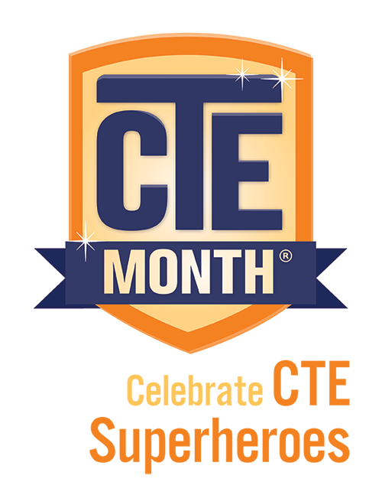
Notes:
Emil says “Stick out your neck and be a CTE Super Hero!”
Tell everyone you meet about the great things that are happening in CTE classrooms across the country.
====
Text to accompany the CTE Month logo
"The Association for Career and Technical Education does not endorse any third-party statements or techniques in particular—for details, please contact webmaster@acteonline.org (mailto:webmaster@acteonline.org)."

Slide 3
Fastest Growing Occup. in USA Requiring Postsecondary Education (Total Change in Positions Projected from 2010 - 2020)
711,900 Registered Nurses
358,400 Elementary and Middle School Teachers
314,600 Software Developers and Programmers
305,700 Postsecondary Teachers
302,000 Nursing Aides, Orderlies, and Attendants
248,800 Elementary School Teachers, Except Special Education
190,700 Accountants and Auditors
183,700 Health Practitioner Support Technologists and Technicians
178,600 Counselors
168,500 Licensed Practical and Licensed Vocational Nurses
168,300 Physicians and Surgeons
157,200 Management Analysts
146,300 Preschool and Kindergarten Teachers
143,800 Software Developers, Applications
Notes:
3
Not counting the occupations that require less than a year of on-the-job-training (OJT),
here are the high-demand occupations in the United States that require some kind of postsecondary education.
The number listed is the projected change in the number of positions in the United States over the ten-year projection period.
I’ve highlighted in red the teachers we need at all levels of education.
What are you doing to recruit new teachers?
==========
These data are from www.CareerOutlook.US
http://www.bls.gov/emp/ep_table_112.htm
Education and training assignments
updated January 13, 2012

Slide 4
Fastest Growing Occup. in USA (Total Change in Positions Projected from 2010 - 2020)
711,900 Registered Nurses
706,800 Retail Salespersons
706,300 Home Health Aides
607,000 Personal Care Aides
497,700 Driver/Sales Workers and Truck Drivers
489,500 Office Clerks, General
437,300 Laborers and Material Movers, Hand
425,400 Fast Food and Counter Workers
398,000 Combined Food Preparation and Serving Workers, Including Fast Food
359,000 Building Cleaning Workers
358,400 Elementary and Middle School Teachers
338,400 Customer Service Representatives
330,100 Heavy and Tractor-Trailer Truck Drivers
328,500 Miscellaneous Healthcare Support Occupations
319,100 Laborers and Freight, Stock, and Material Movers, Hand
314,600 Software Developers and Programmers
305,700 Postsecondary Teachers
302,000 Nursing Aides, Orderlies, and Attendants
262,000 Childcare Workers
259,000 Bookkeeping, Accounting, and Auditing Clerks
250,200 Cashiers
248,800 Elementary School Teachers, Except Special Education
248,500 Receptionists and Information Clerks
247,800 Cashiers
246,400 Janitors and Cleaners, Except Maids and Housekeeping Cleaners
240,800 Landscaping and Groundskeeping Workers
223,400 Sales Representatives, Wholesale and Manufacturing, Except Technical and Scientific Products
212,400 Construction Laborers
210,200 Medical Secretaries
203,400 First-Line Supervisors of Office and Administrative Support Workers
196,000 Carpenters
195,900 Waiters and Waitresses
195,600 Security Guards and Gaming Surveillance Officers
195,000 Security Guards
191,100 Teacher Assistants
190,700 Accountants and Auditors
190,400 Therapists
183,700 Health Practitioner Support Technologists and Technicians
178,600 Counselors
172,700 Miscellaneous Community and Social Service Specialists
168,500 Licensed Practical and Licensed Vocational Nurses
168,300 Physicians and Surgeons
162,900 Medical Assistants
Notes:
4
Here I’ve added to the list the short and moderate on-the-job-training occupations in green so you can compare their demand with the others.
Thus the green jobs are the ones you can get right out of high school, whereas the blue ones need some college work.
This list shows all occupations in The United States that require the most new workers projected through 2020.
Only one occupation on this top list requires a 4-year degree!
In 2020 the United States will need 711,900 more registered nurses than we had in 2010.
That’s almost three-quarters of a million more nurses.
From where will they all come?
…
--------
These data are from www.CareerOutlook.US
http://www.bls.gov/emp/ep_table_112.htm
Education and training assignments
updated January 13, 2012

Slide 5
Fastest Growing Occup. in USA (Percent Change in Positions Projected from 2010 - 2020)
70.5 Personal Care Aides
69.4 Home Health Aides
61.7 Biomedical Engineers
60.1 Helpers--Brickmasons, Blockmasons, Stonemasons, and Tile and Marble Setters
55.7 Helpers--Carpenters
52.0 Veterinary Technologists and Technicians
48.6 Reinforcing Iron and Rebar Workers
45.7 Physical Therapist Assistants
45.4 Helpers--Pipelayers, Plumbers, Pipefitters, and Steamfitters
44.6 Physical Therapist Assistants and Aides
43.7 Meeting, Convention, and Event Planners
43.5 Diagnostic Medical Sonographers
43.3 Occupational Therapy Assistants
43.1 Physical Therapist Aides
42.4 Glaziers
42.2 Interpreters and Translators
41.3 Medical Secretaries
41.2 Market Research Analysts and Marketing Specialists
41.2 Marriage and Family Therapists
41.2 Occupational Therapy Assistants and Aides
40.5 Brickmasons and Blockmasons
39.9 Brickmasons, Blockmasons, and Stonemasons
39.0 Physical Therapists
37.7 Dental Hygienists
37.6 Bicycle Repairers
36.8 Audiologists
36.5 Health Educators
36.5 Stonemasons
36.4 Cost Estimators
1,017,700 in 2010 :: 706,000 increase
15,700 in 2010 :: 9,700 increase
Notes:
5
Here you see the projected percentage change over the same ten-year period.
Sometimes you might have a small number of workers in a particular occupation, but the percentage change might be high, which means that the industry is expanding.
->There were only 15,700 Biomedical Engineers in the United States in 2010, so a 61 percent increase is 9,700 positions.
Compare that with the Home Health Aides with over a million positions in 2010, so a 69 percent increase is 706,000 positions. That’s a lot!
You need to look at both the numbers of positions and the percentage increase to truly understand the demand.
--------
These data are from www.CareerOutlook.US
http://www.bls.gov/emp/ep_table_112.htm
Education and training assignments
updated January 13, 2012

Slide 6
Fastest Declining Occup. in USA (Total Change in Positions Projected from 2010 - 2020)
-96,100 Farmers, Ranchers, and Other Agricultural Managers
-68,900 Postal Service Mail Sorters, Processors, and Processing Machine Operators
-42,100 Sewing Machine Operators
-38,100 Postal Service Mail Carriers
-33,200 Switchboard Operators, Including Answering Service
-31,600 Postal Service Clerks
-19,100 Cooks, Fast Food
-15,900 Data Entry Keyers
-13,200 Word Processors and Typists
-13,000 Textile Machine Setters, Operators, and Tenders
-12,400 Electrical, Electronics, and Electromechanical Assemblers
-12,400 Miscellaneous Plant and System Operators
-11,500 Door-to-Door Sales Workers, News and Street Vendors, and Related Workers
-10,600 Food Service Managers
-10,400 Electrical and Electronic Equipment Assemblers
-8,800 File Clerks
-8,100 Prepress Technicians and Workers
-7,400 Computer Operators
-6,800 Office Machine Operators, Except Computer
-6,800 Pressers, Textile, Garment, and Related Materials
-6,800 Postmasters and Mail Superintendents
-6,200 Floral Designers
-6,200 Petroleum Pump System Operators, Refinery Operators, and Gaugers
-5,700 Loan Interviewers and Clerks
-5,500 Paper Goods Machine Setters, Operators, and Tenders
-5,300 Chemical Plant and System Operators
-4,500 Photographic Process Workers and Processing Machine Operators
Notes:
6
And here are the jobs to stay away from.
We need this many less of each of these jobs over this 10-year projection period.
For most of these positions, machines are replacing humans.
--------
These data are from www.CareerOutlook.US
http://www.bls.gov/emp/ep_table_112.htm
Education and training assignments
updated January 13, 2012
Textiles – socks in NC
http://www.nctextileconnect.com/connect_detail.cfm?valuechain_catid=38
Socks made in USA
http://www.americansworking.com/socks.html

Slide 7
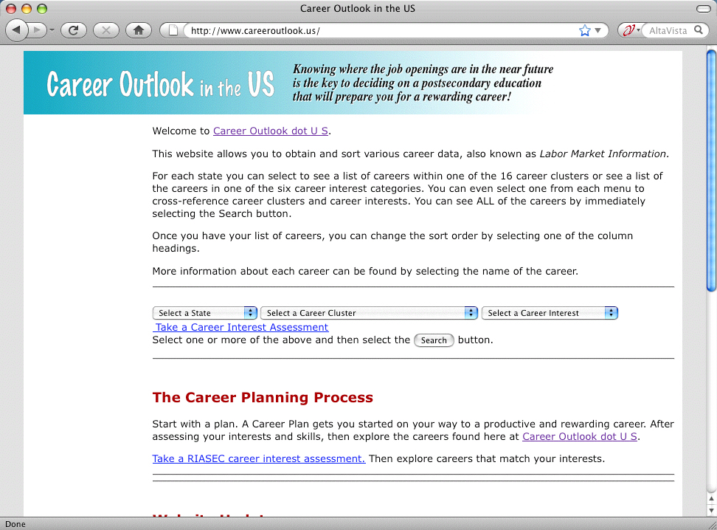
www.CareerOutlook.US
Notes:
You can see all of that data and much more at Career Outlook dot US.
You can see the job projections and salaries for each occupation for each state.
And as I said earlier, at the bottom of the main web page is a link to my presentations, like this one. And it’s all free!
====
www.CareerOutlook.US
7

Slide 8
States with Most New Jobs (Total Change in Positions Projected from 2008 - 2018)
15,273,900 United States
1,996,020 Texas
1,652,300 California
679,770 Georgia
597,930 Virginia
548,420 Illinois
438,110 Florida
419,680 North Carolina
310,090 Utah
304,670 Washington
287,050 New York
266,410 Indiana
257,640 Michigan
251,750 Maryland
249,000 Ohio
233,930 Alabama
195,660 Mississippi
195,000 Minnesota
178,670 Oklahoma
172,990 Tennessee
172,610 Iowa
164,870 Colorado
163,520 Louisiana
159,950 Oregon
158,480 Arizona
157,310 South Carolina
148,690 Kentucky
147,720 Kansas
145,900 Pennsylvania
120,400 New Jersey
112,430 Massachusetts
111,300 Idaho
110,840 Nebraska
95,420 Missouri
95,210 Arkansas
93,900 Nevada
83,670 Wisconsin
82,950 Connecticut
73,140 New Mexico
61,050 New Hampshire
59,384 Puerto Rico
54,370 D.C.
52,320 Montana
48,850 Hawaii
41,145 South Dakota
39,670 Rhode Island
38,530 North Dakota
34,450 Delaware
33,670 Alaska
31,180 Vermont
26,520 Wyoming
25,830 West Virginia
14,390 Maine
% change
21.41 Utah
17.04 Texas
15.58 Idaho
15.41 Georgia
14.90 Virginia
14.32 Mississippi
11.03 Montana
10.61 Alabama
10.46 Alaska
10.21 Oklahoma
10.15 Nebraska
10.12 United States
9.82 Kansas
9.79 Iowa
9.71 California
9.44 North Carolina
9.17 North Dakota
9.15 Maryland
9.06 Oregon
9.03 Washington
8.89 South Dakota
8.78 New Hampshire
8.66 Illinois
8.65 Wyoming
8.60 Indiana
8.51 Vermont
8.20 New Mexico
8.01 Louisiana
7.81 South Carolina
7.79 Rhode Island
7.58 Delaware
7.45 Kentucky
7.12 Hawaii
6.98 Arkansas
6.94 Nevada
6.91 D.C.
6.59 Minnesota
6.53 Colorado
5.66 Tennessee
5.65 Michigan
5.55 Arizona
5.31 Puerto Rico
5.15 Florida
4.56 Connecticut
4.35 Ohio
3.27 West Virginia
3.22 Missouri
3.20 Massachusetts
3.04 New York
2.75 New Jersey
2.72 Wisconsin
2.34 Pennsylvania
2.13 Maine
Notes:
If you are looking for work, it should make sense to move where the jobs are going to be
On the left you see the number of job openings projected over the 10-year period for each state.
On the right you see the percentage change in jobs over the next ten years for each state.
Some states are predicting a large number of job openings, but for our highly populated states it might not be a large percentage of jobs based on the size of the population.
You see states that I’ve highlighted in red - like Utah, Texas, Georgia, and Virginia are near the top of both sides. That means they are expecting a large number of job openings, which is also a large percentage of their current workforce. Those are the states that are growing the fastest.
Maine is at the bottom of both lists with about 14,000 job openings projected over the ten-year period.
============
“Total, All Occupations” for each state.
“Numeric Employment Change” is the number of new jobs projected over the ten year period.
www.projectionscentral.com/

Slide 9
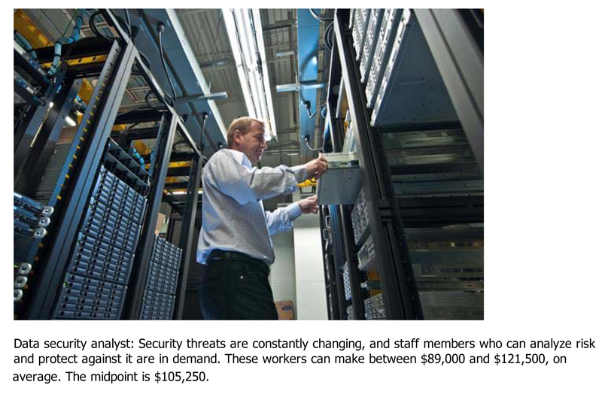
Notes:
Let’s look at a few new careers…
Here is the Data Security Analyst who works hard to keep our computer networks safe. The average salary is over 100,000 dollars.
And if you can figure out how to keep our credit card numbers safe, you’ll probably get paid a million dollars.
===
Some surprising six-figure jobs
====
http://www.bizjournals.com/triangle/blog/2012/06/slideshow-six-surprising-six-figure.html?ana=e_du_pap&s=article_du&ed=2012-06-27

Slide 10
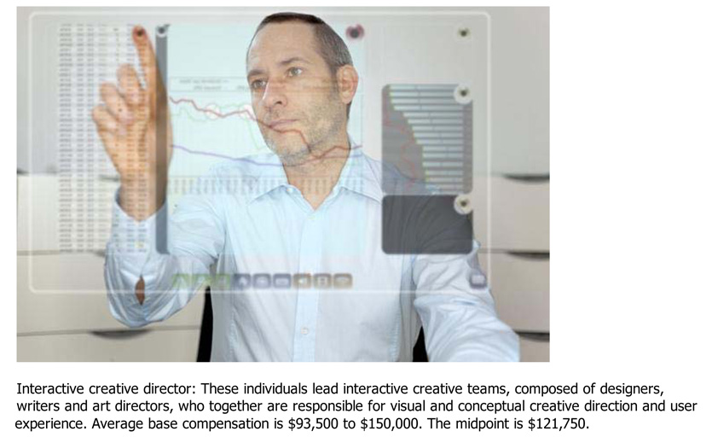
Notes:
How about an Interactive Creative Director?
They create the interface that allows you to use the computer without having to know binary numbers.
Once again, the average salary is over 100,000 dollars.
====
Some surprising six-figure jobs
====
http://www.bizjournals.com/triangle/blog/2012/06/slideshow-six-surprising-six-figure.html?ana=e_du_pap&s=article_du&ed=2012-06-27

Slide 11
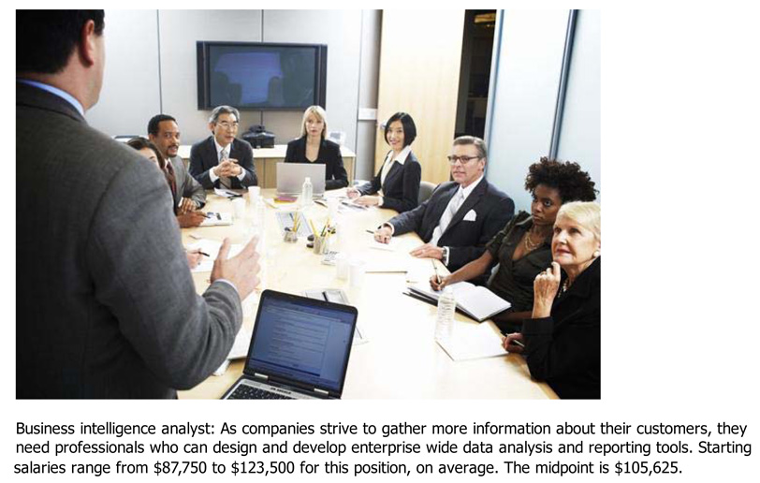
Notes:
Who’s heard of a Business Intelligence Analyst?
They gather data from all sources, turn it into useful information, and use it to help improve companies.
===
Some surprising six-figure jobs
====
http://www.bizjournals.com/triangle/blog/2012/06/slideshow-six-surprising-six-figure.html?ana=e_du_pap&s=article_du&ed=2012-06-27

Slide 12
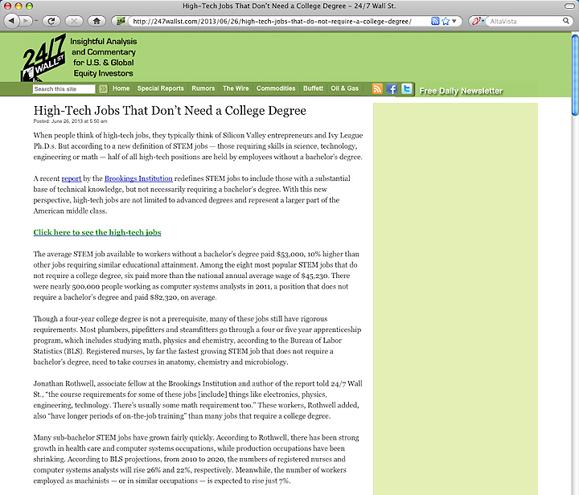
1. Registered Nurses
2. Automotive Service Technicians and Mechanics
3. Carpenters
4. Electricians
5. Computer Systems Analysts
6. Machinists
7. Plumbers, Pipefitters, Steamfitters
8. Welders, Cutters, Solderers and Brazers
Notes:
There are lots of different hot job lists out there. Make sure your kids find a few of them.
This list shows the top jobs that don’t require a four-year degree.
All high-demand jobs.
====
The average STEM job available to workers without a bachelor’s degree paid $53,000, 10% higher than other jobs requiring similar educational attainment.
1. Registered Nurses
2. Automotive Service Technicians and Mechanics
3. Carpenters
4. Electricians
5. Computer Systems Analysts
6. Machinists
7. Plumbers, Pipefitters, Steamfitters
8. Welders, Cutters, Solderers and Brazers
====
http://247wallst.com/2013/06/26/high-tech-jobs-that-do-not-require-a-college-degree/
High-Tech Jobs That Don’t Need a College Degree
Read more: High-Tech Jobs That Don’t Need a College Degree - 24/7 Wall St. http://247wallst.com/2013/06/26/high-tech-jobs-that-do-not-require-a-college-degree/#ixzz2XQ7hpswB
June 26, 2013
The average STEM job available to workers without a bachelor’s degree paid $53,000, 10% higher than other jobs requiring similar educational attainment. Among the eight most popular STEM jobs that do not require a college degree, six paid more than the national annual average wage of $45,230. There were nearly 500,000 people working as computer systems analysts in 2011, a position that does not require a bachelor’s degree and paid $82,320, on average.
Though a four-year college degree is not a prerequisite, many of these jobs still have rigorous requirements. Most plumbers, pipefitters and steamfitters go through a four or five year apprenticeship program, which includes studying math, physics and chemistry, according to the Bureau of Labor Statistics (BLS). Registered nurses, by far the fastest growing STEM job that does not require a bachelor’s degree, need to take courses in anatomy, chemistry and microbiology.
Read more: High-Tech Jobs That Don’t Need a College Degree - 24/7 Wall St. http://247wallst.com/2013/06/26/high-tech-jobs-that-do-not-require-a-college-degree/#ixzz2XQ7ptbo3

Slide 13
10 Hardest to Fill Jobs in America
Notes:
Sales Representatives are in high demand because businesses need to sell their products and services.
======
Forbes recently looked at the 10 Hardest to Fill Jobs in America
===
http://www.forbes.com/sites/jacquelynsmith/2013/05/28/the-10-hardest-jobs-to-fill-in-2013/

Slide 14
10 Hardest to Fill Jobs in America
Notes:
Skilled trades are in high demand because years ago we started discouraging kids from going into blue-collar jobs.
======
Forbes recently looked at the 10 Hardest to Fill Jobs in America
===
http://www.forbes.com/sites/jacquelynsmith/2013/05/28/the-10-hardest-jobs-to-fill-in-2013/

Slide 15
Top 10 Job Titles that Didn’t Exist Five Years Ago
Notes:
You’ve heard about the cloud … Now someone has to maintain it and keep it going.
=====
http://talent.linkedin.com/blog/index.php/2014/01/top-10-job-titles-that-didnt-exist-5-years-ago-infographic
Top 10 Job Titles That Didn’t Exist 5 Years Ago
Methodological details: We counted the frequencies of all English words and phrases used in job titles that were held in 2013 and compared the results to job titles that were held in 2008. We then took the top titles that saw the largest growth in frequency in that 5 year period and ranked them by their relative size in 2013. “Big data” and “cloud services” were the root phrases used to determine frequencies for “big data architect” and “cloud services manager” (which had many permutations, e.g. “big data architect/analyst/engineer” etc.). For simplicity’s sake, the titles you see above were used as examples. Data is current as of November 26, 2013.

Slide 16
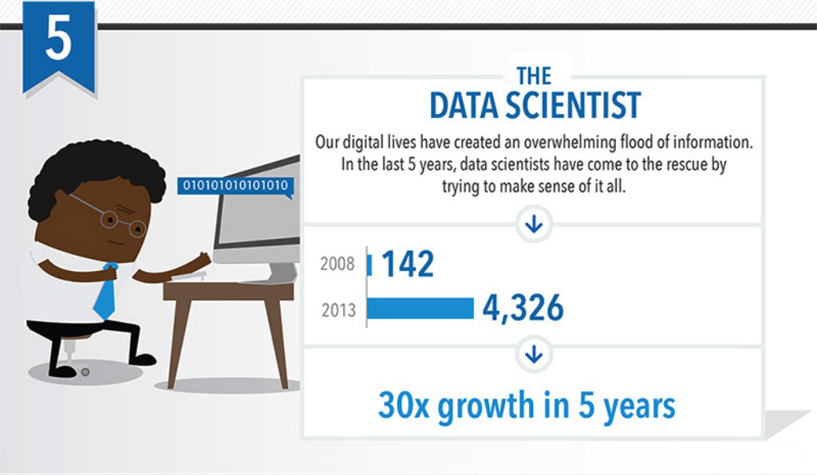
Top 10 Job Titles that Didn’t Exist Five Years Ago
Notes:
Someone needs to take all that data we’ve collected and turn it into information.
That’s the Data Scientist.
=====
http://talent.linkedin.com/blog/index.php/2014/01/top-10-job-titles-that-didnt-exist-5-years-ago-infographic
Top 10 Job Titles That Didn’t Exist 5 Years Ago
Methodological details: We counted the frequencies of all English words and phrases used in job titles that were held in 2013 and compared the results to job titles that were held in 2008. We then took the top titles that saw the largest growth in frequency in that 5 year period and ranked them by their relative size in 2013. “Big data” and “cloud services” were the root phrases used to determine frequencies for “big data architect” and “cloud services manager” (which had many permutations, e.g. “big data architect/analyst/engineer” etc.). For simplicity’s sake, the titles you see above were used as examples. Data is current as of November 26, 2013.

Slide 17
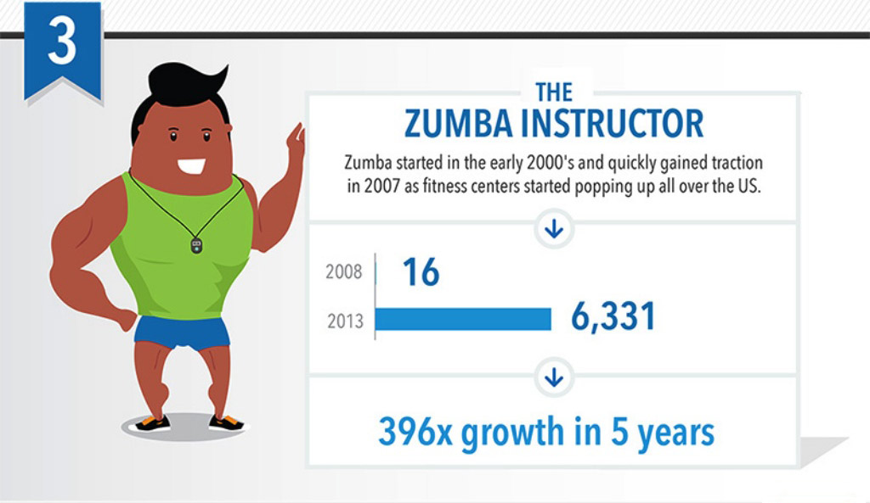
Top 10 Job Titles that Didn’t Exist Five Years Ago
Notes:
Look! It’s a high demand job that does not require a computer!
Raise your hand if you Zumba.
=====
http://talent.linkedin.com/blog/index.php/2014/01/top-10-job-titles-that-didnt-exist-5-years-ago-infographic
Top 10 Job Titles That Didn’t Exist 5 Years Ago
Methodological details: We counted the frequencies of all English words and phrases used in job titles that were held in 2013 and compared the results to job titles that were held in 2008. We then took the top titles that saw the largest growth in frequency in that 5 year period and ranked them by their relative size in 2013. “Big data” and “cloud services” were the root phrases used to determine frequencies for “big data architect” and “cloud services manager” (which had many permutations, e.g. “big data architect/analyst/engineer” etc.). For simplicity’s sake, the titles you see above were used as examples. Data is current as of November 26, 2013.

Slide 18
Top 10 Job Titles that Didn’t Exist Five Years Ago
Notes:
The Apple iPhone has been around for 7 years --- now the competition is heating up.
Someone needs to write the code for these smart phone aps that we can’t live without.
=====
http://talent.linkedin.com/blog/index.php/2014/01/top-10-job-titles-that-didnt-exist-5-years-ago-infographic
Top 10 Job Titles That Didn’t Exist 5 Years Ago
Methodological details: We counted the frequencies of all English words and phrases used in job titles that were held in 2013 and compared the results to job titles that were held in 2008. We then took the top titles that saw the largest growth in frequency in that 5 year period and ranked them by their relative size in 2013. “Big data” and “cloud services” were the root phrases used to determine frequencies for “big data architect” and “cloud services manager” (which had many permutations, e.g. “big data architect/analyst/engineer” etc.). For simplicity’s sake, the titles you see above were used as examples. Data is current as of November 26, 2013.

Slide 19
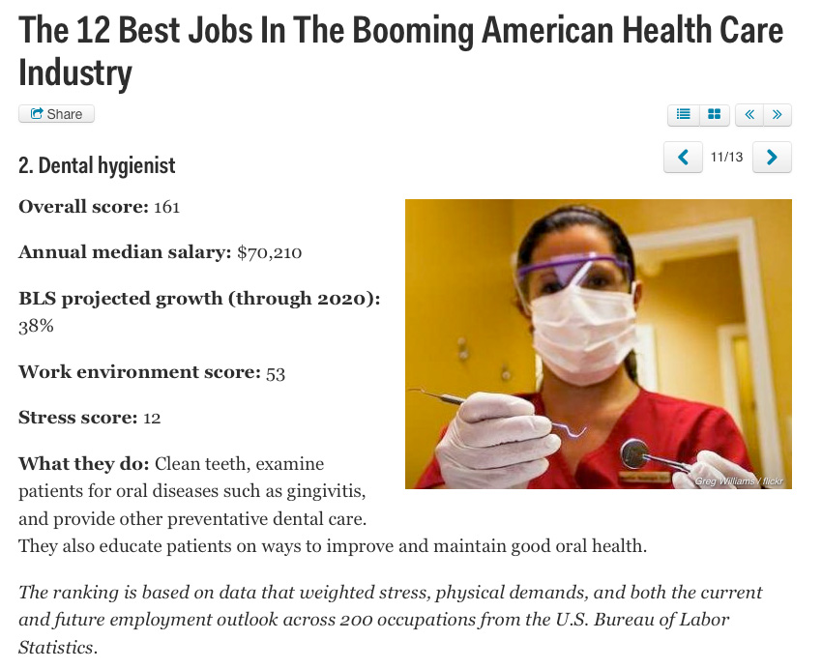
Notes:
I believe the most recession-proof jobs that pay well are the “assisting-type” jobs in health care.
That includes the dental hygienists and dental assistants, surgical technologists, medical assistants, sonographers., and many others.
These are the folks that are assisting the medical doctors.
All of these jobs are in high demand and will be until the baby boomers die off.
And at that time we will need more mortician assistants.
=====
http://www.businessinsider.com/best-health-care-jobs-2013-12
The 12 Best Jobs In The Booming American Health Care Industry
To find out which jobs offer the best opportunities in health care, job search site CareerCast analyzed survey data that weighed stress, physical demands, and both the current and future employment outlook of 200 occupations.
"What's similar for the jobs on this list, with the exception of biomedical engineer, is that they work individually one-on-one with another person," Tony Lee, publisher at CareerCast.com, tells Business Insider. "When you're working with someone else, the job satisfaction is pretty high because you see someone often and they're giving you feedback, as opposed to having very few people thanking you."
Lee predicts that the need for these professionals will last for years to come. "Baby boomers are entering retirement, and as our body ages, the type of medical professionals that are needed to help people deal with that are going to be in greater demand."
The overall score for each job takes into account the pay; hiring outlook; stress; emotional factors, including the level of competitiveness and degree of public contact; and physical demands, such as stamina required and work conditions, that normally come with a job. Once the categories are combined, a lower overall score signals that the job is more desirable to employees.

Slide 20
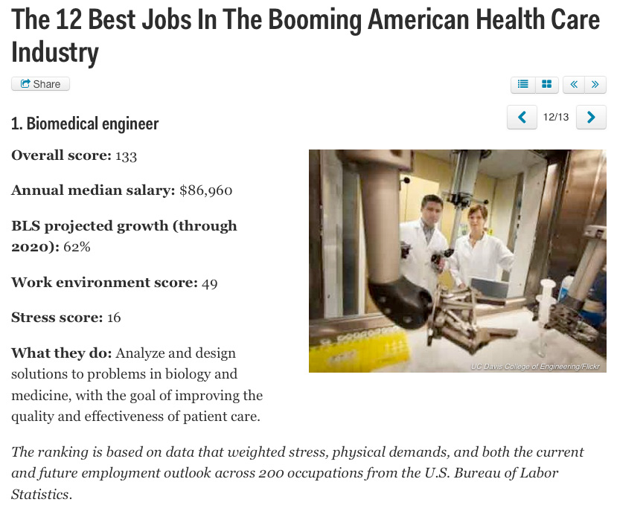
Notes:
New forms of engineering emerge every year.
The Biomedical Engineer combines engineering principals with medicine and biology to create better healthcare for all of us.
And as you saw at the beginning of this webinar, Biomedical Engineer is the third fastest growing occupation by percentage growth,
=====
http://www.businessinsider.com/best-health-care-jobs-2013-12
The 12 Best Jobs In The Booming American Health Care Industry
To find out which jobs offer the best opportunities in health care, job search site CareerCast analyzed survey data that weighed stress, physical demands, and both the current and future employment outlook of 200 occupations.
"What's similar for the jobs on this list, with the exception of biomedical engineer, is that they work individually one-on-one with another person," Tony Lee, publisher at CareerCast.com, tells Business Insider. "When you're working with someone else, the job satisfaction is pretty high because you see someone often and they're giving you feedback, as opposed to having very few people thanking you."
Lee predicts that the need for these professionals will last for years to come. "Baby boomers are entering retirement, and as our body ages, the type of medical professionals that are needed to help people deal with that are going to be in greater demand."
The overall score for each job takes into account the pay; hiring outlook; stress; emotional factors, including the level of competitiveness and degree of public contact; and physical demands, such as stamina required and work conditions, that normally come with a job. Once the categories are combined, a lower overall score signals that the job is more desirable to employees.
Definition: http://en.wikipedia.org/wiki/Biomedical_engineer

Slide 21
Notes:
Here is a recent Georgetown study that looked at Job Growth and Education Requirements Through 2020.
They found that STEM, Healthcare Professions, Healthcare Support, and Community Services will be the fastest growing occupations,
And they found that they all require high levels of postsecondary education.
This report has details for each state, so check it out. Remember, the link to the report is in the notes section of this slide.
=====
http://cew.georgetown.edu/recovery2020/
Recovery 2020: Job Growth and Education Requirements Through 2020
June 26, 2013
Recovery 2020 finds that:
There will be 55 million job openings in the economy through 2020: 24 million openings from newly created jobs and 31 million openings due to baby boom retirements.
By educational attainment: 35 percent of the job openings will require at least a bachelor’s degree, 30 percent of the job openings will require some college or an associate’s degree and 36 percent of the job openings will not require education beyond high school.
STEM, Healthcare Professions, Healthcare Support, and Community Services will be the fastest growing occupations, but also will require high levels of post-secondary education.
Most jobs will require some type of post-secondary education, and individuals that only posses a high school diploma will have fewer employment options.
Employers will seek cognitive skills such as communication and analytics from job applicants rather than physical skills traditionally associated with manufacturing.
The United States will fall short by 5 million workers with postsecondary education – at the current production rate – by 2020.

Slide 22
The primary aim of education is not to enable students to do well in school, but to help them do well in the lives they lead outside of school.
Elliot W. Eisner
Notes:
Sometimes we get too caught up in how well kids do in school –
and we loose sight of the goal to produce adult citizens who can function outside of school.
We have to get back to the true purpose of education.
===
This line is often quoted without any reference. Here are two people who claim the quote and a school district that uses it as their motto.
Elliot W. Eisner
http://www.ascd.org/publications/educational-leadership/dec03/vol61/num04/Preparing-for-Today-and-Tomorrow.aspx
Raymond McNulty
http://unioneagle.com/2012/01/education-leader-challenges-teachers-to-be-different/
Bellevue Community School District
http://bellevue.k12.ia.us/
22

Slide 23
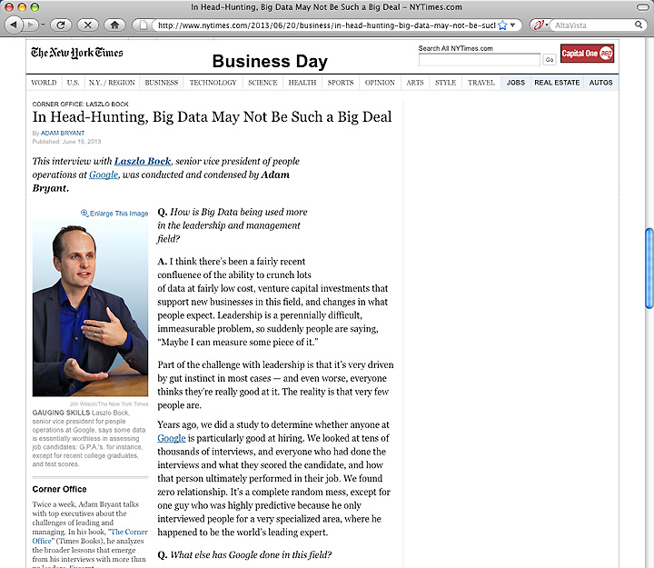
Notes:
Google has done the research and found that GPA is a worthless criteria for hiring.
But the thing that stood out for me in this article is their characterization of the academic environment as being an artificial environment.
They say they want more from their new recruits.
They want new recruits who can work in a team to solve a problem that has never been solved before.
Google claims that educators spend too much time helping their students solve the problem their way rather than encouraging their students to really step outside the box.
Of course as an educator, I know that it would be harder to assess and place a grade on that, but in reality, it’s what the business community needs, and after all-- aren’t we in the business of creating their future employees?
=======
http://www.nytimes.com/2013/06/20/business/in-head-hunting-big-data-may-not-be-such-a-big-deal.html?pagewanted=all&_r=1&
In Head-Hunting, Big Data May Not Be Such a Big Deal
June 19, 2013
One of the things we’ve seen from all our data crunching is that G.P.A.’s are worthless as a criteria for hiring, and test scores are worthless — no correlation at all except for brand-new college grads, where there’s a slight correlation. Google famously used to ask everyone for a transcript and G.P.A.’s and test scores, but we don’t anymore, unless you’re just a few years out of school. We found that they don’t predict anything.
What’s interesting is the proportion of people without any college education at Google has increased over time as well. So we have teams where you have 14 percent of the team made up of people who’ve never gone to college.
After two or three years, your ability to perform at Google is completely unrelated to how you performed when you were in school, because the skills you required in college are very different. You’re also fundamentally a different person. You learn and grow, you think about things differently.
Another reason is that I think academic environments are artificial environments. People who succeed there are sort of finely trained, they’re conditioned to succeed in that environment. One of my own frustrations when I was in college and grad school is that you knew the professor was looking for a specific answer. You could figure that out, but it’s much more interesting to solve problems where there isn’t an obvious answer. You want people who like figuring out stuff where there is no obvious answer.
===
Google no longer hires based on GPA or test scores
"One of the things we’ve seen from all our data crunching is that G.P.A.’s are worthless as a criteria for hiring, and test scores are worthless"
Google also said that "academic environments are artificial environments." Students are "conditioned to succeed in that environment ... looking for a specific answer." Google wants "people who like figuring out stuff where there is no obvious answer."
These problem-solving skills that Google and others are looking for can be taught in our CTE classes, but the learning can be hard to measure, which makes it tough to convice the administration that these skills need to be taught.
http://www.nytimes.com/2013/06/20/business/in-head-hunting-big-data-may-not-be-such-a-big-deal.html?pagewanted=all&_r=1&

Slide 24
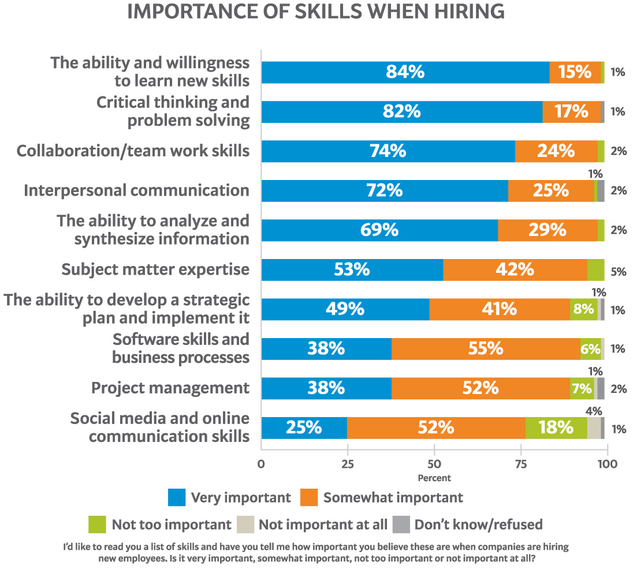
Notes:
24
Here is a recent publication from the US Chamber of Commerce
Here is their list of skills that employers said were important when hiring their new recruits. Do you think our students should know this information?
Where in our K-12 schools are we teaching these skills that the employers say are the most important when hiring new employees?
===
http://icw.uschamber.com/publication/life-21st-century-workforce-national-perspective
Life in the 21st Century Workforce: A National Perspective
Posted September 27, 2011

Slide 25
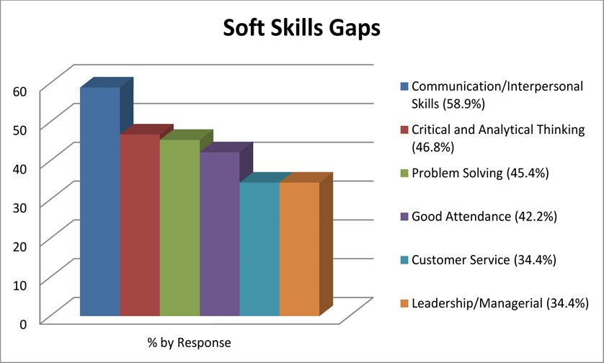
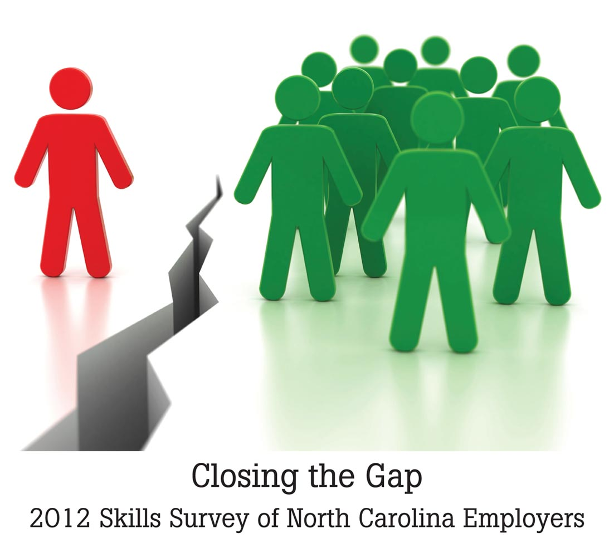
xx
Notes:
Here is a similar list showing that employers say their new recruits don’t know how to communicate, think critically, and solve problems.
An employer recently told me that when interviewing new recruits, he determines if this would be someone with whom he would like to have lunch.
His reasoning was that if you can’t hold up your end of a casual lunch conversation, then you probably can’t communicate on the job.
Which of these skills are we teaching in our high schools?
=======
Skills Survey
http://www.agreatworkforce.com/newsstory.cfm?NewsID=13
news article, news video
http://triangle.news14.com/content/top_stories/652523/survey-shows-n-c--workforce-skills-lacking

Slide 26
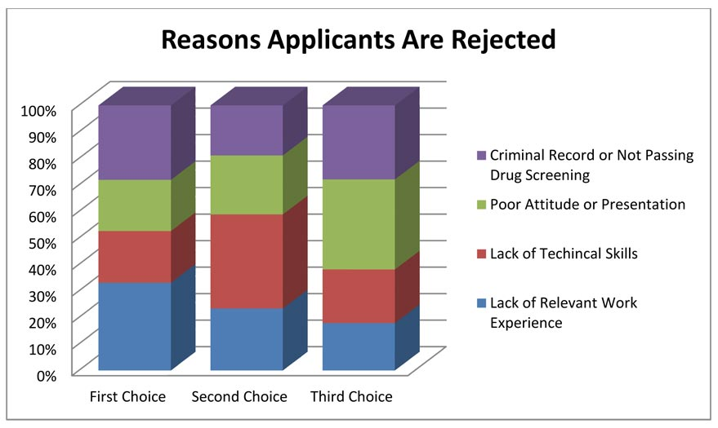
xx
Notes:
Over forty-six percent of the businesses indicated the primary reason for rejecting applications was due to Lack of Relevant Work Experience.
Sounds like we need more job shadowing and internships.
Lack of Technical Skills was indicated more frequently as a second choice.
Respondents indicated a strong third choice as being Applicants with Poor Attitude or Presentation.
That means our students need more practice standing in front of the classroom giving presentations. When I was in high school I hated presenting before the class, and I was not very good at it. But through repeated attempts, and lots of constructive criticism, this shy introvert has become a decent public speaker.
Criminal record is an often overlooked item. A single drug conviction can lock you out of the entire healthcare industry, and that’s were most of the jobs are. Even the military is not recruiting anyone with the criminal background. I know several ex-offenders who are having a hard time finding employment.
=======
Skills Survey
http://www.agreatworkforce.com/newsstory.cfm?NewsID=13
news article, news video
http://triangle.news14.com/content/top_stories/652523/survey-shows-n-c--workforce-skills-lacking

Slide 27
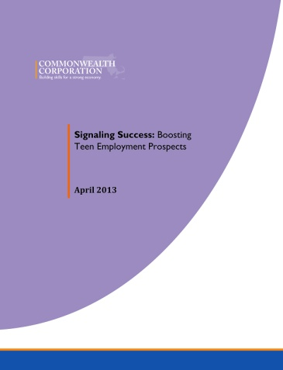
Interview tips
Do NOT bring drinks, food, cell phone, friends, parents
Make good eye contact
Shake hands
Ask questions
Be clean and neat
Dress for the job
Explain your availability
Notes:
I have heard from many employers that the way you enter the door and greet the interviewer has a dramatic impact on getting hired.
Also the interview starts the first time you have contact with the company. Through an employee, the application process, scheduling the interview, etc.
Don’t come to a job interview ready to answer questions, come to the job interview ready to demonstrate why the company needs you.
=====
http://www.commcorp.org/resources/detail.cfm?ID=988
Commonwealth Corporation
Since 1999, the share of employed teens in Massachusetts plummeted from 53 percent to 26.8 percent during 2012. This reflects a national trend in declining teen employment rates over the last decade.
While working certainly has the ability to bolster the consumption of teens and their families, working at an early age generates a set of additional and longer lasting benefits that are manifest in improved lifetime employment and earnings outcomes as well as improved educational attainment outcomes.
Through this study, we have learned that employers of entry level workers such as teens take recruitment and hiring very seriously and engage in a variety of activities to find prospective workers they believe will contribute to output and profitability in their organizations. The findings of this study can inform the ways that schools, community based organizations, workforce boards, career centers and businesses can intervene to help increase youth employment.

Slide 28
Myth # 1
All of the manufacturing is moving to China.
Notes:
28
If you read the front page of the newspaper you might still believe this.
But if you read the Business section like I do …

Slide 29
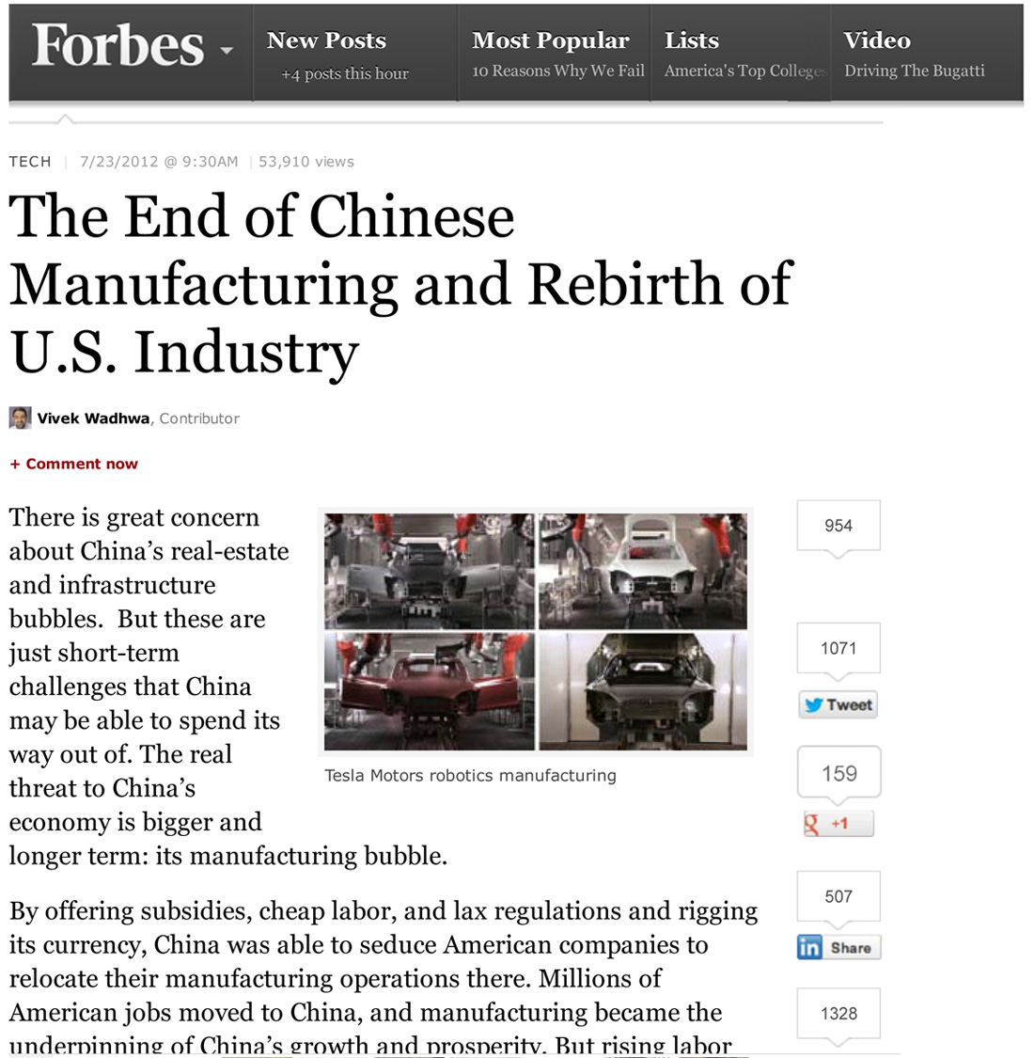
Notes:
… you will find that times have changed -- and the manufacturing is coming back home.
=====
http://www.forbes.com/sites/singularity/2012/07/23/the-end-of-chinese-manufacturing-and-rebirth-of-u-s-industry/
The End of Chinese Manufacturing and Rebirth of U.S. Industry

Slide 30
Notes:
But why would a school counselor allow a young lady to take a manufacturing class knowing that she could end up with a job like this?
Compare the cleanliness of the work environment in this picture with …
====
https://dwd.wisconsin.gov/dwd/dwdhistory/images/women_in_factory_big.jpg

Slide 31
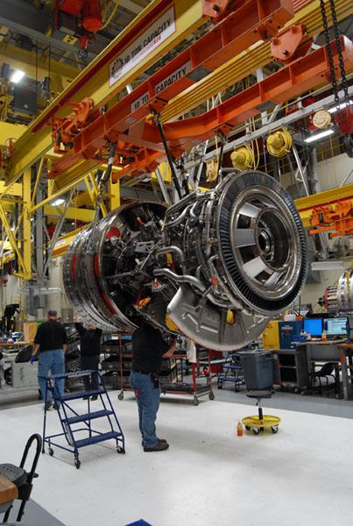
Notes:
…this one, where they are building jet engines in Durham, North Carolina.
You could eat off of that floor!
The reality is that most educators, students, and their parents have no idea of what is happening in today’s factories.
Name one TV show that shows employees working in a modern factory.
How can students, teachers, and everyone else learn about modern industry?
Field trips, job shadowing, internships, open houses?
====
http://www.bizjournals.com/triangle/news/2012/08/03/slideshow-a-look-at-ge-aviations.html?ana=e_du_pap&s=article_du&ed=2012-08-03
Slideshow: A look at General Electric Aviation engine plant
The Durham plant, just off Miami Boulevard, is beginning to retool as the company triples its production of GEnx turbofan engines for Boeing Co.’s (NYSE: BA) new 787 Dreamliner. It has also recently expanded production of the giant GE90 engine and several lines of smaller engines, all of which are aimed at replacing older designs that are less fuel efficient.
photo shows:
A GE90 engine nears completion at the GE Aviation factory off South Miami Boulevard in Durham. The GE90 is used for large commercial aircraft such as the Boeing 777. More than 1,000 777s have been built over the years, incorporating a total of more than 2,000 engines from Boeing, Rolls-Royce and United Technologies' Pratt & Whitney division.

Slide 32
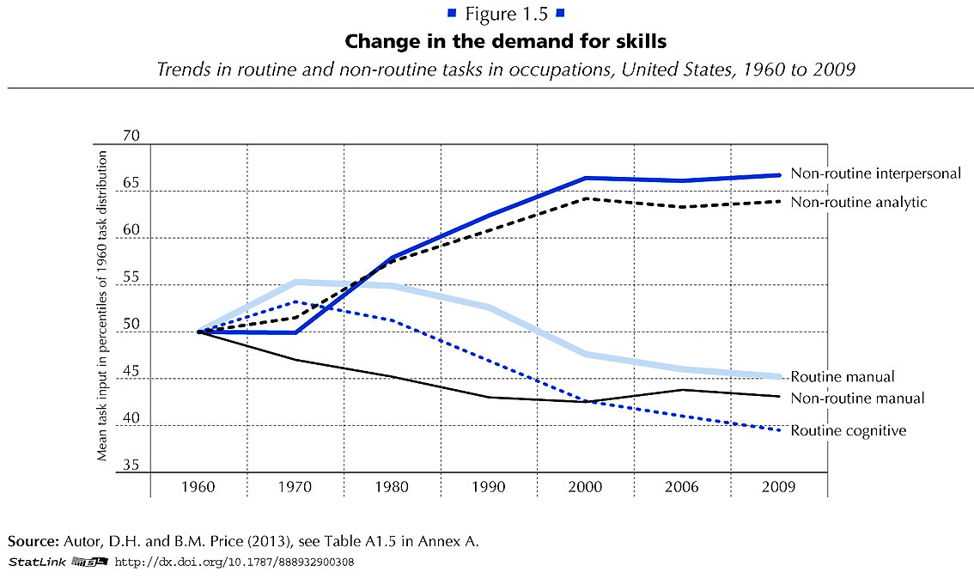
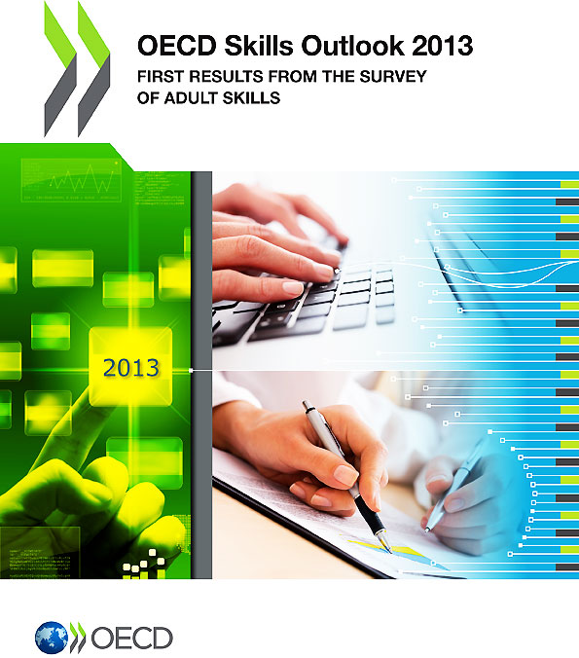
Notes:
Employers want employees that can do non-routine work.
They want folks that can identify and solve new problems.
Gone are the jobs that required routine manual labor.
===
http://www.oecd.org/site/piaac/
https://www.oecd.org/site/piaac/
-----
OECD Skills Outlook 2013
http://skills.oecd.org/skillsoutlook.html
First Results from the Survey of Adult Skills
OECD_Skills_Outlook_2013.pdf
Key Findings
SkillsOutlook_2013_KeyFindings.pdf
Summary
9789264204256-sum-en.pdf
-----
PIAAC Results Released
On Oct. 8, 2013, the Organization for Economic Cooperation and Development (OECD) released the results of the Program for International Assessment of Adult Competencies, (PIAAC). This direct assessment was conducted with nationally representative samples from 23 countries from adults ages 16 through 65. It is an international household survey to assess the cognitive and workplace skills needed for success in the 21st-century global economy. The results are designed to help public, private, educational, and philanthropic sectors work with a shared language and set of benchmarks to enhance cooperation around the development and implementation of economic, education, and social policies that strengthen adult skills. The survey is intended to be administered every 10 years, making this a baseline report to set benchmarks against which countries and sectors can measure their improvement efforts. Multiple reports, datasets, and several data tools were released with the results, including:
The OECD Skills Outlook 2013: First Results from the Survey of Adult Skills, a freely available book in PDF form;
a summary, Skilled for Life? Key Findings;
a brief U.S. report, Survey of Adult Skills, First Results: United States; and
a report from the U.S. Department of Education’s National Center for Educational Statistics, Literacy, Numeracy, and Problem Solving in Technology-Rich Environments Among U.S. Adults: Results from the Program for the International Assessment of Adult Competencies 2012: First Look, was published on Oct. 18, once the U.S. federal government was re-opened. This report highlights the U.S. performance in the international data and unique U.S. demographic characteristics.
On Nov. 12, 2013, the OECD-authored report, Time for the United States to Reskill? What the Survey of Adult Skills Says, will be released. This report was funded by OVAE to offer a more detailed profile of low-skilled adults in the U.S. It will also identify policy implications and offer broad policy recommendations for the U.S.
Links to all of these resources, as well as events and press coverage, may be found at www.piaacgateway.com.
This article relies heavily on data included in the NCES “First Look” report. Further analysis of the PIAAC data will appear in future issues of OVAE Connection.
The Survey
The PIAAC assessment focuses on the working-age adult population, and measures cognitive and workplace skills necessary for successful participation in the 21st century society and global economy. In the U.S., as in all of the countries participating, 5,000 individuals were surveyed to create a nationally representative dataset. An additional 5,000 people will be surveyed for a supplement that will be added to the data set in 2015.
Drawing from a rich background questionnaire, the PIAAC measures relationships among respondents’ educational background, parental educational attainment, work history and skills, occupational attainment, use of information and communications technology, and cognitive skills in the domains of literacy, numeracy, and problem solving in technology-rich environments.
Findings are presented in the First Look report as country averages, and tables are used to place countries’ performances above, at, or below the international average. Within each domain, performance is also reported as a percentage of the population that performs in five levels of proficiency: Below Level 1, Level 1, Level 2, Level 3, and combined Levels 4/5, Level descriptors can be found in the First Look report in Exhibit B-1 for literacy, B-3 for numeracy, and B-5 for problem-solving in a technology-rich environment. Performance below Level 2 is considered “weak” or “low.”
The assessment is unique in that it is the first international literacy survey that is both adaptive and administered on a laptop computer. Given as a household survey, respondents were allowed to choose whether to take the assessment on a laptop or with pencil and paper. In the U.S., nearly 80 percent of respondents completed the survey on the computer, which means that they passed an initial screening test on basic computer use and navigation.
The direct measure of cognitive and workplace skills in this study creates a much more nuanced perspective on skills than the more commonly reported measure of educational attainment. For example, the attainment category of “some college,” which appears on many surveys of adult skills, says very little about the knowledge, skills, and abilities of an individual, and is rarely accompanied by information on the courses taken, training completed, and skills gained. Having more information about skills, including where they are learned and how they are used, as this survey provides, will inform educators, workforce development stakeholders, human resource personnel, employers, and policymakers about the mechanisms that are effective in increasing the skill and talent inventory in regions, sectors, and across the country.
Key Findings
On three domains (literacy, numeracy, and problem-solving in a technology-rich environment) the U.S. average performance is significantly lower than the international average. Within domains, the U.S. profile shows a large portion of adults with skills below Level 2, and small percentages of adults with strong skills in the upper level.
In the literacy domain, the U.S. average percentile performance is 270; the international average is 273. Within the domain, the U.S. profile shows 4 percent at Below Level 1, 14 percent at Level 1, 34 percent at Level 2, 36 percent at Level 3, and 12 percent at the combined Level 4/5. The U.S. has an equivalent percentage of adults in the highest level as the international average, 12 percent (see First Look, Figure 2A).
In the numeracy domain, the U.S. average performance is 253; the international average is 269. Within the domain, the U.S. profile shows 10 percent at Below Level 1, 20 percent at Level 1, 34 percent at Level 2, 27 percent at Level 3, and 9 percent at the combined Level 4/5. The U.S. has a lower percentage of adults in the highest level than the international average, which is 12 percent (see First Look, Figure 2B).
In problem-solving in a technology-rich environment, the U.S. average performance is 277; the international average is 283. Within the domain, which reports only four levels, the U.S. profile shows 20 percent at Below Level 1, 41 percent at Level 1, 33 percent at Level 2, and 6 percent at Level 3. The U.S. has a lower percentage of adults in the highest level than the international average, which is 8 percent (see First Look, Figure 2C).
The PIAAC item framework is aligned to previous international literacy assessments, allowing trend analysis for the past 20 years. The First Look report shows that the average U.S. literacy score for adults on the PIAAC is not significantly lower than it was in 2003-08 as reported on the International Adult Literacy Survey (IALS), but is lower than the average score was in 1994-98 as reported on the Adult Literacy and Lifeskills Survey (ALL) (Tables 1-A and 1-B). The average U.S. numeracy score on the PIAAC is lower than it was in 2003-08 as reported in the IALS.
Implications
These survey findings show that the U.S. has significant basic skill weaknesses within the adult working-age population in comparison to other industrialized countries. This skill profile has negative implications for the growth and strength of the U.S. economy and middle class. Although two-thirds of the low-skilled respondents in the U.S. sample are employed, they are not employed in jobs with high wages.
The findings show that work tasks influence skills. Adults who report frequently using literacy, numeracy, and problem-solving skills in their daily work routines have greater proficiencies in those skills. The reverse is also shown in the data: Workers in low-skilled jobs may have fewer opportunities to use and enhance their skills (see First Look, Figures 8 A, B, and C).
Weak skills have implications for civic life as well, as has been demonstrated in previous surveys of adult literacy. Adults with weak skills are less likely to vote or volunteer in their communities, and more likely to suffer poor health. In fact, adults with low skills are four times more likely to report “fair” or “poor” health than those with strong skills (see First Look, Figures 10 A, B, and C). This relationship is twice as strong as the international average.
Moreover, a concerning trend emerges in this data set. Unlike most other countries surveyed, in the U.S., younger cohorts’ skills are not surpassing the older cohorts’ skills. This has serious implications for the future of our workforce and underscores the need for continuing education and training.

Slide 33
Notes:
Sometimes we have to think outside the box.
Let’s look at some business ventures that our children are thinking up.
====
http://cdn.elev8.com/files/2010/07/think-outside-the-box.jpg

Slide 34
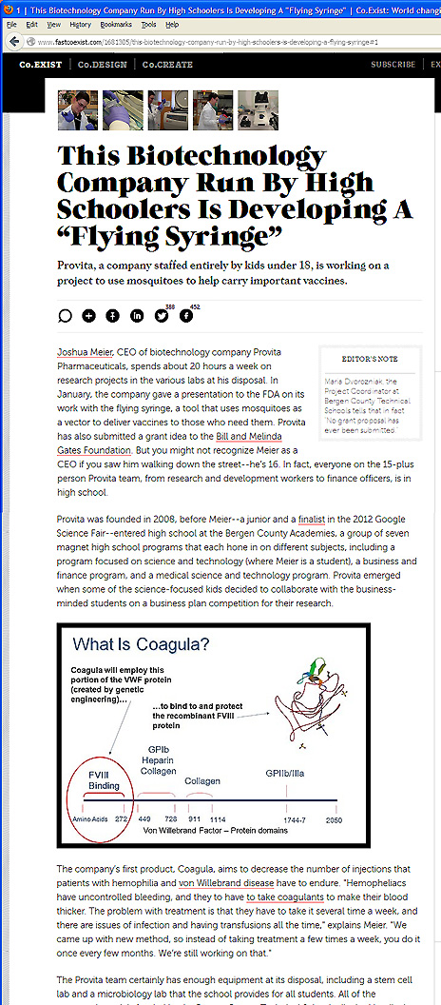
Notes:
You know how mosquitos can spread malaria and other diseases?
Here is a company comprised of kids under the age of 18 who are going to get the mosquitos to instead carry vaccines.
Imagine being able to vaccinate an entire village without a single syringe?
Their first goal is to combat the West Nile Virus.
Who’s got kids like this in their school, and what are we doing to help them learn.
Sometimes we just have to point them to the lab and then get out of their way.
=====
http://www.fastcoexist.com/1681305/this-biotechnology-company-run-by-high-schoolers-is-developing-a-flying-syringe#1

Slide 35
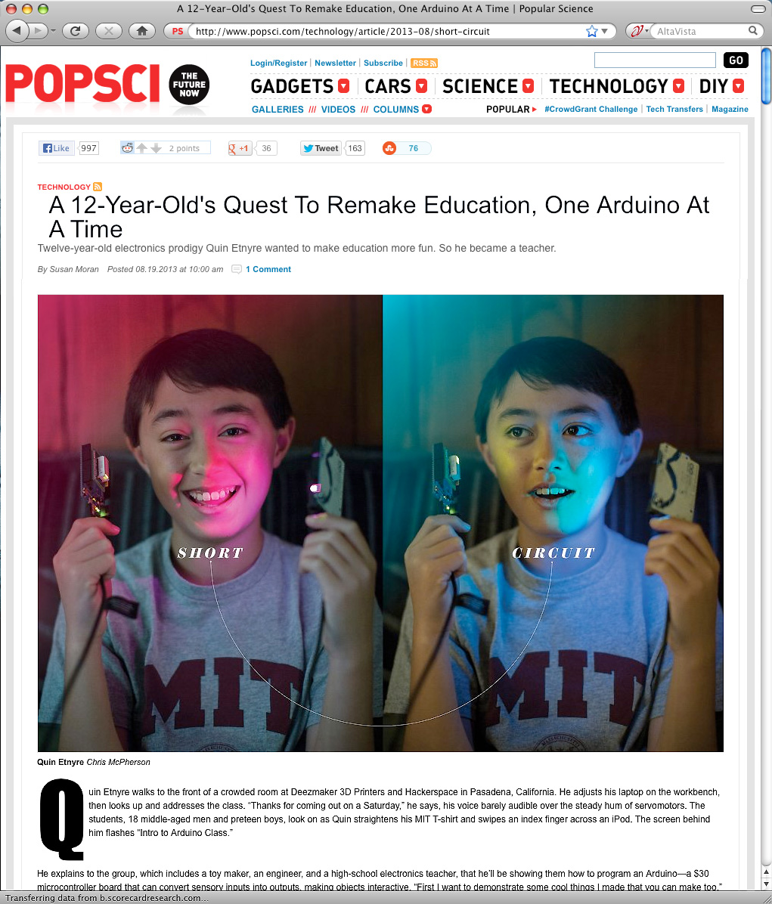
Notes:
An Arduino is a small circuit board with a microprocessor that can be used to build almost anything.
Here is a 12-year old who has unleashed the potential and is building useful products.
======
http://www.popsci.com/technology/article/2013-08/short-circuit
A 12-Year-Old's Quest To Remake Education, One Arduino At A Time

Slide 36
Notes:
Here is a closeup of this circuit board that costs about $30.
Think of this as an electronic version of the tinker toys or erector sets that we grew up with.
======
http://www.popsci.com/technology/article/2013-08/short-circuit
A 12-Year-Old's Quest To Remake Education, One Arduino At A Time

Slide 37
Notes:
What does a typical 12 year old build with all this technology? . . .
Here is a small robot that is built around one of these Arduino circuits that has a built-in methane detector.
In plain language--- this 12-year old boy has built a remote-controlled fart detector.
======
http://www.popsci.com/technology/article/2013-08/short-circuit
A 12-Year-Old's Quest To Remake Education, One Arduino At A Time

Slide 38
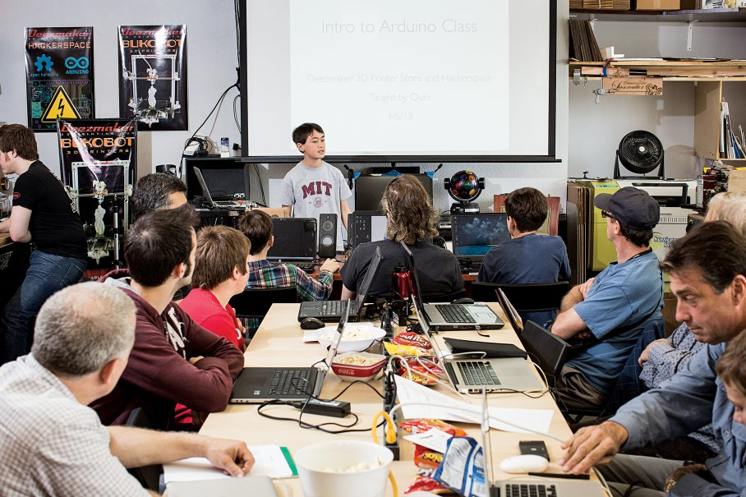
Notes:
Here is the same 12-year old teaching a class on a Saturday morning to people that want to learn how to make and program things with the Arduino microprocessor.
This kid might just end up at MIT.
======
http://www.popsci.com/technology/article/2013-08/short-circuit
A 12-Year-Old's Quest To Remake Education, One Arduino At A Time

Slide 39
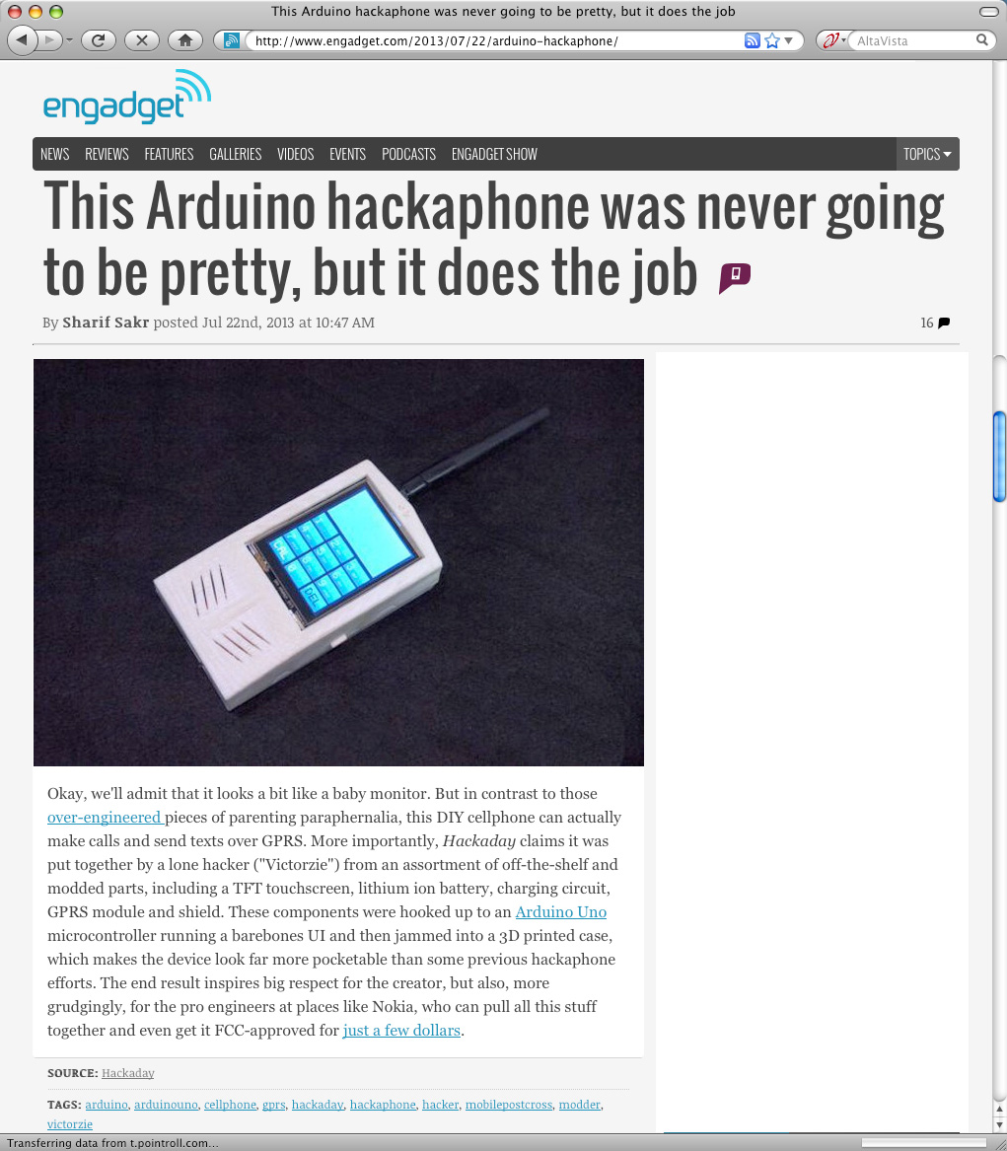
Notes:
And here is a cell phone that you can make using the Arduino microprocessor and a 3D-printed case.
Are we setting up our students to be this creative?
===
http://www.engadget.com/2013/07/22/arduino-hackaphone/
This Arduino hackaphone was never going to be pretty, but it does the job

Slide 40
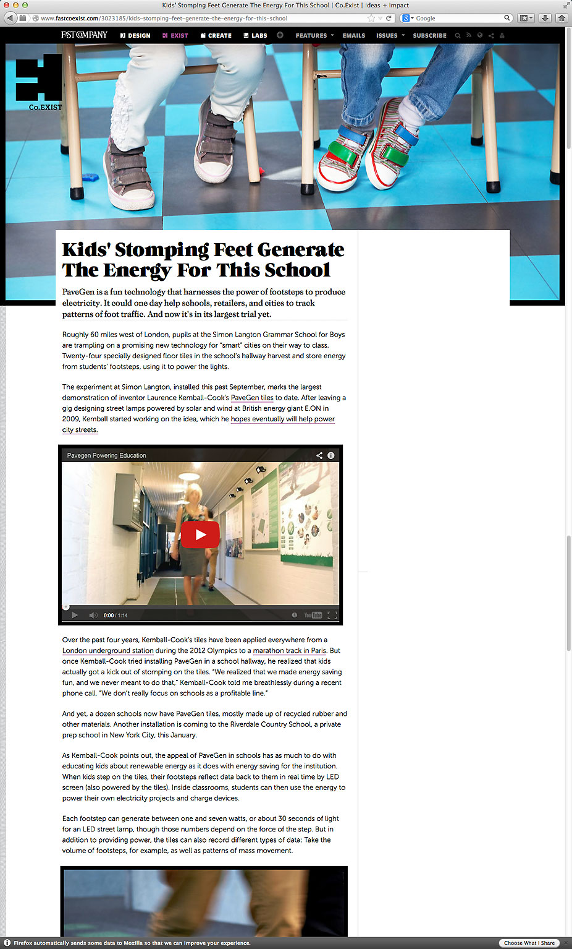
Notes:
Some of the floor tiles at this school have been replaced by special tiles that produce energy when they are stepped upon.
Yes, someone has figured out how to harness some of the energy of the kids and put it to good use.
====
http://www.fastcoexist.com/3023185/kids-stomping-feet-generate-the-energy-for-this-school
Kids' Stomping Feet Generate The Energy For This School
PaveGen is a fun technology that harnesses the power of footsteps to produce electricity. It could one day help schools, retailers, and cities to track patterns of foot traffic. And now it's in its largest trial yet.

Slide 41
The way of doing business is changing
Competitiveness is not working and is going away.
Collaboration is the way of the future. Businesses creating a niche market and working with other businesses to help each other.
We need to change the focus from self-centered learning to group-centered learning.
Notes:
We need more diversity of thought. With more women entering the higher levels of business, we are seeing a shift in the way of doing business. And I like it.
The traditional male version of running a business, built upon a platform of competitiveness, is now evolving.
Collaboration is the new way of life in the business world. Small businesses supporting each other rather than trying to buy out the competition.
So how does this affect what we are doing in the classroom?
Our education system is set up to encourage students to compete with each other for the best grades, class rank, and the honor of being the valedictorian. Is this preparing them for the future workplace?
In schools, we have traditionally called collaboration -- “cheating.”
Kids are collaborating with each other on their smart phones, but rather then trying to stop it, we should be encouraging it.
And we should be teaching them the proper way of using technology and the proper way of collaborating that brings about synergistic results.
We need to change the focus from self-centered learning to group-centered learning.
From individuals doing great on individualized assessments to students working together to solve a relevant problem.
We need to change our schools to reflect this change in the work environment.
This is assuming that one of the purposes of education is to prepare kids for the workplace.
41

Slide 42
The 10 key skills for the future of work
Sense-making
Social intelligence
Novel and adaptive thinking
Cross-cultural competency
Computational thinking
New-media literacy
Transdisciplinarity
Design mind-set
Cognitive load management
Virtual collaboration
Notes:
Here are some broad skills that will help workers adapt to the changing career landscape:
Sense-making is the ability to determine the deeper meaning or significance of what is being expressed
Social intelligence is the ability to connect to others in a deep and direct way, to sense and stimulate reactions and desired interactions
Novel and adaptive thinking is proficiency at thinking and coming up with solutions and responses beyond that which is rote or rule-based
Cross-cultural competency is the ability to operate in different cultural settings
Computational thinking is the ability to translate vast amounts of data into abstract concepts and to understand data-based reasoning
New-media literacy is the ability to critically assess and develop content that uses new media forms and to leverage these media for persuasive communication
Transdisciplinarity is literacy in, and ability to understand concepts across multiple disciplines
Design mind-set is the ability to represent and develop tasks and work processes for desired outcomes
Cognitive load management is the ability to discriminate and filter information for importance and to understand how to maximize cognitive functioning using a variety of tools and techniques, and
Virtual collaboration is the ability to work productively, drive engagement, and demonstrate presence as a member of a virtual team
Are we teaching these skills to our students? If not, then who will?
========
GigaOM
Dec. 16, 2011,
http://gigaom.com/collaboration/the-10-key-skills-for-the-future-of-work/?utm_source=General%20Users&utm_campaign=9bd9bdcde9-c%3Atec%20d%3A12-17&utm_medium=email
What are the jobs of the future? The demographics of an aging population suggests health care will be big, say some.
Broad skills that will help workers adapt to the changing career landscape:
Sense-making. The ability to determine the deeper meaning or significance of what is being expressed
Social intelligence. The ability to connect to others in a deep and direct way, to sense and stimulate reactions and desired interactions
Novel and adaptive thinking. Proficiency at thinking and coming up with solutions and responses beyond that which is rote or rule-based
Cross-cultural competency. The ability to operate in different cultural settings
Computational thinking. The ability to translate vast amounts of data into abstract concepts and to understand data-based reasoning
New-media literacy. The ability to critically assess and develop content that uses new media forms and to leverage these media for persuasive communication
Transdisciplinarity. Literacy in and ability to understand concepts across multiple disciplines
Design mind-set. Ability to represent and develop tasks and work processes for desired outcomes
Cognitive load management. The ability to discriminate and filter information for importance and to understand how to maximize cognitive functioning using a variety of tools and techniques
Virtual collaboration. The ability to work productively, drive engagement and demonstrate presence as a member of a virtual team

Slide 43
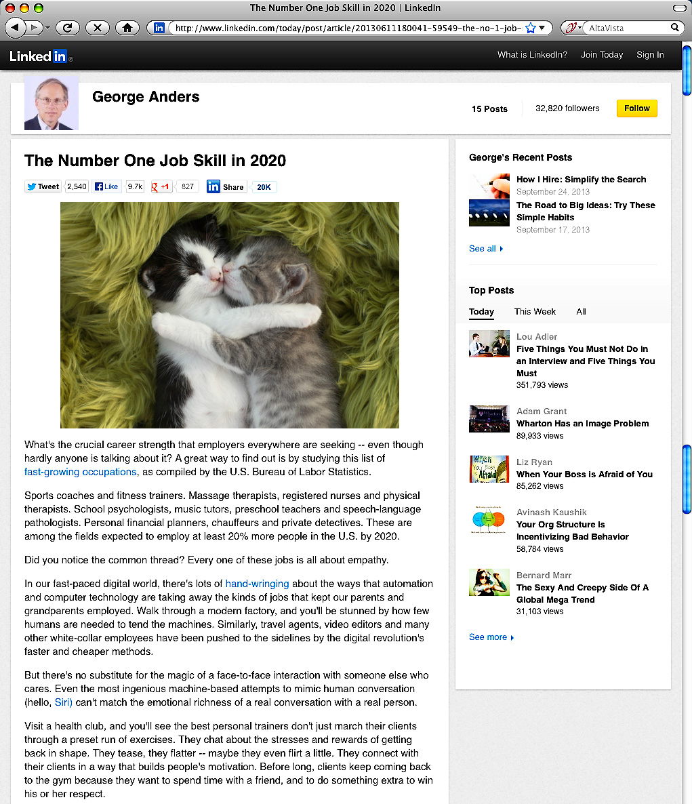
Notes:
What will be the number one job skill that employers are looking for in 2020?
It’s getting past the computer screen and really getting to know your customer as a person, not just a number. It’s getting to know them so well that you truly feel their pain.
This crucial career skill is called Empathy.
Not to just feel sorry for someone, like Sympathy, but to truly feel their pain is Empathy.
When do we get to know our students so well we feel their pain?
How can we teach this highly prized skill to our students?
=====
http://www.linkedin.com/today/post/article/20130611180041-59549-the-no-1-job-skill-in-2020
The Number One Job Skill in 2020
June 11, 2013
Empathy
Dictionary: the intellectual identification with or vicarious experiencing of the feelings, thoughts, or attitudes of another.
Cultural Dictionary: Identifying oneself completely with an object or person, sometimes even to the point of responding physically, as when, watching a baseball player swing at a pitch, one feels one's own muscles flex.

Slide 44
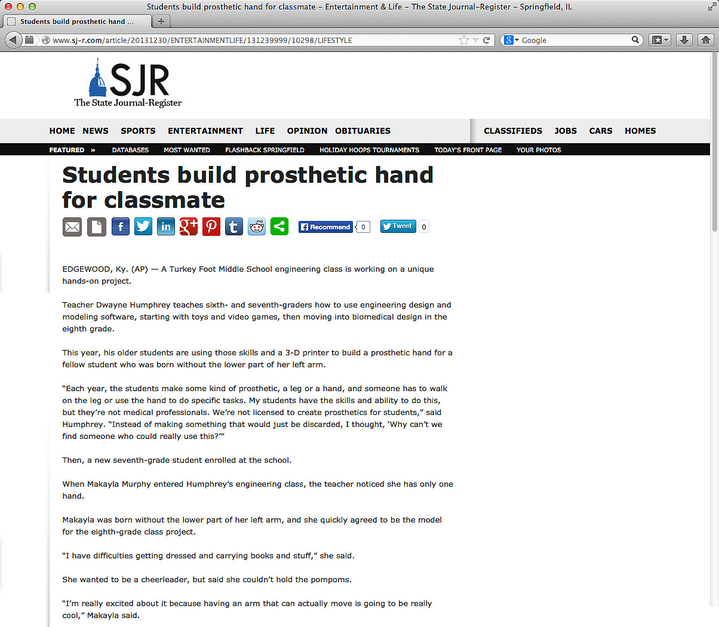
Notes:
Speaking of Empathy,
Here is a middle school engineering class that is designing a prosthetic hand for a classmate -- who wants to be a cheerleader, -- but couldn’t hold the pompoms.
So far they have built a working prototype of a finger. With the help of her classmates, -- I believe she will hold those pompoms some day.
====
http://www.sj-r.com/article/20131230/ENTERTAINMENTLIFE/131239999/10298/LIFESTYLE
Students build prosthetic hand for classmate
By Amy Scalf
The Kentucky Enquirer
Posted Dec. 30, 2013 @ 9:50 pm
Dec 30, 2013 at 11:27 PM
EDGEWOOD, Ky. (AP) — A Turkey Foot Middle School engineering class is working on a unique hands-on project.
Teacher Dwayne Humphrey teaches sixth- and seventh-graders how to use engineering design and modeling software, starting with toys and video games, then moving into biomedical design in the eighth grade.
This year, his older students are using those skills and a 3-D printer to build a prosthetic hand for a fellow student who was born without the lower part of her left arm.
“Each year, the students make some kind of prosthetic, a leg or a hand, and someone has to walk on the leg or use the hand to do specific tasks. My students have the skills and ability to do this, but they’re not medical professionals. We’re not licensed to create prosthetics for students,” said Humphrey. “Instead of making something that would just be discarded, I thought, ‘Why can’t we find someone who could really use this?’”
Then, a new seventh-grade student enrolled at the school.
When Makayla Murphy entered Humphrey’s engineering class, the teacher noticed she has only one hand.
Makayla was born without the lower part of her left arm, and she quickly agreed to be the model for the eighth-grade class project.
“I have difficulties getting dressed and carrying books and stuff,” she said.
She wanted to be a cheerleader, but said she couldn’t hold the pompoms.
“I’m really excited about it because having an arm that can actually move is going to be really cool,” Makayla said.
“We’re on a journey here. We don’t know how it’s going to end. We do know we’re going to give it our best effort and it’s coming together pretty nicely,” said Humphrey. “It’s incredible how quickly things are changing. As we look into the future, we realize we haven’t seen anything yet.”
He also said the project has sparked a special interest among the students.
“Middle-schoolers want to influence the world and they get frustrated over lack of control in their lives. With this project, they get to change someone’s real life. There’s a real opportunity in class to design lessons that have real-world connections,” Humphrey said. “Around the world, kids between the ages of 11-14 are adding to the well of human knowledge and invention. We’re trying to engage students in work that is meaningful.”
Josh Suedkamp and Malachi Pike said that’s exactly why they like this project.
“It’s better because you’re actually affecting someone’s life,” said Malachi. “It’s cool because it helps a real person and it’s not just a school project.”
“I think we’re setting the right kind of tone to really get kids to consider their future careers and giving opportunities to research many of them,” Humphrey said. “Hopefully, we’ll spark something great.”
Read more: http://www.sj-r.com/article/20131230/ENTERTAINMENTLIFE/131239999/10298/LIFESTYLE#ixzz2pGvV3D3y

Slide 45
Help students discover their passion, then help them get on a pathway where they can turn that passion into a career.
Emil Barnabas
Notes:
We need to help students discover their passion.
What makes them get up in the morning and want to learn something new?
And we need to help them to turn that passion into a rewarding career.
==============
Emil Barnabas
====
Though the term “vocational” has earned a bad reputation in the last few decades, the original meaning of the term is clear that your “vocation” is your life’s calling.
Our vocation as educators is educating young minds and preparing them for the real world.
What is your student’s vocation? What is life calling them to do? What is their purpose in life?
We need to help students discover their passion.
What makes them get up in the morning and want to learn something new?
And we need to help them to turn that passion into a rewarding career.
-- --
In the future -- when our students are employed and someone asks them what they do for a living, --
wouldn’t it be great if they could say –
“I get to make a difference in the world.”
45

Slide 46
Thanks for listening!
Emil Barnabas
Emil@barnabas.com
Get the PowerPoint
www.CareerOutlook.US/presentations
Notes:
Thanks for taking time out of your day to listen to me ramble.
I hope we still have time for questions.

